Slide 1
Animal Science/Dairy Science 434
Reproductive Physiology
Introduction - Fall 2021
Notes:
This is the introductory lecture for AS/DS 434, Reproductive Physiology in the Fall semester of 2020.

Slide 2
Dr. John J Parrish
Notes:
Hello I am John Parrish and I am the instructor for Animal Science / Dairy Science 434, Reproductive Physiology. This is the introductory lecture and you will hear in a second, I have an avatar that I will be using during the class so I do not have to record video of myself but I want you to know I am here in person for the live lab sections 301-303 and have online office hours as you will see in the syllabus. So we are looking forward to getting going, good luck and we will see you soon.

Slide 3

Dr. John J Parrish
Notes:
Hello I am John Parrish and I am the instructor for Animal Science / Dairy Science 434, Reproductive Physiology. This is the introductory lecture and you will hear in a second, I have an avatar that I will be using during the class so I do not have to record video of myself but I want you to know I am here in person for the live lab sections 301-303 and have online office hours as you will see in the syllabus. So we are looking forward to getting going, good luck and we will see you soon.

Slide 4
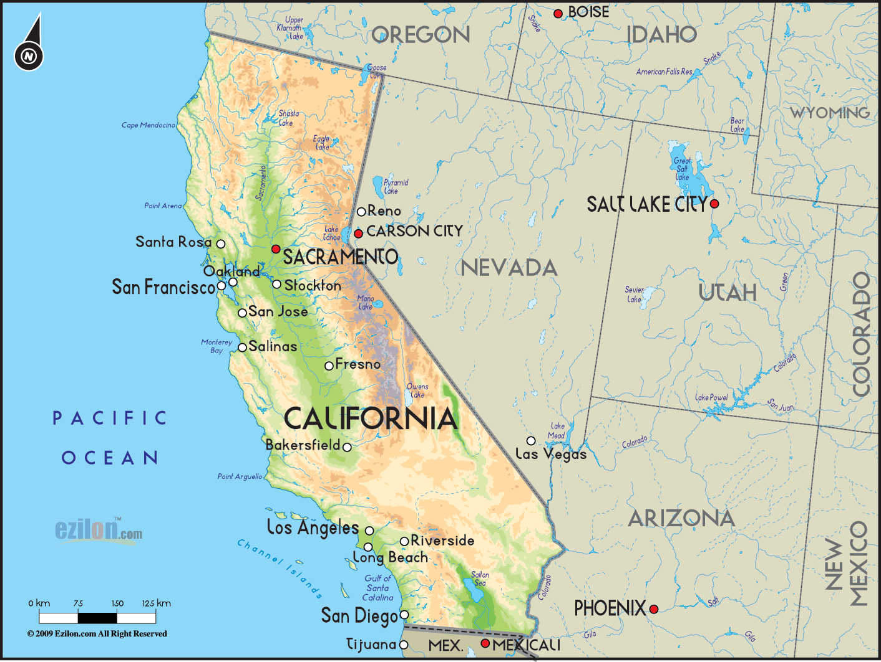

Notes:
I grew up in the central valley of California. Specifically I lived most of my life up to and including college in Fresno.

Slide 5
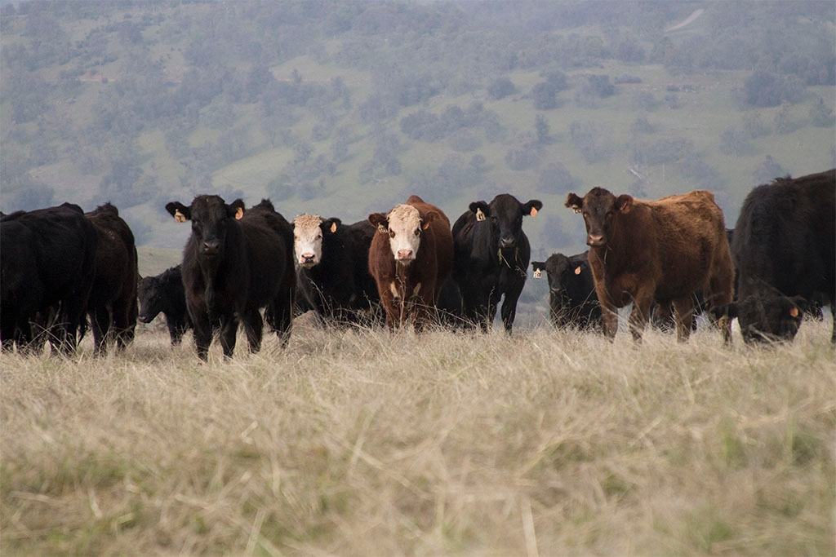
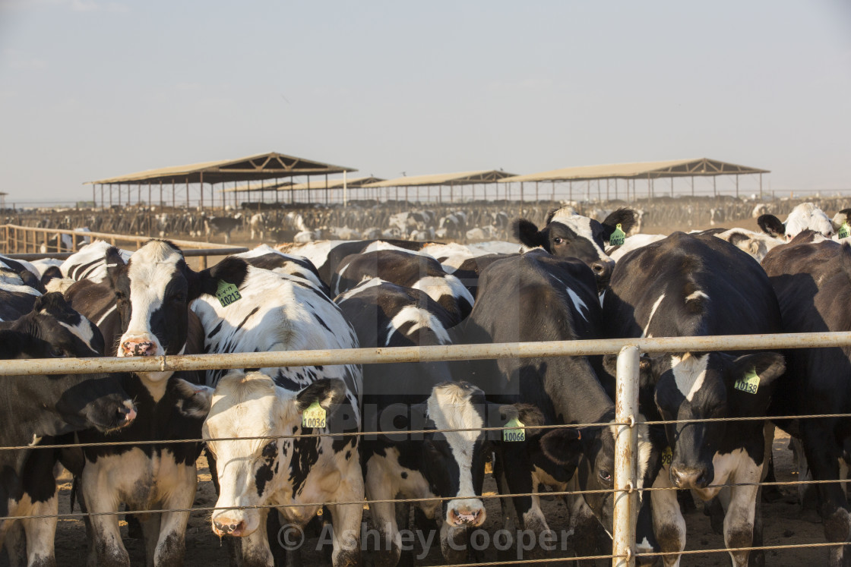
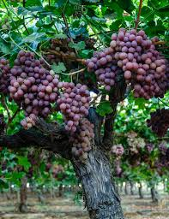
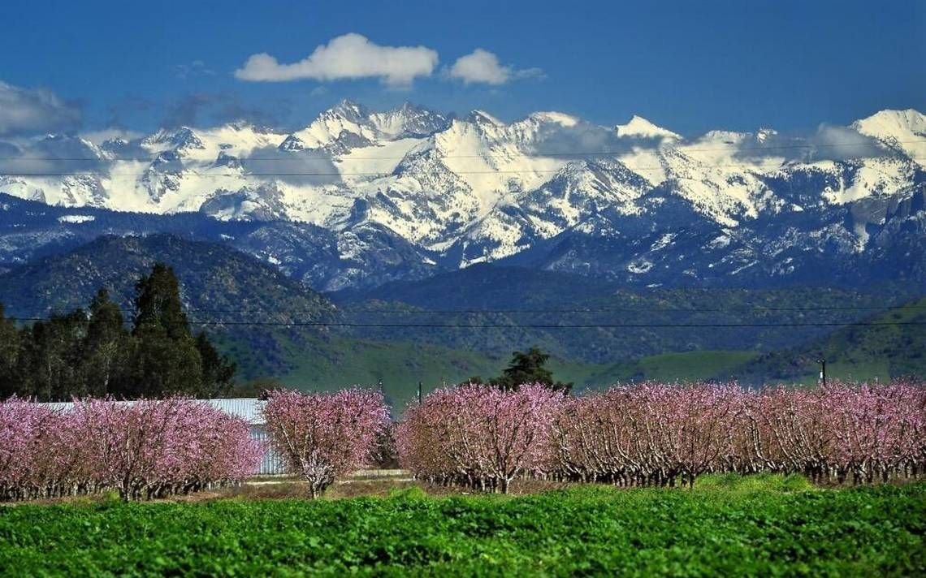
Notes:
The central valley is the agricultural heart land of California. It is well known for grapes used in raisins and wine as well as a variety of tree fruits and nuts such as peaches shown in this image but importantly the Sierra Nevada mountains to the east. In terms of livestock there are beef cattle raised in the foothills of the Sierra Nevada mountains as well as the coast range off to the west. Dairy cattle are raised in large open pen operations. When I was in college, the smallest operation by my friends was about 6,000 head and went up to 20,000. This changes the way in which you think about dairy production with the large scale of the operations.

Slide 6

Bachelor of Science
  Animal Science, 1977
Notes:
I attended California State University Fresno where I got a Bachelor of Science in Animal Science. Keep in mind that I grew up in suburbia and my exposure to livestock production was in college. 0

Slide 7
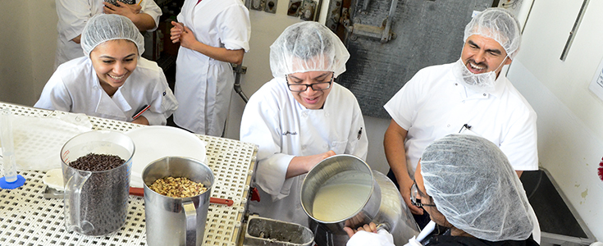
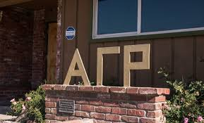

Notes:
For fun I worked in the swine unit for several years and even made some money on pig projects bank rolled by the university. I cleaned milk cans in the dairy processing plant that came back from the dorms and worked with beef cattle getting them ready for the county fair. Keep in mind the Fresno County fair was much larger than the Wisconsin State fair. I was also member of Alpha Gamma Rho.

Slide 8
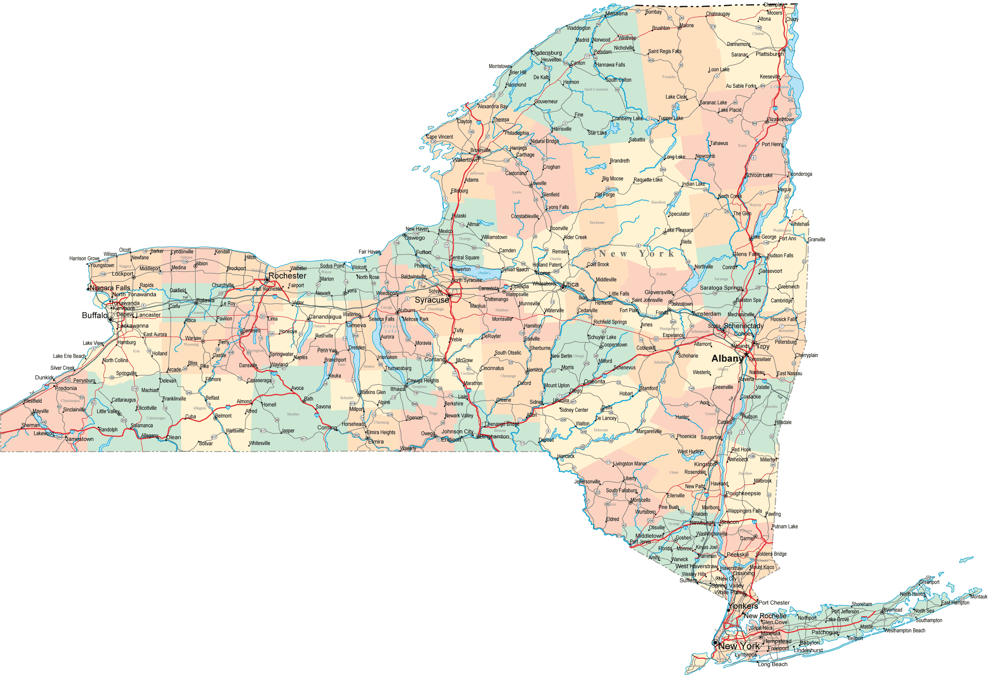
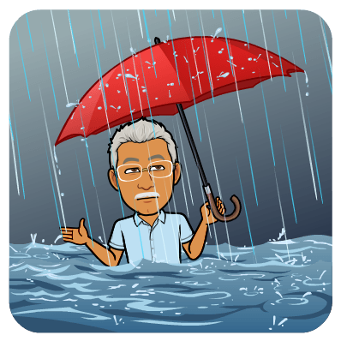
Cornell University
State of New York
Notes:
Following graduation, I moved to upstate New York to attend the Cornell University. While the campus is beautiful it does rain a lot in Ithaca where Cornell is located. Only 50 cloud free days a year. When I arrived it rained almost all of September; over 20 inches or rain. Fresno only had 10 inches a year and I did not own an umbrella.

Slide 9

Ph.D.
  Animal Science, 1983
  Male Fertility
Species
  Cattle, Rabbits, Hamsters, Guinea Pigs, Goats, Sheep, Dogs, Humans
Notes:
I received a PhD in Animal Science in 1983 and focuses on Male Fertility. I used a wide range of species in my research from livestock to rodents and even pets and humans.

Slide 10

Post Doc.
  Animal Science, 1983
  In Vitro Fertilization
Faculty
  Animal Science, 1988
Species
  Cattle, Swine, Horses, Water Buffalo, Humans, Chickens, Turkeys
Notes:
From Cornell I came to Wisconsin where I was a post doc and worked on In Vitro Fertilization of Cattle where I created the techniques used around the world today to create in excess of 500,000 calves a year. I was hired on faculty in 1988 in Animal Science and have done work again with many species.

Slide 11
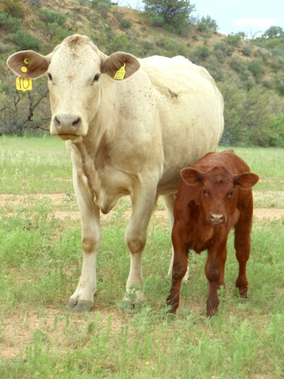
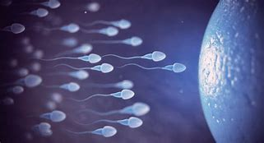
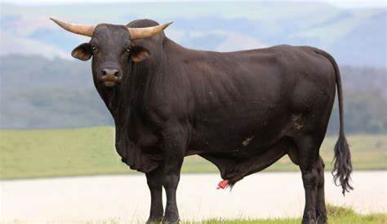
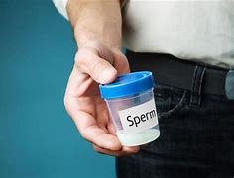
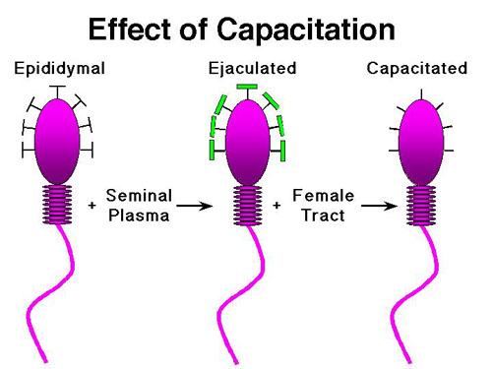
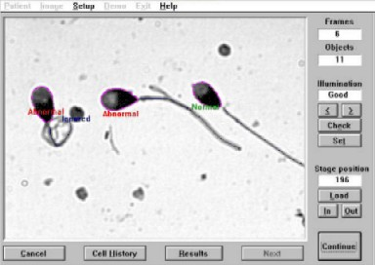
Male Reproduction (40+ years)
Notes:
Over my 40+ years of work I have been mainly examined Male Reproduction with a focus first on why some sperm reach the site of fertilization and then how to do this in vitro with the work mainly in cattle and producing the first calf from in vitro fertilization of an in vitro matured oocyte. I then turned my attention to what makes males different in fertility first looking at mechanisms and differences in capacitation, a process by which an ejaculated sperm becomes capable of fertilization. Over the last 20 years my labs focus has been on methods to describe the morphology of sperm via computer analysis and how heat stress impact sperm production.

Slide 12
Quiz 0 - a
Dr. Parrish is best known for his research on In Vitro Fertilization in cattle.
True
False

Slide 13

Quiz 0 - a
Dr. Parrish is best known for his research on In Vitro Fertilization in cattle.
True
False

Slide 14
Special 2021 Information
Lectures – Live with 2021 Podcast available after lecture period.
  Previous years show up prior to 2021 lecture.
Dr. Parrish is available in person during lab, virtual office hours or via email.
  Currently Thursday, 12 – 2, online
Information for course activities are via Canvas and email (UW-Madison account).
Notes:
For fall 2020, the following is specifically for this semester.

Slide 15
Instructors
John J. Parrish (Professor)
  Responsible for entire course and online lab section
Ahmed Said Aly (Lab TA, Course coordinator)
Contact information in Canvas

Slide 16
Laboratories
Labs (sections 301, 302 and 303)
  Live in person and planned for the full 2 hours
Lab involves work with tissue and animals.
  Fall 2021 – Cattle, horses and swine
Notes:
Pay particular attention to when your specific lab section meets.

Slide 17
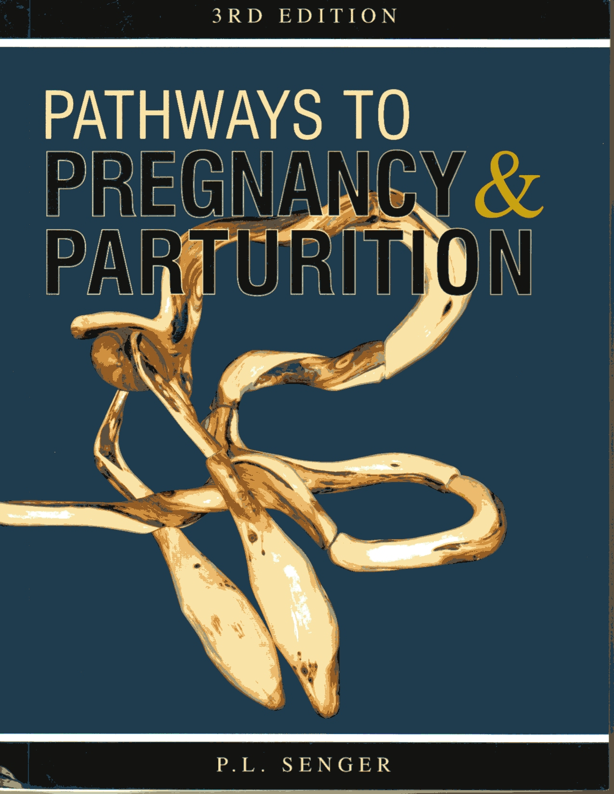
Text (Required)
Pathways to Pregnancy and Parturition – Third Edition
  P.L. Senger
UW Bookstore, Amazon
E-book ($100) from publisher
Library (not on reserve)
Read assigned chapters before viewing lecture material!!!
Specific edition guaranteed OK for exams!

Slide 18
Canvas
Course Management Software for UW
All material and submissions can be accessed via canvas

Slide 19
Effort and Difficulty
3 Credit hours are met by 135 hours of interaction with course material over the semester
  Average is 9 hours/week.
Intermediate course
Notes:
This is an Intermediate course and so is involved. For Dairy and Animal Science Students this is likely the most difficult in your major. For Biology students it varies depending on what else you will be taking but is similar to other serious science classes.

Slide 20
Grading
See Syllabus!

Slide 21
Overall Philosophy
We are attempting to return to regular in class activities for Fall 2021.
We want you to learn!!!
The course is intended to challenge you.
Notes:
Course is organized to educate you.
Learning objectives and outcomes are specified
Lecture and Lab are linked.
A variety of learning approaches are used.
The course is intended to challenge you and you must work to succeed.

Slide 22
Overall Philosophy (cont.)
Get your money’s worth; extrapolate and integrate. This is how you succeed!
Memorization does not lead to success in life!
Must engage with course material every day for success.

Slide 23
Overall Philosophy (cont.)
What soft skills did you gain in this course?
  These are what employers are looking for!!!!
  Time management, critical thinking, writing, oral communication, interaction experiences with students in lab

Slide 24
Notes:
Ok let's start and have fun. However you need to first complete a quiz.

