Slide 1
Animal Science/Dairy Science 434
Reproductive Physiology
Introduction and Course Structure
Fall 2019

Slide 2
Dr. John J Parrish

Slide 3
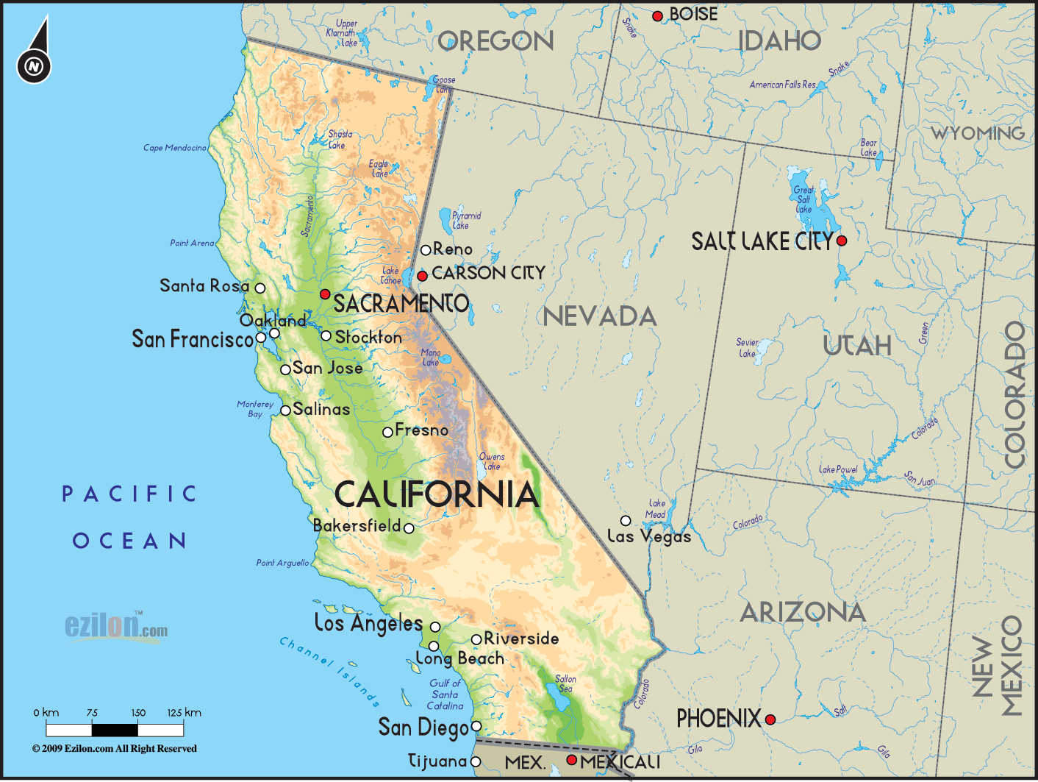

Slide 4

Bachelor of Science
  Animal Science
Species
  Swine
  Cattle
Campus Activities
  Milk processing
  Swine farm
  Alpha Gamma Rho

Slide 5
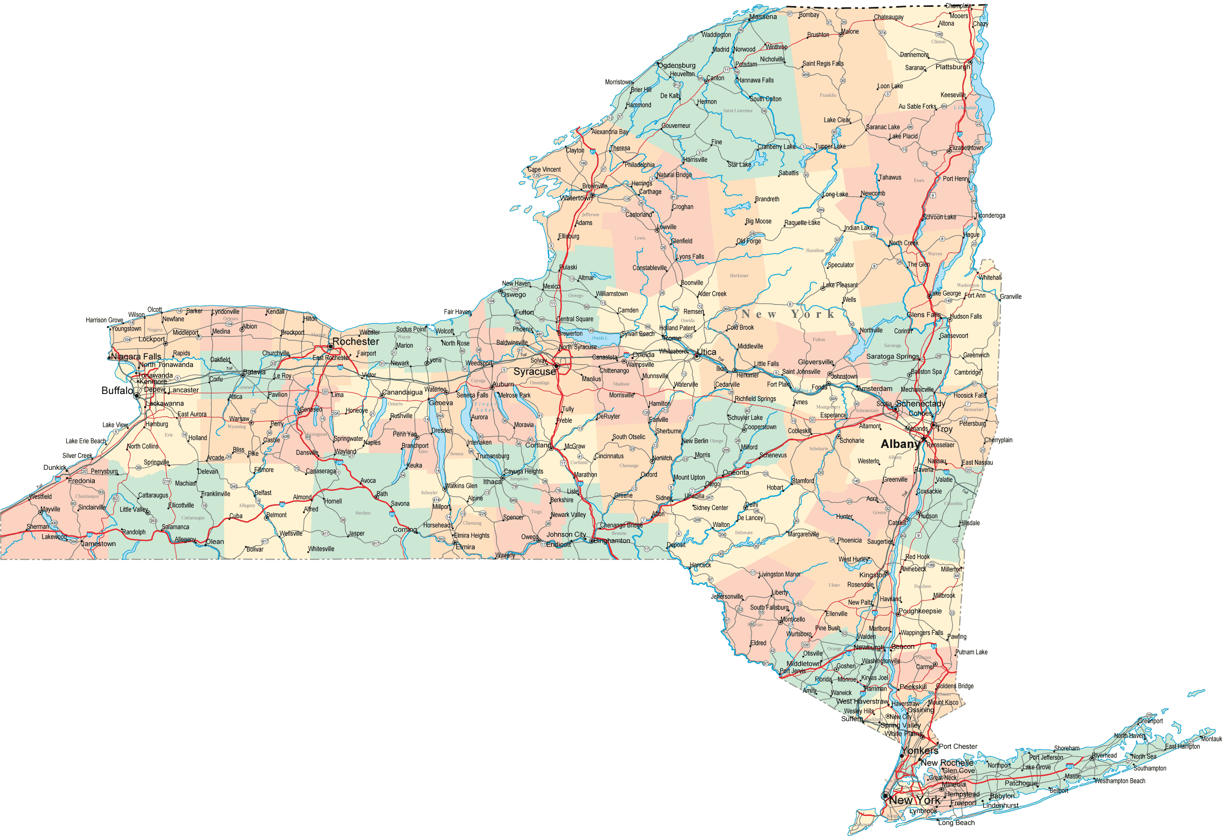
Cornell University
State of New York

Slide 6

Ph.D.
  Animal Science
  Male Fertility
Species
  Cattle, Rabbits, Hamsters, Guinea Pigs, Goats, Sheep, Dogs, Humans

Slide 7

Post Doc.
  Animal Science
  In Vitro Fertilization
Faculty
  Animal Science
Species
  Cattle, Swine, Horses, Water Buffalo, Humans, Chickens, Turkeys

Slide 8
Male Reproduction (40+ years)
Semen evaluation
Fertility Prediction
In vitro fertilization
Sperm capacitation
Quantitative image analysis of sperm

Slide 9
Species of Males
Large Animal
  Bull, stallion, ram, boar, water buffalo, human
Small Animal
  Dog, rabbit, mouse, hamster, guinnea pig
Avian
  Rooster, turkey

Slide 10
Special 2019 Information
Lectures – Podcast only
  Recorded in 2017, 2018 or 2019.
Dr. Parrish is available in person during lab or via email.
Information comes via lecture, email and Canvas.

Slide 11
Instructors
John J. Parrish (Professor)
  Responsible for entire course
Jodi Berndtson (Lab TA, Course coordinator)
Contact information in Course Website

Slide 12
Laboratories
Labs (sections 301 and 303)
  Planned for 2 hr
  may last 2.5 hr so plan ahead
Lab involves work with tissue and animals.
  Bring appropriate cloths
  Will be covered more in lab.

Slide 13

Text (Required)
Pathways to Pregnancy and Parturition – Third Edition
  P.L. Senger
UW Bookstore, Amazon
E-book ($100) from publisher
Library (not on reserve)
Read assigned chapters before viewing lecture material!!!
Specific edition guaranteed OK for exams!

Slide 14
Canvas
Course Management Software
All material and submissions can be accessed via canvas
  Some material is in a Animal Science Website or Kaltura but seamless access is via canvas.

Slide 15
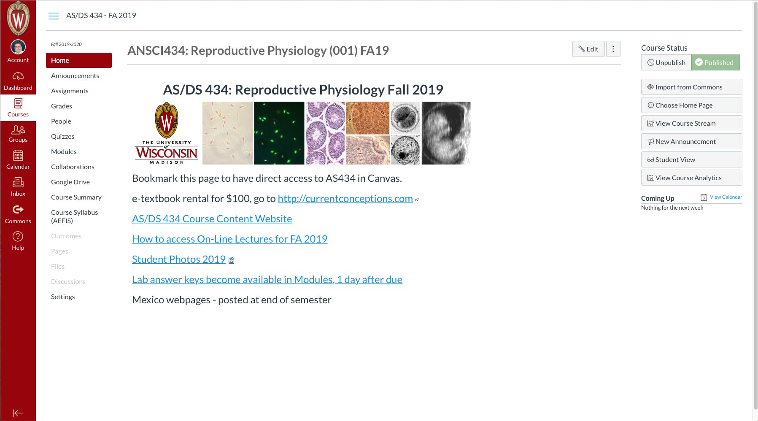

Slide 17
434 Web Site Modifications
Both Canvas and Course Content Website Updates may occur multiple times/day.

Slide 18
Lecture Material
Lecture in course content website Nav Bar
  Chapters in Text
  Outlines
  Powerpoint
    ppt or pptx file
    PDF slide handout (6 slides/page)
  Video/animations
  Kaltura/Podcast - Streaming video, UW service

Slide 19
Effort and Difficulty
Credit hours are met by 135 hours of interaction with course material over the semester
  Includes lecture, lab, projects, outside of class animal time, lab write-ups, study time.
  Average is 9 hours/week.
Intermediate course and so is involved.
  Dairy and Animal Science Students
    One of the most difficult in your majors

Slide 20
Grading
See Syllabus!

Slide 21
Overall Philosophy
Course is organized to educate you.
  Learning objectives and outcomes are specified
  Lecture and Lab are linked.
  A variety of learning approaches are used.
The course is intended to challenge you and you must work to succeed.

Slide 22
Overall Philosophy (cont.)
Get your money’s worth; extrapolate and integrate. This is how you succeed!
Memorization does not lead to success in life!
Must engage with course material every day for success.

Slide 23
Overall Philosophy (cont.)
What soft skills did you gain in this course?
  These are what employers are looking for!!!!

