Slide 1
Animal Science/Dairy Science 434
Reproductive Physiology
Introduction and Course Structure
Fall 2017

Slide 2
Dr. John J Parrish

Slide 3
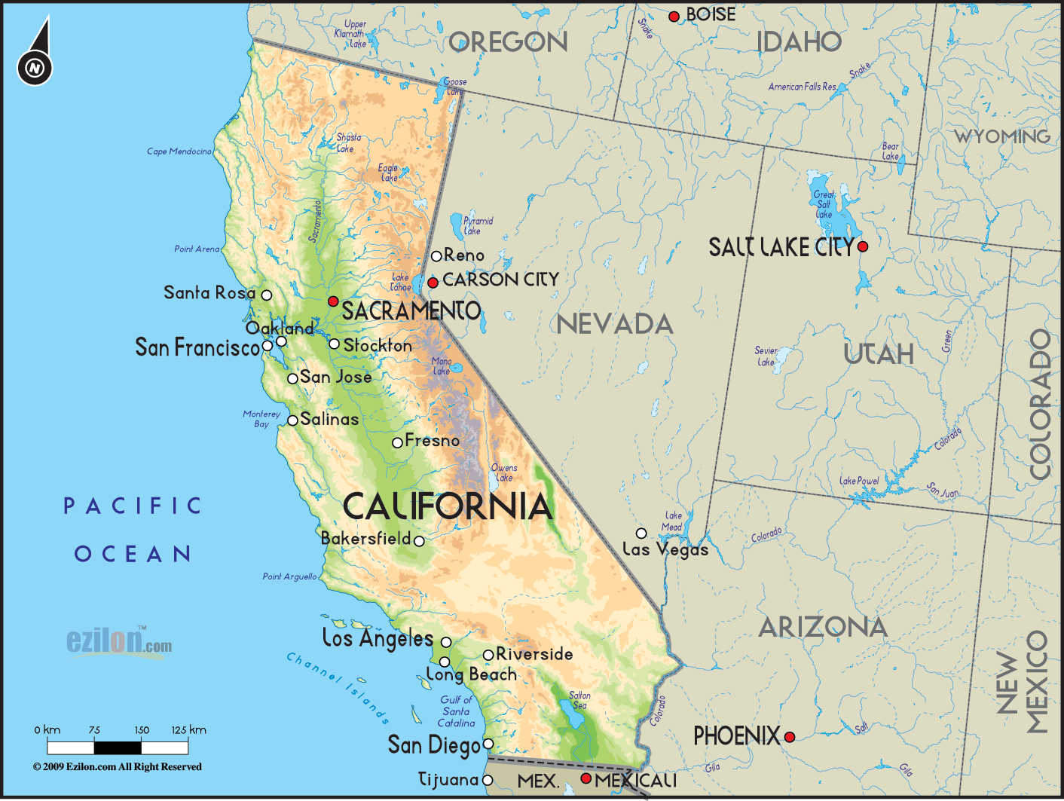

Slide 4

Bachelor of Science
  Animal Science
Species
  Swine
  Cattle
Campus Activities
  Milk processing
  Swine farm
  Alpha Gamma Rho

Slide 5
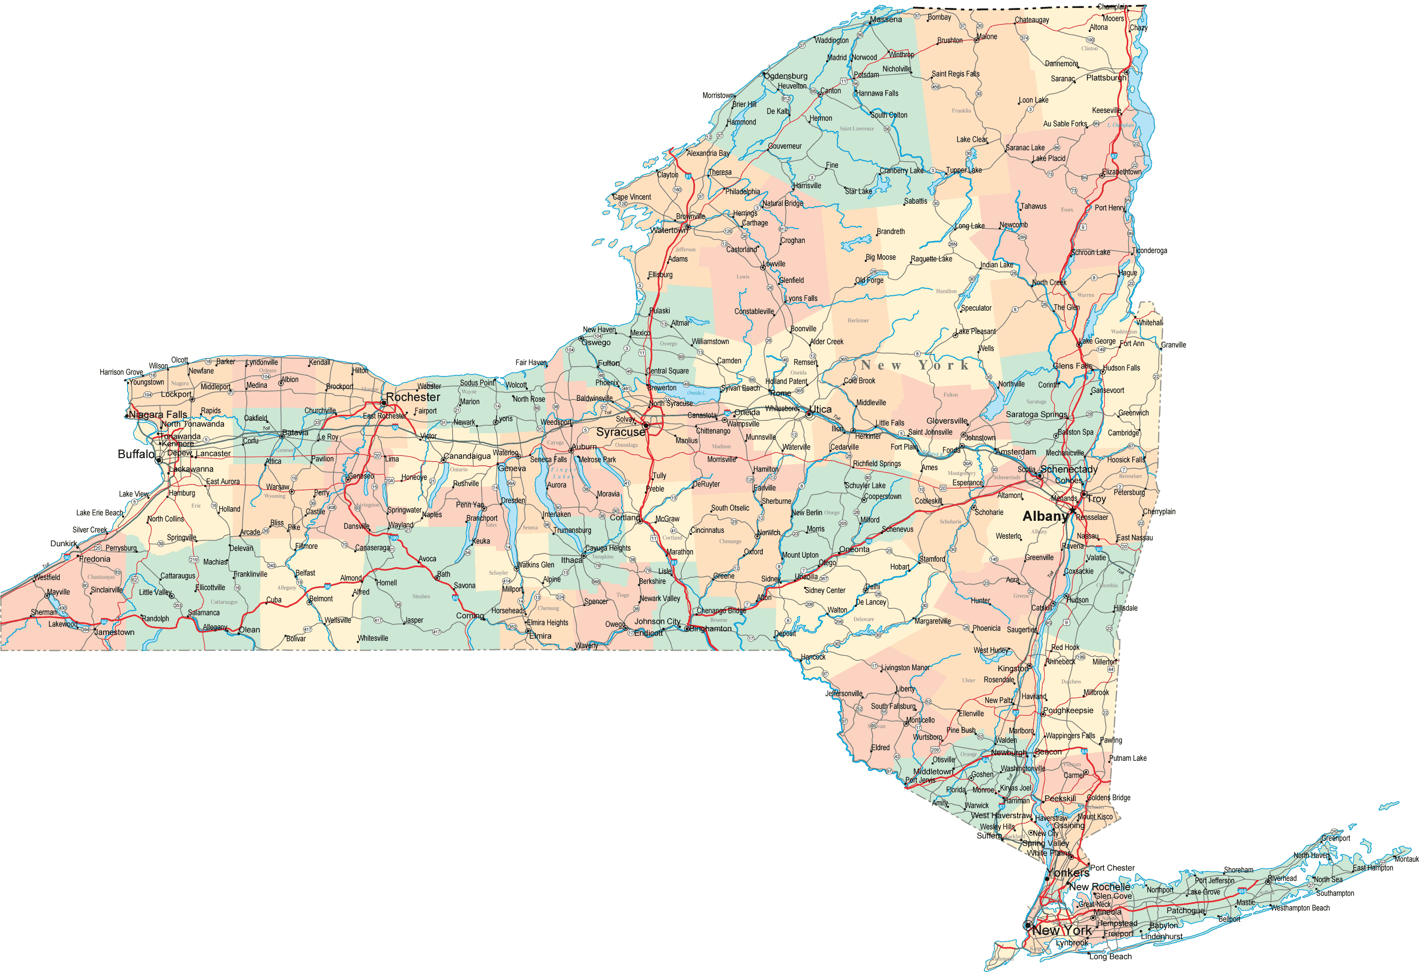
Cornell University
State of New York

Slide 6

Ph.D.
  Animal Science
  Male Fertility
Species
  Cattle, Rabbits, Hamsters, Guinea Pigs, Goats, Sheep, Dogs, Humans

Slide 7

Post Doc.
  Animal Science
  In Vitro Fertilization
Faculty
  Animal Science
Species
  Cattle, Swine, Horses, Water Buffalo, Humans, Chickens, Turkeys

Slide 8
Male Reproduction (40 years)
Semen evaluation
Fertility Prediction
In vitro fertilization
Sperm capacitation
Quantitative image analysis of sperm

Slide 9
Species of Males
Large Animal
  Bull, stallion, ram, boar, water buffalo, human
Small Animal
  Dog, rabbit, mouse, hamster, guinnea pig
Avian
  Rooster, turkey

Slide 10
Special 2017 Information
Lectures – Live only
  Some podcasts may become available but do not count on them.
Dr. Parrish is available in person during lab 301 and 303 or via email.
  Sorry I have another class during lab 304
Information comes via lecture, email and Canvas.

Slide 11
Instructors
John J. Parrish (Professor)
  Responsible for entire course
Rick Monson (Faculty Associate)
  Coordinator for sections 301, 303.
Nicole Gross (Graduate Student)
  Coordinators for sections 304
Contact information in Course Website

Slide 12
Laboratories
Labs (sections 301, 303 and 304)
  Planned for 2 hr
  may last 2.5 hr so plan ahead
Lab involves work with tissue and animals.
  Bring appropriate cloths
  Will be covered more in lab.
    Section 301 we will not meet live in week 1. In week 2 you will work with tissue and cattle so dress appropriately.

Slide 13

Text (Required)
Pathways to Pregnancy and Parturition – Third Edition
  P.L. Senger
UW Bookstore, Amazon
Library (not on reserve)
Read assigned chapters before viewing lecture material!!!
Specific edition guaranteed ok for exams!

Slide 14
Canvas
Course Management Software
All material and submissions can be initially accessed via canvas

Slide 15
Canvas and Course Websites
Canvas
Course Web Site
(ANSCI Server)
Syllabus and Course summary
Submit and view assignments
Group enrollment (People, Groups)
Answer keys (Modules)
Grades
Collaborations
Google drive or Office 365
Student Photos
Syllabus
Lecture
  Powerpoint files
  Outlines, handouts
  Other files
  Podcast if available
Labs
Lab, Cow project Calendar
Practice Lecture Quizzes

Slide 18
434 Web Site Modifications
Both Canvas and Course Website Updates may occur daily.

Slide 19
Lecture Material
Lecture in course website Nav Bar
  Chapters in Text
  Outlines
  Powerpoint
    ppt or pptx file
    PDF slide handout (6 slides/page)
  Video/animations
  Podcast when available - Streaming video - Kaltura

Slide 20
Study Time and Difficulty
Lecture
  2 hours study time for each 1 hour of lecture
Lab
  1 hour study time for each hour of lab
Course difficulty
  Dairy and Animal Science Students
    One of the most difficult in your majors
  Biology majors
    Similar to other science classes

Slide 21
Grading
See Syllabus!

Slide 22
Overall Philosophy
Course is organized to educate you.
  Learning objectives and outcomes are specified
  Lecture and Lab are linked.
  A variety of learning approaches are used.
The course is intended to challenge you and you must work to succeed.

Slide 23
Overall Philosophy (cont.)
Get your money’s worth; extrapolate and integrate. This is how you succeed!
Memorization does not lead to success in life!

Slide 24
Overall Philosophy (cont.)
What soft skills did you gain in this course?
  These are what employers are looking for!!!!

