Slide 1
Animal Science/Dairy Science 434
Reproductive Physiology
Introduction and Course Structure
Fall 2016

Slide 2
Dr. John J Parrish

Slide 3
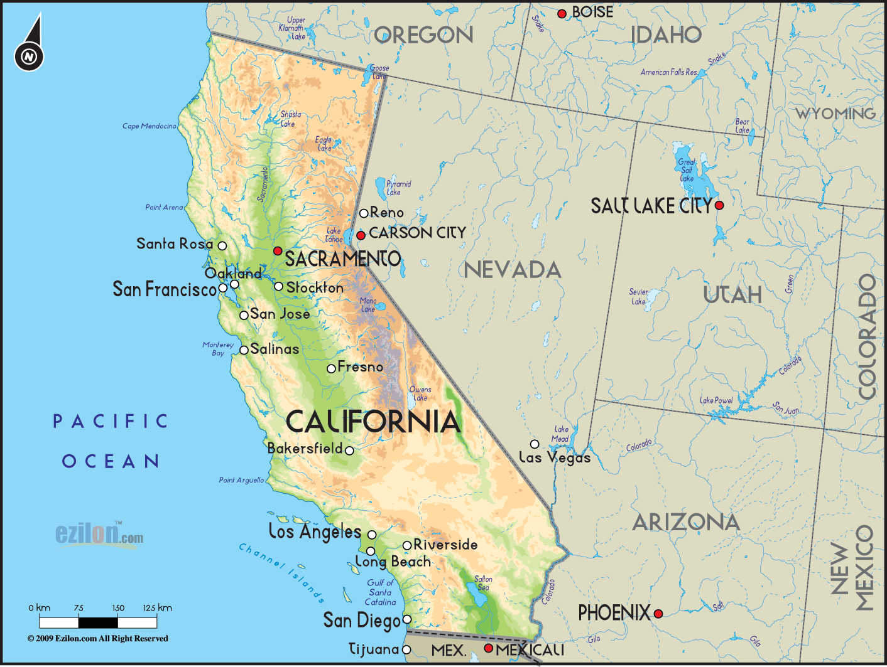

Slide 4

Bachelor of Science
  Animal Science
Species
  Swine
  Cattle
Campus Activities
  Milk processing
  Swine farm
  Alpha Gamma Rho

Slide 5
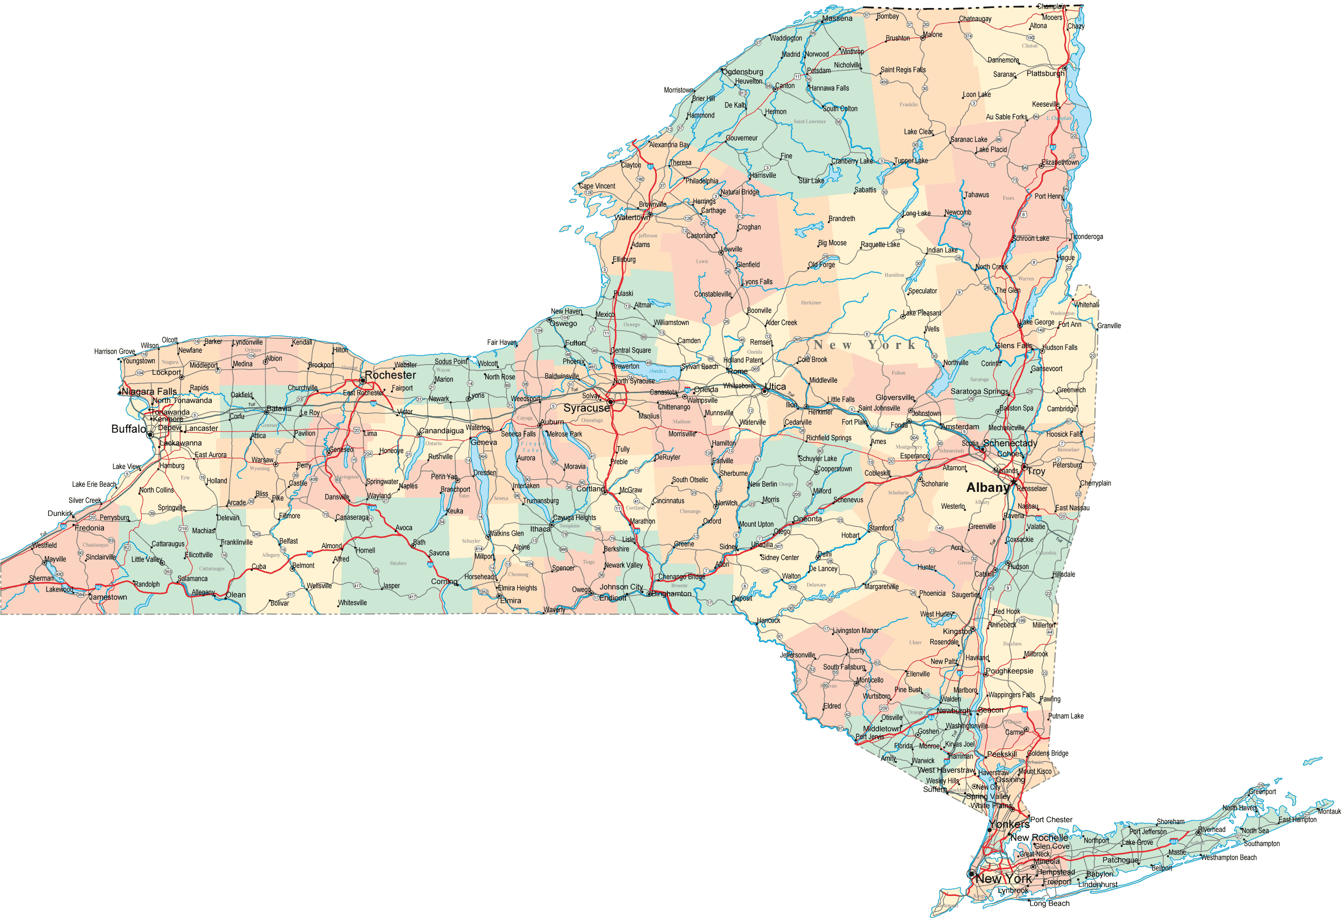
Cornell University
State of New York

Slide 6

Ph.D.
  Animal Science
  Male Fertility
Species
  Cattle, Rabbits, Hamsters, Guinea Pigs, Goats, Sheep, Dogs, Humans

Slide 7

Post Doc.
  Animal Science
  In Vitro Fertilization
Faculty
  Animal Science
Species
  Cattle, Swine, Horses, Water Buffalo, Humans, Chickens, Turkeys

Slide 8
Male Reproduction (39 years)
Semen evaluation
Fertility Prediction
In vitro fertilization
Sperm capacitation
Quantitative image analysis of sperm

Slide 9
Species of Males
Large Animal
  Bull, stallion, ram, boar, water buffalo, human
Small Animal
  Dog, rabbit, mouse, hamster, guinnea pig
Avian
  Rooster, turkey

Slide 10
Special 2016 Information
Lectures – Podcast only
  discipline
Discussions – asynchronously on-line???
Dr. Parrish is available in person during lab or via email.
We contact you via email and announcements from within Canvas.

Slide 11
Instructors
John J. Parrish (Professor)
  Responsible for entire course
Rick Monson (Project Manager)
  Coordinator for sections 301, 303 and 304.
Jodi Berndtson (Graduate Student)
  Coordinators for sections 302
Contact information in Course Website

Slide 12
Laboratories
Labs (sections 301-304)
  Planned for 2 hr
  may last 2.5 hr so plan ahead
Lab involves work with tissue and animals.
  Bring appropriate cloths
  Will be covered more in lab.

Slide 13

Text (Required)
Pathways to Pregnancy and Parturition – Third Edition
  P.L. Senger
UW Bookstore, Amazon
Library (not on reserve)
Read assigned chapters before viewing lecture material!!!
Specific edition guaranteed ok for exams!

Slide 14
Learn@UW vs. Canvas
Course Management Software
Campus is moving to Canvas
Start in Canvas
If problems, then we will return to Learn@UW.

Slide 15
Canvas and Course Websites
Canvas
Course Web Site
(ANSCI Server)
Submit and view assignments
Group enrollment (People)
Answer keys (Modules)
Syllabus
Lecture Material/Podcast
Lab
On-Line Quizzes

Slide 16
Canvas

Slide 17
Course Website see link in canvas

Slide 18
What is in the class website?
Reach through Canvas - Announcements section
Syllabus
Lecture
  Podcasts, Outlines, Handouts, Powerpoint Files
Labs
Project Information
Quizzes (practice)

Slide 19
434 Web Site Modifications
Updates may occur daily.
Most updates are minor. If a major change is made you will be notified via email.
You may need to dump the cache or history in your web browser to see the most current pages.
Podcasts from 2013, 2014, 2015 or 2016.

Slide 20
Lecture Material
Lecture in course website Nav Bar
  Chapters in Text
  Podcast - Streaming video - Kaltura
  Outlines
  Powerpoint
    ppt or pptx file
    PDF slide handout (6 slides/page)
  Video/animations
  View the week’s lectures before lab!!!!

Slide 21
Study Time and Difficulty
Lecture
  2 hours study time for each 1 hour of lecture
Lab
  1 hour study time for each hour of lab
Course difficulty
  Dairy and Animal Science Students
    One of the most difficult in your majors
  Biology majors
    Similar to other science classes

Slide 22
Grading
See Syllabus!

Slide 23
Overall Philosophy
Course is organized to educate you.
  Learning goals and outcomes
  Lecture and Lab are linked.
  A variety of learning approaches are used.
The course is intended to challenge you and you must work to succeed.

Slide 24
Overall Philosophy (cont.)
Get your money’s worth; extrapolate and integrate. This is how you succeed!
Memorization does not lead to success in life!

