Slide 1
Pregnancy and Fetal Development
John J. Parrish

Slide 2
Placental Functions
Exchange
Endocrine
Placenta
Chemical Protection
Physical Protection

Slide 3
Placental Functions
Exchange
Endocrine
Gas
Nutrients
Waste products
Transient
Estrogen
Progesterone
HCG
eCG
PL
Placenta
Chemical Protection
Physical Protection
Immunosupression
Prevents infiltration by maternal defenses
Filters toxins
Shock Absorber

Slide 4
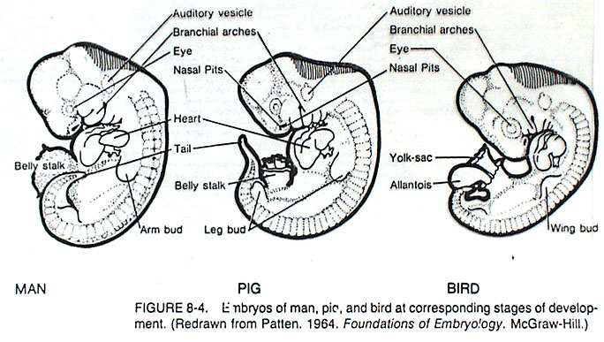
Similarities in Early Development
MAN
PIG
BIRD

Slide 5
Developmental Features
Developmental Horizons Mare Cow Ewe Sow Woman
Germ layers 13-14 14 10-14 7-8 10-14
Open neural tube 20 15-21 13
Fusion of chorioamniontic folds 18 17 16
Heart beat apparent 24 21-22 20 16 25
Limb buds visible 24 25 28-35 17-18 28
Cotelydons first appear 30
Eye differentiation 40 30-45 42-49 21-28
Birth 340 280 147-155 112 266
Critical Organ Systems Develop Early!

Slide 6
Fetal Development in the Human
50
3
40
Length
2
30
Length (cm)
Weight (kg)
20
1
Parturition
Weight
10
Ovulation
0
0
0
4
8
12
16
20
24
28
32
36
40
Age of Fetus (weeks since last menstruation)

Slide 7
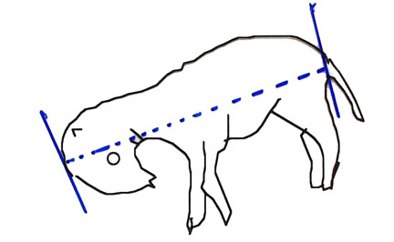
Rump
Crown
Estimates of Age
Crown rump length
Length femur, radius or tibia
Circumference of head

Slide 8
Factors Influencing Fetal Growth
Genetics
Species
Breed
Litter size
Genotype
Environment
Mother
Nutrition
Size, Parity
Placenta
Blood flow
Size
Fetal Hormones
Thyroid
Insulin
Growth hormone

Slide 9
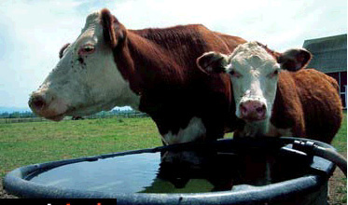
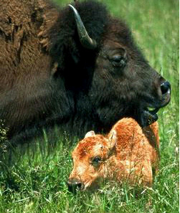
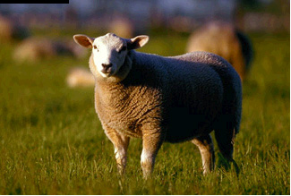
Factors Influencing Fetal Growth
Genetics
Species
Breed
Litter size
Genotype

Slide 10
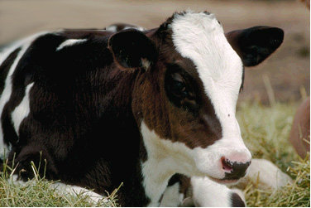
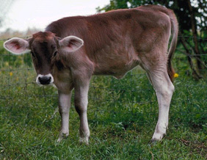
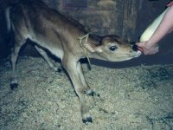
Factors Influencing Fetal Growth
Genetics
Species
Breed
Litter size
Genotype

Slide 11
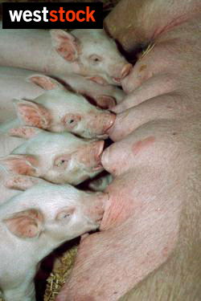
Factors Influencing Fetal Growth
Genetics
Species
Breed
Litter size
Genotype

Slide 12
Factors Influencing Fetal Growth
Genetics
Species
Breed
Litter size
Genotype
Certains lines of animals may grow faster.

Slide 13
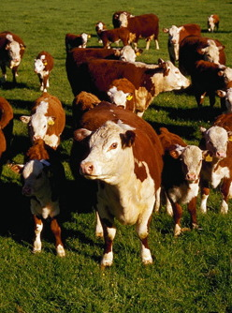
Factors Influencing Fetal Growth
Environment
Mother
Nutrition
Size, Parity
Placenta
Blood flow
Size

Slide 14
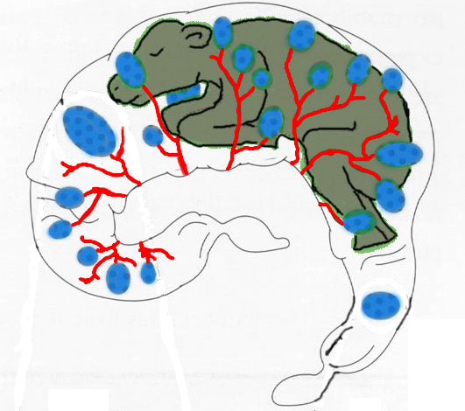
Factors Influencing Fetal Growth
Environment
Mother
Nutrition
Size, Parity
Placenta
Blood flow
Size

Slide 15
Factors Influencing Fetal Growth
Fetal Hormones
Thyroid
Insulin
Growth hormone
Skeletal and muscular development
Increased energy substrate availability and stimulates placental growth
Stimulates fetal growth

Slide 16
Uterine Size Changes During Pregnancy
Hyperplasia
  Increase in # of cells
Hypertrophy
  Increase in size of cells
Stretching

Slide 17
Placenta
Umbilical Vein
Ductus
Venosus
Portal Vein
Liver
Vena Cava
Foramen
Ovale
Left Atrium
Lungs
Right Atrium
Head
and
Heart
Ductus
Arteriosus
Aorta
Tissues
Umbilical Arteries

Slide 18
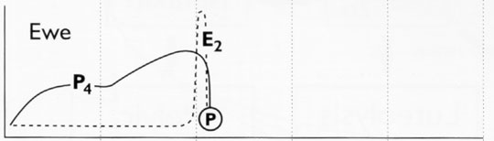
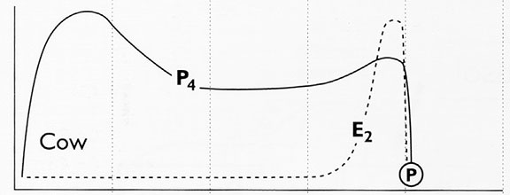
Relative P₄ and E₂
Weeks of Gestation
Ovulation

Slide 19
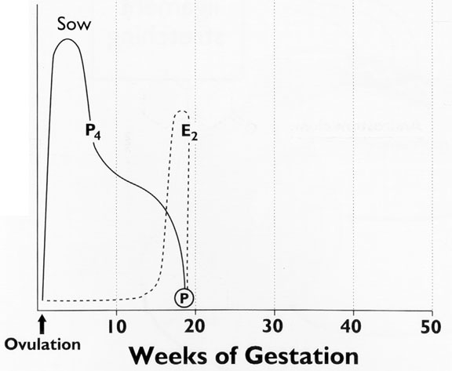
Relative P₄ and E₂

Slide 20
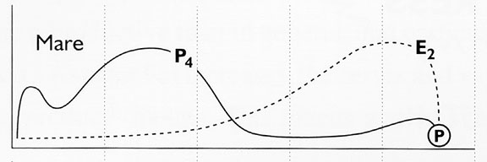
Relative P₄ and E₂
Weeks of Gestation
Ovulation

Slide 21
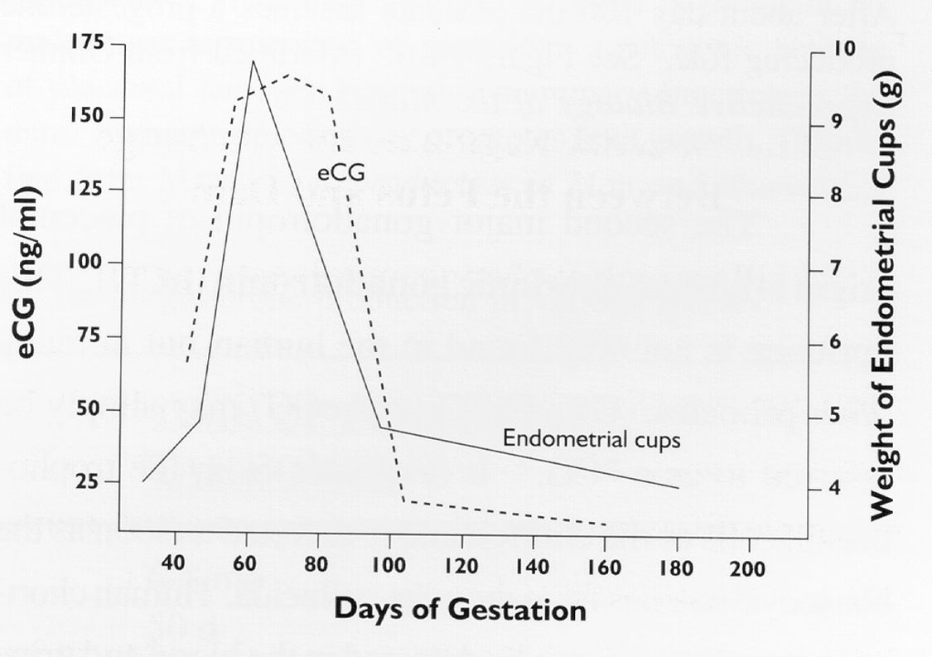

Slide 22
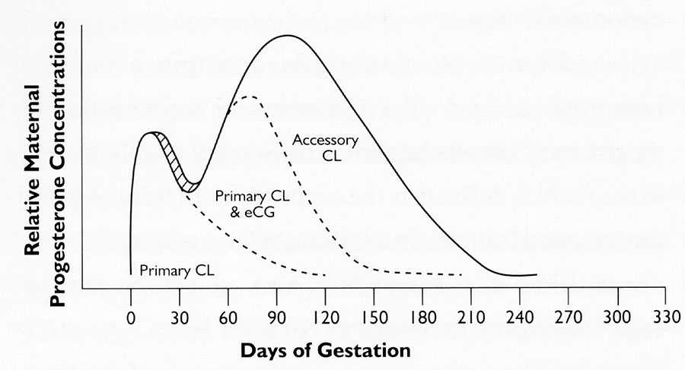

Slide 23
Relative P₄ and E₂
Weeks of Gestation
Ovulation

Slide 24
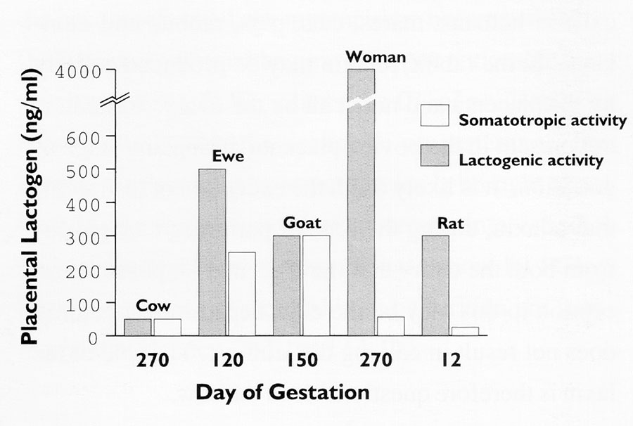

Slide 25
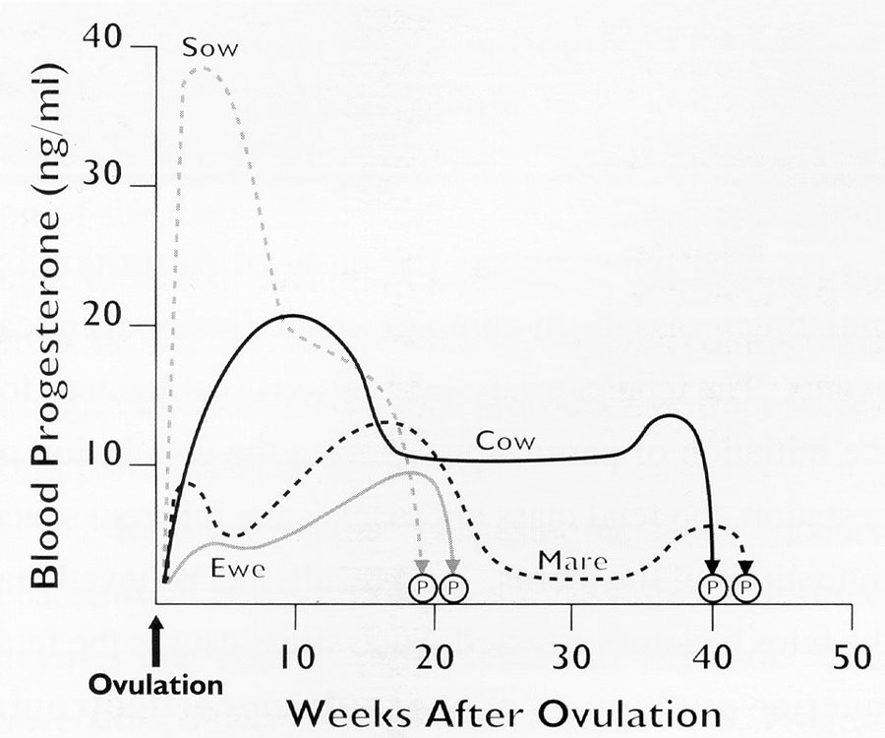
Progesterone Maintains Pregnancy!

Slide 26
Progesterone is Essential To Maintain Pregnancy
Corpus Luteum
Placenta
Species Gestation Placental
Length Takeover
Sow 3.8 mo 3.8 mo(none)
Cow 9 mo 6 - 8 mo
Ewe 5 mo 50 d
Mare 11 mo 70 d
Human 9 mo 60-70 d

Slide 27
Other Species in Which Placenta Does not Take-over Progesterone Production
Bitch
Queen
Alpaca, Llama, Camel
Rabbit
Goat

