Slide 1
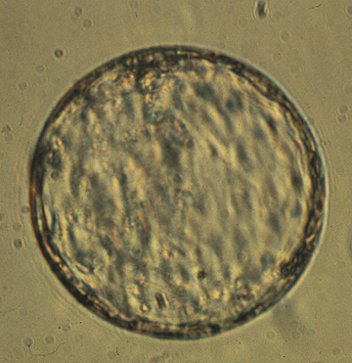
Embryo Development
Animal Science 434
John Parrish

Slide 2
Errors in Fertilization
Polyspermy - polyandry
  Multiple sperm penetration
  Invertebrates
    excess sperm eliminated because sperm centriole contributes to first embryonic cleavage spindle
  Mammals
    Sperm centriole not essential so development continues but fails early to midpregnancy due to multiploidy
    Occurs most often in aged oocytes due to failure of zona block to polyspermy

Slide 3
Errors in Fertilization (cont.)
Polygyny
  Multiple maternal pronuclei + 1 paternal pronuclei
  Artificially created only
    Suppress extrusion of the PBII
Androgenote
  Union of 2 paternal pronuclei
  Artificially created only
    From pronuclear exchange

Slide 4
Errors in Fertilization (cont.)
Gynogenote
  Union of 2 maternal pronuclei
  Artificially created
    Induced oocyte activation and supression of PBII extrusion
Parthenogenesis
  Activation of the oocyte without a sperm
  Embryo is either haploid or gynogenesis occurs to form diploid
    Platties - sperm activates but then gynogenesis occurs and sperm extruded from embryo

Slide 5
Oocyte Development and Fertilization
LH Surge (0 hr)
Primary Oocyte
GVBD (8 hr)
Metaphase I
MPF
MPF
GV-Intact
PB-1
Ovulation
(29 hr)
MPF
MPF
Metaphase II (21 hr)
Secondary Oocyte

Slide 6
Zona Pellucida
Oocyte
Ca²⁺
Sperm Penetration
of the
Zona Pellucida
and
Fusion with the Oocyte
(30 hr)
Perivitelline
Space

Slide 7
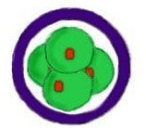
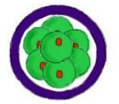
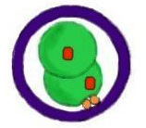
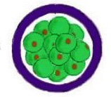
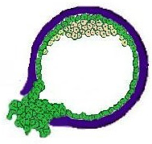
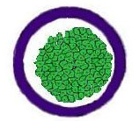
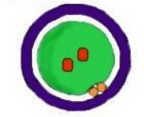
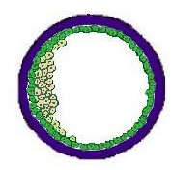
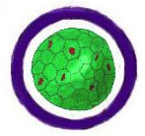
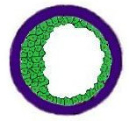
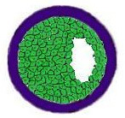
Embryo Development in the Bovine
4 cell (75 hr, day 3)
8 cell (90 hr, day 3)
2 cell (62 hr, day 2)
16 cell (120 hr,
day 4)
Zygote
(34 hr, day 1)
Hatched
Blastocyst
(day 9-11)
32 cell
Morula
(day 5-6)
Trophectoderm
Blastocoel
Compaction
Inner Cell
Mass
Early Blastocyst
(day 7-8)
Expanded
Blastocyst
(day 8-10)
Tight
Morula
(day 6-7)
Blastocyst (day 7-9)

Slide 8
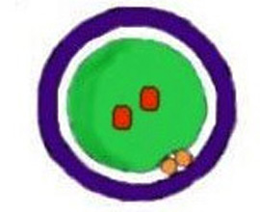

Fertilization to Cleavage
Zygote
Zona Pellucida
Perivitelline Space
Pronuclei
Polar Body
Blastomere

Slide 9
Fertilization to Cleavage
Imprinting
Maternal Gene Control
Long Cell Cycle

Slide 10
Imprinting
Sperm Pronucleus
Egg Pronucleus

Slide 11
Imprinting
Sperm Pronucleus
Egg Pronucleus
Androgenote
Gynogenote

Slide 12
Imprinting
Sperm Pronucleus
Egg Pronucleus
Controls
Androgenote
Gynogenote

Slide 13
Imprinting
Androgenote
Gynogenote
Controls
No Inner Cell Mass
Normal Placenta
Fails during embryo
development
Normal Fetus
Small Placenta
Fails Midpregnancy
Normal Fetus
Normal Placenta
Normal Pregnancy
Maternal and Paternal Genomes Are Expressed Differently in the Embryo and Fetus

Slide 14
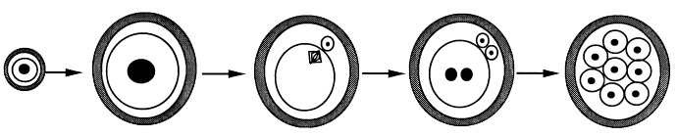
Gene Control of Development
Embryonic
Gene
Control
Maternal Gene Control
Oocyte
Growth
LH
Surge
Fertilization
Cleavage
Transciption
Translation
No transcription
Translation
Post-Translation
Translation
Post-Translation
Transcription
Translation
Post
-Translation

Slide 15
Fertilization to Cleavage
Maternal Gene Control

Slide 16
Fertilization to Cleavage
Long Cell Cycle
  Penetration to Cleavage
32 hour
(Bovine)

Slide 17
Precompaction Cleavage
Cell size decreases
Cell cycle
Embryonic gene control
Asynchrony of cell divisions
Movement into Uterus
Early pregnancy factor

Slide 18
Precompaction Cleavage
Cell size decreases
Cell cycle
Asynchrony of cell divisions
Embryonic gene control
Movement into Uterus
Early pregnancy factor

Slide 19
Precompaction Cleavage
32 hours
13 hours
Cell size decreases
Cell cycle
Embryonic gene control
Asynchrony of cell divisions
Movement into Uterus
Early pregnancy factor
15 hours
30 hours

Slide 20
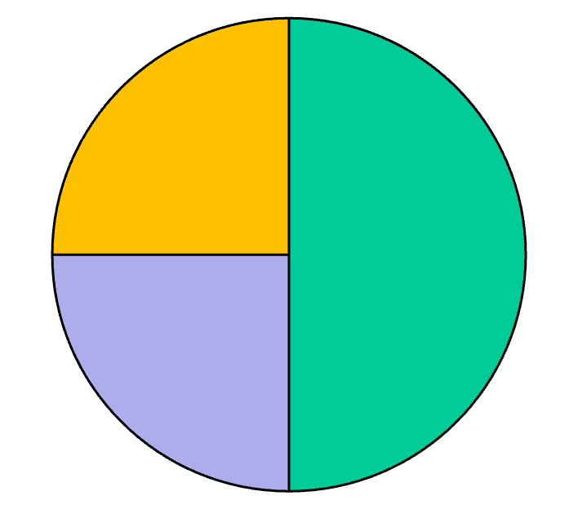
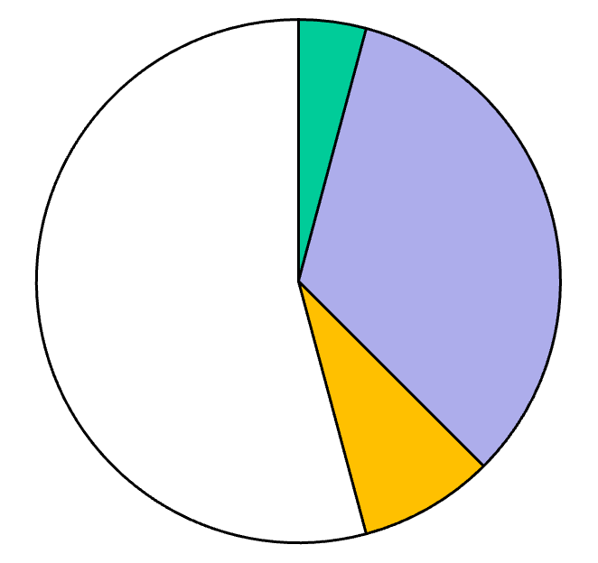
Cell Cycle Lengths
1st Cell Cycle
(zygote 2 cell)
2nd Cell Cycle
(2 cell 4 cell)
8 hr
<1 hr
16 hr
8 hr
8 hr
2 hr
G1
S
Total = 32 hr
G2 + M
Total = 13 hr

Slide 21
Precompaction Cleavage
32 hours
Short G1 and G2
13 hours
Cell size decreases
Cell cycle
Embryonic gene control
Asynchrony of cell divisions
Movement into Uterus
Early pregnancy factor
Short G1 and G2
15 hours
30 hours

Slide 22
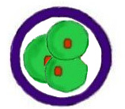
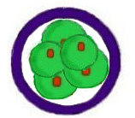
Precompaction Cleavage
Cell size decreases
Cell cycle
Asynchrony of cell divisions
Embryonic gene control
Movement into Uterus
Early pregnancy factor
Faster dividing
blastomeres go
to center of embryo

Slide 23
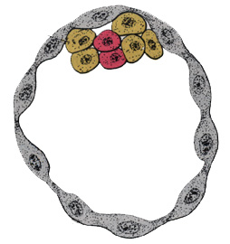
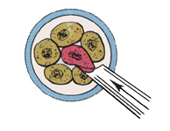
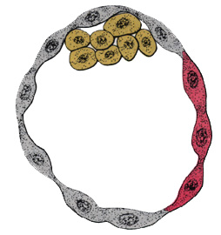
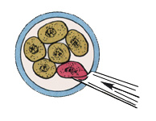
Asynchronous Cleavage - Inside Outside Theory
Inner Cell Mass
If a marked blastomere
is placed into the interior of a 8-cell embryo, it and its progeny become part of the ICM.
Trophectoderm
If a marked blastomere is placed on the outside of a 8-cell embryo, it and its progeny become part of the trophectoderm.

Slide 24
Asynchronous Cleavage Use
Create embryos from different species
  Placenta from one species
    Host mother
  Embryo from some other species
    Donor mother

Slide 25
Precompaction Cleavage
Cell size decreases
Cell cycle
Asynchrony of cell divisions
Embryonic gene control
Movement into Uterus
Early pregnancy factor

Slide 26
Gene Control of Development
Embryonic
Gene
Control
Maternal Gene Control
Oocyte
Growth
LH
Surge
Fertilization
Cleavage
Transciption
Translation
No transcription
Translation
Post-Translation
Translation
Post-Translation
Transcription
Translation
Post
-Translation

Slide 27
Transition from Maternal to Embryonic Gene Control
Transcription of the embryonic genome
Species
First begins
Development is
dependent on
Mouse 1 cell 2 cell
Rabbit 2 cell 8 cell
Pig 4 cell 8 cell
Cattle 4 cell 8-16 cell
Sheep 8 cell 16 cell
Human 4 cell 8 cell
In vitro blocks to development often occur here!!!!!

Slide 28
Precompaction Cleavage
32 hours
13 hours
Cell size decreases
Cell cycle
Asynchrony of cell divisions
Embryonic gene control
Movement into Uterus
Early pregnancy factor
15 hours
Embryo runs out of key factors coded for by maternal mRNA
30 hours
Cell Cycle Length Increases
Pause in G1

Slide 29
Precompaction Cleavage
Cell size decreases
Cell cycle
Asynchrony of cell divisions
Embryonic gene control
Movement into Uterus
Early pregnancy factor

Slide 30
Movement into the Uterus
Ampulla
Uterine Horn
Isthmus
< 8 cell
> 8 cell
Occurs around day 4
Cause
  Change in estrogen progesterone

Slide 31
Precompaction Cleavage
Cell size decreases
Cell cycle
Asynchrony of cell divisions
Embryonic gene control
Movement into Uterus
Early pregnancy factor

Slide 32
Early Pregnancy Factor
Found at 24 - 72 hours after fertilization
  Mice, hamster, sheep, cattle, swine, human
Seen only in viable pregnancy
  More recent experience in cattle may not agree with this
Function
  Sensitize the uterus to implantation
  Basis for early pregnancy kit in cattle

Slide 33
Morula to Blastocyst
Polarization
Compaction

Slide 34
Polarization
Polar Blastomeres
Microvilli
Non-polar Blastomeres

Slide 35
Polarization (cont.)
Gap Junctions
Tight Junctions

Slide 36
Cell Linage
Polar Cells
Non-polar Cells
2 polar cells
1 polar
1 non-polar
2 non-polar

Slide 37
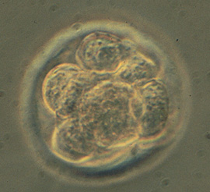
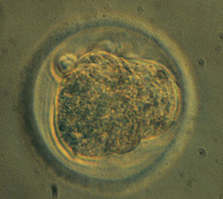
Compaction
Occurs at fixed time after fertilization
Membranes are very close and begin to flatten. Resulting in loss of the round cell outlines.
Differentiational event
Genome controlled and involves microtubules and microfilaments.

Slide 38
Blastocyst Formation and Hatching
Blastocoel formation
Hatching

Slide 39
Blastocoel Formation
Morula
H₂O
Na⁺
Gap Junctions
Tight Junctions

Slide 40
Blastocoel Formation
Morula
H₂O
Na⁺
Gap Junctions
Tight Junctions

Slide 41
Blastocoel Formation
Blastocoel
Early
Blastocyst
Morula
H₂O
Na⁺
Gap Junctions
Tight Junctions

Slide 42
Blastocyst Formation and Hatching
Blastocoel formation
Hatching
Early
Blastocyst
H₂O
Blastocoel formation
  not dependent on:
    Cell number
    Cell division
  Embryonic genome expression required
Na⁺
Blastocyst
Inner Cell
Mass
Expanded
Blastocyst
Trophectoderm

Slide 43
Blastocyst Formation and Hatching
Blastocoel formation
Hatching
Early
Blastocyst
Enzymatic digestion of zona
  Plasminogen and plasminogen activator made by embryo
  Softening of zona by uterine enzymes
Increase in size of blastocyst due to water pumping
  Most important
Day 9 - 11 in cattle, 6 in swine, and day 7 - 8 in horses or sheep
Blastocyst
Hatching
Blastocyst
Expanded
Blastocyst

Slide 44
Formation of Twins
Dizygotic
  Not identical
  Double ovulation
Monozygotic
  Identical
  Several potential mechanisms

Slide 45
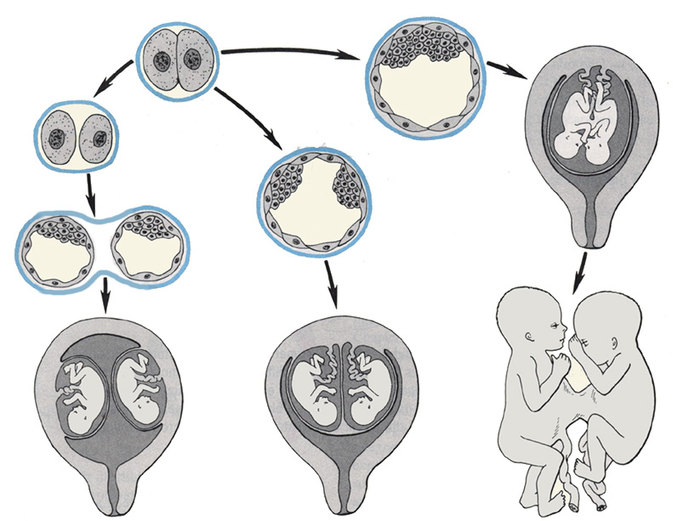
Formation of Monozygotic Twins
Siamese
Twins

