Slide 1
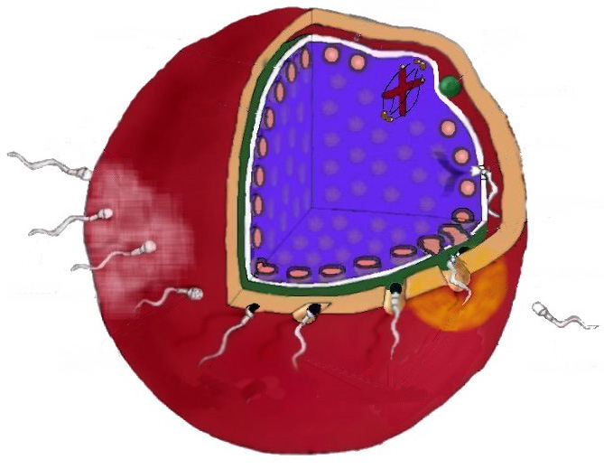
Fertilization
Animal Science 434
John J. Parrish

Slide 2
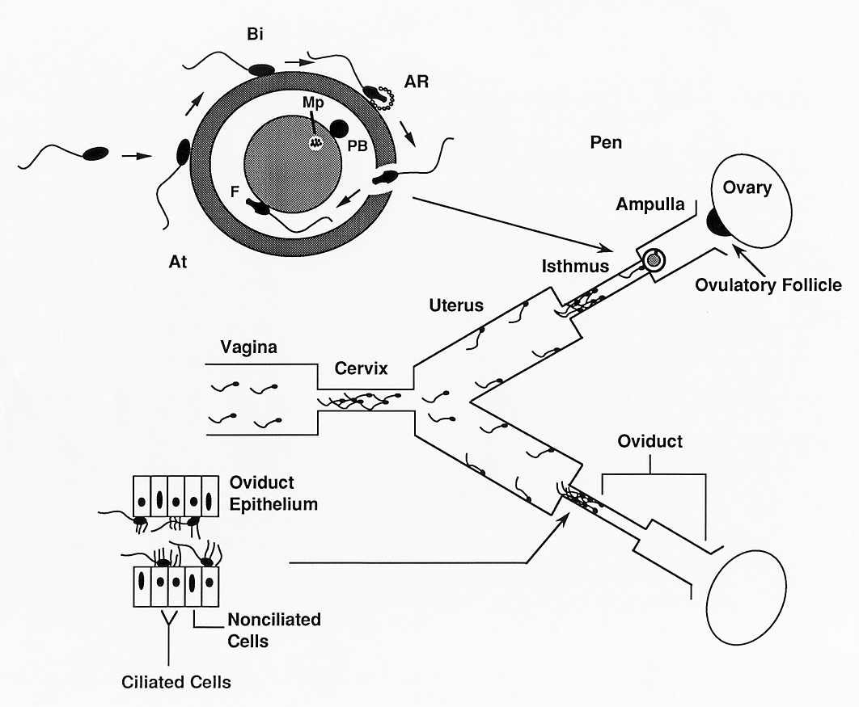

Slide 3
Capacitation
1951
Austin - rat
Chang - rabbit
Fertilization does not occur until several hours after sperm are placed in the uterus or oviduct

Slide 4
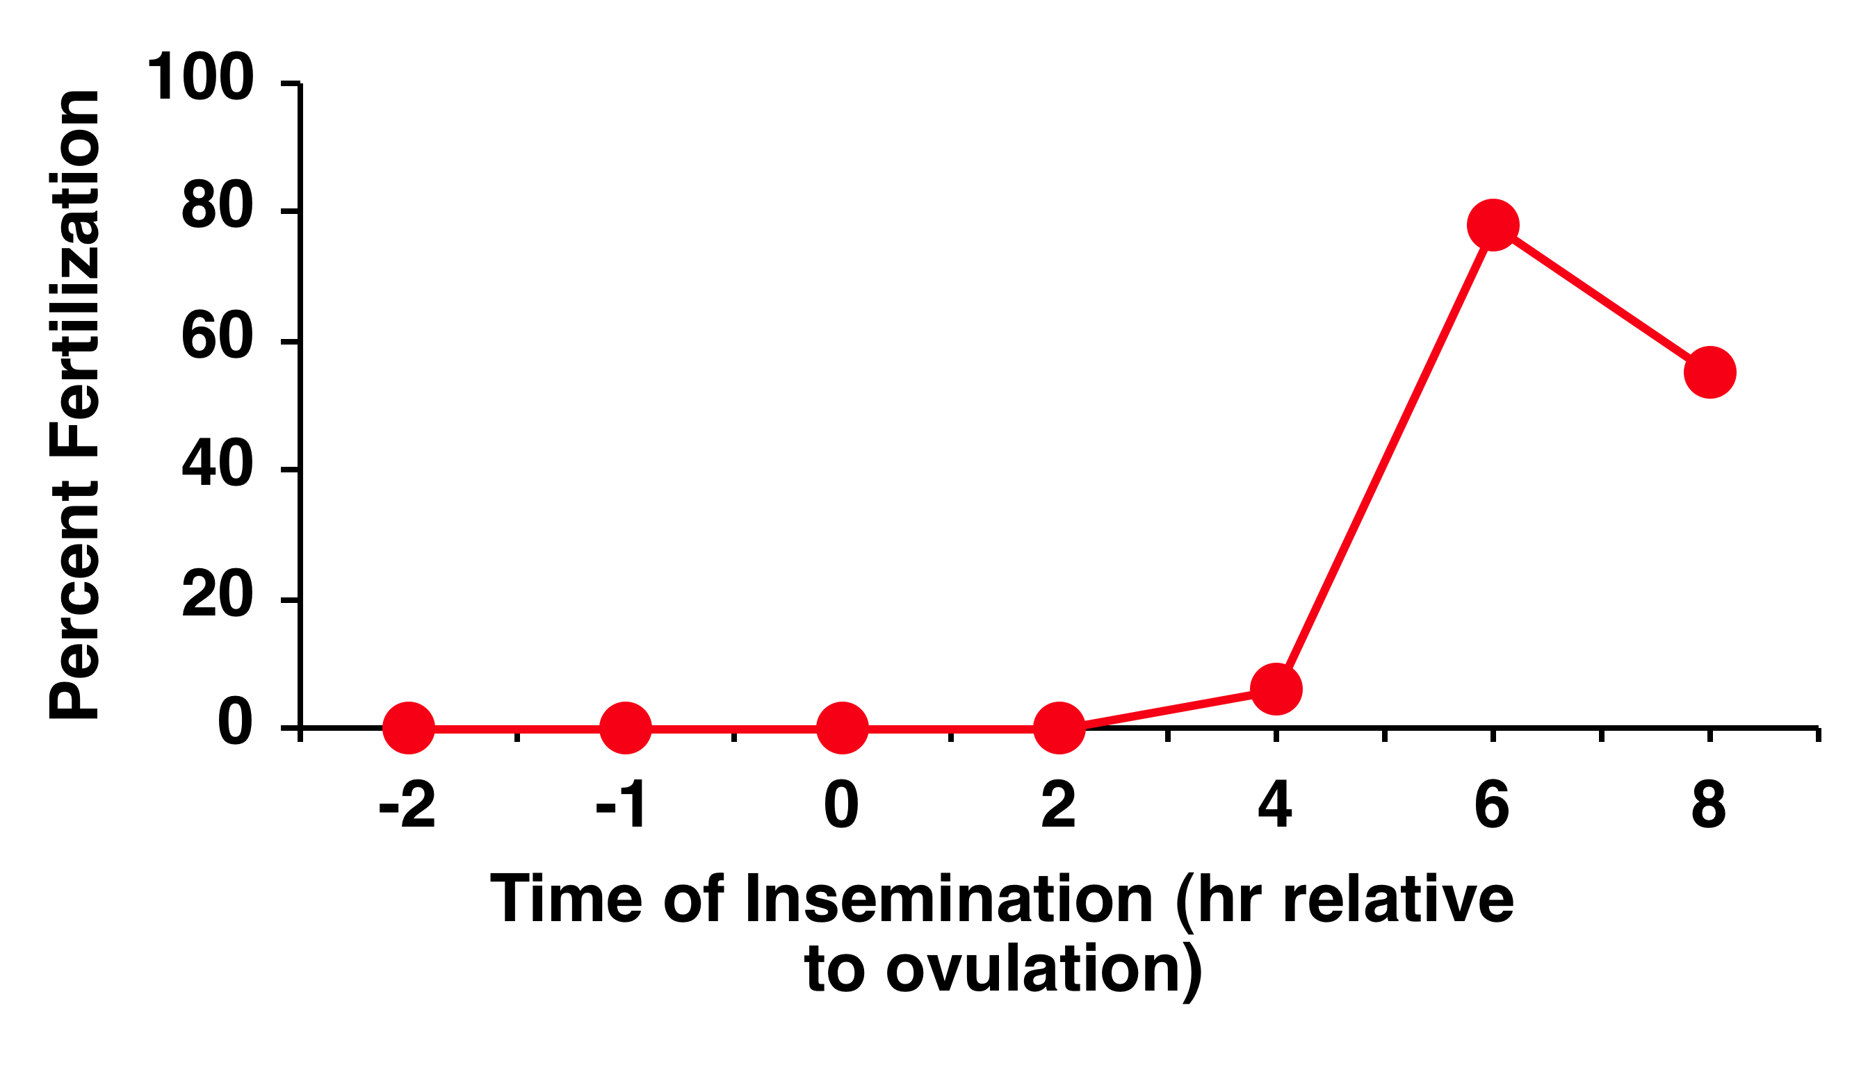
Chang Experiment - 1951
Ovulation
After
Before
Percent Fertilization

Slide 5
Capacitation
The changes within sperm that confer upon the sperm the ability to acrosome react in response to the appropriate stimulus.
Zona Pellucida
Cumulus Cells
Follicular Fluid

Slide 6
Effect of Capacitation
Epididymal
Ejaculated
Capacitated
Seminal
Plasma
and/or
Epididymal
Secretions
Female
Tract
+
+

Slide 7
DF (BSP in Bovine)
Plasma Membrane
Decapacitation Factor – Stabilizes plasma membrane and inhibits a premature acrosome reaction

Slide 8
Cholesterol
Acceptor
BSP
Heparin
Plasma Membrane
Cholesterol Acceptor
Albumin
HDL

Slide 9
Cholesterol
Acceptor
BSP
Heparin
Zp binding
clustering
Plasma Membrane
Raft Migration

Slide 10
H⁺
HCO₃⁻
Cholesterol
Acceptor
BSP
Heparin
Zp binding
clustering
Raft Migration
(+)
sAC
H⁺
HCO₃⁻
(+)
cAMP
(+)
pH_{i}
PK-A
(+)
(-)
PTK
Ptyr-Ptase
(+)
(-)
Protein Tyrosine Phosphorylation

Slide 11
Extracellular Space
Diffusion
CO₂ + H₂O H₂CO₃ H⁺ + HCO₃⁻
Carbonic Anhydrase

Slide 12
H⁺
HCO₃⁻
Cholesterol
Acceptor
BSP
Heparin
Zp binding
clustering
Raft Migration
(+)
sAC
H⁺
HCO₃⁻
(+)
cAMP
(+)
pH_{i}
PK-A
(+)
(-)
PTK
Ptyr-Ptase
(+)
(-)
Protein Tyrosine Phosphorylation

Slide 13
Ca²⁺
ATP
ADP
Ca²⁺
ATP
ADP
Ca²⁺
Acrosome

Slide 14
Cholesterol
Acceptor
BSP
Ca²⁺
Heparin
Raft Migration
ATP
ADP
Ca²⁺
Ca²⁺
ATP
ADP
Ca²⁺
Acrosome

Slide 15
H⁺
HCO₃⁻
Cholesterol
Acceptor
BSP
Heparin
Ca²⁺
(+)
sAC
(+)
H⁺
HCO₃⁻
Ca²⁺
(+)
cAMP
(+)
ATP
ADP
pH_{i}
PK-A
(+)
(-)
Ca²⁺
Ca²⁺
Acrosome
PTK
Ptyr-Ptase
(+)
(-)
Protein Tyrosine Phosphorylation

Slide 16
Capacitation
No change in sperm morphology
Motility change
  hyperactivation
cAMP
Power output

Slide 17
The Acrosome Reaction
Plasma Membrane
Fused Plasma
Membrane and
Outer Acrosomal
Membrane
Acrosin
Hyaluronidase
Acrosome
Nucleus

Slide 18
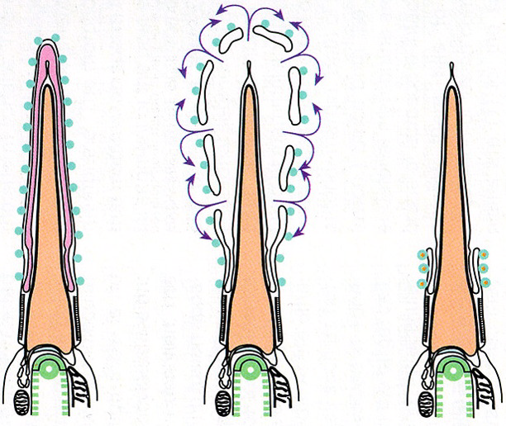
Modification
of the
Equitorial
Region

Slide 19
The Zona Pellucida
ZP1 ZP2 ZP3

Slide 20
Sperm Interaction with the Zona
Attachment
Zona
Pellucida
Binding
ZP₃
Acrosome Reaction
Induction
Acrosome Reaction

Slide 21
Zona
Pellucida
Secondary Binding
ZP₂
ZP₂
Zona Penetration
ZP₂
ZP₂
Motility

Slide 22
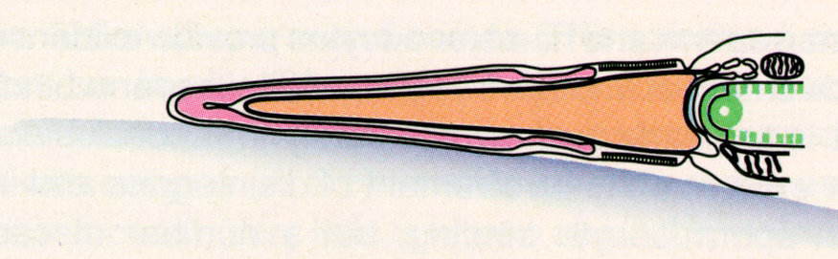
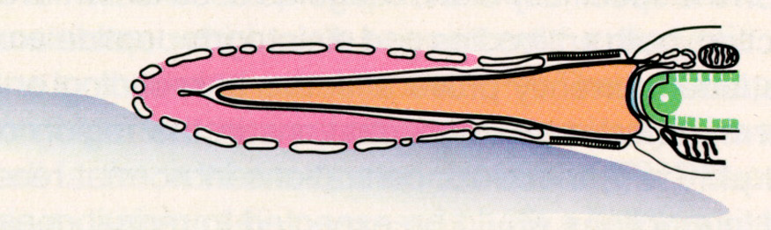
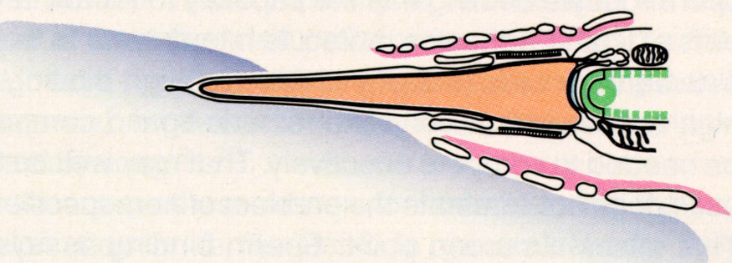
Zona Pellucida

Slide 23
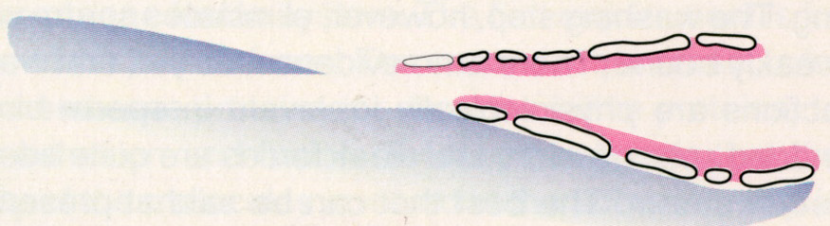
Sperm tract through zona pellucida

Slide 24
6-12 hr
18-24 hr

Slide 25
Maturation Promoting Factor
(MPF)
LH Surge
Metaphase Promoting Factor
Primary Oocyte
GVBD
Metaphase I
MPF
MPF
GV-Intact
PB-1
Ovulation
MPF
MPF
Metaphase II
Secondary Oocyte

Slide 26
Zona Pellucida
Oocyte
Ca²⁺
Ca²⁺
Ca²⁺
Ca²⁺
Perivitelline
Space

Slide 27
Zona Pellucida
Oocyte
Ca²⁺
Ca²⁺
Ca²⁺
Ca²⁺
Perivitelline
Space

Slide 28
Zona Pellucida
Oocyte
Ca²⁺
Ca²⁺
Ca²⁺
Ca²⁺
Perivitelline
Space

Slide 29
Zona Pellucida
Oocyte
Ca²⁺
Ca²⁺
Ca²⁺
Ca²⁺
Perivitelline
Space

Slide 30
Zona Pellucida
Oocyte
Ca²⁺
Ca²⁺
Ca²⁺
Ca²⁺
Perivitelline
Space

Slide 31
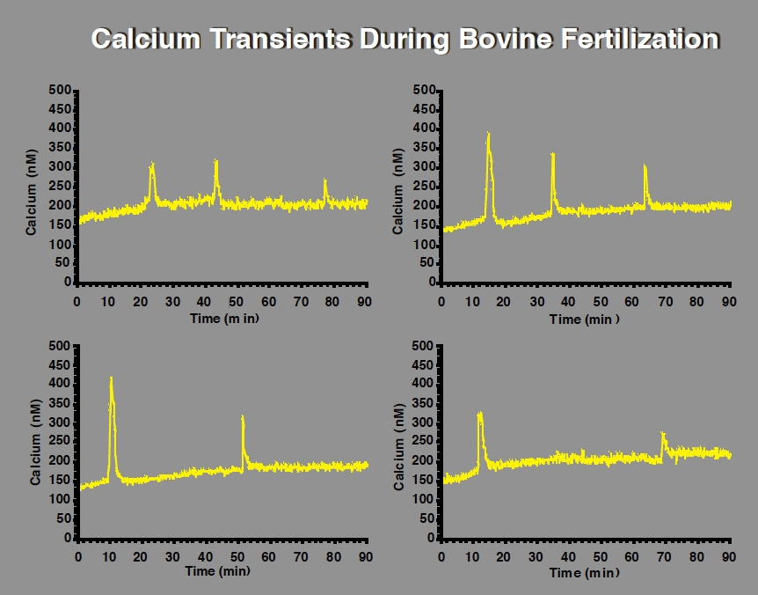

Slide 32
Initiation of Calcium Pulse by Soluble Sperm Component
DAG
Oocyte
PIP₂
PLC_{zeta}
IP₃
Ca²⁺
Ca²⁺
Endoplasmic Reticulum

Slide 33
Zona Pellucida
Oocyte
Pronuclei
Ca²⁺
AII
TII
X
MPF
Perivitelline
Space
MII
PBII

Slide 34
Zona Pellucida
Oocyte
Decondensation
Pronuclei
Zygote
Pronuclei
Ca²⁺
AII
TII
X
MPF
Perivitelline
Space
MII
PBII

Slide 35
Zona Pellucida
Oocyte
Ca²⁺
Zona Block to
Polyspermy
Cortical
Granules
Perivitelline
Space

Slide 36
Zona Pellucida
Oocyte
Ca²⁺
Zona Block to
Polyspermy
Cortical
Granules
Perivitelline
Space

Slide 37
Blocks to Polyspermy
Species
1. Mammals
3. Invertebrates
Amphibians
Fish
Rabbits
4. Amphibians
Avians
1
2
3
4

Slide 38
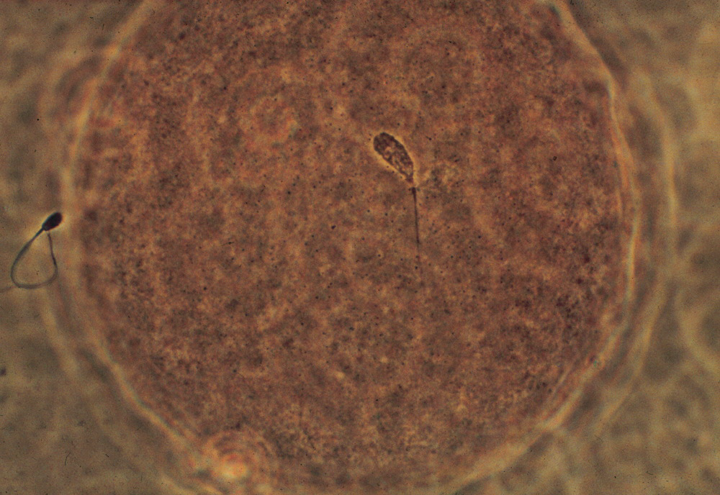

Slide 39
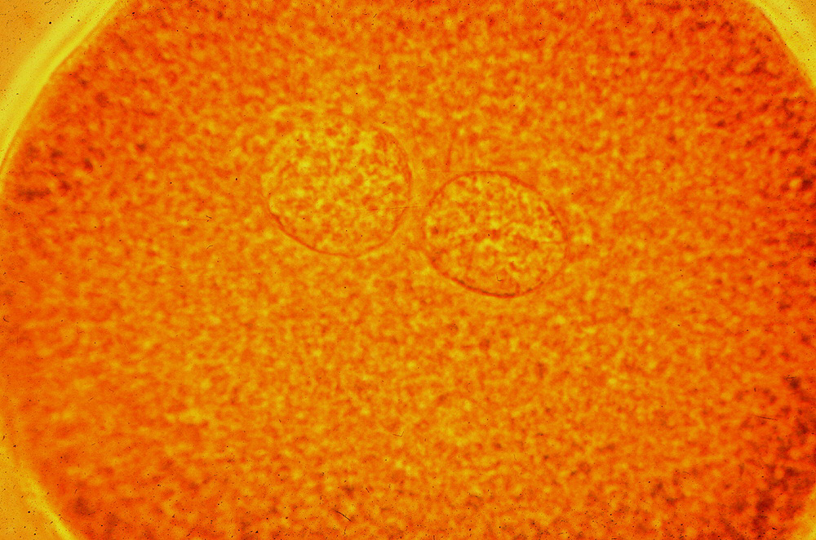

Slide 40
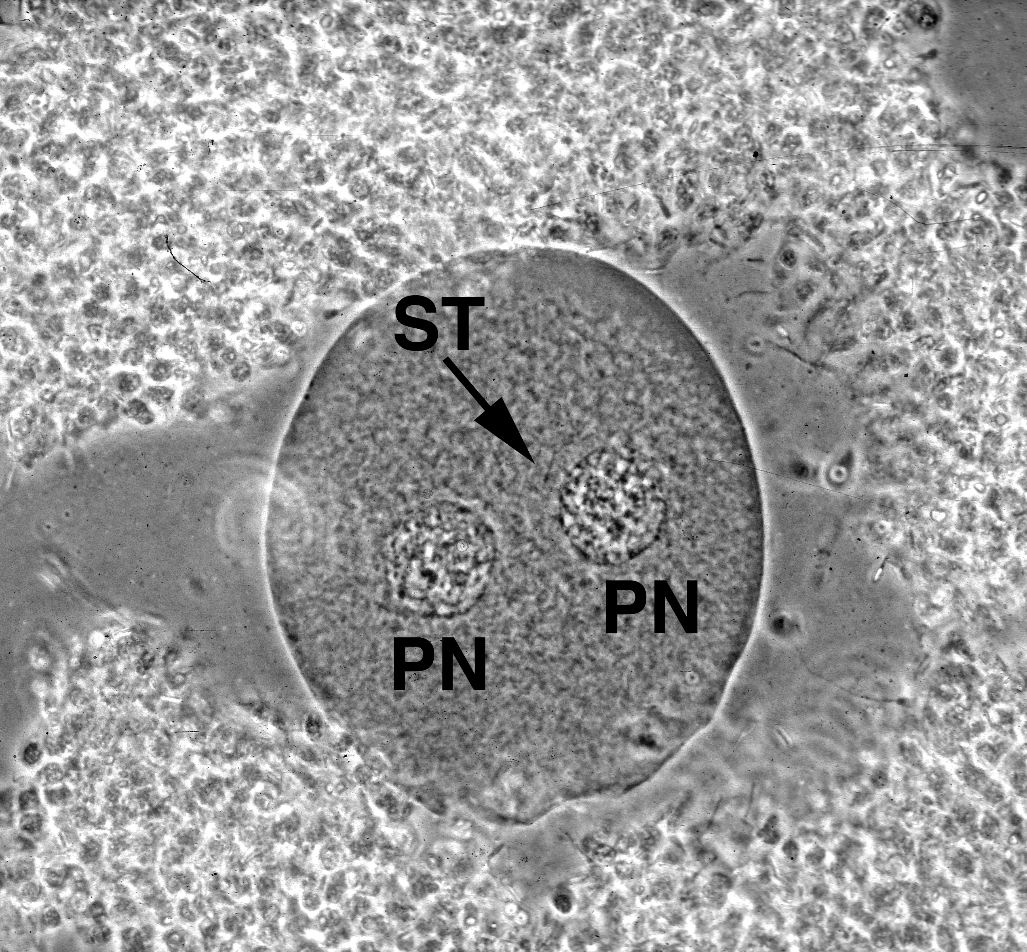

Slide 41
Gamete Aging
Oocyte life span approx. 6 – 12 hours after ovulation
Sperm life span approx. 24 – 48 hours after ejaculation

