Slide 1
Animal Science 434
Gamete Transport

Slide 2
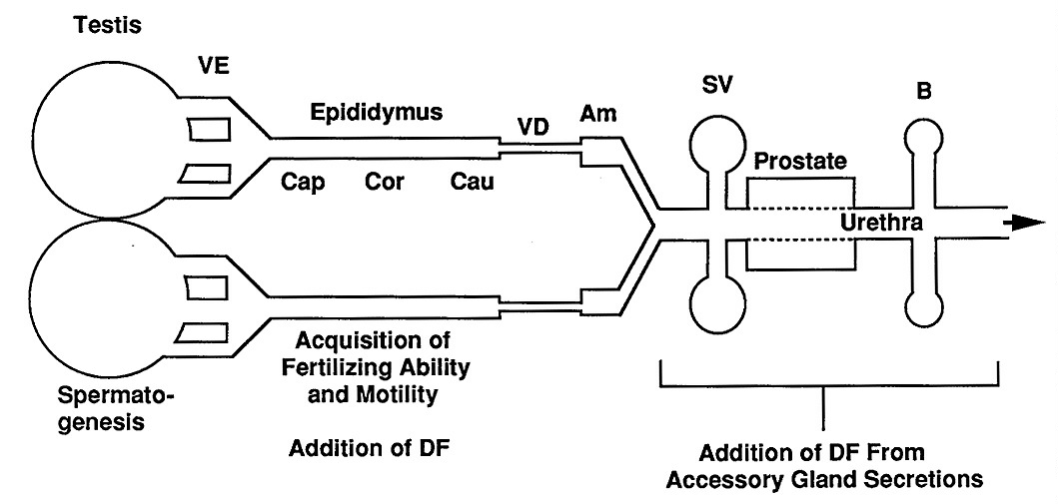
Sperm Transport in the Male Tract
Cilia
Fluid Flow
Muscle
Contractions
Fluid Flow

Slide 3
Sperm Transport in the Male Tract
Acquisition of
Fertilizing Ability
and Motility
No protein synthetic ability
addition or loss of plasma membrane proteins and lipids
redistribution of proteins and lipids within sperm
changes in lipid diffusion coefficients

Slide 4
Sperm Transport in the Male Tract
Addition of Decapacitation Factor
Addition of DF From Accessory Gland Secretions
Decapacitation Factor
protein, glycolipid and/or lipid
stabilizes the plasma membrane

Slide 5
Site of Ejaculation
Site of ejaculation Semen Characteristics Species
Vagina slight coagulation of ejaculate human, rabbit
vagina semen with high sperm cattle, sheep
concentration
uterus voluminous, distention of cervix horse
cervix, uterus voluminous, retention of penis dog, pig
during copulation
uterus vagina plug rodents

Slide 6
Sperm Loss From Female Tract
retrograde flow
phagocytosis by neutrophils

Slide 7
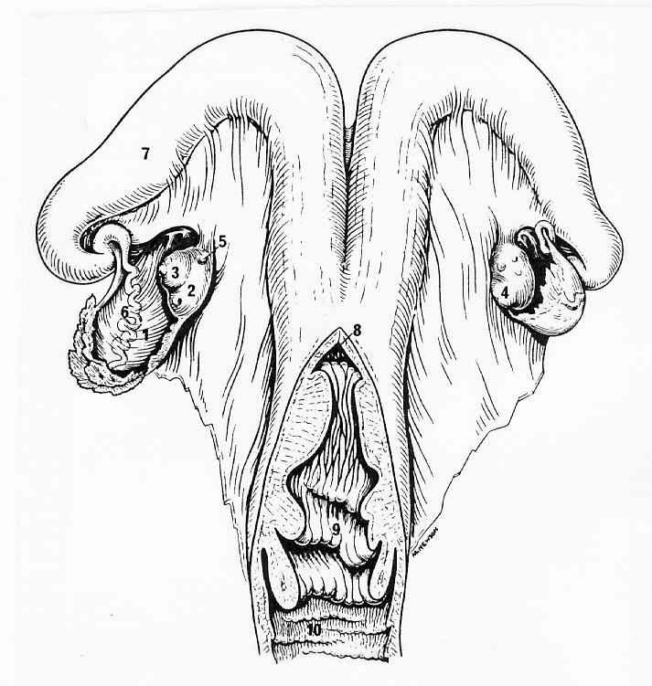
Experiment on Retrograde Flow in the Cow
Uterine Horn
Insemination at 3 different spots
Uterine Body
Cervix

Slide 8
20
Uterine Body
15
Cumulative % Sperm Recovered
From the Vagina
10
Cumulative % Sperm
Recovered From Vagina
Uterine Horn
5
0
0
1
2
3
4
5
6
7
8
Hour After Insemination

Slide 9
60
Cervix
50
40
Cumulative % Sperm Recovered
From the Vagina
Uterine Horn
cervix
30
20
10
0
0
1
2
3
4
5
6
7
8
Hours After Insemination
Hour After Insemination

Slide 10
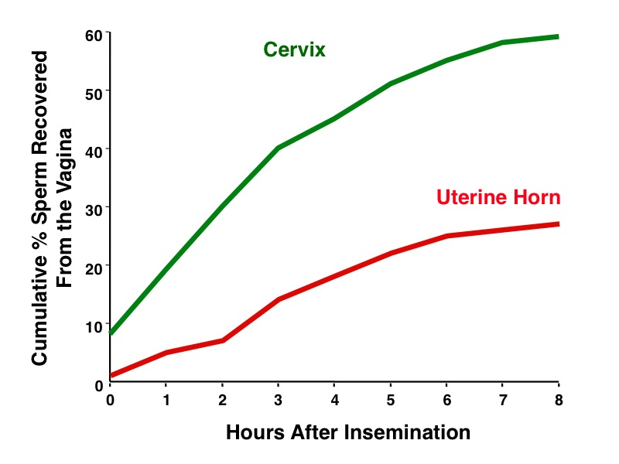
Assume 10 million inseminated
Uterine Horn at 8 hr = 25% loss or 75% retained = 7.5 million sperm retained
Cervix at 8 hr = 60% loss or 40% retained = 4 million sperm retained

Slide 11
Evolutionary Strategies for Dealing With Retrograde Flow of Semen
coagulation of semen or a plug
concentrated semen
semen deposited in uterus

Slide 12
Sperm Loss From Female Tract
retrograde flow
phagocytosis by neutrophils

Slide 13
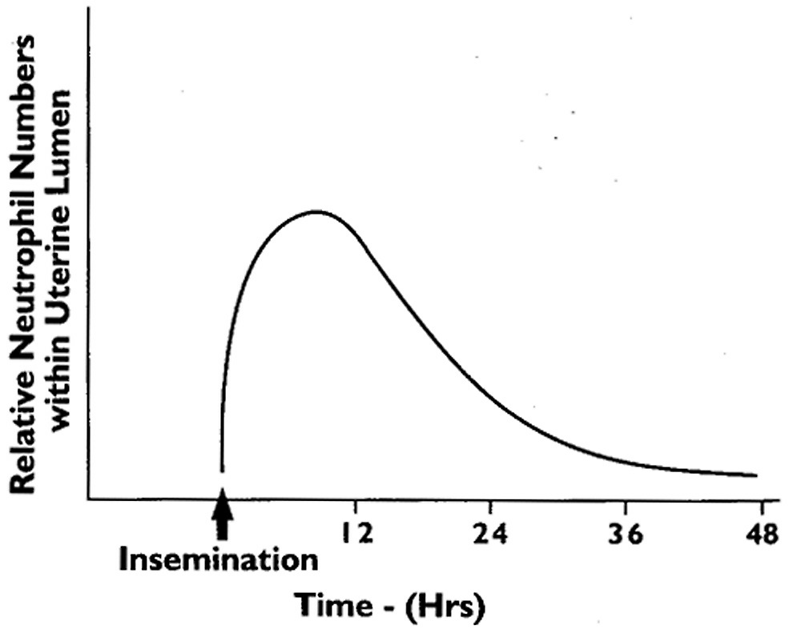
Neutrophile Infiltration of Uterus

Slide 14
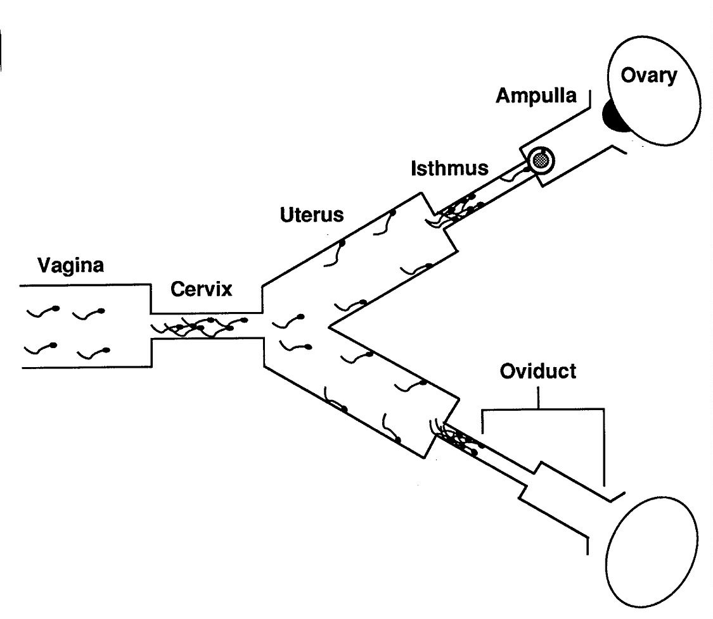
Phases of Sperm Transport
rapid
  15-30 min
sustained
  6 - 12 hr
oviductal
  at ovulation

Slide 15
Evidence for Sustained Transport
Ligatures at
Utero-tubal
Junction

Slide 16
Effect of Oviduct Transection on Fertilization in Heifers
Interval from mating* to Oocytes Fertilized
transection of UTJ
6 0%
8 50%
12 83%
* Mating was done at the start of estrus.

Slide 17
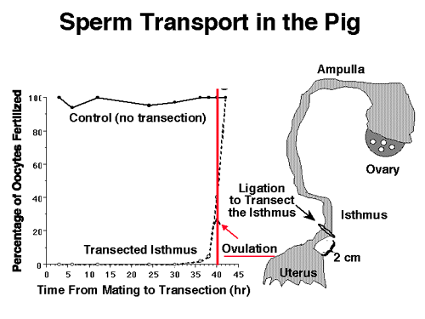

Slide 18
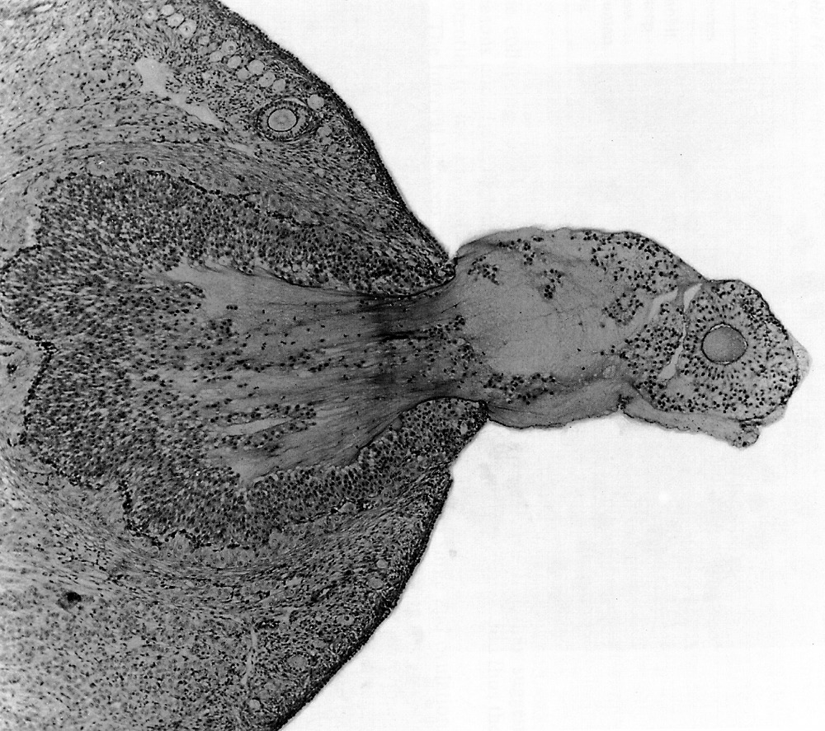
Ovulation
Oocyte
Cumulus Cells Follicular Fluid

Slide 19
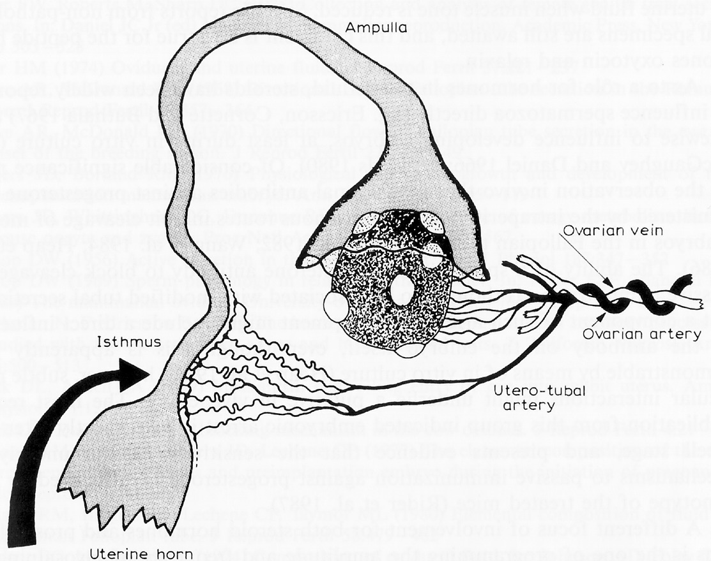
Cue for ovulation may effect isthmus to trigger oviductal transport

Slide 20
Location of Fertilizing Sperm
18-24 hr
1-2 hr
6-12 hr

Slide 21
Barriers To Sperm Transport

Slide 22
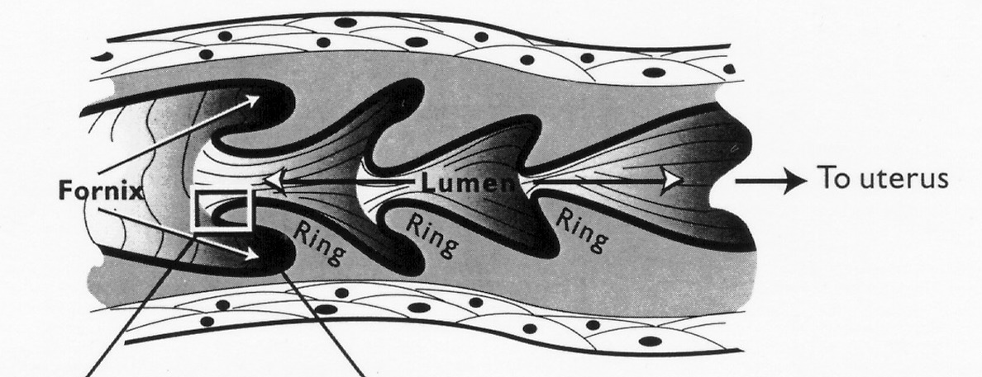
Cervix

Slide 23
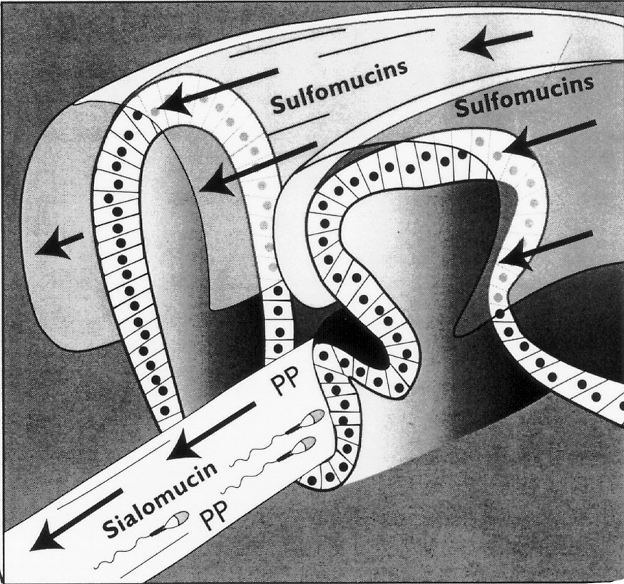

Slide 24
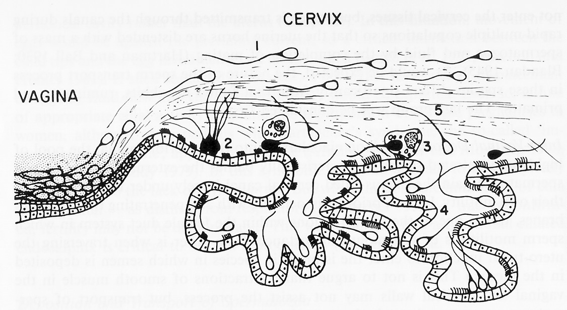

Slide 25
Barriers To Sperm Transport
Uterotubal Junction

Slide 26
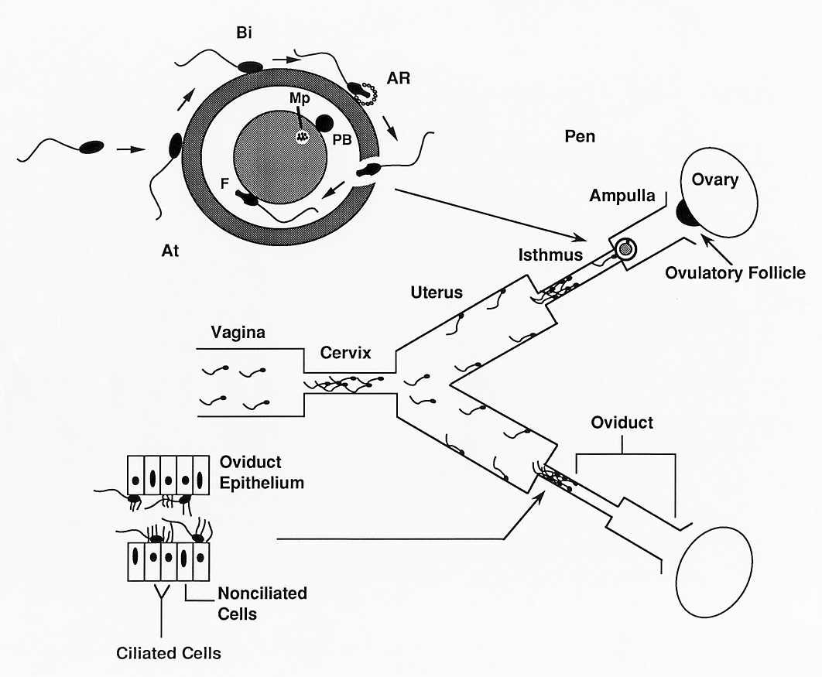

Slide 27
Ovulation
Oocyte
Cumulus Cells Follicular Fluid

Slide 28
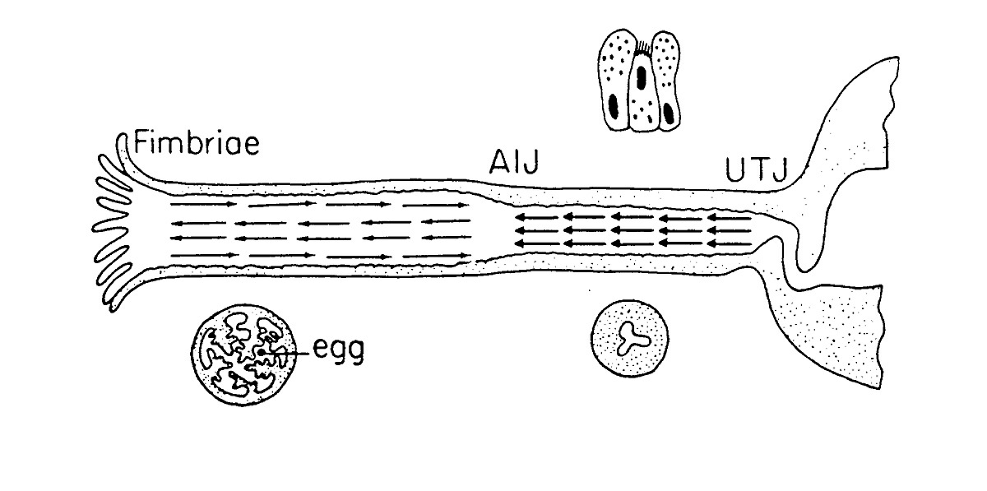
Factors Regulating Oocyte Transport in the Oviduct
Fluid Flow
Remains closed until
day 3 - 5 post ovulation

Slide 29
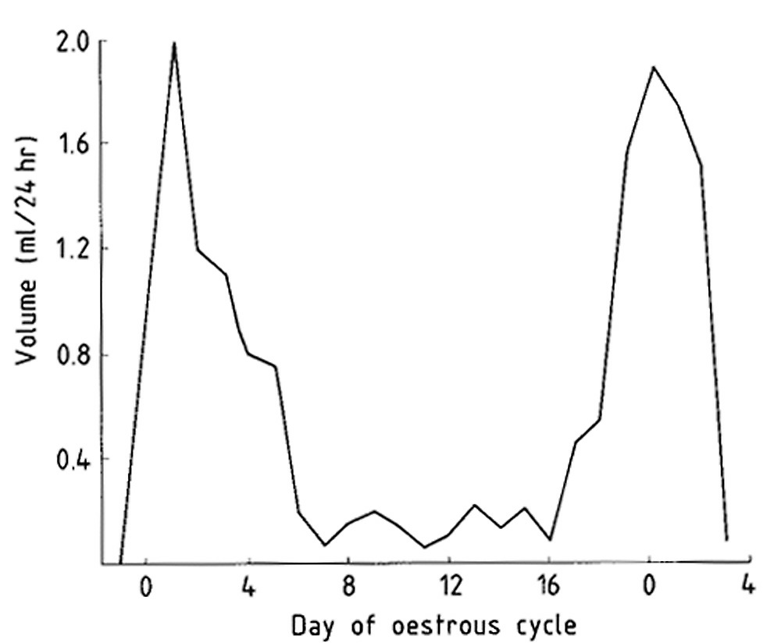

Slide 30
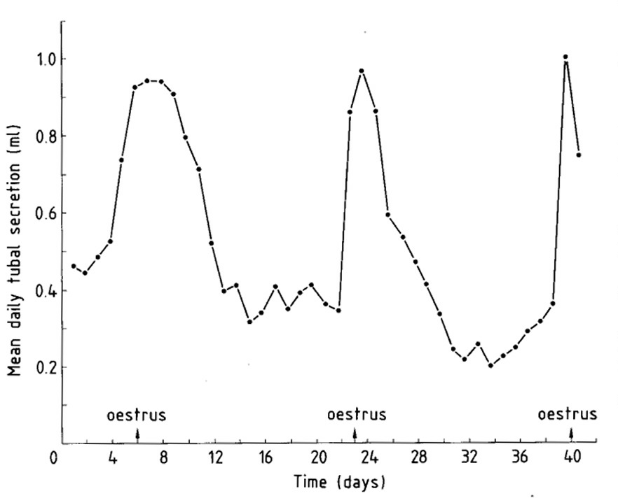

Slide 31
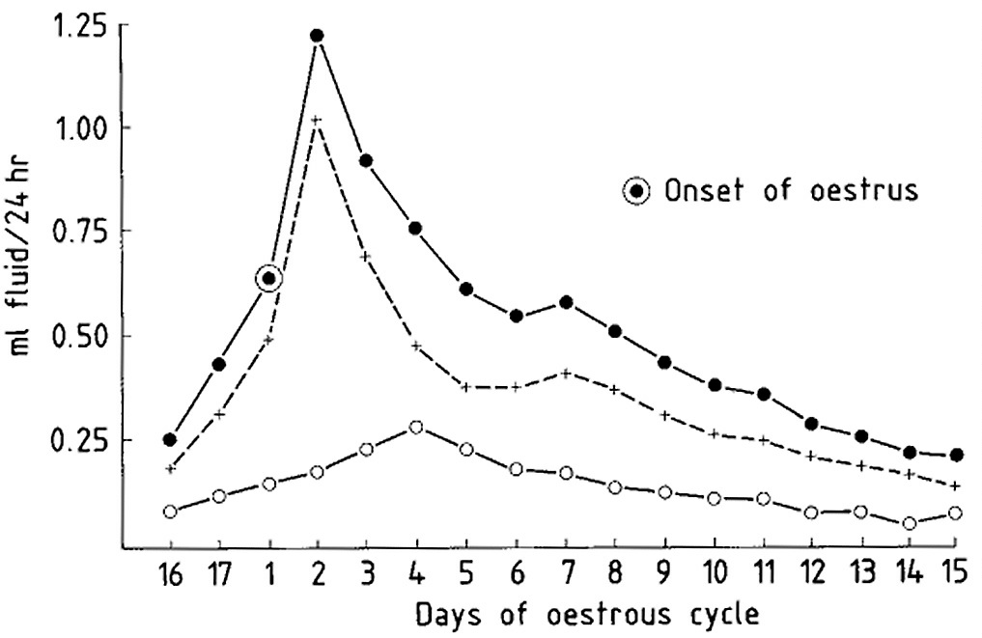
Total Fluid Production
Toward
Ampulla
Toward Uterus

Slide 32
Factors Regulating Oocyte Transport in the Oviduct
Site of
Fertilization
No
Contractions
Cilia
Muscle
Contractions
Fluid Flow
Remains closed until
day 3 - 5 post ovulation

Slide 33
Now view the video podcast entitled
View Video on Ovulation and Oocyte Transport
Found at:
http://www.ansci.wisc.edu/jjp1/ansci_repro/lec/lec_16_gamete_tran/ovulation_oocyte_trans.html

