Slide 1
Sexual Behavior (cont.)
B. Applied Reproductive Behavior of the Male: Semen Collection and Processing
Text: Ch. 10 and 11
Animal Science 434

Slide 2
Age When Semen Can Be Collected
Bull 12 months
Boar 6 - 8 months
Ram 6 - 9 months
Stallion 20 - 24 months
Dog 8 - 12 months

Slide 3
Effect of Age on Sperm Output
Bull
Sperm Output
0
10
20
30
40
50
60
Age in Months

Slide 4
Semen Collection
Sexual arousal
  Sight, sound, smell, touch
  Best mount - Live

Slide 5
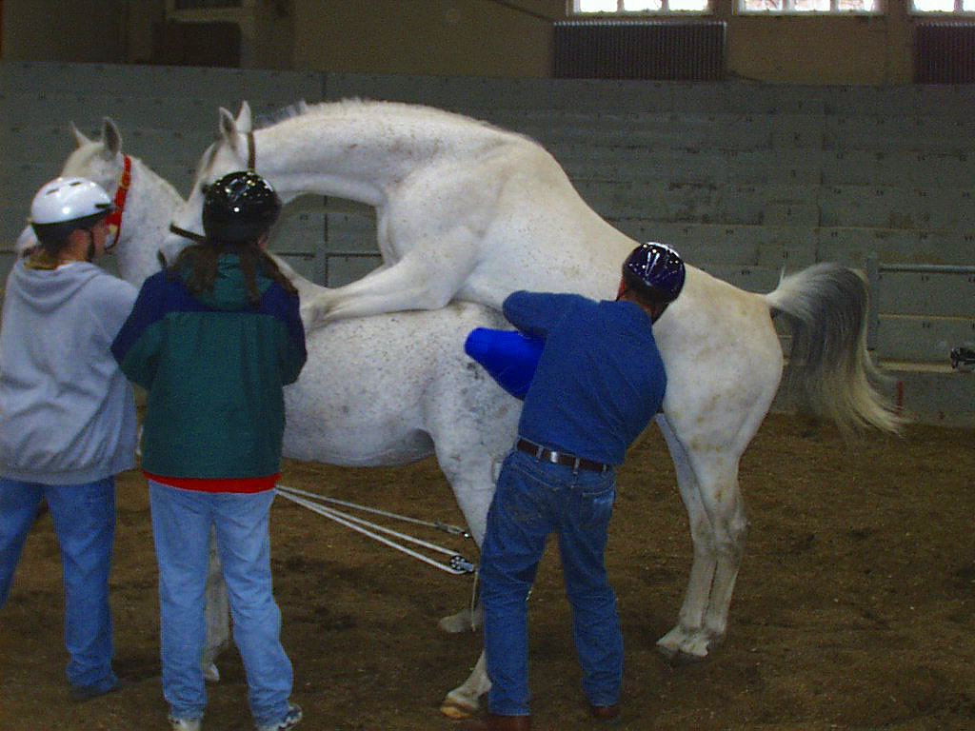
Collection on a Live Mount

Slide 6
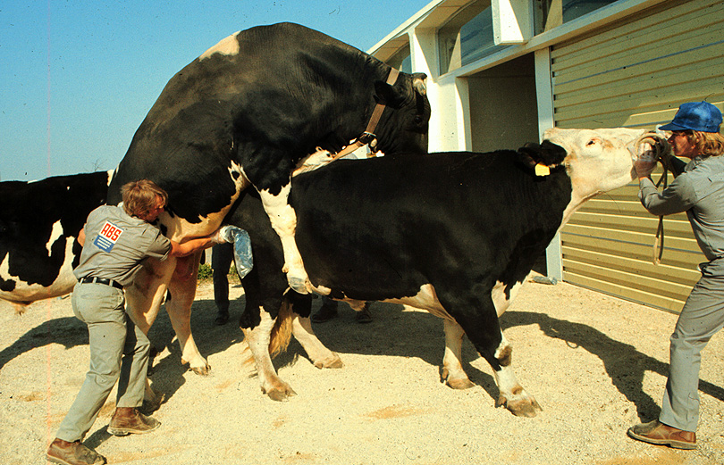
Collection on a Live Mount

Slide 7
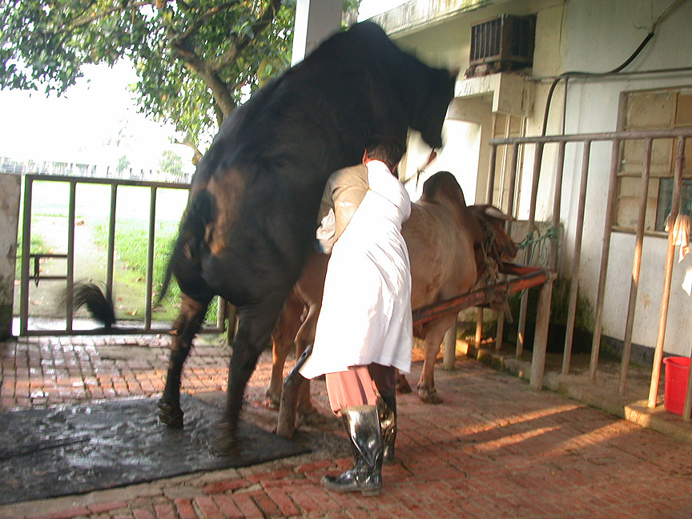

Slide 8
Semen Collection
Sexual arousal
  Sight, sound, smell, touch
  Best mount - Live
  Alternative mount - dummies
    Bull
    Stallion
    Boar
    Ram

Slide 9
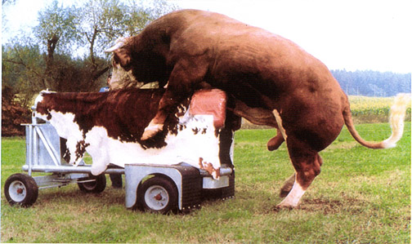
Collection of a Bull on a Dummy

Slide 10
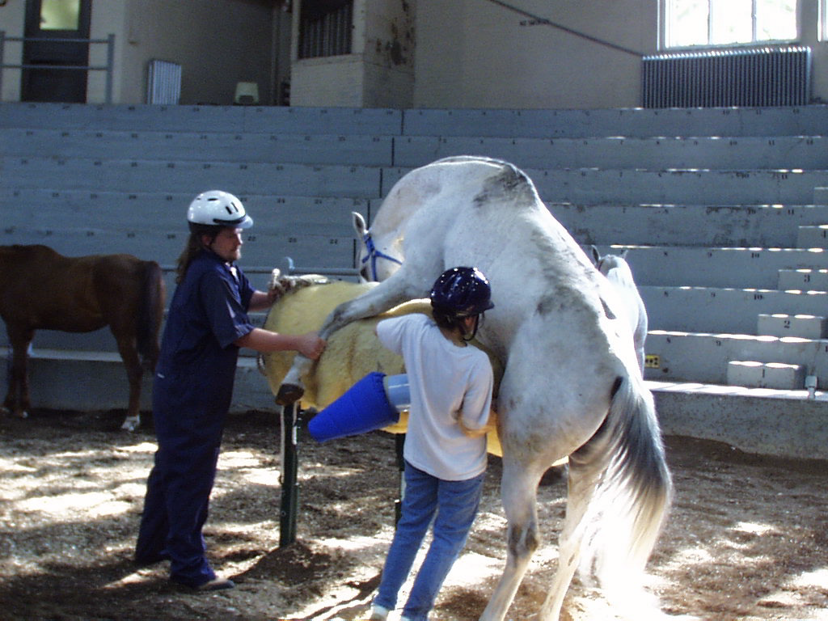
Stallion Collection on a Phantom

Slide 11
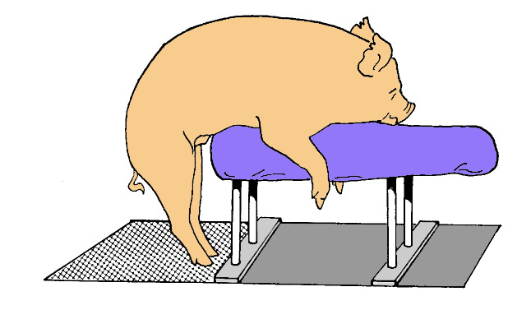
Boar Collection on a Dummy

Slide 12
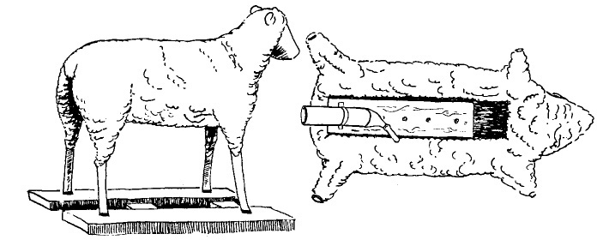
Ram Collection on a Dummy

Slide 13
Semen Collection (cont.)
Sexual Preparation
  False mounts
    In bulls can increase sperm collected by 100%
  Novelty
    Change mounts, location, other males present
  Breed and species differences
    Beef bulls less libido than dairy bulls
    Arab stallions more libido than Quarter horse stallions
    Rams less libido than bulls or male goats

Slide 14
Semen Collection (cont.)
Frequency of collection
  As increase frequency/wk
    decrease sperm/ejaculate
    Increase sperm recovered/wk

Slide 15
Effect of Collection Frequency on Sperm Output
Item Dairy Beef Sheep Swine Horses
# of collections 1-6 1-6 7-25 2-5 2-6
Volume (ml) 5-8 3-6 0.8-1.2 150-300 30-100
Concentration
(million/ml) 1000-2000 800-1500 2000-3000 200-300 200-400
Total sperm/ejac.
(billion) 7-15 5-10 1.6-3.6 30-60 5-10
Total sperm/wk
(billion) 15-40 10-30 25-40 100-150 15-30
Motile sperm(%) 50-75 40-75 60-80 50-80 40-75
Normal sperm(%) 70-95 65-90 80-95 70-90 70-90

Slide 16
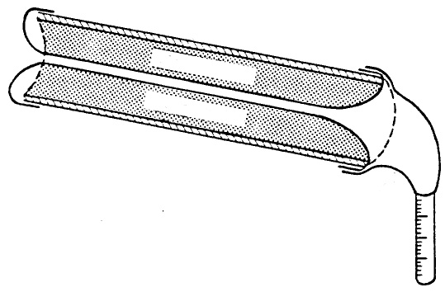
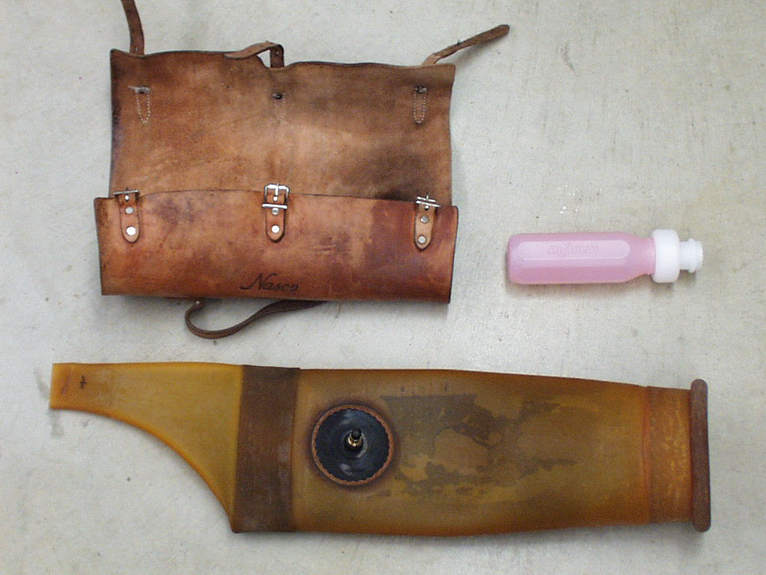
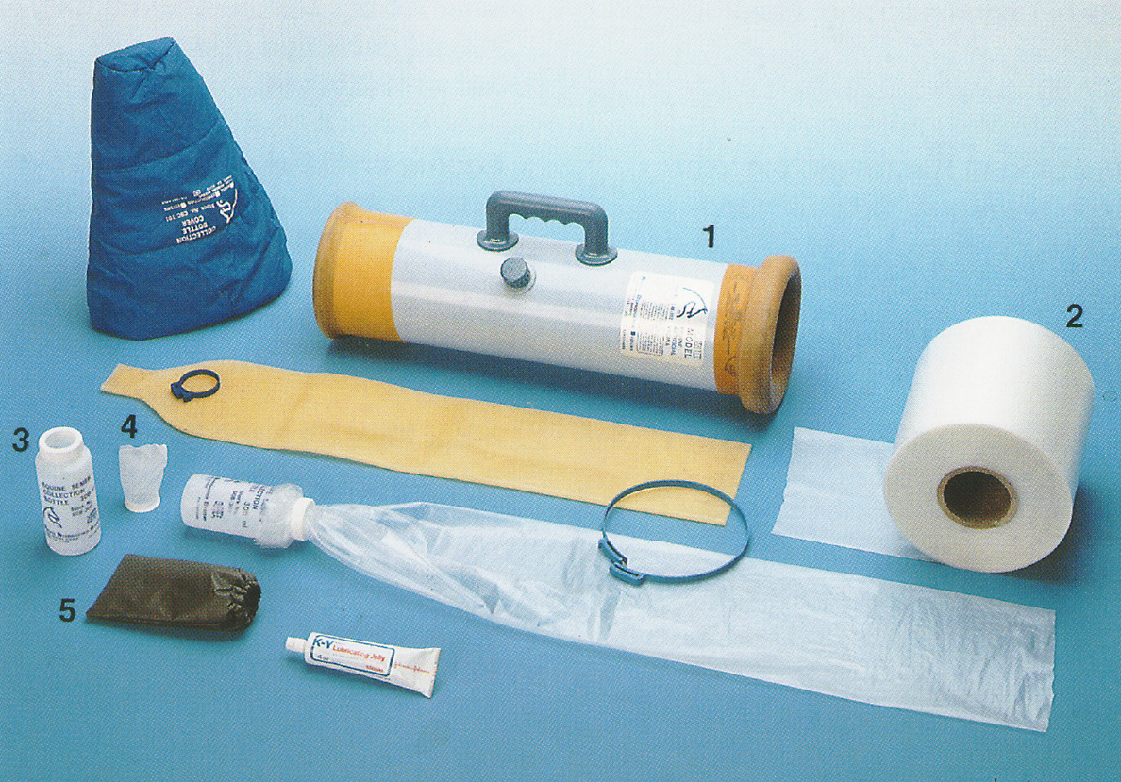
Artificial Vaginas
Water
Water
Inner Liner
Collection cone
Collection vial

Slide 17
Characteristics of AV
Temperature
  Bull, stallion, ram - 45°C
Pressure
Friction
  Lubrication essential

Slide 18
Electroejaculation
Useful if male won’t or can’t mount
  Get urine often
  Poorer quality ejac.
Used in rams and beef bulls

Slide 19
Massage Method
Stimulate by rectal massage
  Seminal vesicles
  Vas deferens

Slide 20
Semen Evaluation
Appearance (color)
  No debris
  No puss
  No urine
Volume
Motility
Concentration
  Hemocytometer, spectrophotometer
Morphology

Slide 21
Preservation of Semen
Extenders (7 components)
  Nutrients
    Glucose, fructose
  Cold shock prevention
    Milk, skim-milk, egg yolk
  Buffer
    Citrate, Tris
  Osmotic pressure
    The buffer component

Slide 22
Preservation of Semen (cont.)
  Inhibit bacterial growth
    antibiotics
  Increase volume
  Cryoprotectant
    glycerol

Slide 23
Preservation of Semen (cont.)
Liquid Semen
  Collect semen
  Semen quality exam
  Extend 1:3 (semen:extender)
    Minimal extension rate
  Cool to 5°C over 2 hours
    OK for bull, stallion, ram
    Boar - cool to 15°C

Slide 24
Preservation of Semen (cont.)
  Once cooled, extend semen to final amount
    Bovine (inseminate 0.5 ml)
      2 to 5 million sperm/ml
    Equine (inseminate 1 billion sperm)
      25 to 50 million sperm/ml
      If don’t cool then inseminate 500 million motile sperm
    Swine (inseminate 1.5 to 6 billion sperm in 50 ml)
      30 to 120 million sperm/ml

Slide 25
Preservation of Semen (cont.)
Frozen semen
  Follow instruction for collecting and cooling semen
  After cooling to 5°C, extend to 2X the final concentration desired
    If want final concentration to be 40 million/ml then dilute to 80 million to ml at this time
  Hold semen for 4 to 6 hours at 5°C
    Equilibrates semen to the cold

Slide 26
Preservation of Semen (cont.)
  Add the cryoprotectant
    Mix extender with 2X final cryoprotectant amount, 1:1 with extended semen
    Do this in small portions to minimize cryoprotectant toxicity
  Package semen
    0.5 ml French straws
    Ampules
  Freeze semen
    Liquid nitrogen vapor
      Static
      Mechanically controlled
    Dry ice depressions for pellet freezing

Slide 27
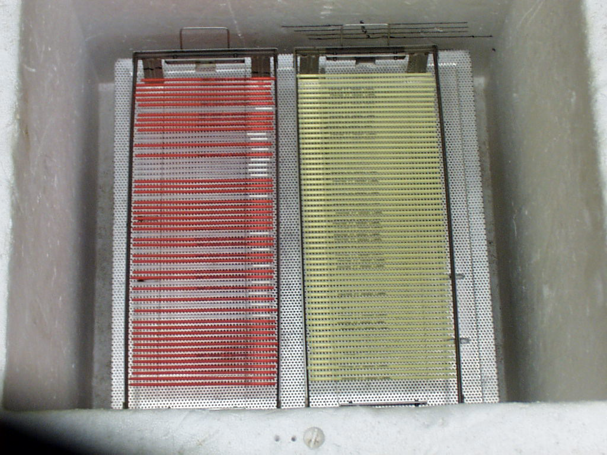

Slide 28
Preservation of Semen (cont.)
Storage
  In a liquid nitrogen tank

Slide 29
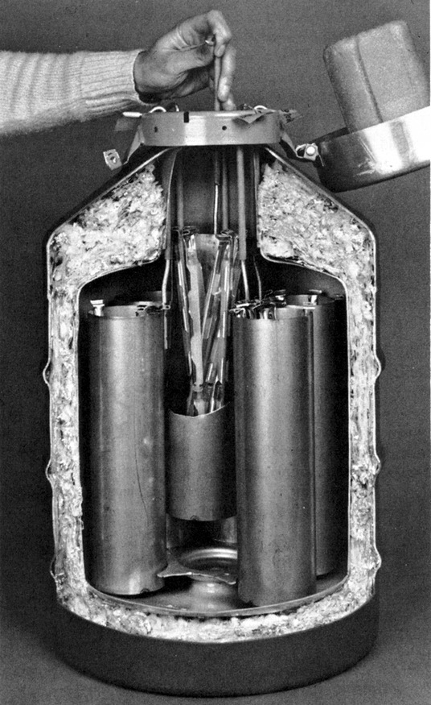
Liquid Nitrogen Tank

Slide 30
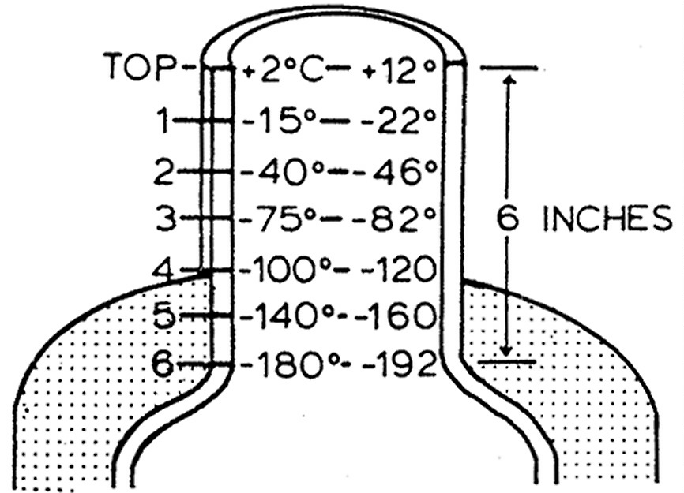
Temperature in Neck of Storage Tank
Liquid Nitrogen -196°C

Slide 31
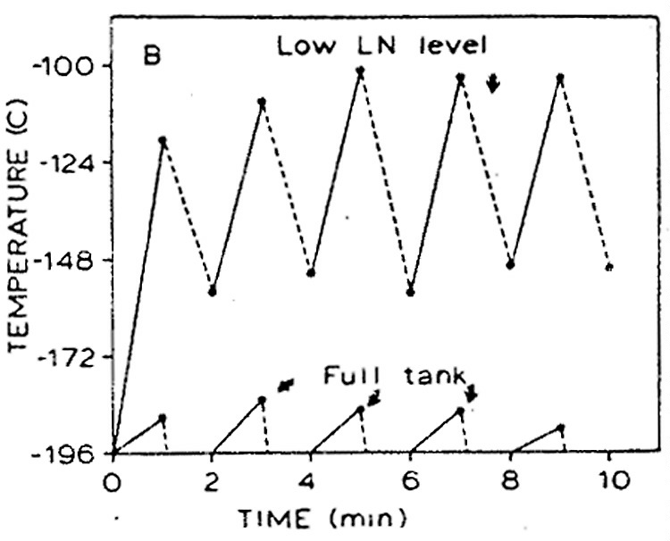
Temperature of Straws If Low LN

Slide 32
Conclusions on LN Tank
Maintain LN level as high as possible.
Keep extra tank (narrow neck) with only nitrogen so semen storage tank can be refilled when opened.
Enter semen storage tank only when needed
Do not hold canes above neck of LN tank

Slide 33
Thawing
Use the procedures recommended by the semen supplier!!!
  35°C water for 30 - 60 seconds
  Ice water for 3 minutes
  Pocket thaw
Have thawing container near LN tank when removing semen

