Slide 1

Sexual Behavior a. General Behavior
Animal Science 434

Slide 2
Reproductive Behavior
Very strong drive and can take precedence over other activities
Purpose
  Promote copulation
  Assure sperm and oocyte meet
  Primates – Social bonding (family groups)
Goal is to achieve pregnancy and parturition
  or social bonding

Slide 3
Stages of Reproductive Behavior
precopulatory
copulatory
post copulatory

Slide 4
Precopulatory Stage
Search for sexual partner
  in female, generally limited to estrus
    increased physical activity
    In primates can occur at any time
  in male can occur at any time
  involves all of the senses
    sight
    smell
    hearing
    tactile

Slide 5
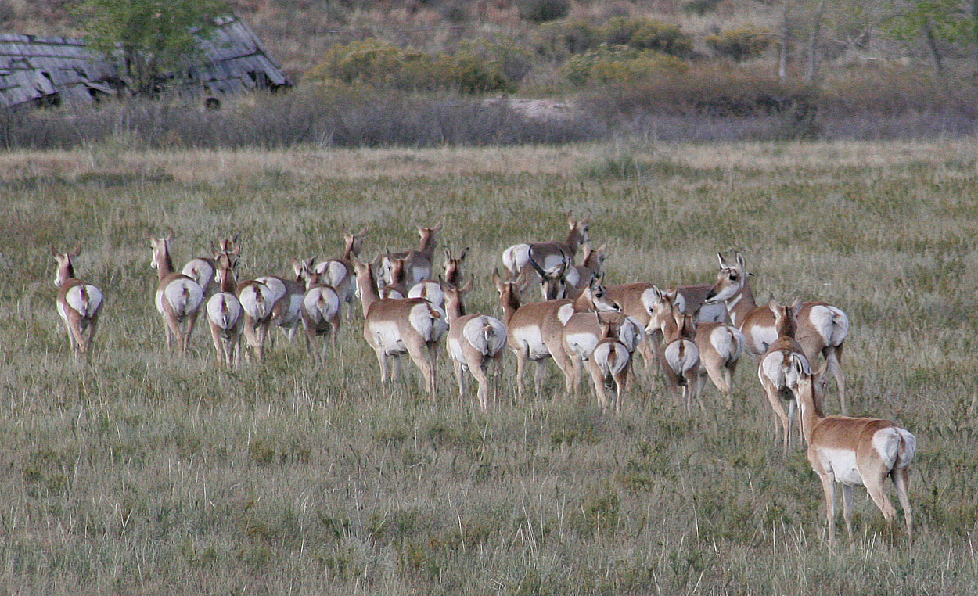
Search For Partner

Slide 6
Search For Partner

Slide 7
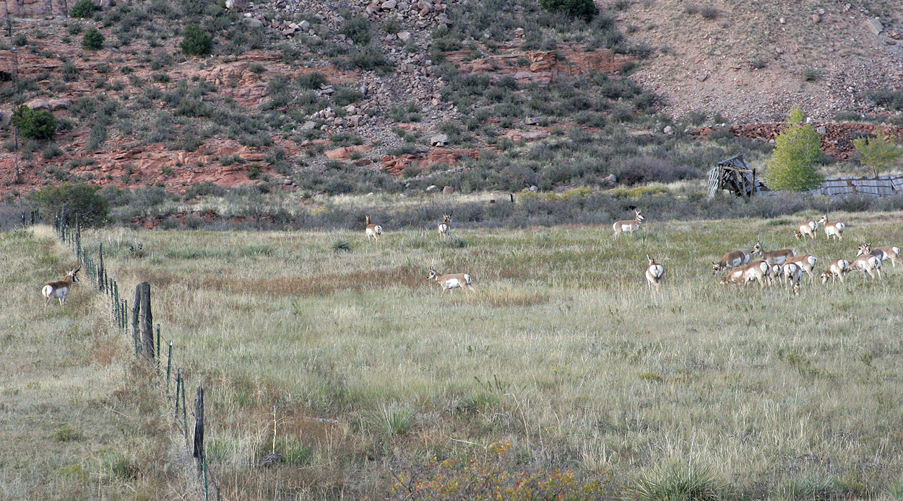
Search for Partner

Slide 8
Search for Partner

Slide 9
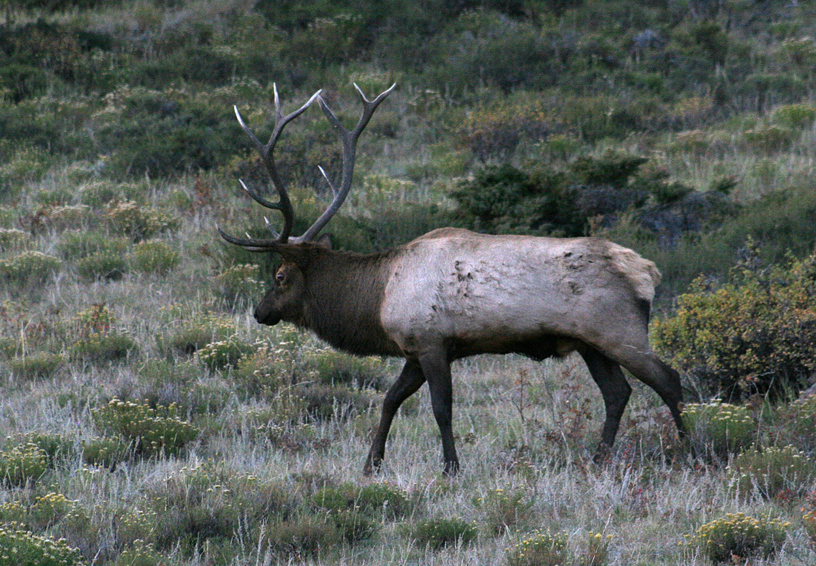
Search for Partner

Slide 10
Precopulatory Stage (cont.)
Courtship
  species specific events
    sniffing of the vulva by male
    urination by the female
    flemen lip curl
    chin resting on female rump
    increased phonation
    male checks for female lordosis
  human
    eye contact, touching, detection of pheromones

Slide 11
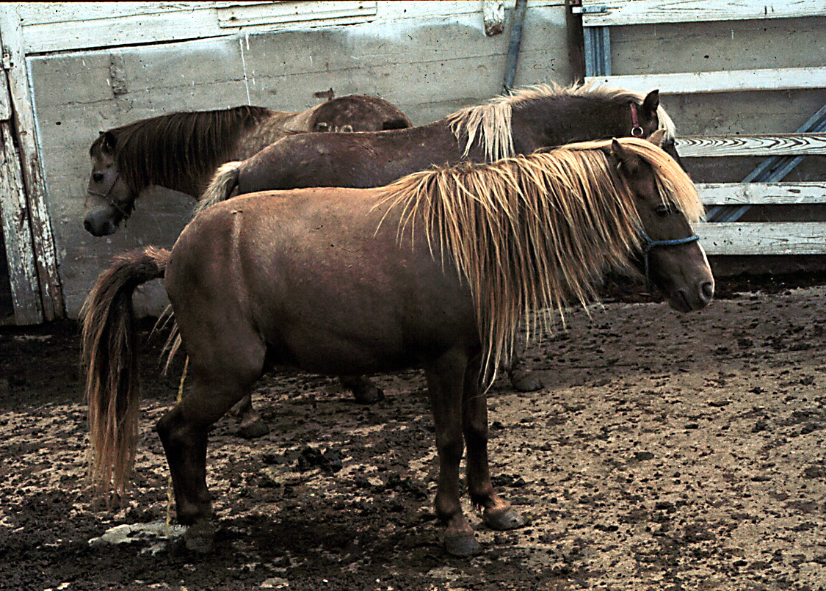
Urination

Slide 12
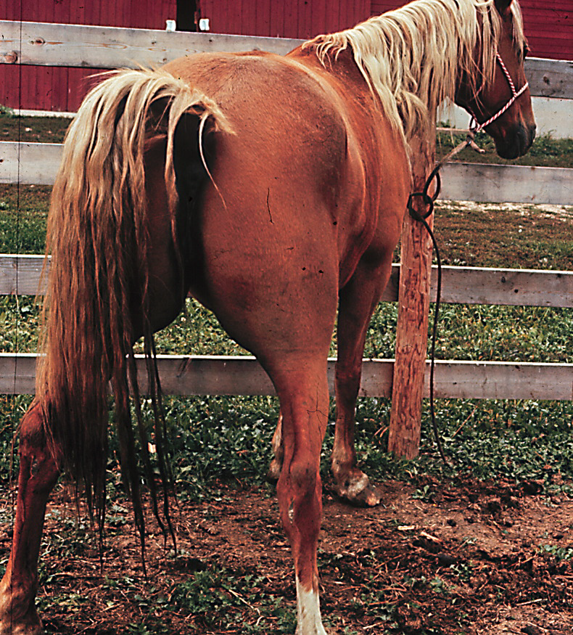
Lordosis

Slide 13
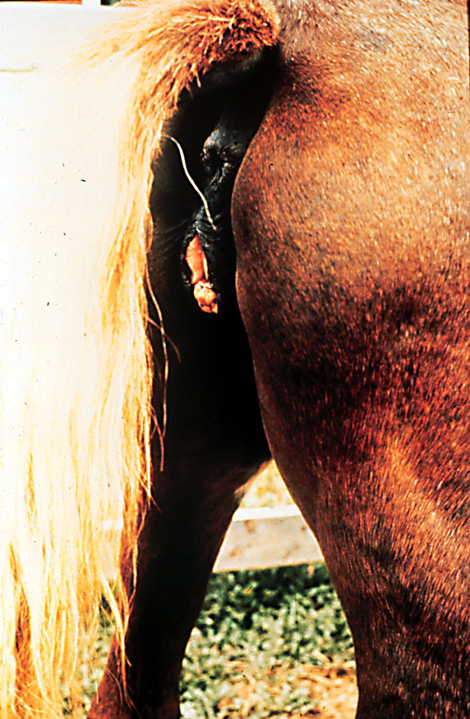
Winking of the Vulva

Slide 14
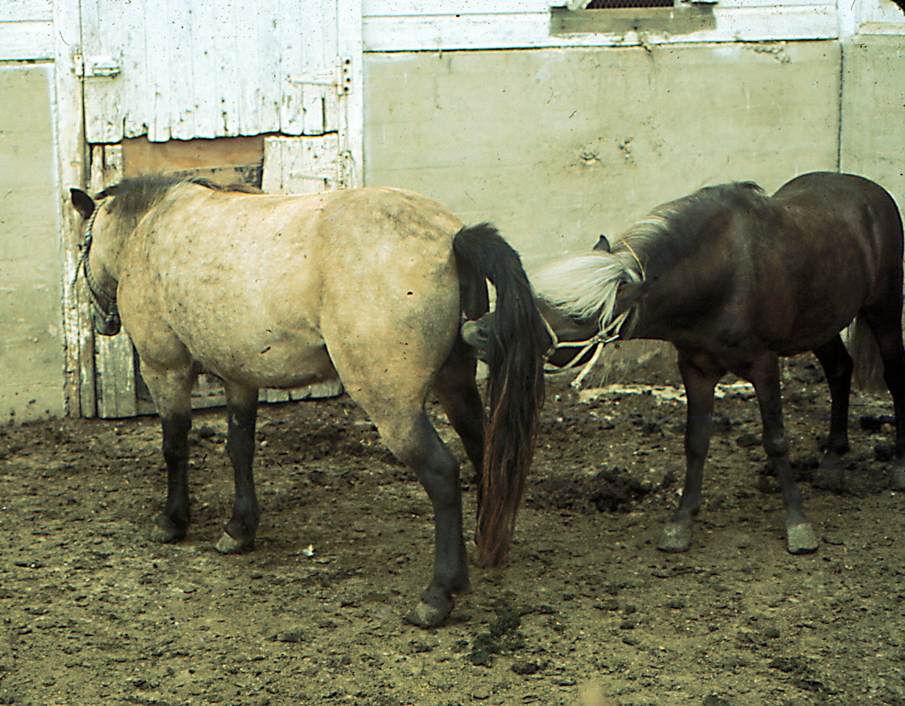
Sniffing the Vulva

Slide 15
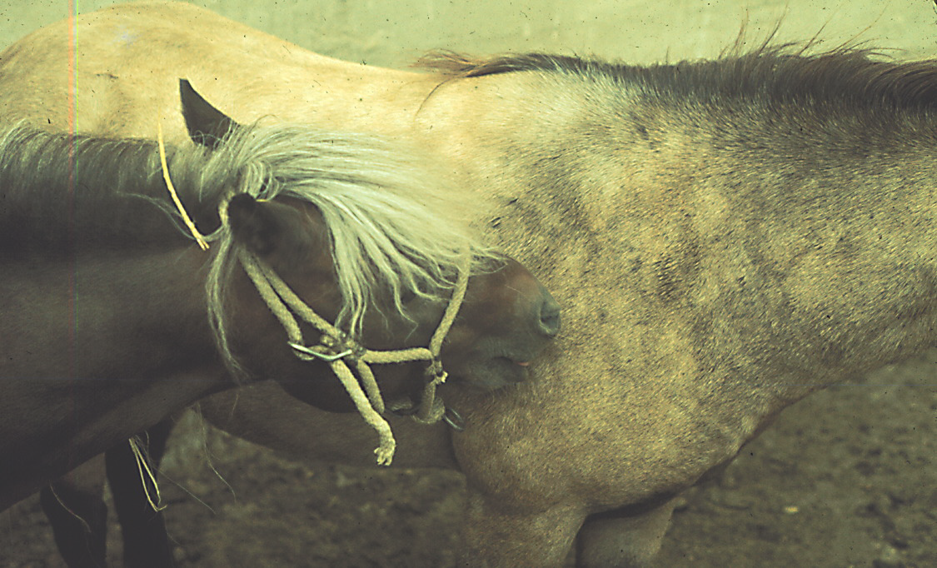
Biting To Check For Lordosis

Slide 16
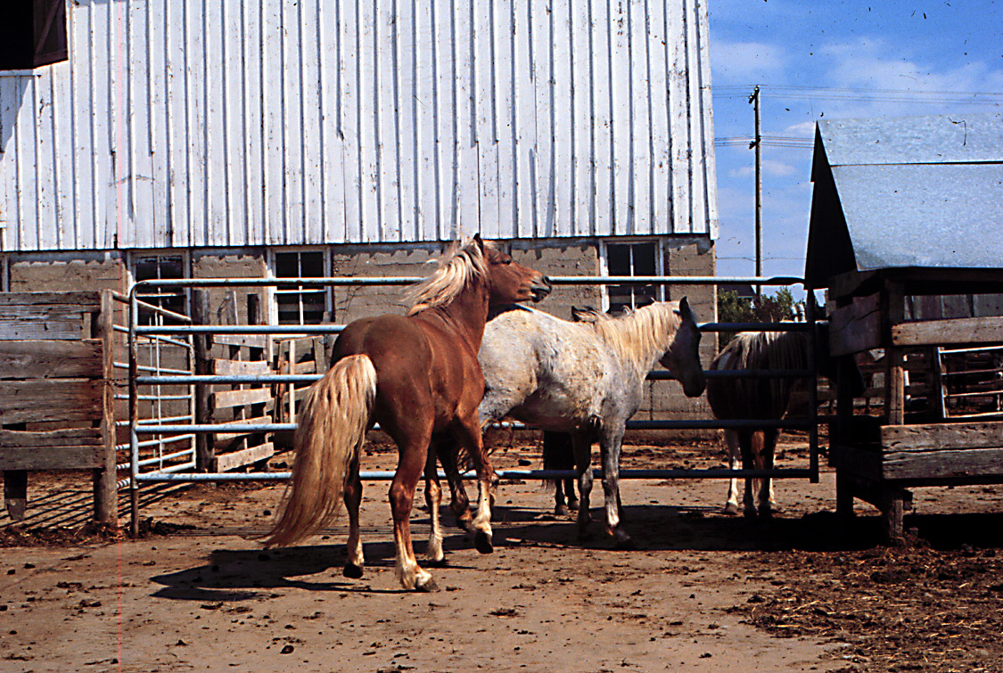
Unresponsive Mare

Slide 17
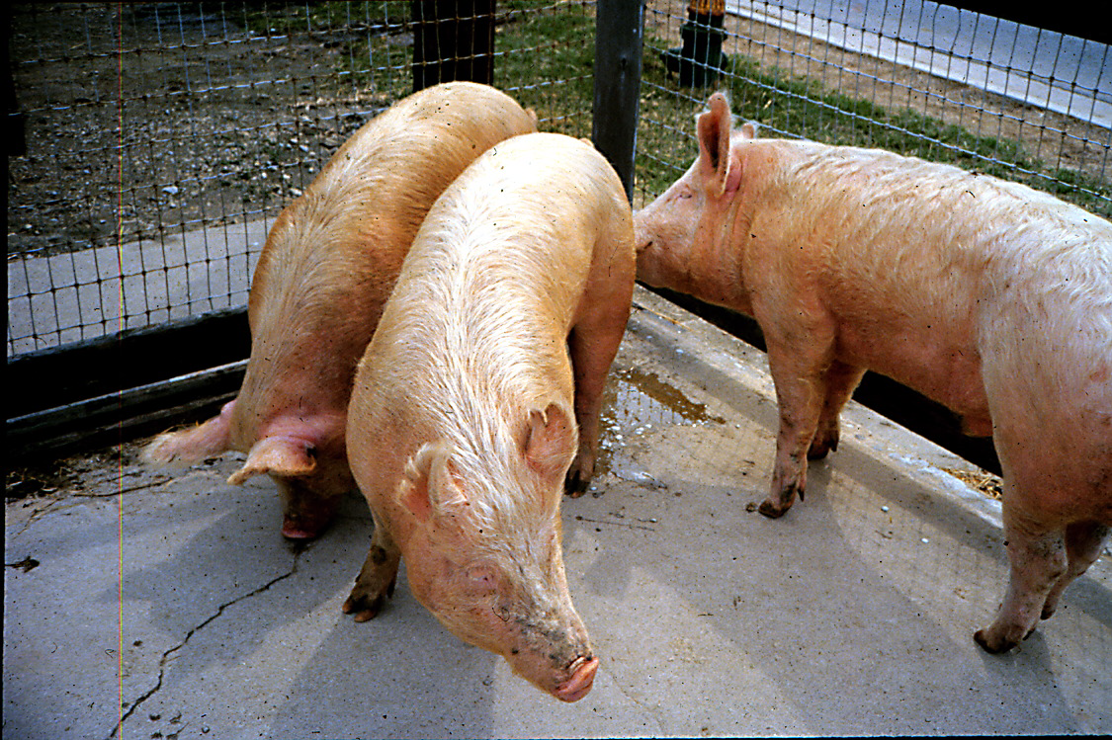
Sniffing the Vulva

Slide 18
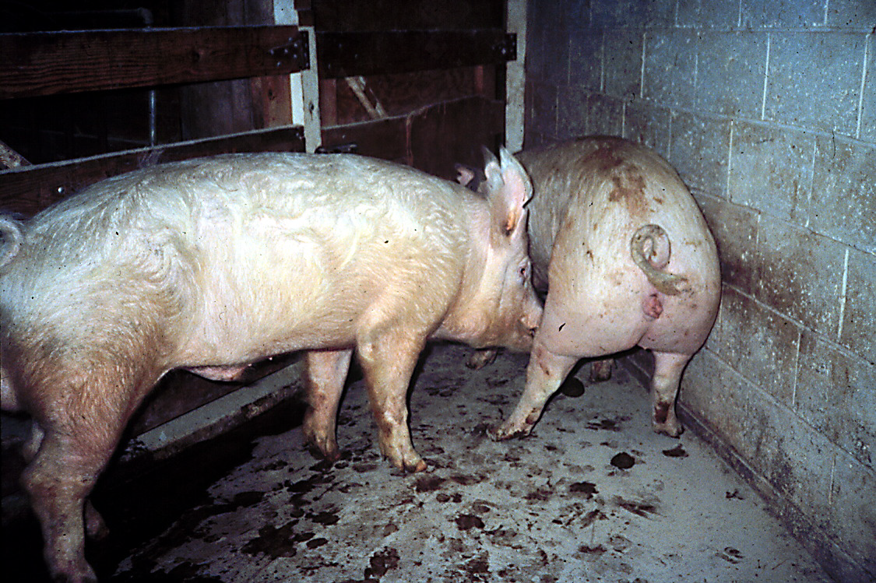
Checking for Lordosis

Slide 19
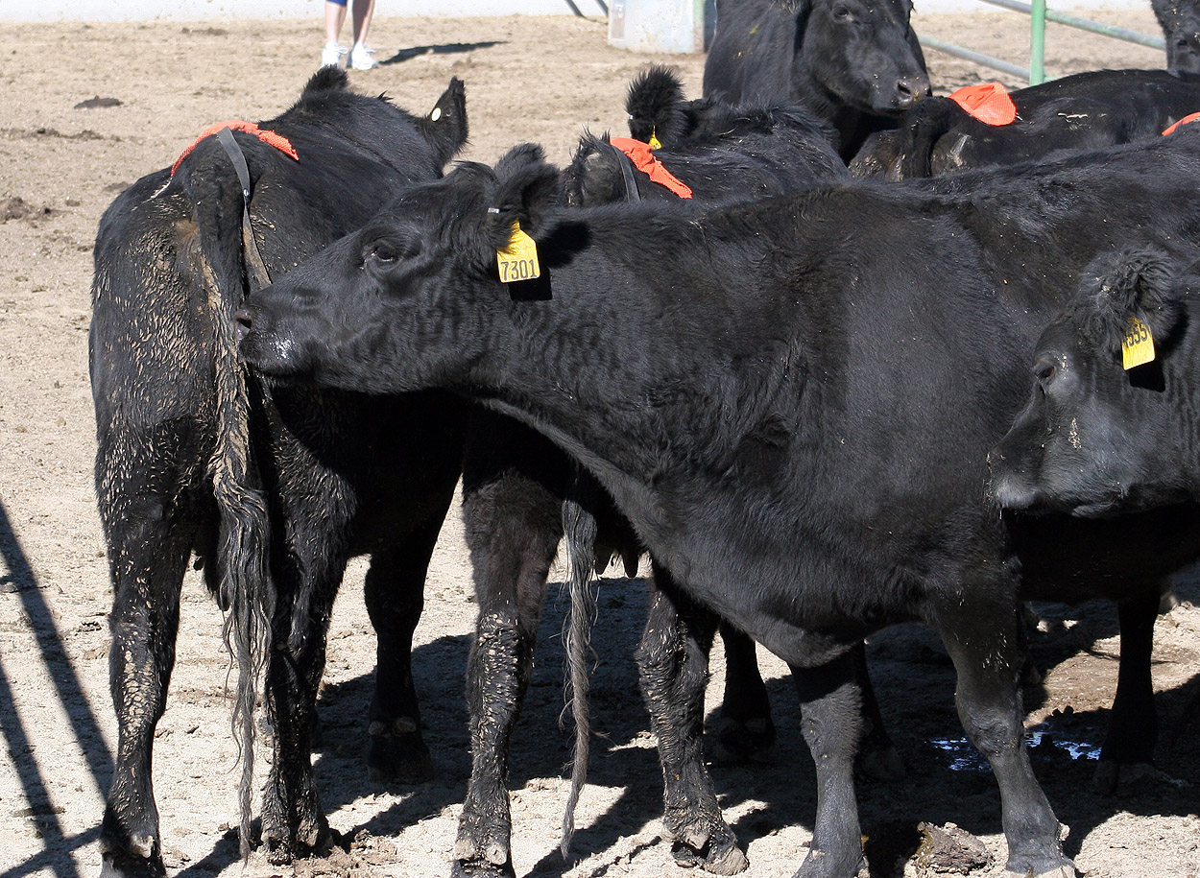
Sniffing Vulva

Slide 20
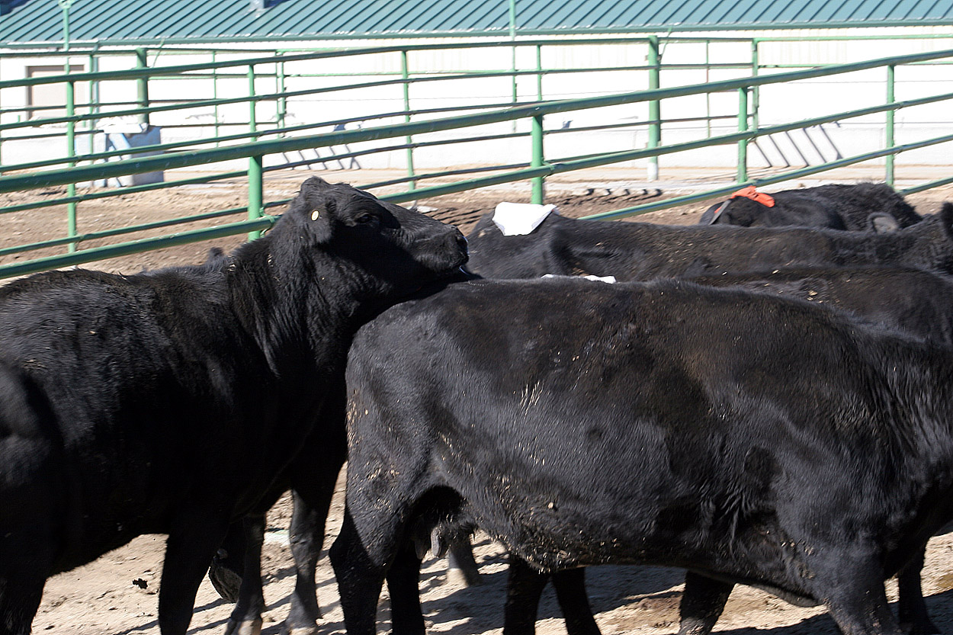
Chin Rest

Slide 21
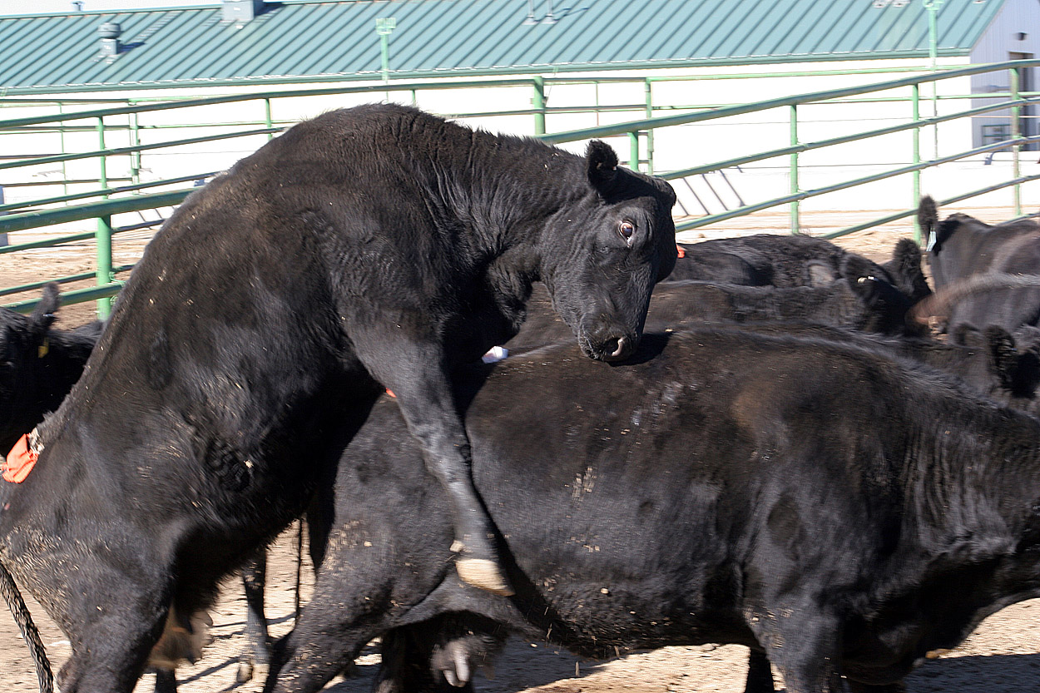
Lordosis and Mount

Slide 22
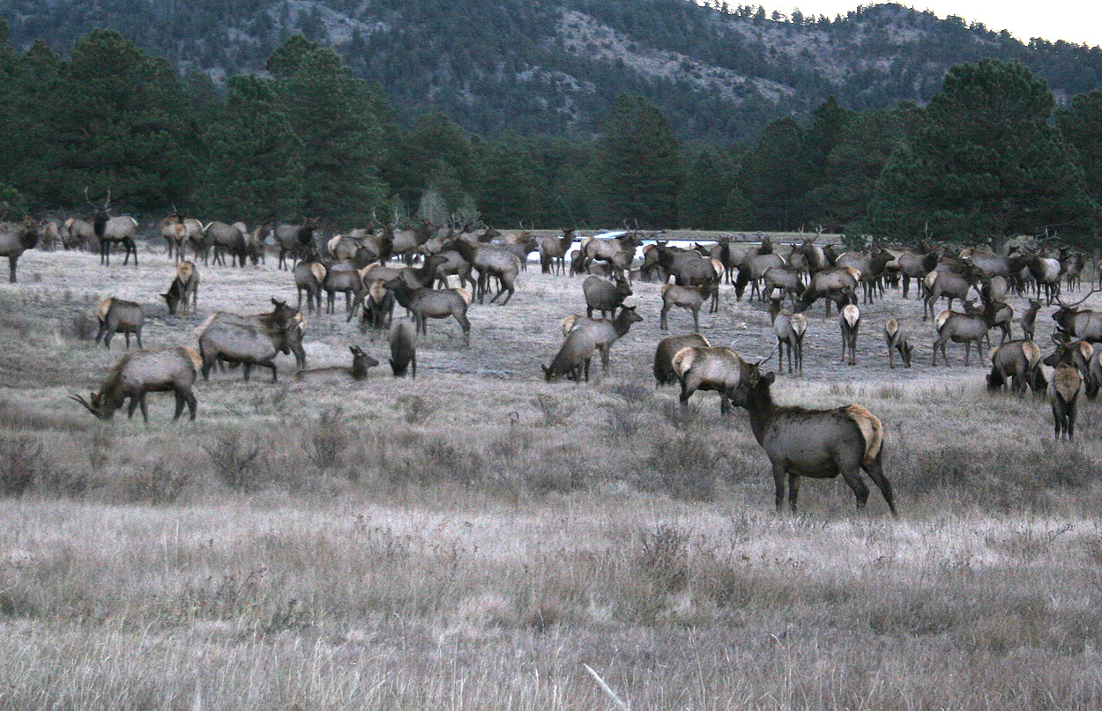
Phonation of Elk

Slide 23
Listen to Elk Phonation
Go to
http://www.ansci.wisc.edu/jjp1/ansci_repro/lec/lec_15a_b_behavior/elk_phonation.html

Slide 24
Human Courtship
Sight, eye contact,
touch, pheromones

Slide 25
Human Behavior
To view video clip go to
View in Kaltura
https://mediaspace.wisc.edu/media/Human+Courtship+Behavior/0_t7jom6wa
View in adjustable html page
http://www.ansci.wisc.edu/jjp1/ansci_repro/lec/lec_15a_b_behavior/human_behavior_2017.html

Slide 26
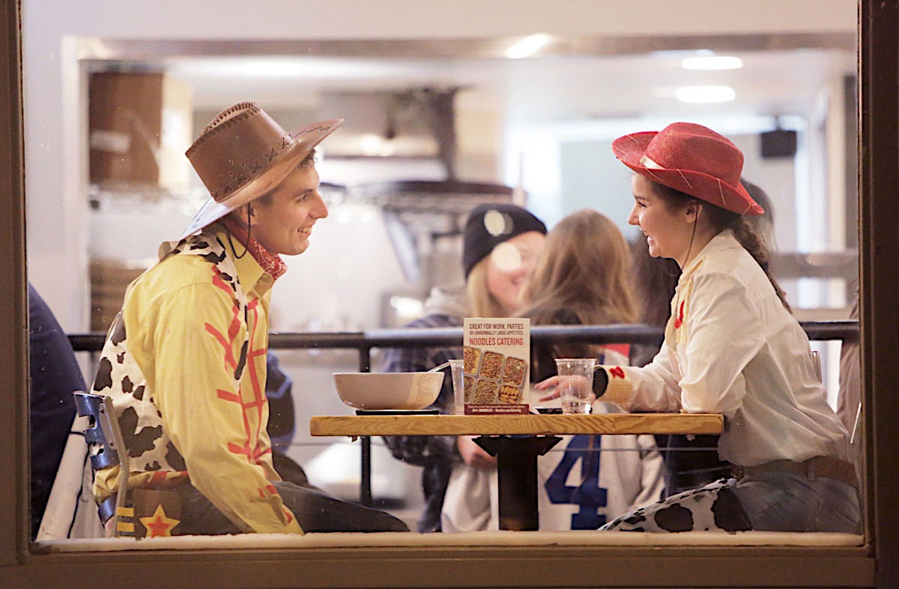
Human Courtship
What do you see in this image?
Wisconsin State Journal, Amber Arnold (photographer), Oct 29, 2017.
Notes:
Looking in each others eyes, leaning in toward each other, smiles as they look at each other, her hands are gesturing to him. Typical male does not know what to do with his hands.

Slide 27
Precopulatory Stage (cont.)
Search for sexual partner
Courtship
Sexual arousal
  Female
    Lordosis
    Presents hindquarters to male
    Vaginal Secretions
  Male
    Erection
    Penile protrusion

Slide 28
Copulatory Behavior
Mounting
Intromission
Ejaculation

Slide 29
Copulatory Behavior (cont.)
Varies among species
  short copulators (1 - 3 seconds)
    bull
    ram
  sustained copulator (5 - 20 minutes)
    boar
  intermediate (20 to 60 seconds)
    stallion

Slide 30
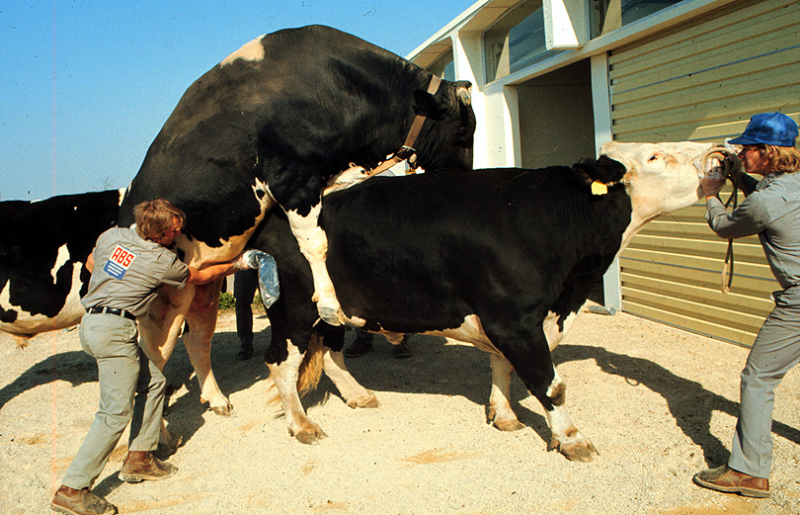
Short Copulator

Slide 31
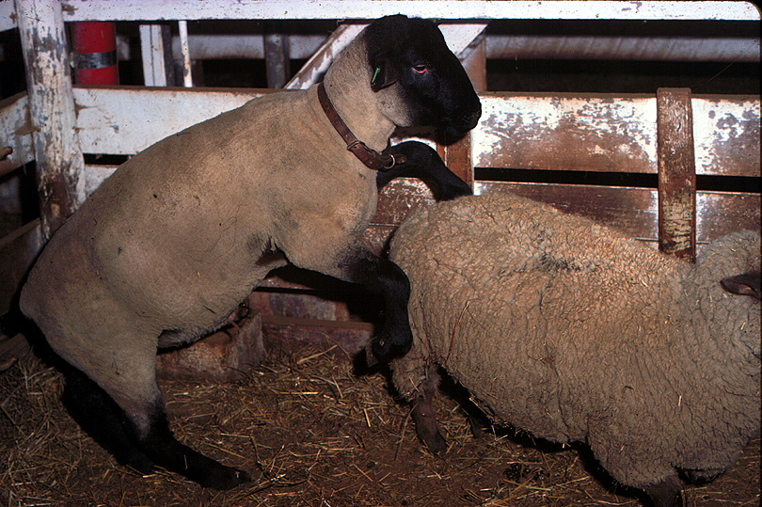
Short Copulator

Slide 32
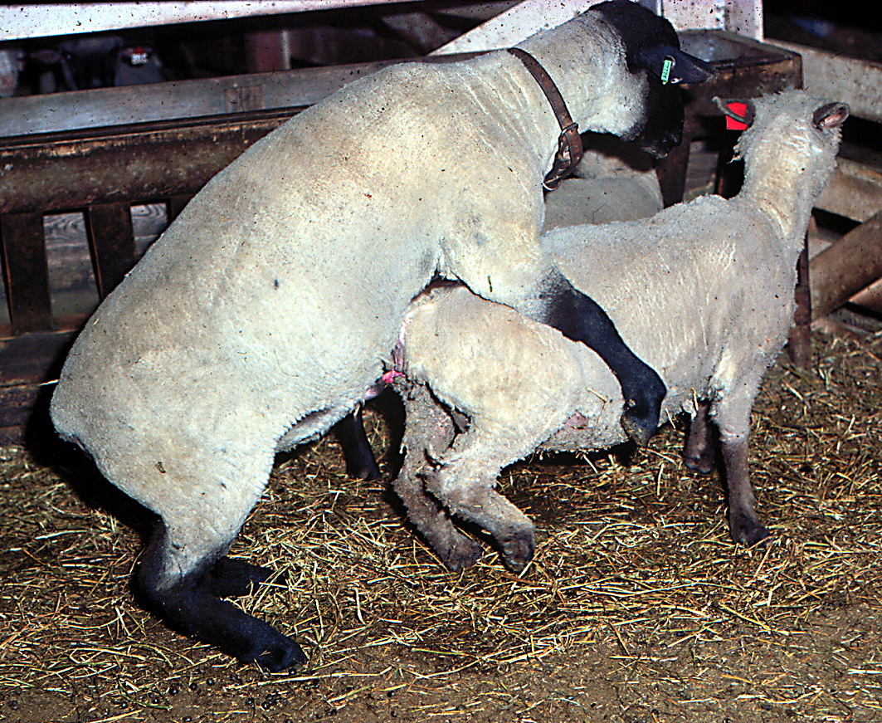
Short Copulator

Slide 33
Copulatory Behavior (cont.)
Varies among species
  short copulators (1 - 3 seconds)
    bull
    ram
  sustained copulator (5 - 20 minutes)
    boar
  intermediate (20 to 60 seconds)
    stallion

Slide 34
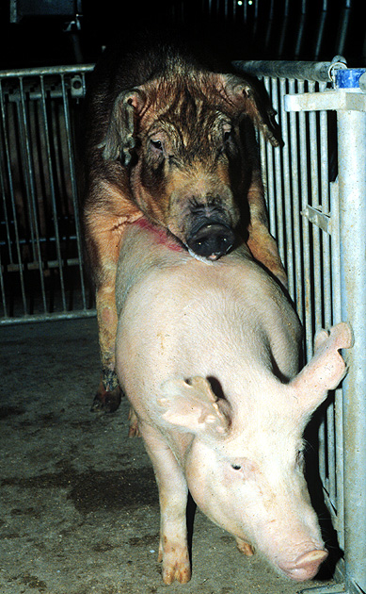
Sustained Copulator

Slide 35
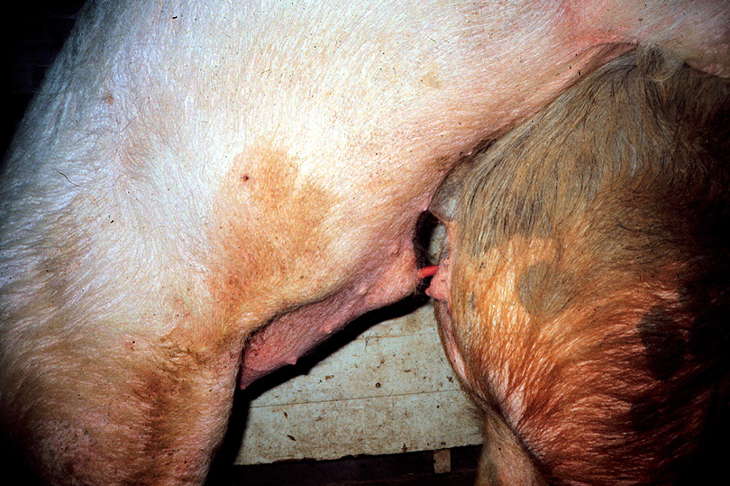
Sustained Copulator

Slide 36
Copulatory Behavior (cont.)
Varies among species
  short copulators (1 - 3 seconds)
    bull
    ram
  sustained copulator (5 - 20 minutes)
    boar
  intermediate (20 to 60 seconds)
    Stallion
    human

Slide 37
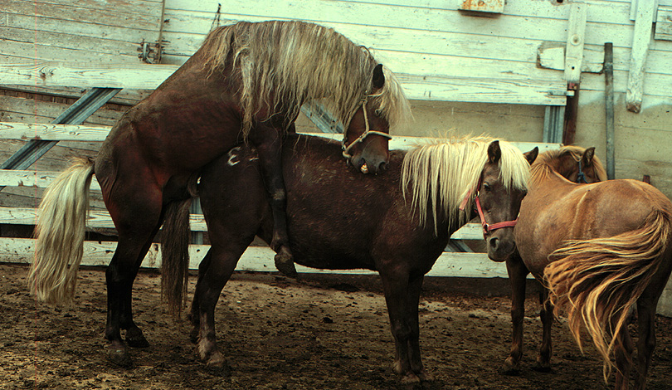
Intermediate Copulator

Slide 38
Postcopulatory Behavior
Male
  Dismounting
  Refractory period - all males have this
    time when copulation will not occur
    Dependent on:
      Species dependent
      sexual rest prior to copulation
      age of male
      degree of female novelty
      number of previous ejaculates
    for semen collection try to minimize
  Memory
    a bad experience will carry over
Female - will often mate again immediately

Slide 39
Endocrine Effects on Sexual Behavior
Prenatal steroid exposure
  Feminization – No steroid exposure
  Masculinization (defeminization) – estradiol or testosterone
Postnatal Behavior
  castrated female
    no steroids - no estrus behavior
    plus estradiol - estrus behavior
    plus progesterone and then estradiol - maximum estrus behavior
    plus testosterone - male-like behavior

Slide 40
Sexual Behavior (cont.)
Postnatal Behavior
  castrated male
    no steroids - decreased sexual behavior
    plus testosterone - sex behavior restored
    plus dihydrotestosterone - decreased sex behavior
    plus estradiol - sex behavior restored
What does this tell you about hormonal receptors required to control behavior in the male?

Slide 41
Aromatization
Testosterone
Estradiol
aromatase
Dihydrotestosterone

Slide 42
Sexual Behavior (cont.)
both male and female sexual behavior is dependent on estradiol receptors in brain

Slide 43
Control of Reproductive Behavior
Sensory systems
  Olfactory, visual, auditory, tactile
Hypothalamus
  Estradiol receptors, increase response to sensory neurons
Midbrain
  Signals from hypothalamus
  Speeds up nerve impulses
Medulla
  Coordinates lordosis and mounting
Spinal Chord
  Sends signals to specific muscles

Slide 44
Sensory Inputs for Reproductive Behavior
specific importance varies with species
olfaction
  pheromone
    volatile substance which elicit specific behavior in the recipient
    males produce
      boars
      humans
    females produce during estrus
      dogs and rats can sense cow pheromones
    flehmen response

Slide 45
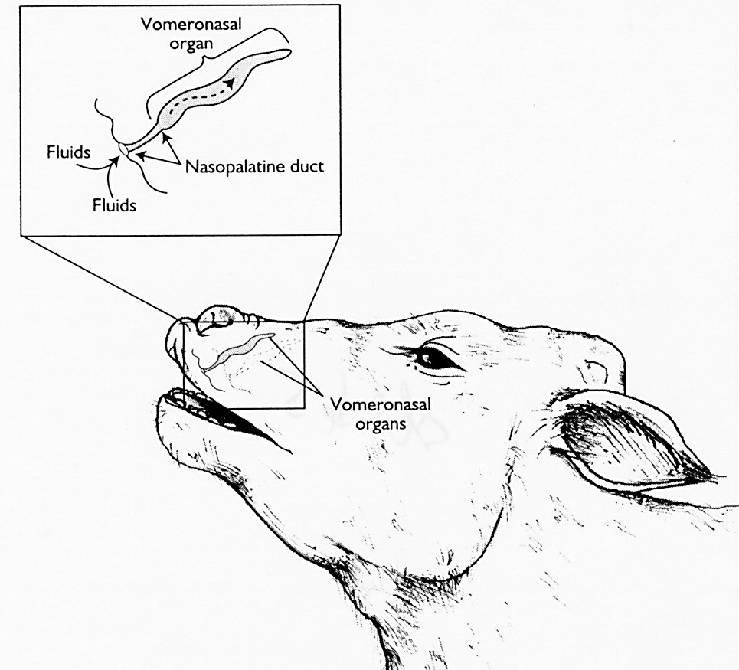
Vomeronasal Organ
Fluids
Nasopalatine Duct
Fluids
Vomeronasal
Organ

Slide 46
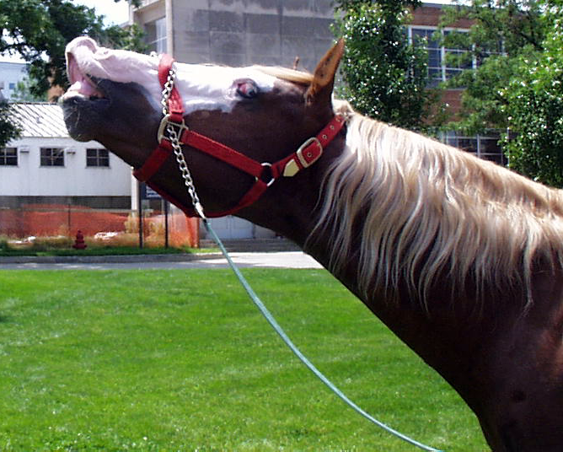

Slide 47
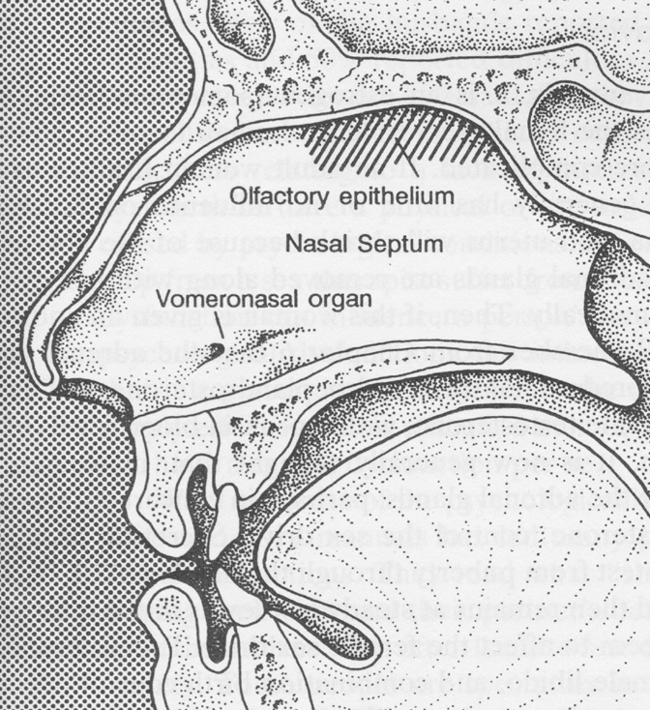

Slide 48
Sensory Inputs for Reproductive Behavior (cont.)
Auditory
  cows bellow
  sows grunt
  good for long-range signaling
Visual
  posturing
  males observing other males or females mounting
  valuable for close encounters

Slide 49
Sensory Inputs for Reproductive Behavior (cont.)
Tactile
  biting on neck or whithers of mare
  chin resting on cow
  boar nudging of sow flank
  final stimulus before copulation
  leads to erection

Slide 50
Erection, Emission and Ejaculation
Erection
  Vasodilatation, inhibit vasoconstriction, relax retractor penis muscle
Emission
  Contraction of cauda epididymis and vas deferens
    Oxytocin from posterior pituitary
    Sympathetic neurons
  Release of accessory gland fluid
    Sympathetic neurons
Ejaculation
  Contraction of smooth and striated muscles

Slide 51
Erection
Sensory
Psychic
Inhibit
Stimulate
Sympathetic (-)
relaxation of penile
retractor muscle
Parasympathetic (+)
Inhibit vasoconstriction
contraction of
ischiocavernosus
muscle
dilation of
vessels
decreased
venous
outflow
engorgement
of corpus
cavernosum

Slide 52
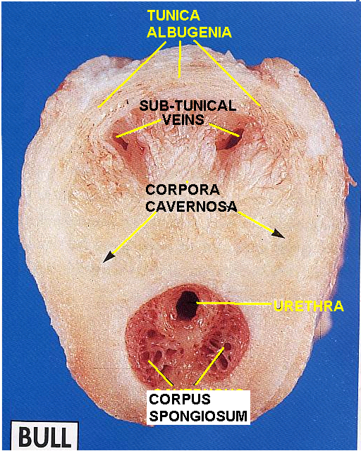
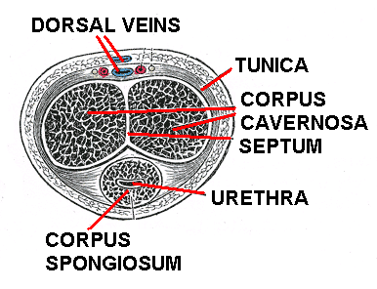

Slide 53
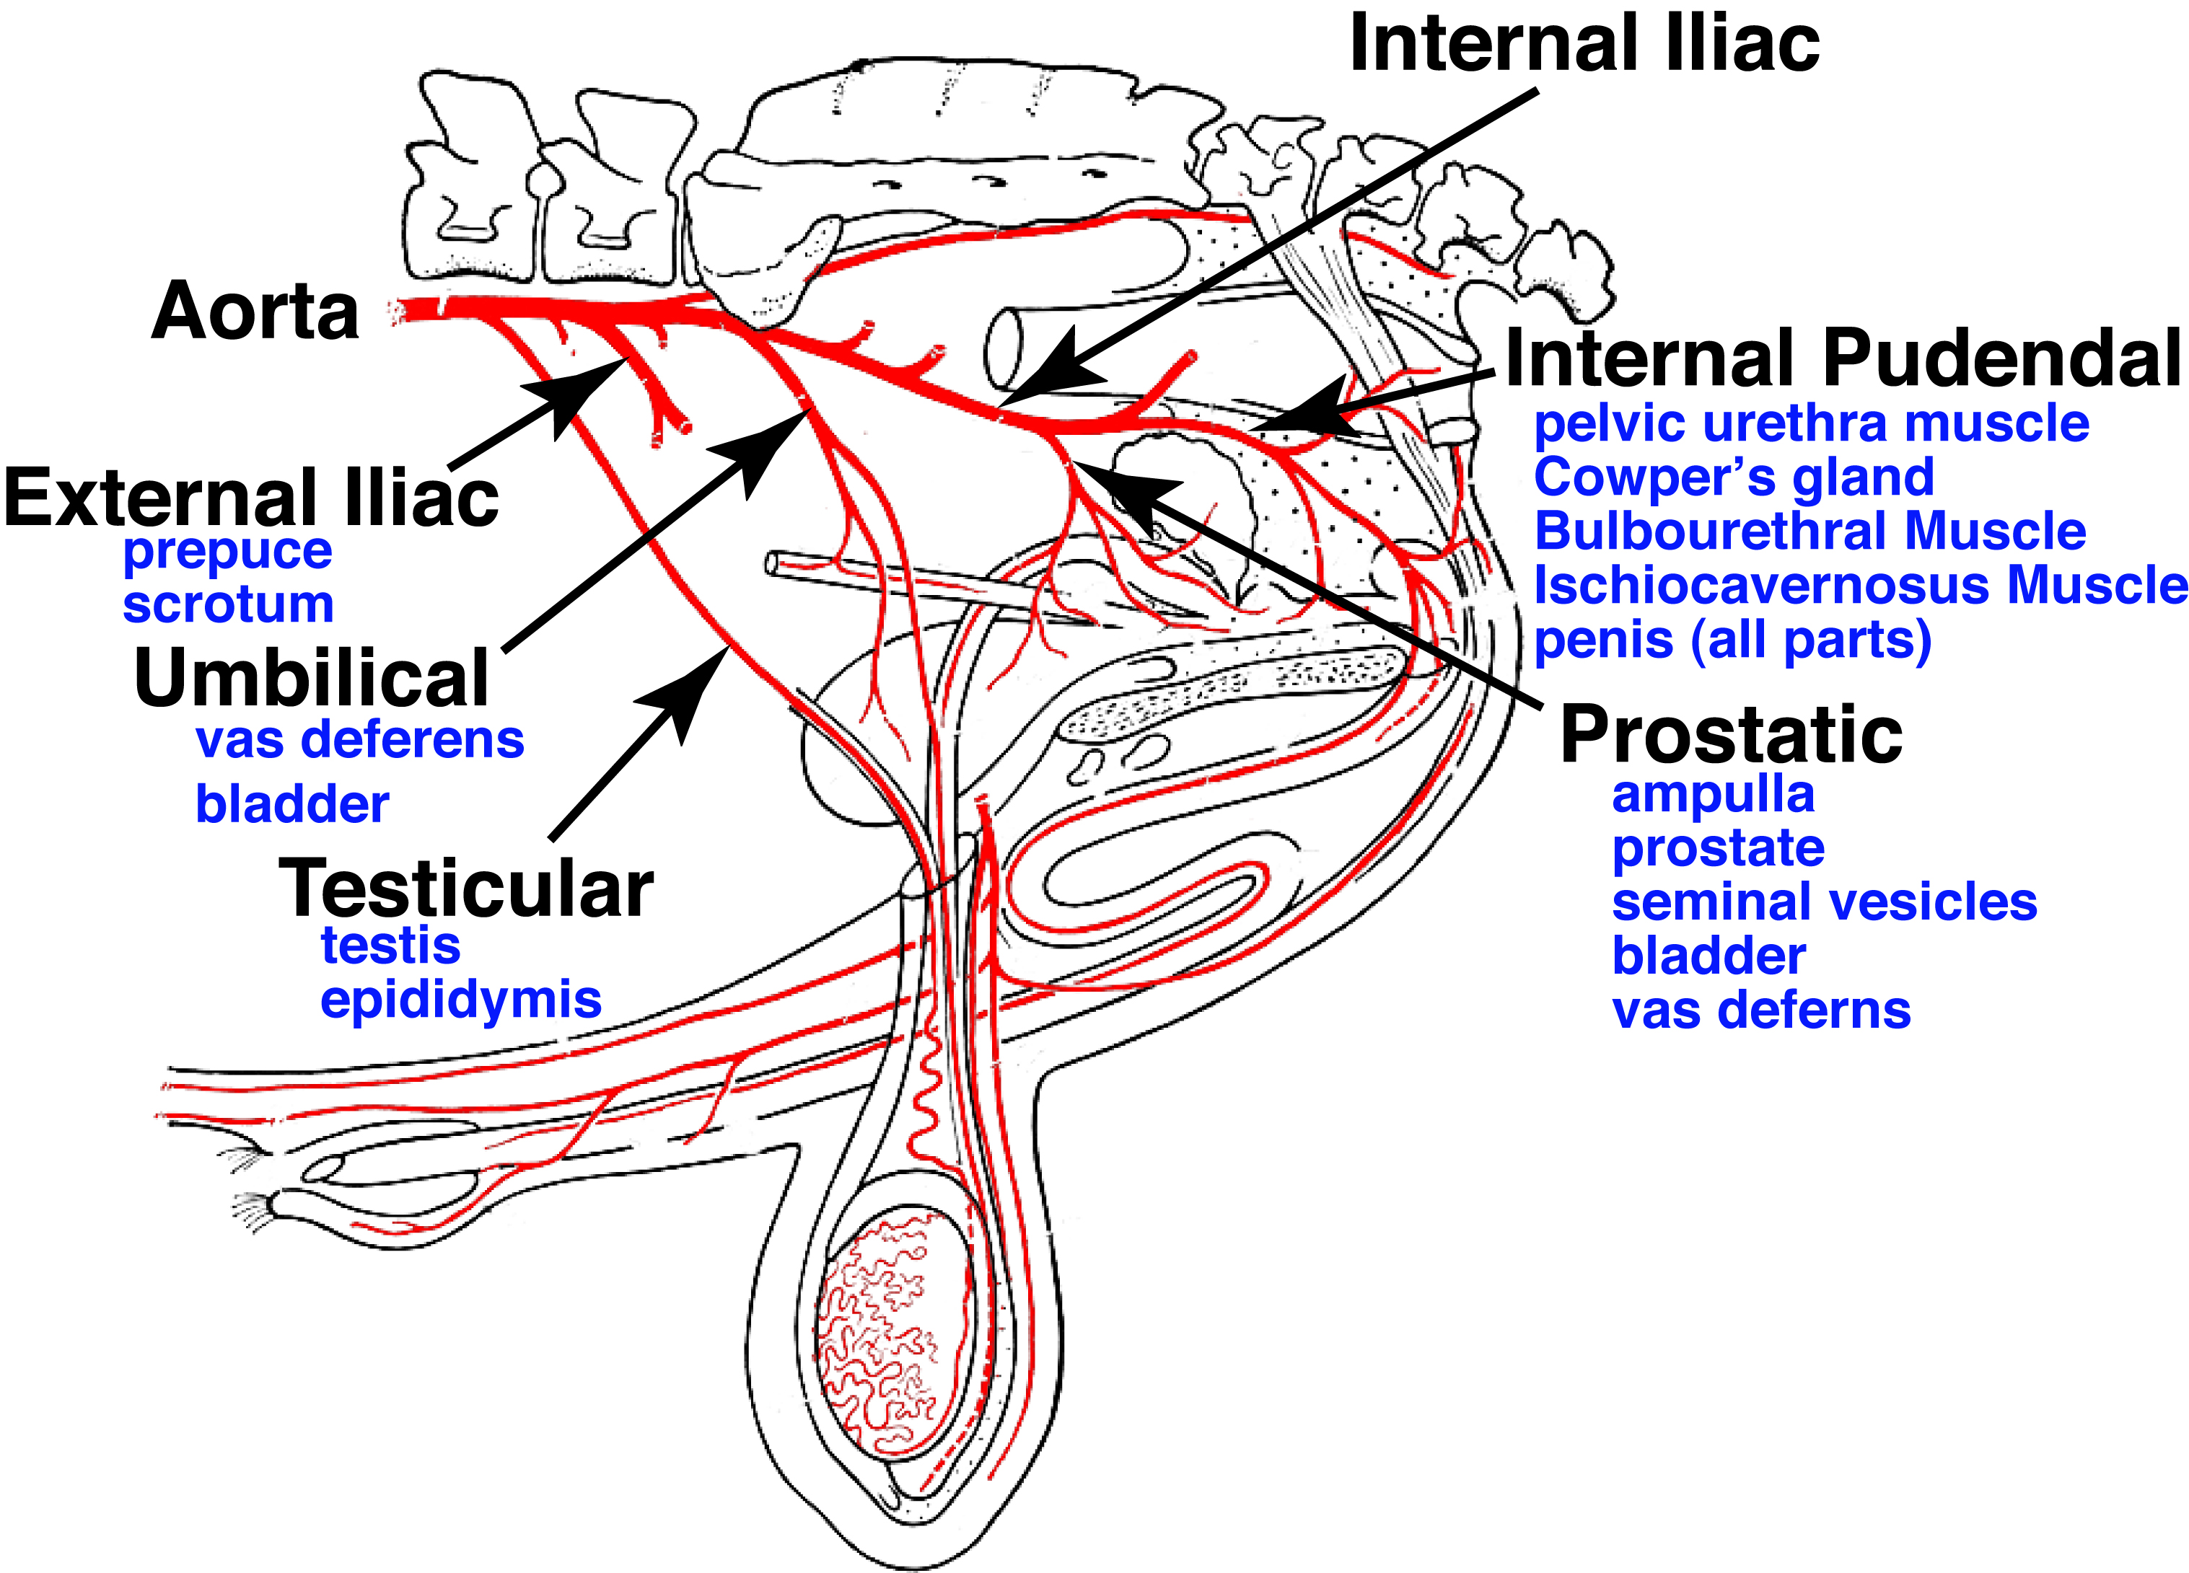
Arterial Supply

Slide 54
Flaccid State of Penis
Corpus Cavernosum (CC)
  Internal Pudendal Artery
  Helical arterioles to
  corporal sinuspoids
Subtunical veins
  Drain CC
Relaxed state
  Sympathetic nerves active
  Norepinehrine (NE) released
  Arterioles contract
  Smooth muscle of Corpus Spongiosum (CS)
  contract

Slide 55
Erect State of Penis
Sympathetic nerves inhibited
Parasympathetic nerves stimulate
  Nitric Oxide (NO)
  Helical arterioles dilate and
  corporal sinusoids swell
  Smooth muscle of Corpus Spongiosum (CS) relax
  Sub-tunical Veins compressed
  Ischiocavernosus muscle contracts

Slide 56
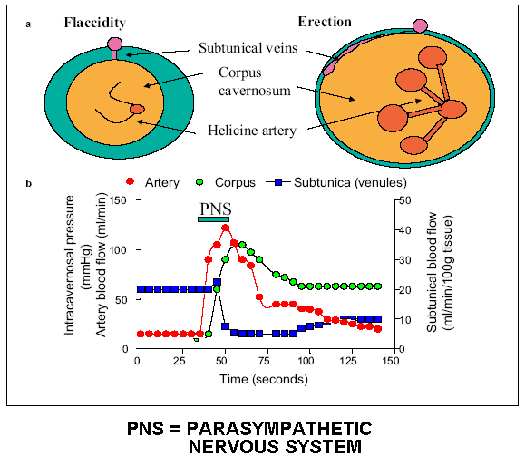

Slide 57
EVENTS IN ERECTION
SEXUAL AROUSAL: AFFERENTS FROM HIGHER CNS & GENITALIA TO LUMBAR SPINAL “ERECTION CENTER” IN LUMBAR SPINAL CORD (IN BOTH MALES AND FEMALES).
PARASYMPATHETIC MOTOR NERVES TO PUDENDAL ARTERIOLES OF PENIS [or CLITORIS] GENERATE NITRIC OXIDE (NO) IN ARTERIOLE SMOOTH MUSCLE ➔
RELAXATION OF ARTERIOLES ➔ MAJOR VASODILATION ➔
INCREASED BLOOD FLOW FILLS TISSUES (CORPUS CAVERNOSUM & SPONGIOSUM)➔
SWELLING BLOCKS SUB-TUNICA VEINS’ OUTFLOW ➔
RAPID RISE IN Corpus Cavernosum TISSUE PRESSURE ➔
ERECTION

Slide 58
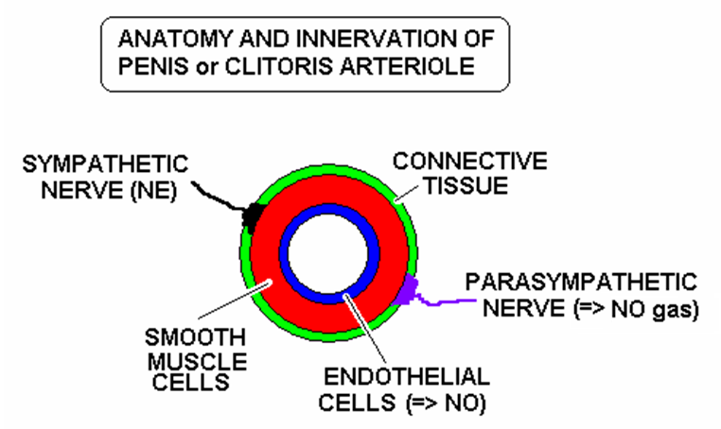

Slide 59
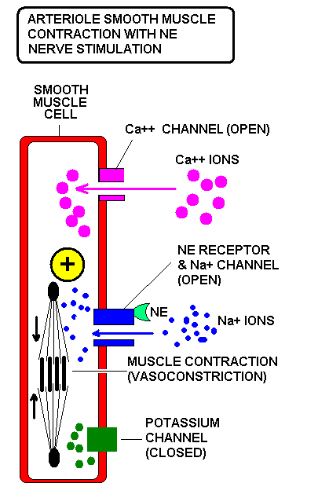
NE RELEASED FROM S NERVE
⬇
NE BINDS TO Na+ CHANNEL
⬇
Na+ IONS ENTER
⬇
CELL DEPOLARIZES
⬇
ACTION POTENTIAL
⬇
Ca++ CHANNELS OPEN
⬇
MUSCLE CONTRACTS
⬇
ARTERIOLE CONSTRICTS
⬇
LOW BLOOD FLOW

Slide 60
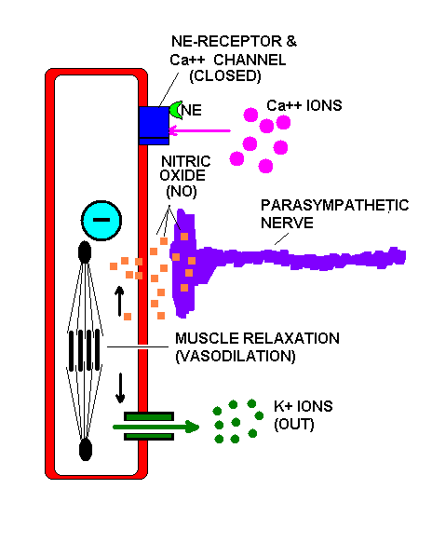
NO GAS DIFFUSES INTO CELL
⬇
GUANYLATE CYCLASE ENZYME ACTIVATED
⬇
CYCLIC GMP (cGMP)
⬇
K+ CHANNEL OPENS
⬇
K+ IONS LEAVE
⬇
INSIDE MORE NEGATIVE
⬇
Ca++ CHANNELS CLOSE
⬇
MUSCLE RELAXATION
⬇
ARTERIOLE DILATES
⬇
HIGH BLOOD FLOW

Slide 61
Sildenafil - Viagra
cGMP is broken down by phosphodiesterase 5 (PDE₅)
Sildenafil is and inhibitor of PDE₅
  cGMP remains elevated and thereby the erection
  Side effect – erection over 4 hours
    Go to Emergency Room – you could not ever have another erection!

Slide 62
Emission and Ejaculation
Sensory
Psychic
Sympathetic
Parasympathetic
smooth muscle contraction of
prostate, seminal vesicles,
vas deferens, cauda epididymis,
closure of the sphincter
to the bladder
striated muscle contraction
of bulbospongiosus and
pelvic urethral
emission
ejaculation

Slide 63
Erection, Emission and Ejaculation
Erection
  Vasodilatation, inhibit vasoconstriction, relax retractor penis muscle
Emission
  Contraction of cauda epididymis and vas deferens
    Oxytocin from posterior pituitary
    Sympathetic neurons
  Release of accessory gland fluid
    Sympathetic neurons
Ejaculation
  Contraction of smooth and striated muscles

Slide 64
Emission and Ejaculation
Sensory
Psychic
Sympathetic
Parasympathetic
smooth muscle contraction of
prostate, seminal vesicles,
vas deferens, cauda epididymis,
closure of the sphincter
to the bladder
striated muscle contraction
of bulbospongiosus and
pelvic urethral
emission
ejaculation

Slide 65
Homosexual Behavior
common in farm animals
useful to detect when females in heat
  selection by man may have enhanced this
can collect bulls off of other bulls as mounts

Slide 66
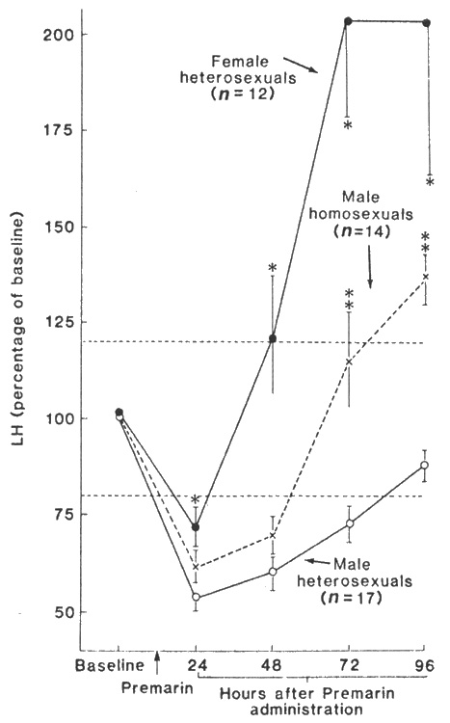
Same Sex / Homosexual Behavior in Humans
Learned behavior
Genetic
Hormonal Exposure

Slide 67
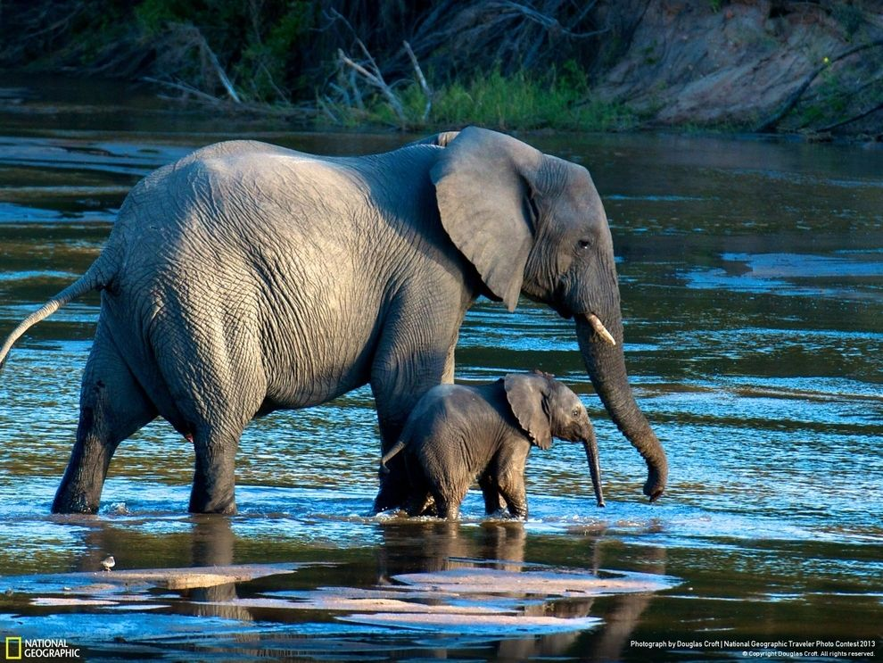
Maternal Behavior

Slide 68
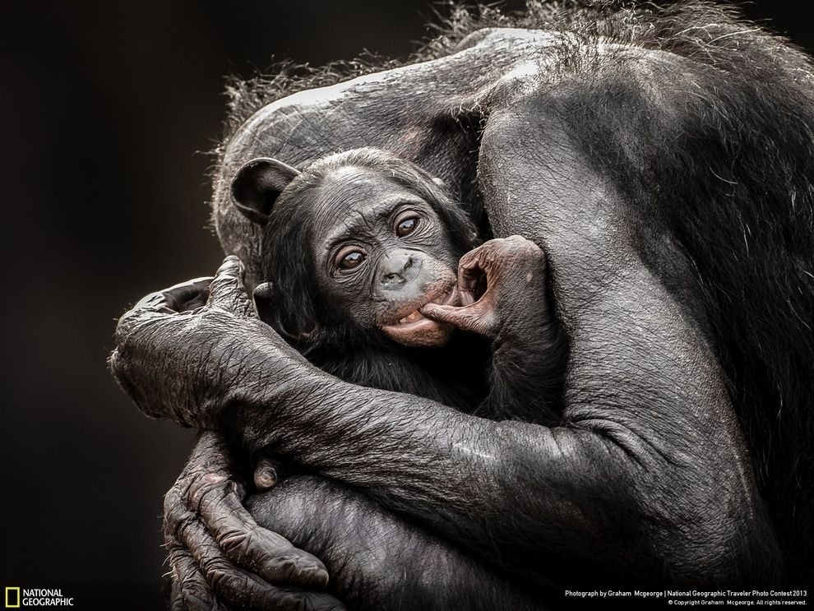
Maternal Behavior

Slide 69
Maternal Behavior
Prepartum
  High estrogen, low progesterone (leading to parturition)
  Prolactin (crosses blood brain barrier)
Postpartum
  Prolactin (mostly lactation, promotes paternal and alloparental care)
  Oxytocin (does not cross blood brain barrier)
    Intracerebral production - social bonding
  Opiods (decreases promote social bonding)
  Serotonin (low levels associated with increased maternal behavior, opposite infant rejection)

