Slide 1


Scrotal Insulation and Sperm Production in the Boar
JJ Parrish, KL Willenburg, KM Gibbs, K Yagoda, MM Krautkramer, TM Loether, FCS Alves de Melo
University of Wisconsin-Madison
and
Federal University of Viçosa, Brazil

Slide 2
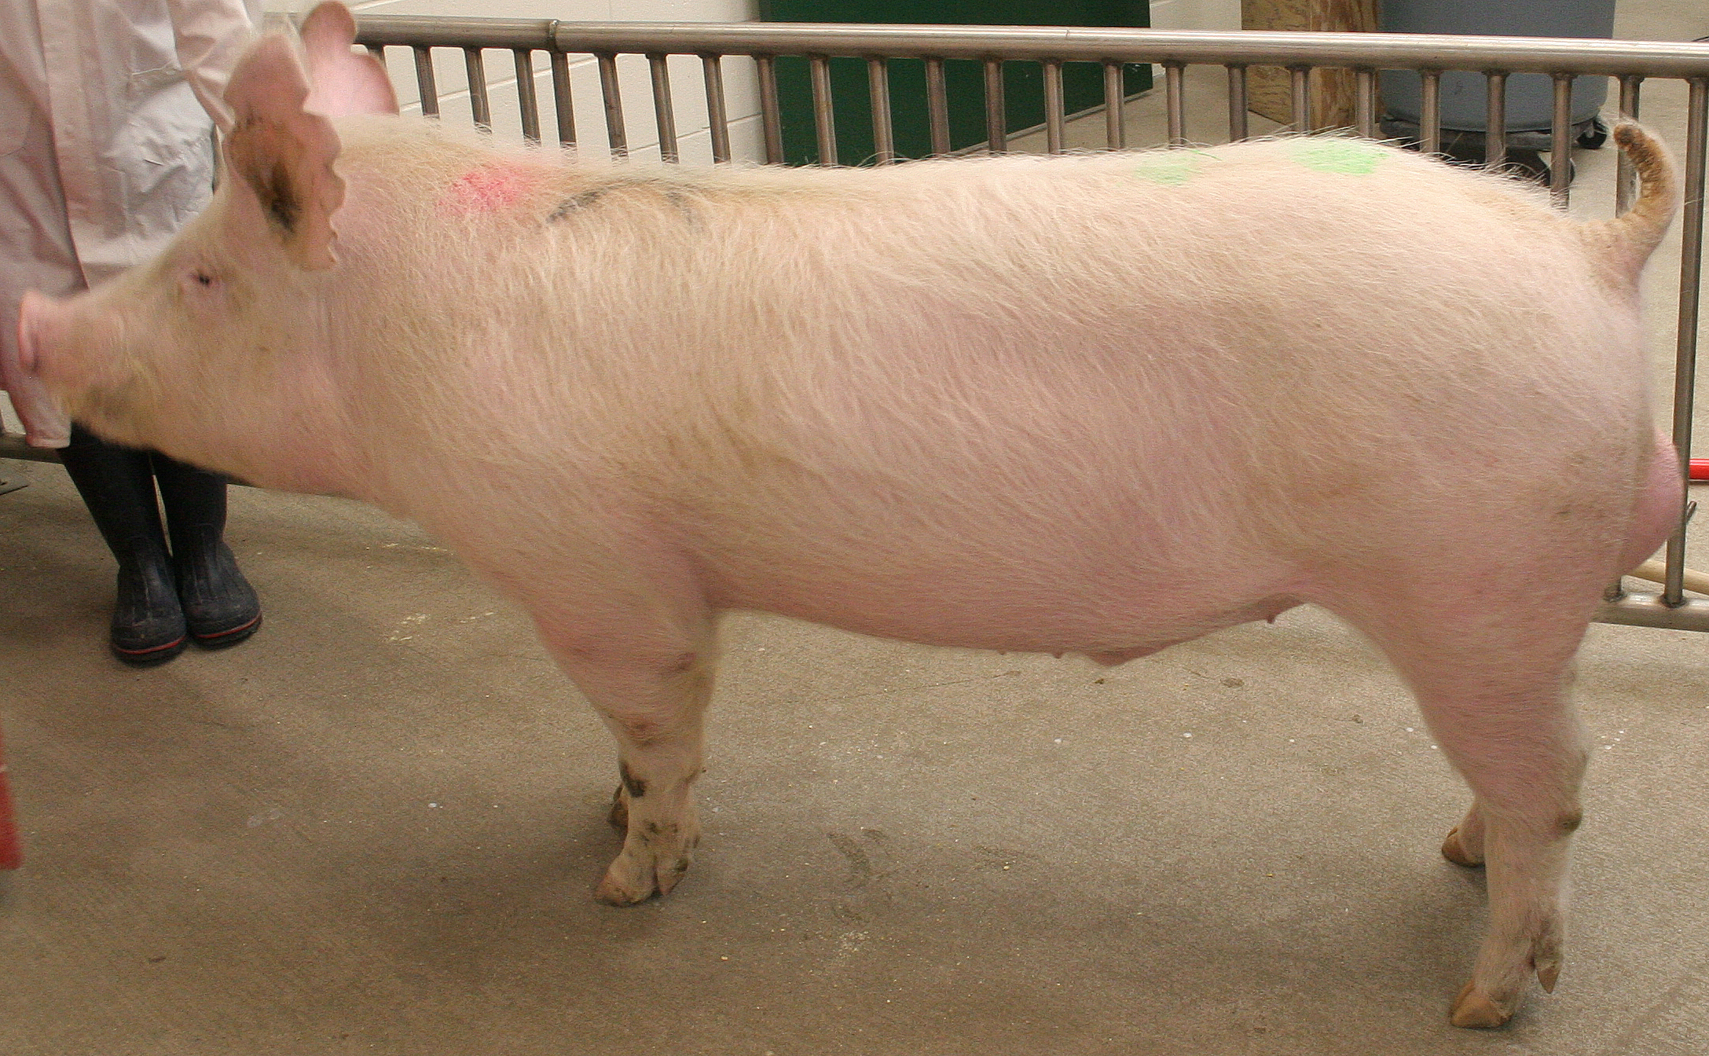
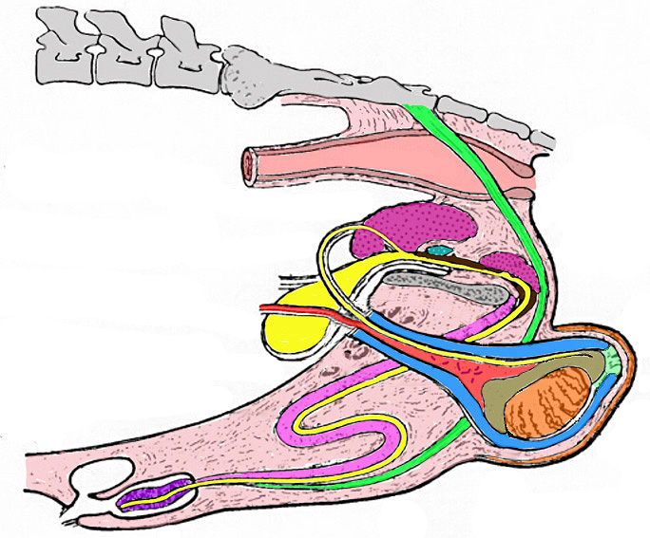
Boar Anatomy

Slide 3
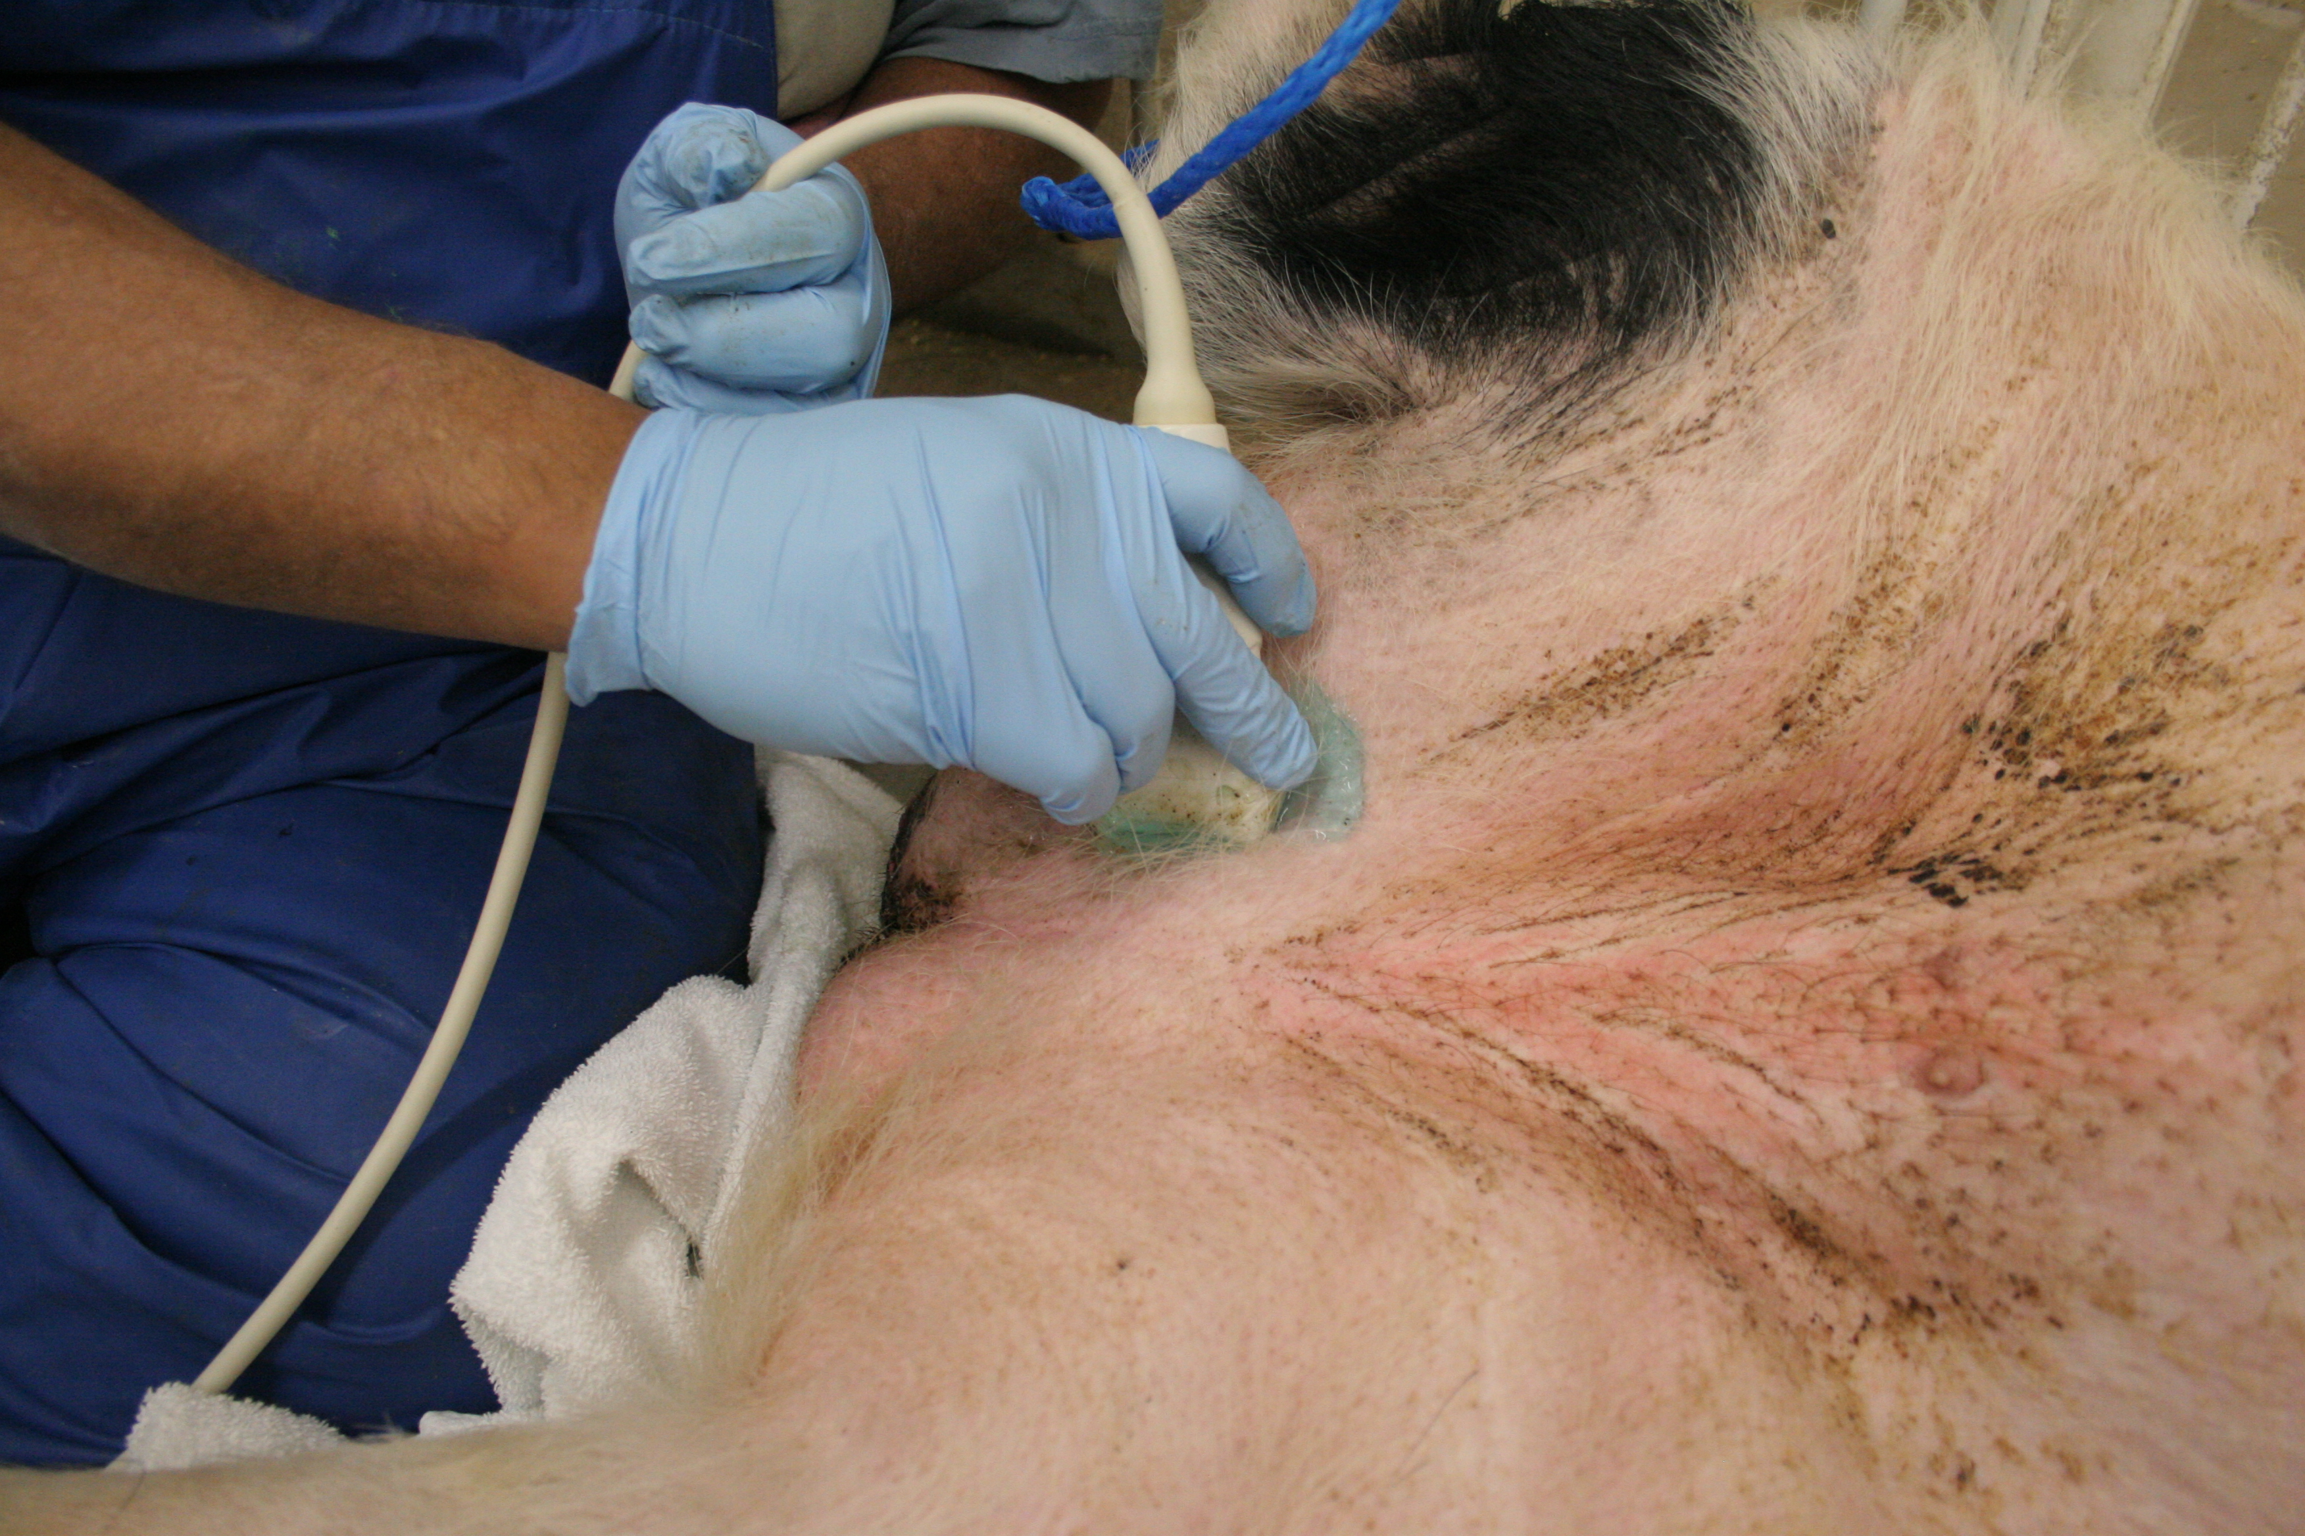
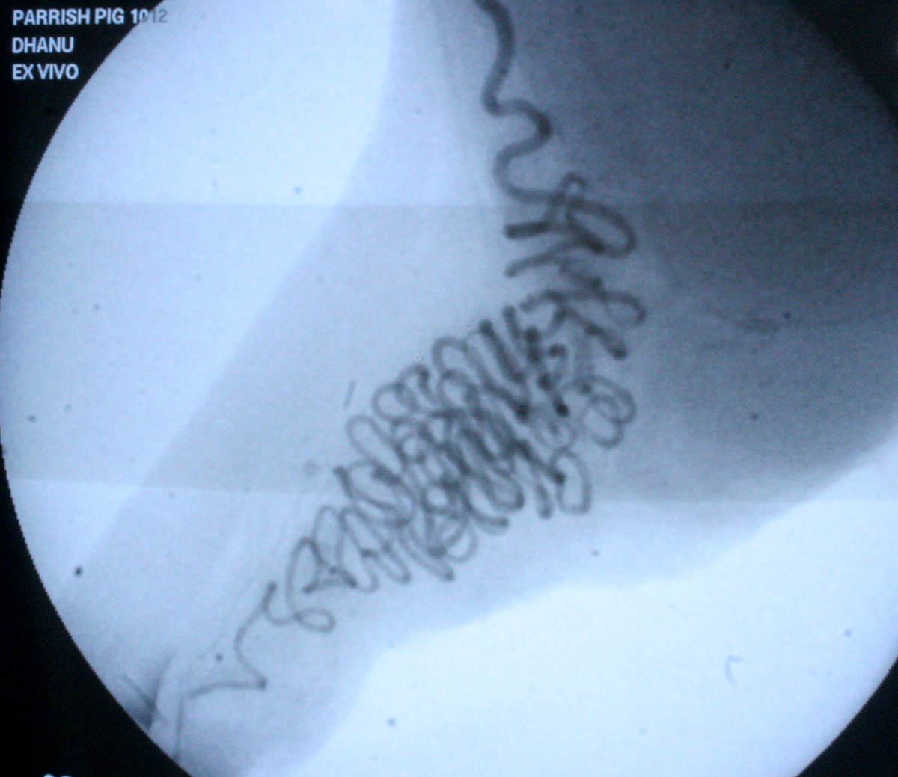
Pampiniform Plexus
Ultrasound
Angiography

Slide 4
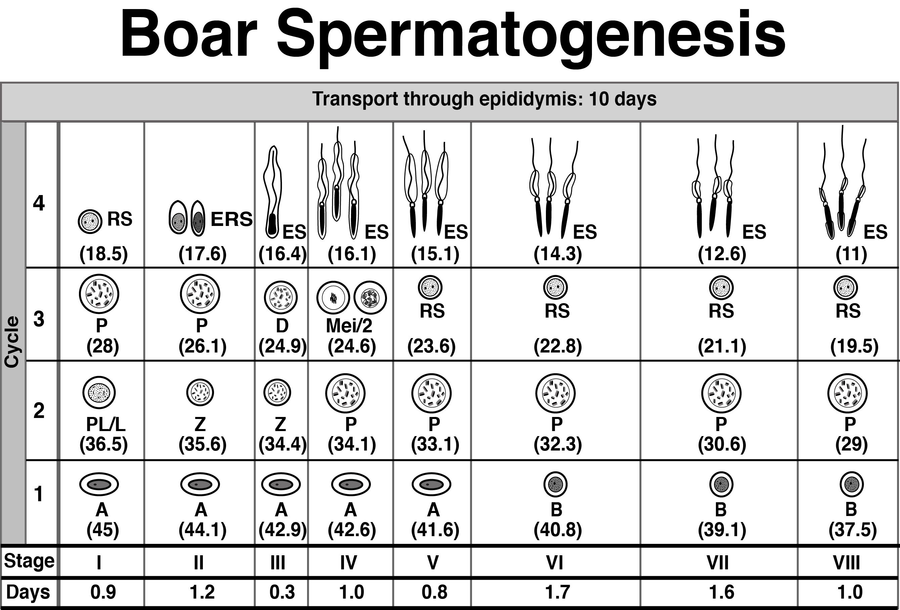
Durations and description of stages were from Swierstra (1968); specific cellular associations are from Frankenhuis et al. (1982) and Costa et al. (2013). 2, secondary spermatocyte; A, spermatogonium type A; B, spermatogonium type B; D, diplotene primary spermatocyte; ERS, elongating round spermatid; ES, elongating spermatid; L, leptotene primary spermatocyte; Z, zygotene primary spermatocyte; P, pachytene primary spermatocyte; PL, preleptotene primary spermatocyte; RS, round spermatid; ( ), estimated days to ejaculation (assuming an epididymal transit time of 10 days).

Slide 6
Temperature Monitors
Location of Temperature Monitor on/in Scrotum

Slide 7
Effect of Insulation on Scrotal Temperatures
Control^{b} Full Insulation
Surface Measurementª 32.1 ± 0.4°C 34.0 ± 0.3°C
N=5 N=5
Below Scrotal Skinª 34.9 ± 0.3°C 38.0 ± 0.1°C
N=6 N=3
ªSurface measurement with old style USB device; Below skin with new iButton device
^{b}Control for surface used sham sack with no insulation; Control for below skin had not sack present.

Slide 8
Experimental Procedures
5 control (sham), 5 insulated boars
48 hr insulation
Semen collected MWF 2 weeks pre- through 6 weeks post-insulation
Semen evaluation
  Motility
  Morphology
  Sperm Nuclear Shape (Fourier Harmonic Analysis)

Slide 9
Normalization of Data
(Sample value) – (Pre-insulation value)
Normalized for each boar
On day 0, all graphed data should be 0
Data
  Primary Abnormalities
  Secondary Abnormalities
  Tertiary Abnormalities
  Motile Sperm

Slide 10
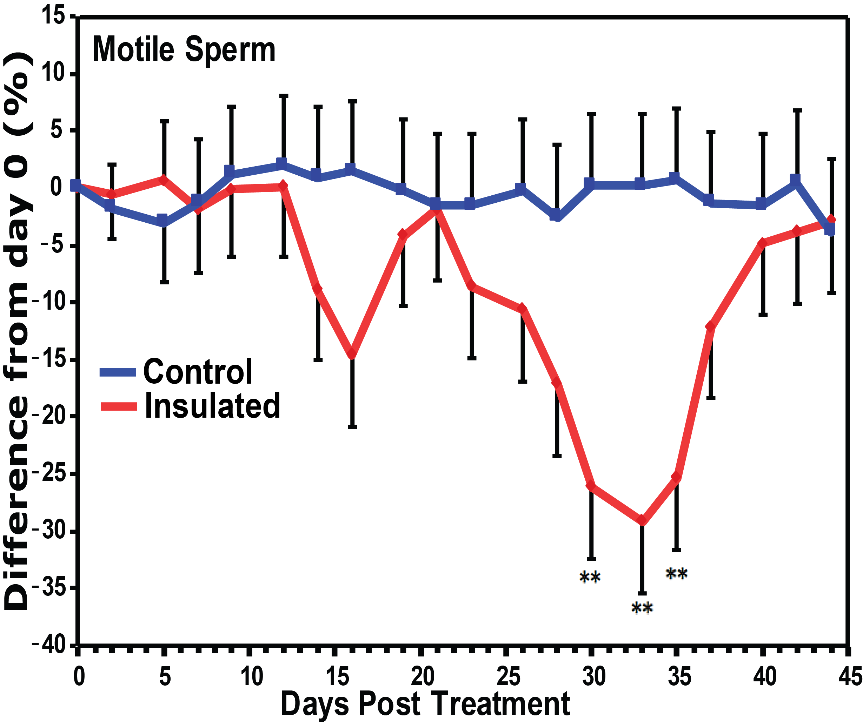

Slide 11
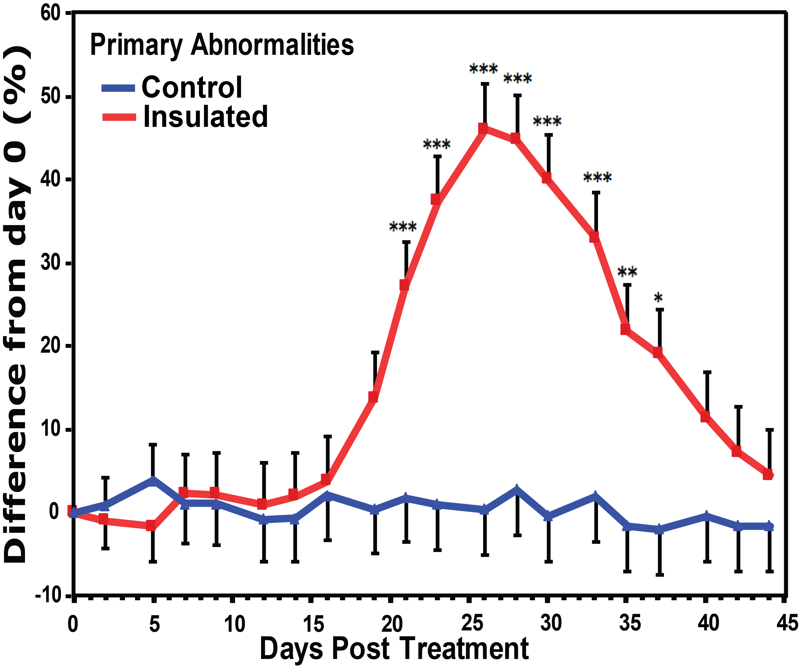

Slide 12
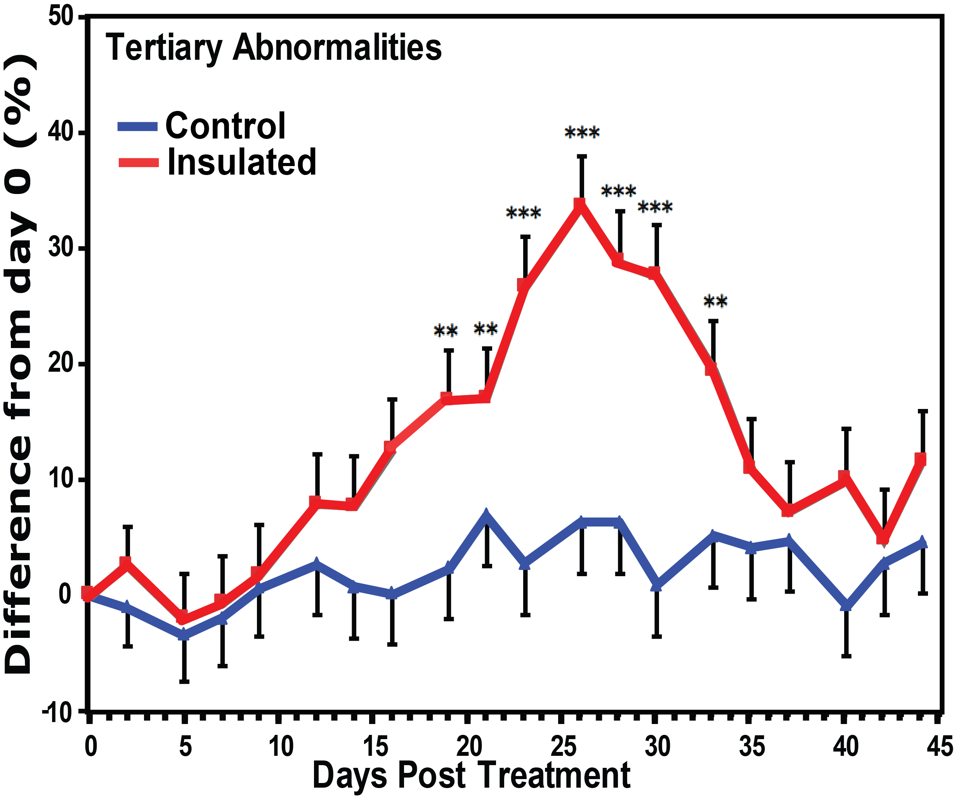

Slide 13
Motility
Morphology
Overall Effects

Slide 14
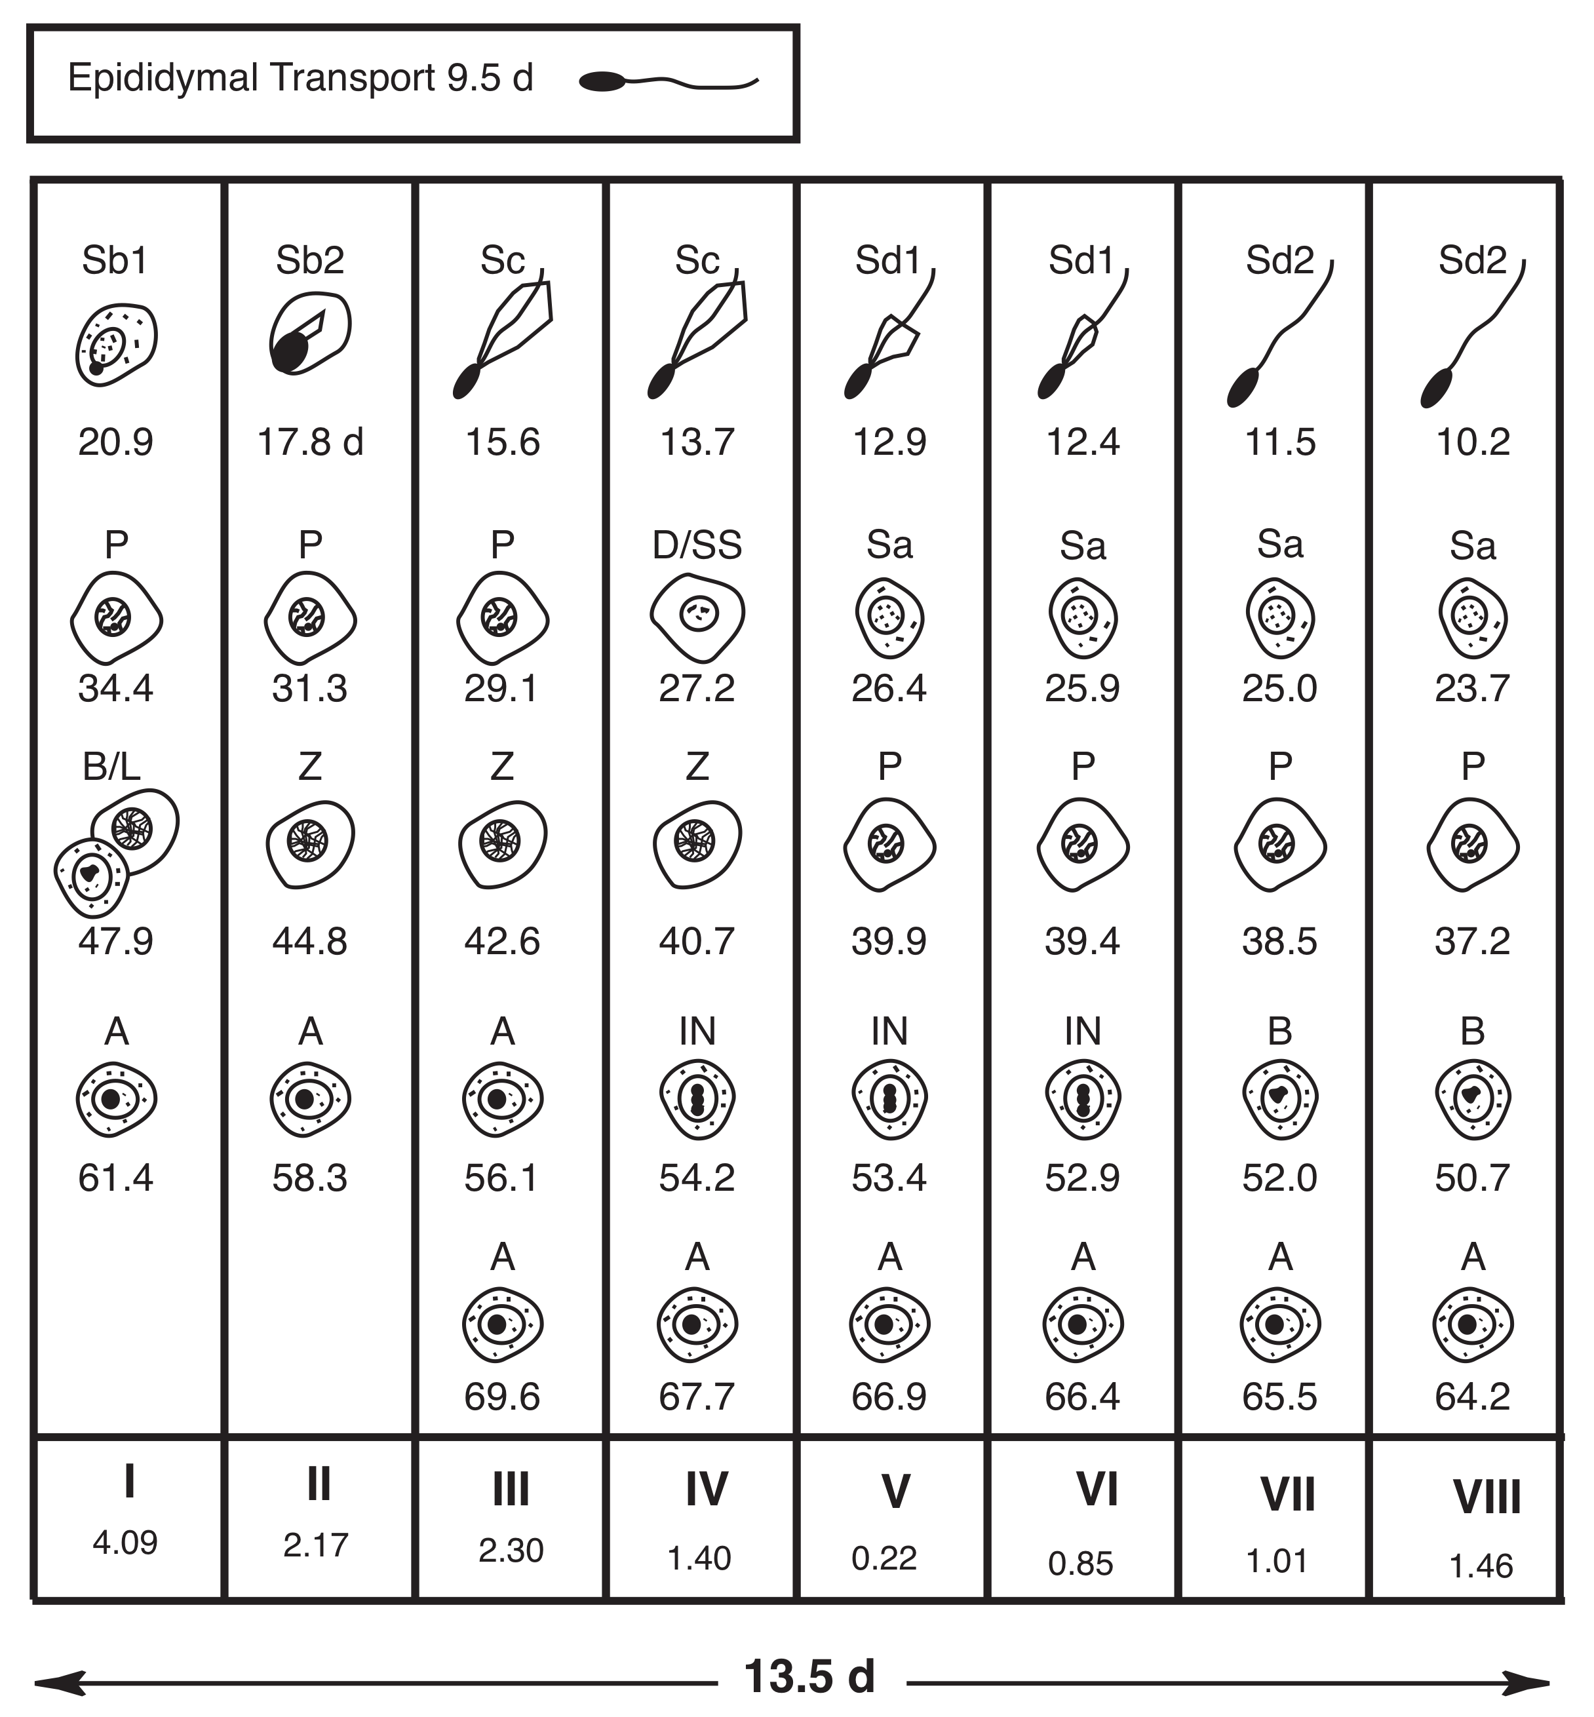
Bull Spermatogenesis

