Slide 1
Animal Science 434
Spermatogenesis

Slide 2
Production of Fertile Sperm
hormonal regulation of the testis
mitotic division of spermatogonia
meiotic divisions of spermatocytes
morphologic transformation of spermatids into spermatozoa

Slide 3
Hormonal Regulation of the Testis

Slide 4
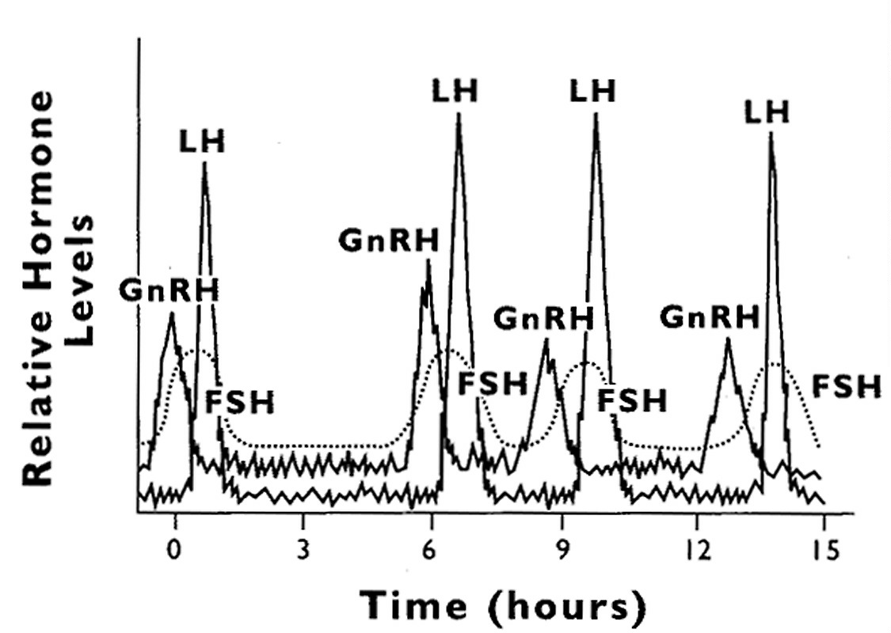
LH
LH
LH
LH
GnRH
GnRH
GnRH
GnRH
FSH
FSH
FSH
FSH
Notes:
FSH is lower and bluntedthan LH due to inhibin production and longer half/life than LH.

Slide 5
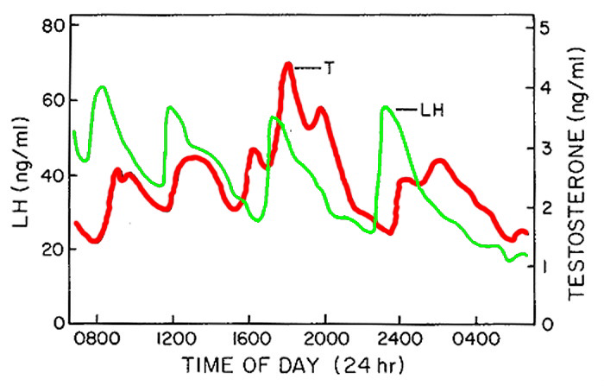
Time of Day (24 hr)
Pulses are important !

Slide 6
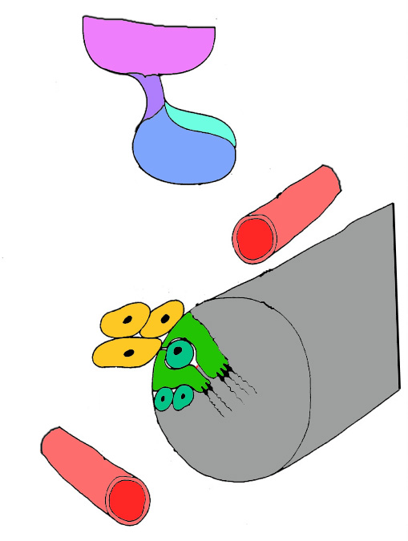
FSH on Sertoli Cells
estradiol
inhibin
ABP
tight junctions
Hypothalamus
GnRH
Ant.
Pituitary
Negative Feedback of
Estradiol and Inhibin
To
Epid.
Negative Feedback of Androgens
LH
FSH
ABP
+
T
E₂
Leydig
Cells
Inhibin
Sertoli
Cells
T
TJ
Germ
Cells
ABP
Seminiferous
Tubule

Slide 7
Spermatogenesis

Slide 8
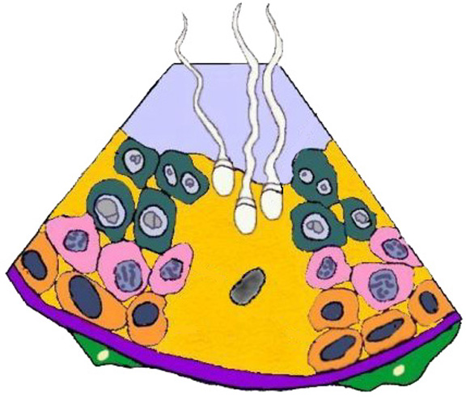
Sertoli Cell
Myoid Cells

Slide 9
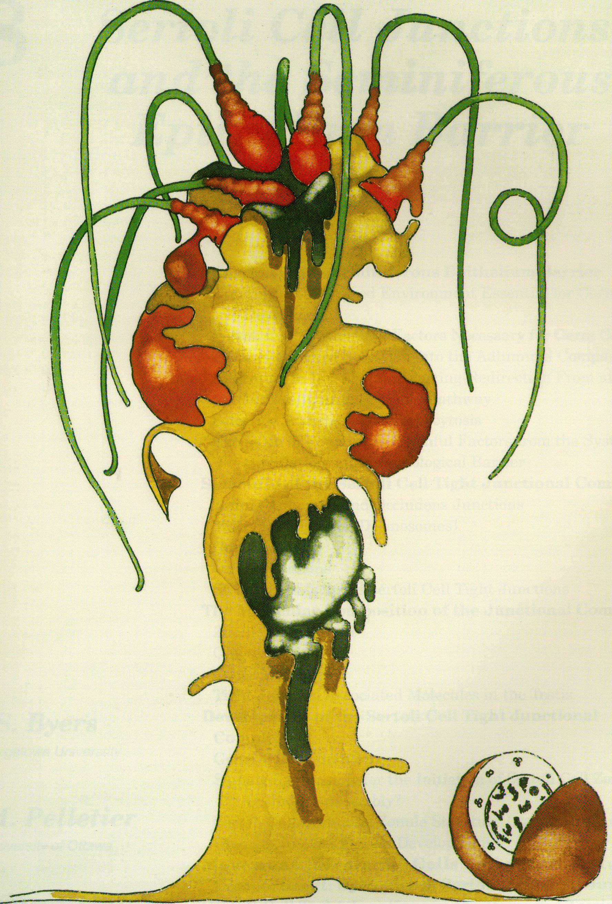
Sertoli Cell

Slide 10
Every 13.5 Days sperm are released from this point
Spermatozoa
Round
Spermatid
Secondary
Spermatocyte
Primary
Spermatocyte
Every 13.5 Days
a new group of cells
initiate the cycle
Spermatogonia

Slide 11
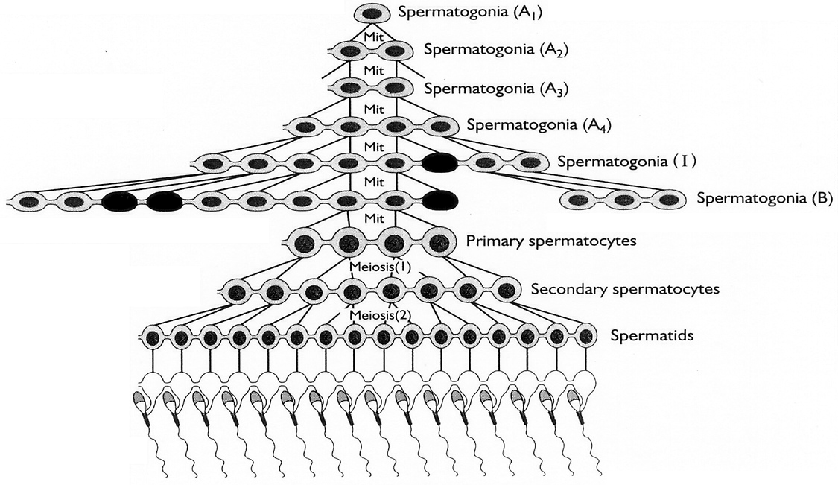
Spermatogenesis

Slide 12
Spermatogenesis
Spermatogonia
A₁ (1)
A₂(2)
A₃(4)
A₄(8)
I (16)
B (32)
Proliferation
Spermato-cytogenesis
Mitosis
Basal
Spermatocyte
P (64)
S (128)
Round Spermatid (256)
Meiosis
Adluminal

Slide 13
Round Spermatid (256)
Differentiation
Spermiogenesis
Adluminal
Spermatozoa (256)
Spermiation
Rete Testis

Slide 14
Mitotic Divisions
species dependent
  between 2 and 6 divisions (4 to 64 potential daughter cells produced)
classifications vary among species and investigators
  A₁, A₂, A₃, A₄, B ₁, B₂, P
  A_{d}, A_{p}, B, P
  A_{s}, A₀, A₁, A₂, I, B, P
cytoplasmic bridges form between daughter cells

Slide 15
Cytoplasmic Bridges Present Among Daughter Cells
All develop surrounded by 1 Sertoli cell !
Degenerating Spermatogonia (Apoptosis, as high as 75%)

Slide 16
Losses During Spermatogenesis
(Boar)
Citation | Round Spermatids/ Sertoli Cell | % Loss
Theoretical | 256 | 0
Franca et al., 2005 | 68 | 73.4%
Costa et al., 2013 | 21.5 | 91.6%
Parrish unpublished | 30.4 | 88.1%
Most losses (approx. 90%) occur during Mitotic processes
  A, I, B Spermatogonia or Primary Spermatocyte

Slide 17
Apoptosis/loss of Germ Cells
Season
Disease
Trauma or heat
Hormone levels
Normal part of spermatogenesis

Slide 18
Stem Cell Renewal
To keep spermatogenesis going indefinitely
Replenish testis incase of injury, trauma, or high heat

Slide 19
Spermatogonial Renewal
Periodic
Entry of
Cells into
Mitosis
A₀
A₂
A₁
Stem Cell
Pool
A₄
A₃
In
B
P

Slide 20
Spermiogenesis

Slide 21
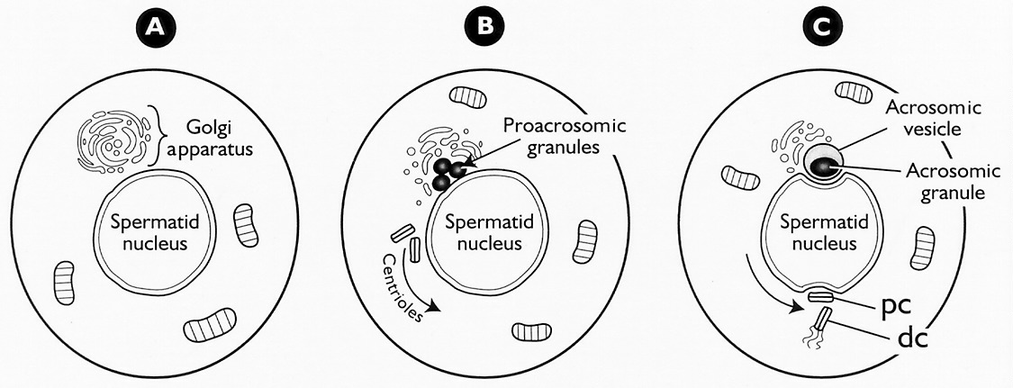
Golgi Phase
Development of Acrosome
Migration of Centrioles

Slide 22
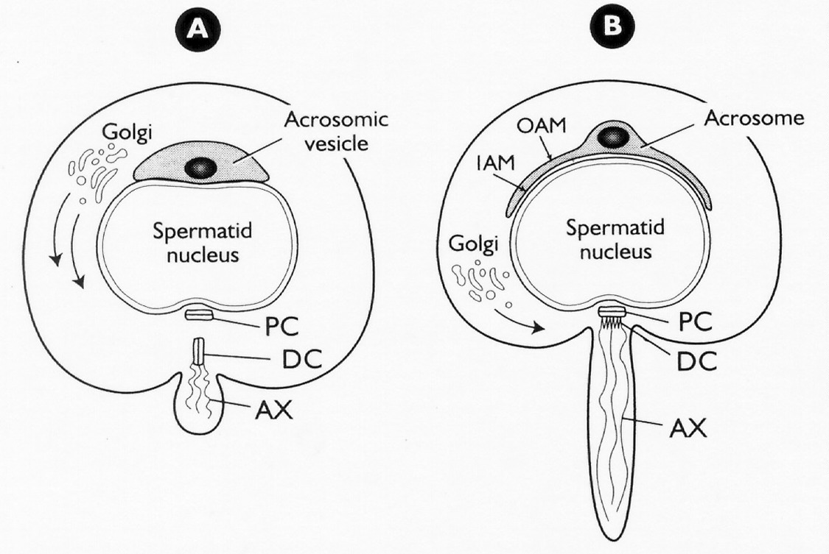
Cap Phase
Acrosome Development Continues
Flagellum Elongates

Slide 23
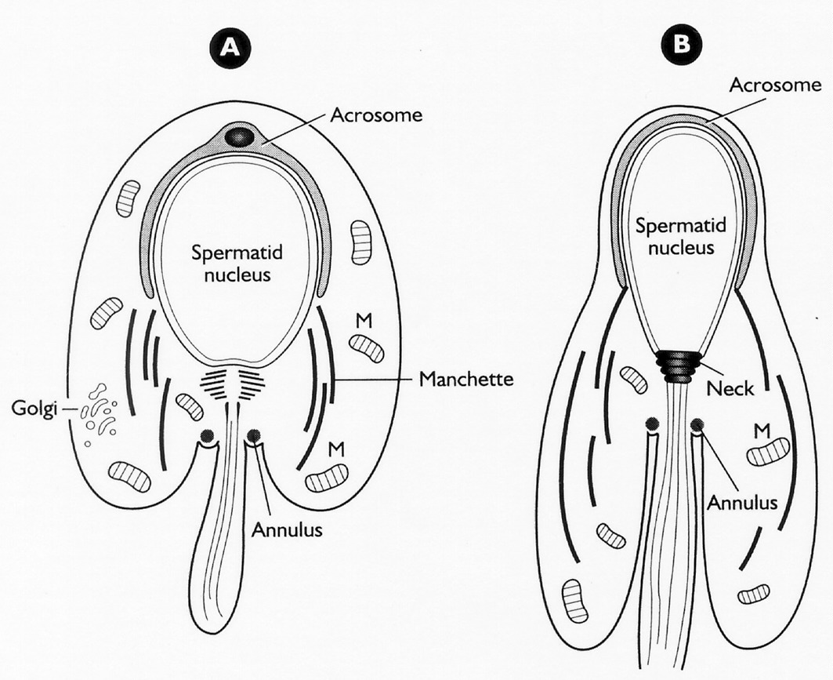
Acrosomal Phase
Acrosome
Manchette
Elongation

Slide 24
Manchette
A series of microtubules
Associated with nuclear elongation

Slide 25
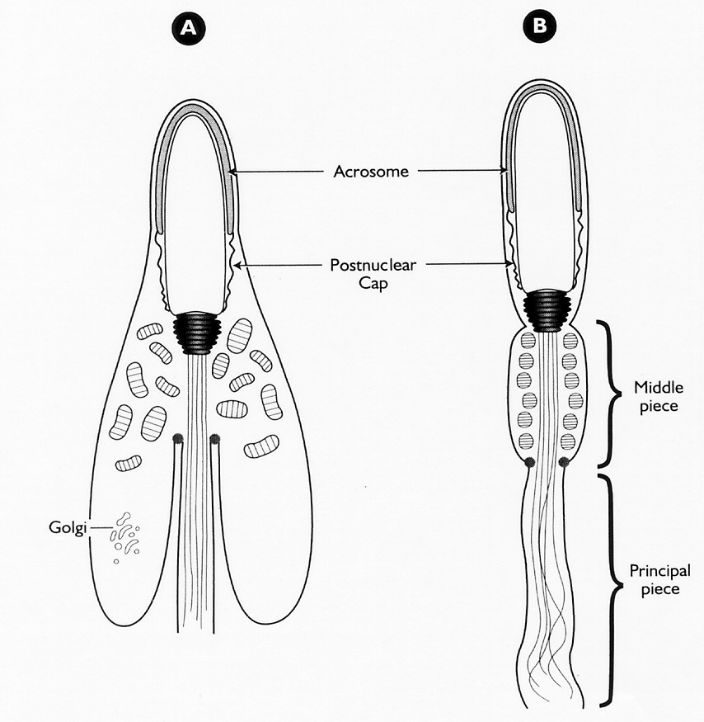
Maturation Phase
Manchette disapears
Mitochondria migrate
Dense fibers form

Slide 26
Spermiation

Slide 27
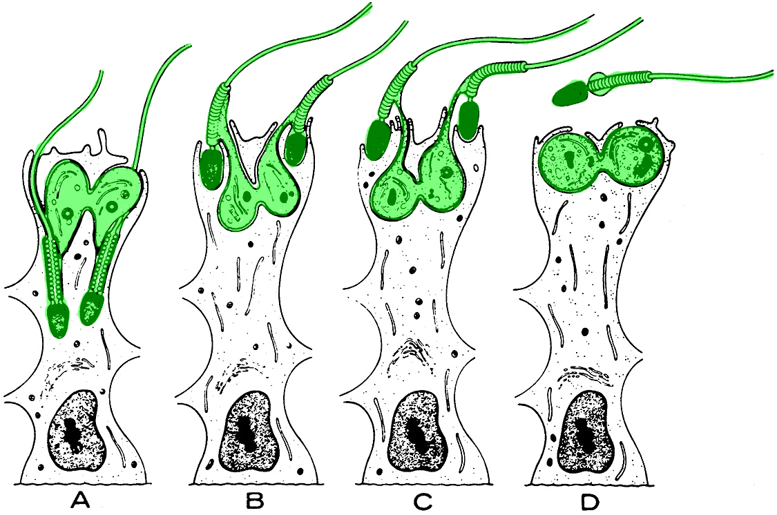
Spermiation
Cytoplasmic
Droplet

Slide 28
Temporal Relationships of Spermatogenesis

Slide 29
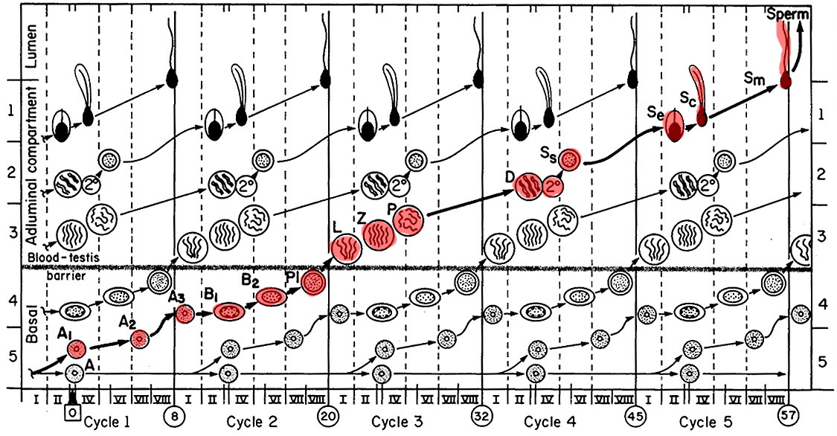
Spermatogenesis
57 days
Stallion

Slide 30
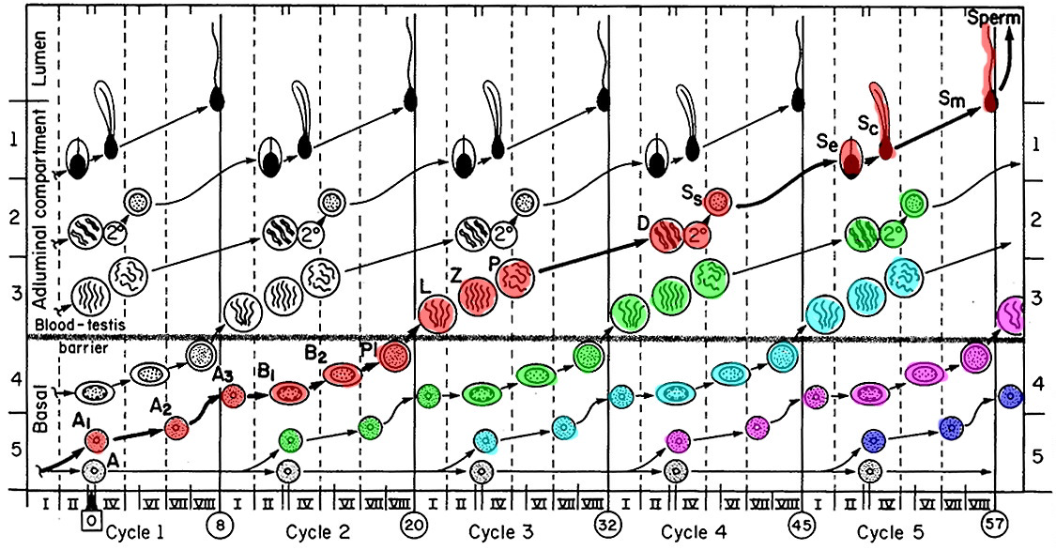
Multiple Generations of Germ Cells

Slide 31
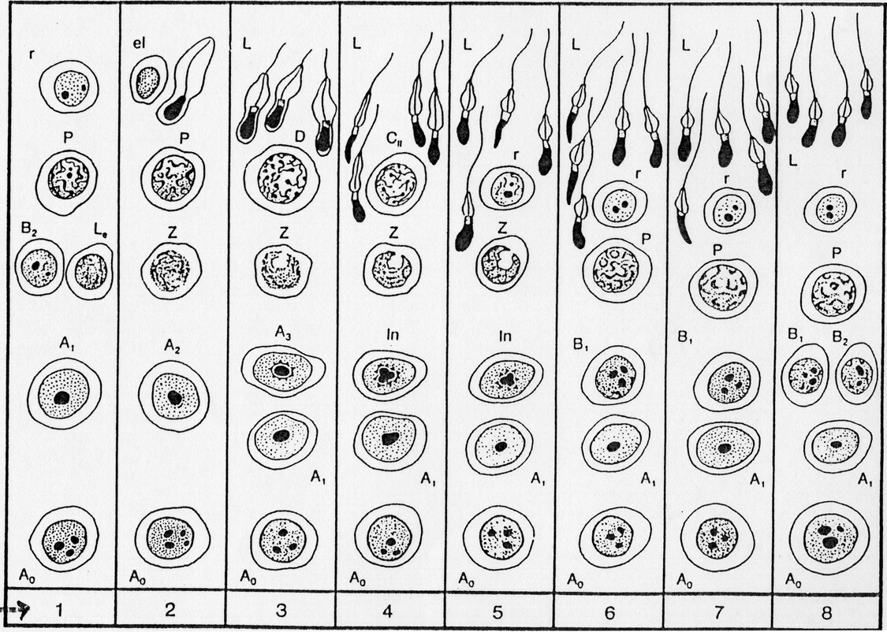
Bull Spermatogenesis

Slide 32
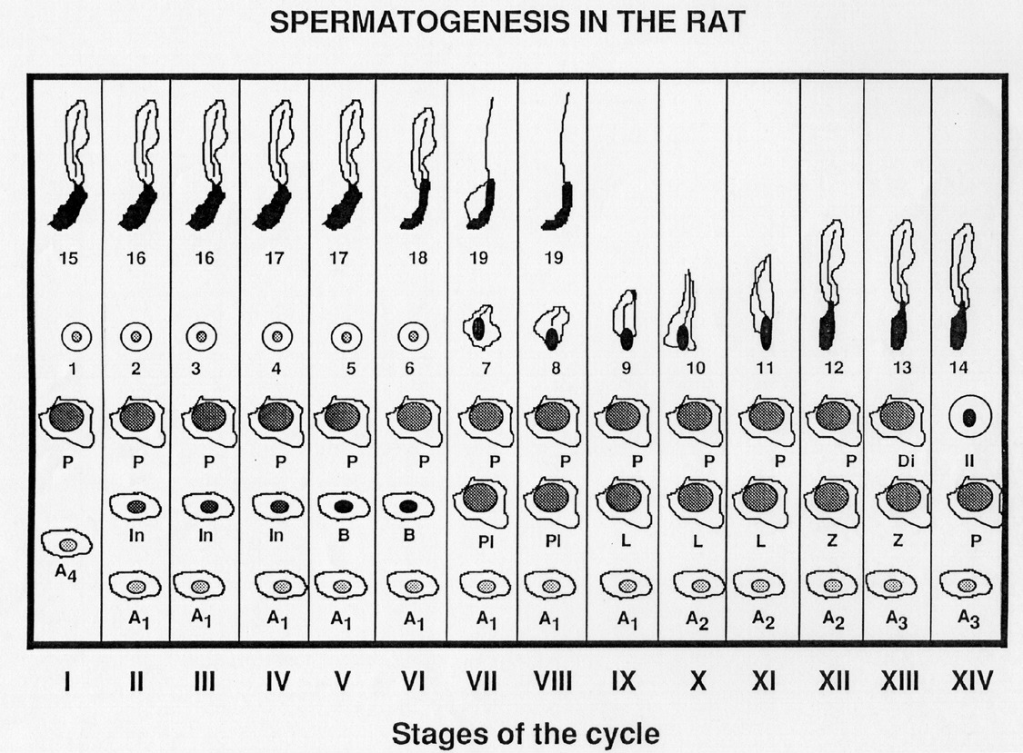

Slide 33
Stages
Specific cellular associations within a small segment of a seminiferous tubule
stages are not the same length in time

Slide 34
Bull Spermatogenesis - Stages

Slide 35
Stages
Specific cellular associations within a small segment of a seminiferous tubule
stages are not the same length in time

Slide 36
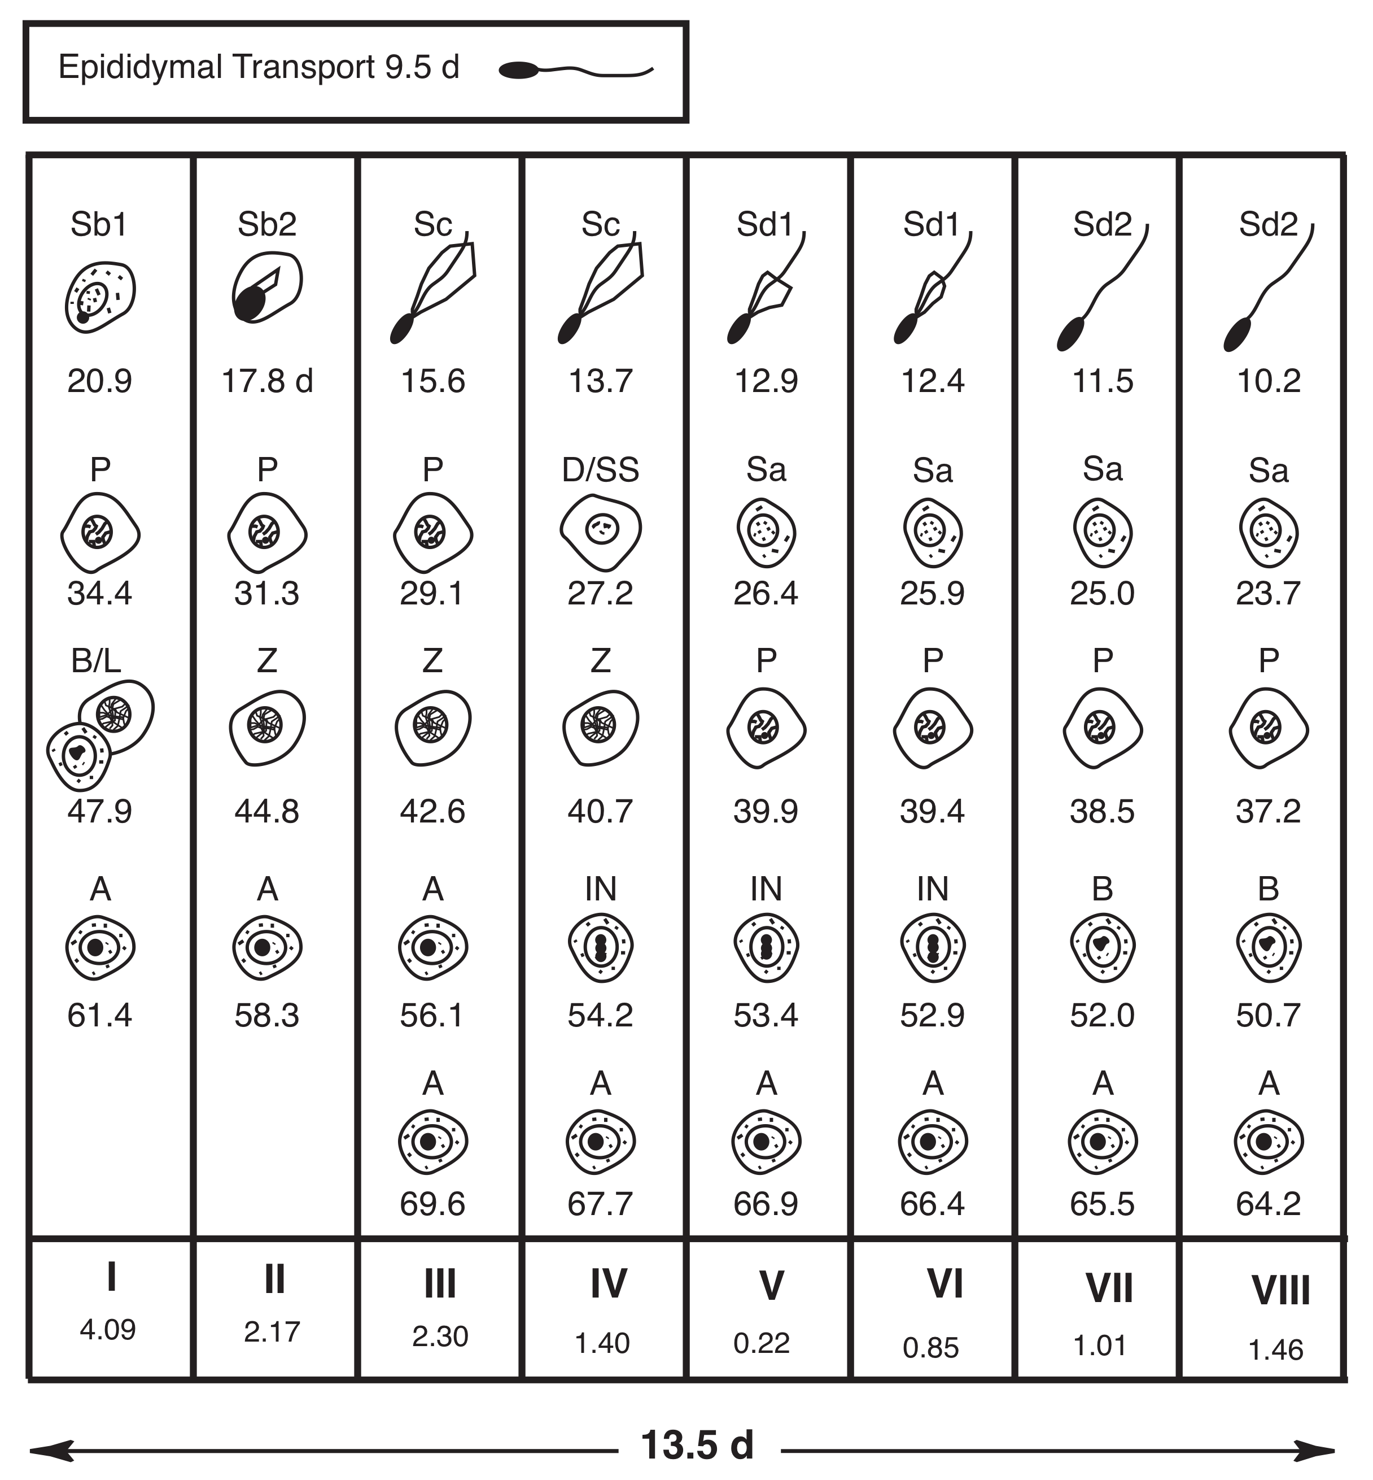
Bull Spermatogenesis

Slide 37
Cycle
progression through sequence of all stages

Slide 38
Bull Spermatogenesis - Cycles

Slide 39
Cycle
progression through sequence of all stages
4.5 cycles to form spermatozoa
  some species variation

Slide 40
Duration of Spermatogenesis
Bull Ram Boar Stallion Man
cycle (days) 13.5 10.4 8.3 12.2 16
Spermatogenesis 61 47 39 57 75

Slide 41
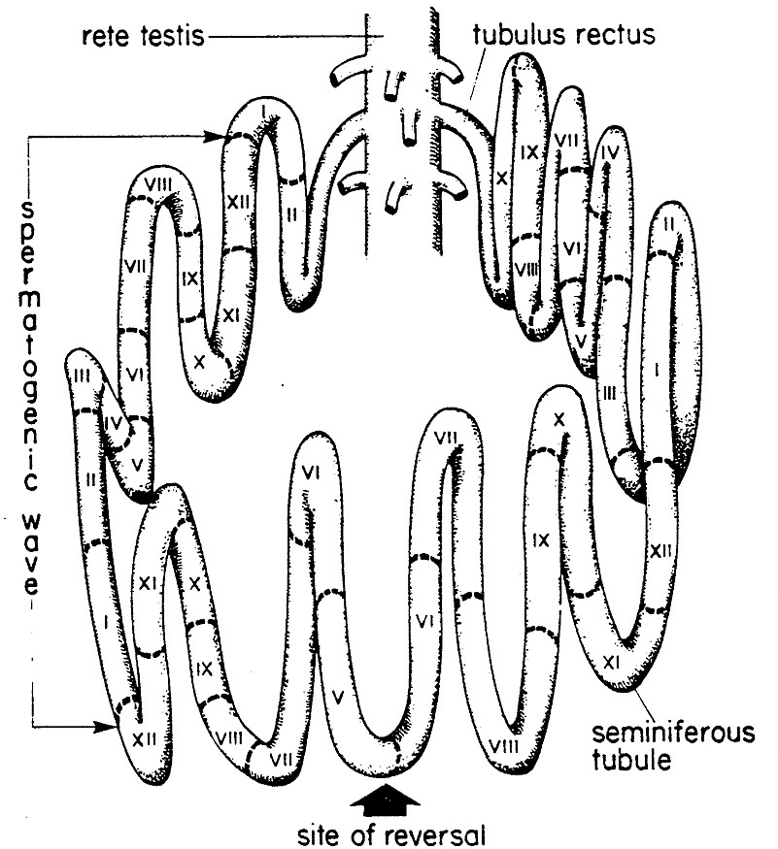
Coordination of Stages Form Waves
some portion of seminiferous tubule is always releasing sperm

Slide 42
Compartmentalization of Spermatogenesis and the
Blood Testis Barrier

Slide 43
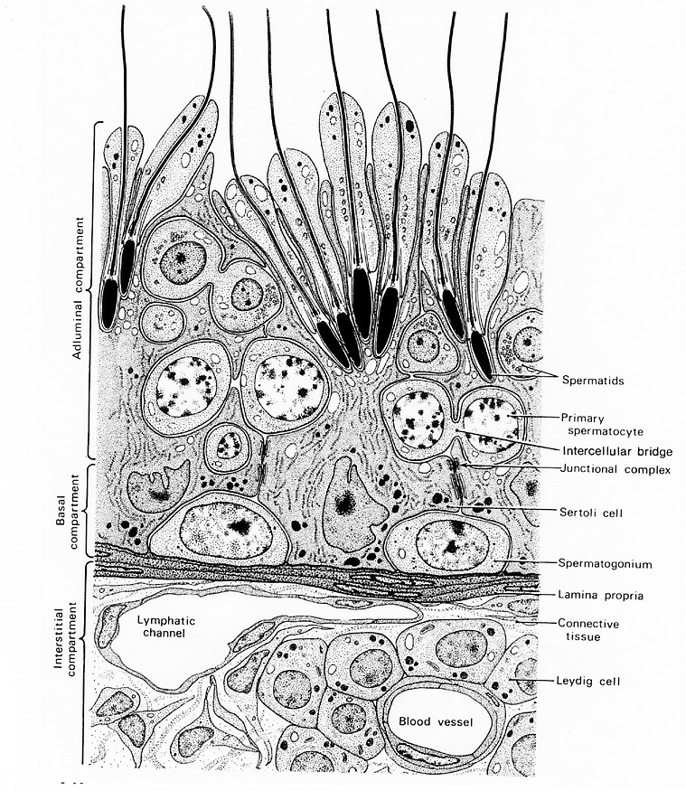
Seminiferous Tubule and
Interstitial Tissue

Slide 44
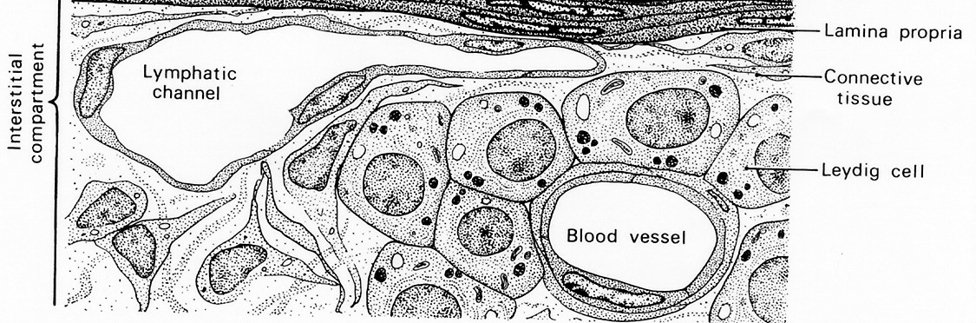
Interstitial Tissue
Blood Vessel
Vascular System Provides
  Nutrients
  Oxygen
  Growth Factors
  Hormones

Slide 45
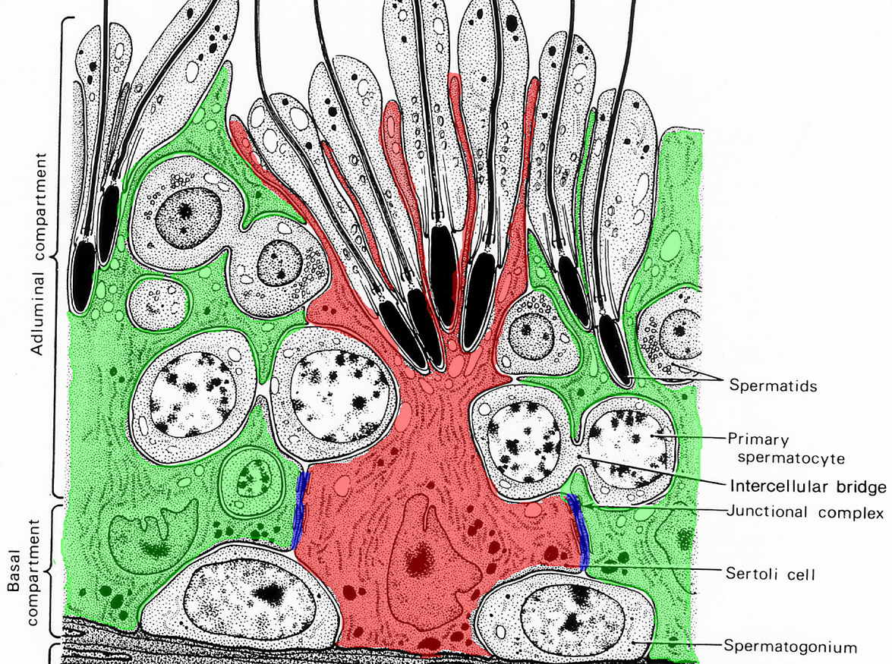
Blood Vessel

Slide 46
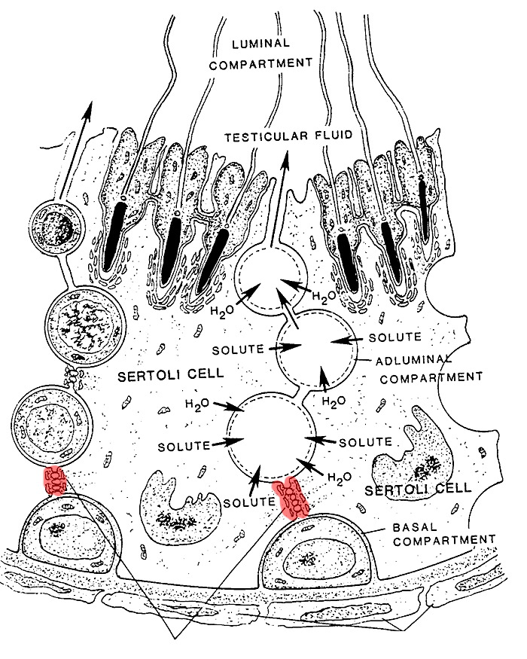
Compartments
Luminal
Adluminal
Basal
Tight Junctions
Myoid Cells

Slide 47
Cycles and Stages

Slide 48
Compartmentalization
Basal
  mitosis
    spermatogonia (A, I, B)
    primary spermatocytes
Adluminal
  meiosis
    primary spermatocytes
    secondary spermatocytes
    spermatids
  spermiogenesis
Lumen
  spermiation

Slide 49
Blood Testis Barrier
Sertoli cells and associated tight junctions
first appears at puberty
induced by FSH
after puberty can be maintained by FSH and/or testosterone
essential for meiosis
!!!!!

Slide 50
Tight Junction Role in Meiosis
Sertoli cells can manipulate environment around 1°spermatocyte
  Enters meiosis
  Completes meiosis
Destruction of TJ causes impairment of meiosis
  Heat, heavy metals, endocrine disruptors, pesticides, lack of FSH or Testosterone

Slide 51
Capacity for Sperm Production
Species Testis Sperm/gm DSP
Weight (gm) (X 10⁶) (X 10⁹)
Dairy Bull 650 18 10
Beef Bull 500 18 8
Ram 550 26 14
Boar 750 30 25
Stallion 165 18 3
Man 40 4 .045 - .2

Slide 52
Duration of Spermatogenesis
Bull Ram Boar Stallion Man
cycle (days) 13.5 10.4 8.3 12.2 16
Spermatogenesis 61 47 39 57 75

Slide 53
Capacity for Sperm Production
Species Testis Sperm/gm DSP
Weight (gm) (X 10⁶) (X 10⁹)
Dairy Bull 650 18 10
Beef Bull 500 18 8
Ram 550 26 14
Boar 750 30 25
Stallion 165 18 3
Man 40 4 .045 - .2

Slide 54
Variation in Sperm Production
Testis Size
Efficiency of spermatogenesis
  mitotic division
  degeneration of germ cells
Length of spermatogenesis

Slide 55
Apoptosis of Germ Cells
Season
Disease
Trauma or heat
Hormone levels
Normal part of spermatogenesis
Notes:
The more apoptosis the more inefficient spermatogenesis will be.

Slide 56
Over Population of Spermatogonia
Tight Junction
Sertoli
Sertoli
SG
SG
SG
SG
SG
SG
SG
SG
SG
Basement Membrane
Normal
Apoptosis Inhibited
PS
Sertoli
SG
Sertoli
PS
Sertoli
SG
Sertoli
AP
AP
SG
SG
SG
SG
SG
AP
SG
AP
SG
SG
SG
SG
SG
SG
Basement Membrane
Basement Membrane
Notes:
Here is what happens in normal situation and then when you inhibit apoptosis.

