Slide 1
The Luteal Phase of the Estrous and Menstrual Cycle
John Parrish

Slide 2
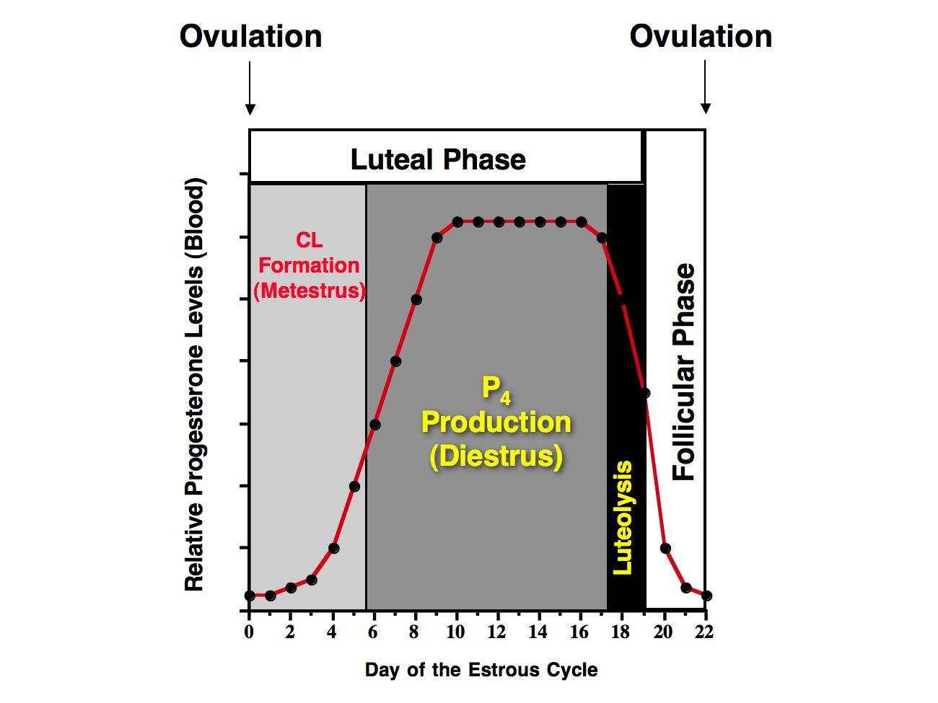

Slide 3
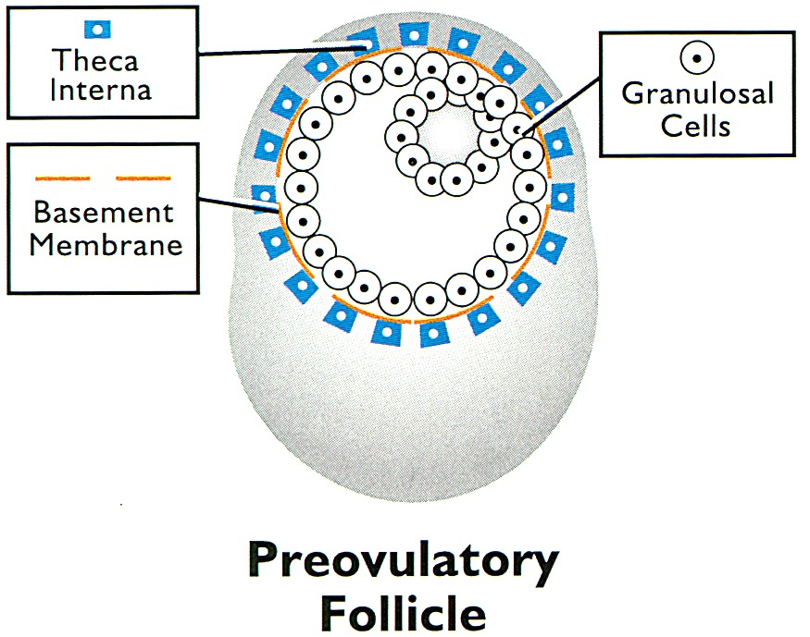
steroid synthesis
  progesterone
collagenase
  theca interna

Slide 4
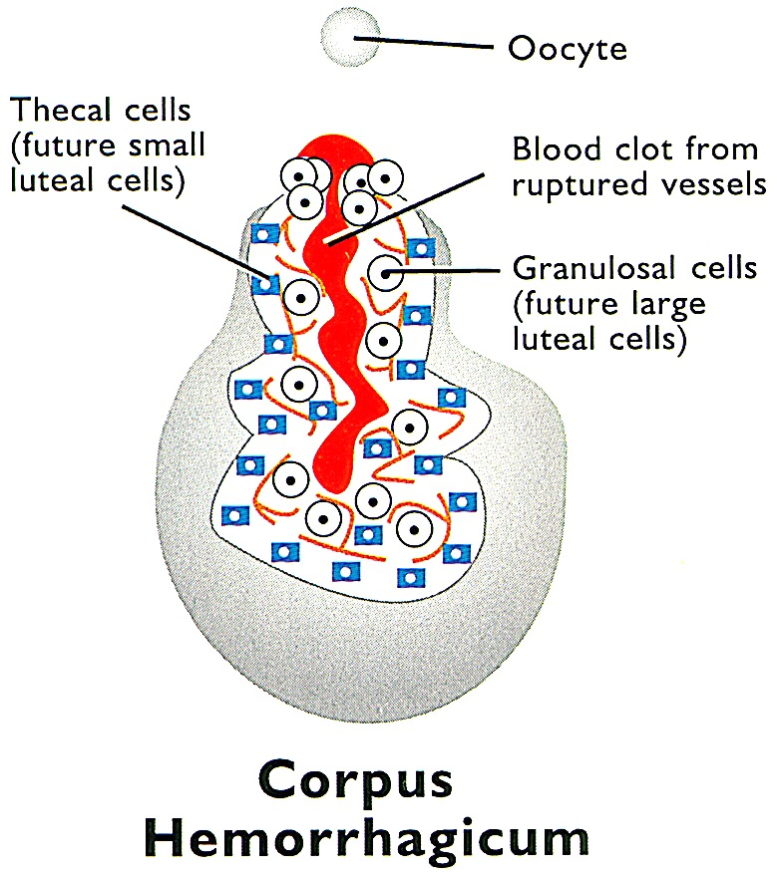
present 1-3 days following ovulation
blood vessels in follicle wall rupture
walls collapse
cells intermix
old basement membrane becomes connective tissue of CL

Slide 5
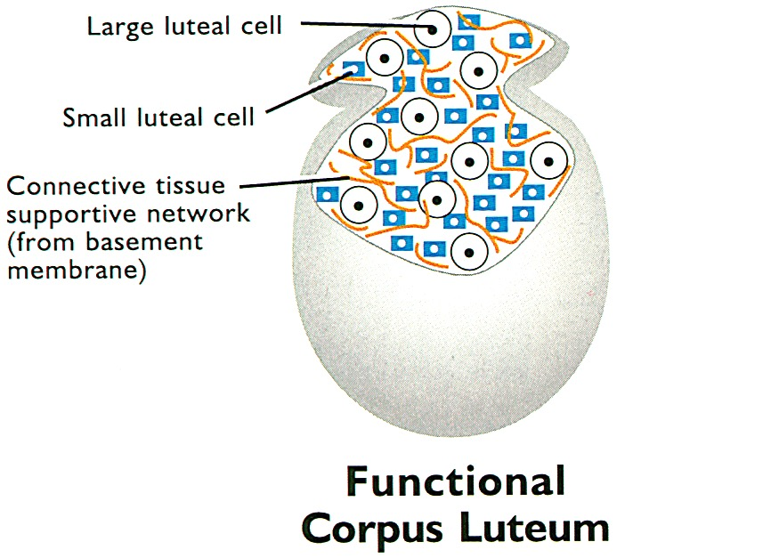
increases in size
  papilla forms
composed of cells from the granulosa and theca interna
progesterone production increases
a small cavity may be present where the folliclular antrum was present

Slide 6
Luteal Tissue
Large cells from granulosa
Small cells from the theca interna

Slide 7
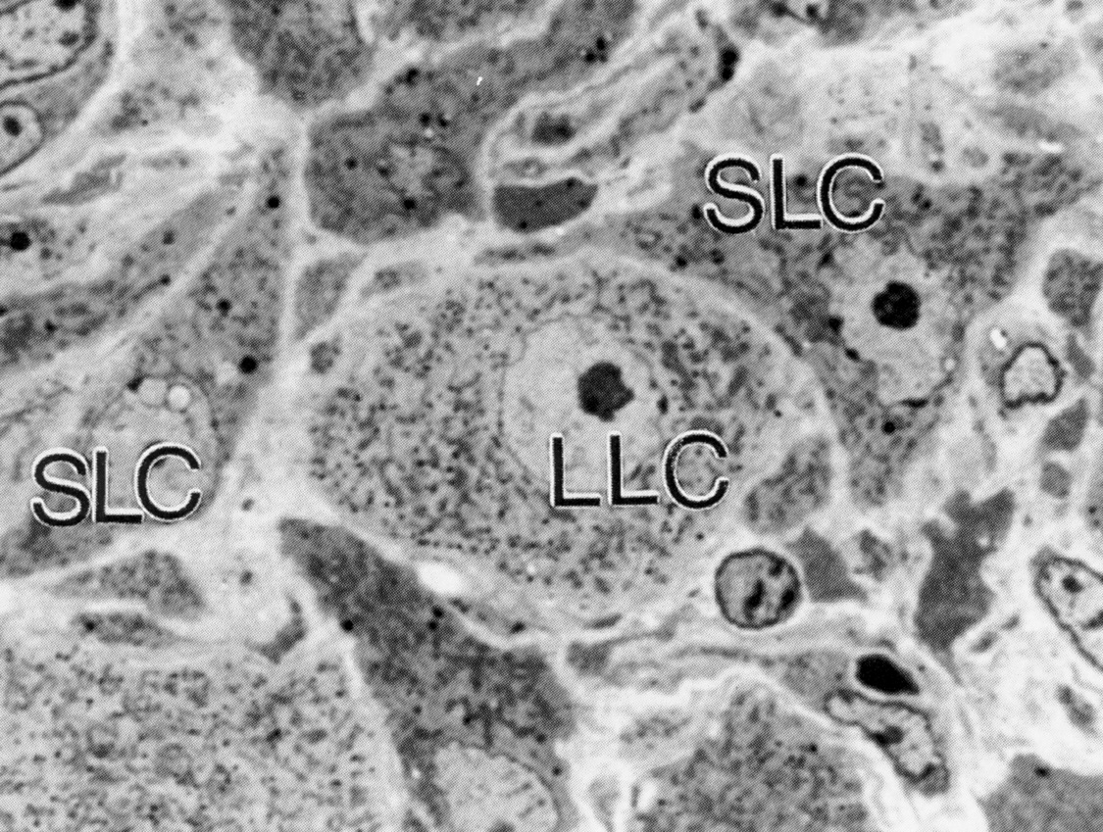

Slide 8
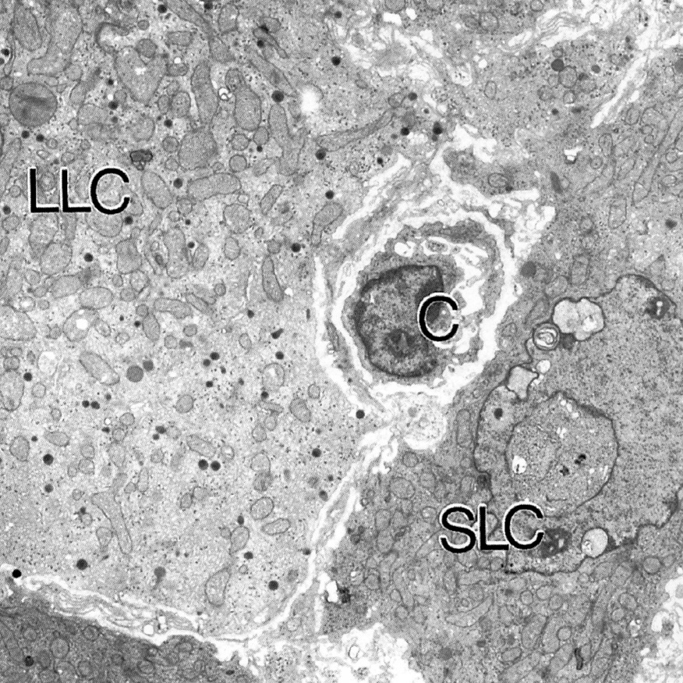
Mitochondria
Secretory
Granules
- Oxytocin
- Relaxin

Slide 9
Functional Capability of CL
the number of luteal cells
  large cells undergo hypertrophy (3 fold)
  small cells undergo hyperplasia (5 fold) and hypertrophy
  vascularization of CL
  Initiated by angiogenic factors from follicle
  Vascularity effects CL steroid synthesis and delivery of hormones
Insufficient CL function
  Failure to maintain pregnancy
  Important in domestic animals

Slide 10
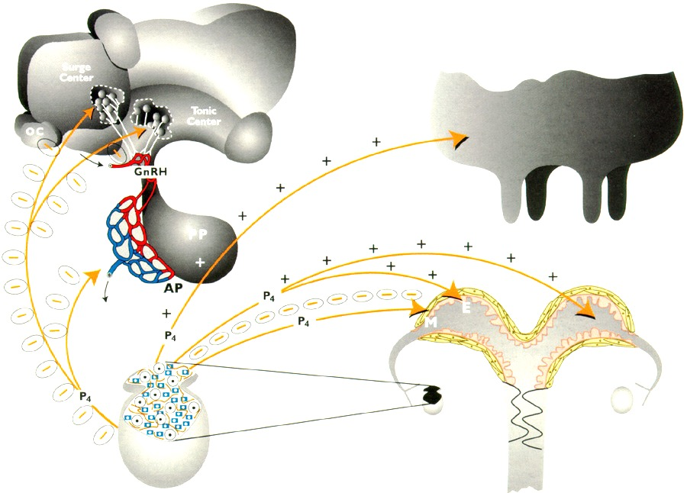
Blocks Estrus
Negative Feedback
Progesterone Targets
Aveolar Development

Slide 11
Molecular Mechanism of LH on Luteal Cell
(cAMP second messenger)
LH
Receptor
G
Plasma Membrane
Adenylate Cyclase
Progesterone
PKA
cAMP
R
ATP
cAMP
S-ER
Steroid Synthesis
C
(+ PO₄)
Mitochondria
Pregnenolone
Cholesterol
Histones
Cholesterol
Nucleus
DNA
Protein
R-ER
Protein Synthesis
Synthesis
mRNA
(Enzymes)

Slide 12
Molecular Mechanism of LH on Luteal Cell
(cAMP second messenger)
Chol
LH
LDL
Receptor
G
Plasma Membrane
Adenylate Cyclase
Progesterone
PKA
cAMP
Chol
R
LDL
ATP
cAMP
S-ER
Steroid Synthesis
C
Chol-Ester
(+ PO₄)
LDL
Mitochondria
Chol Esterase
Pregnenolone
Cholesterol
Cholesterol
Protein
R-ER
Protein Synthesis
Synthesis
(Enzymes)

Slide 13
LH receptor location
Small luteal cells
  LH receptors
  Progesterone production driven by LH
Large luteal cells
  Very few LH receptors
  Progesterone production mostly independent of LH

Slide 14
Luteolysis
Uterus
PGF_{2α}
Oxytocin

Slide 15
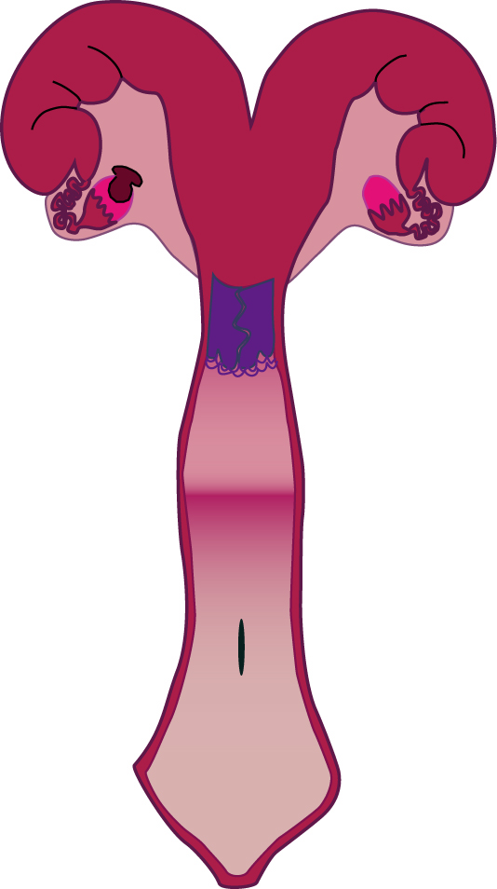
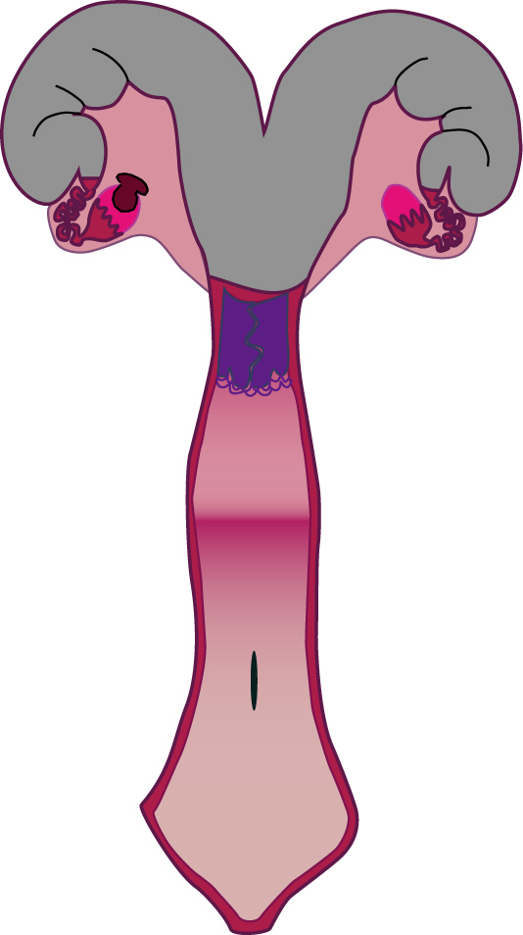
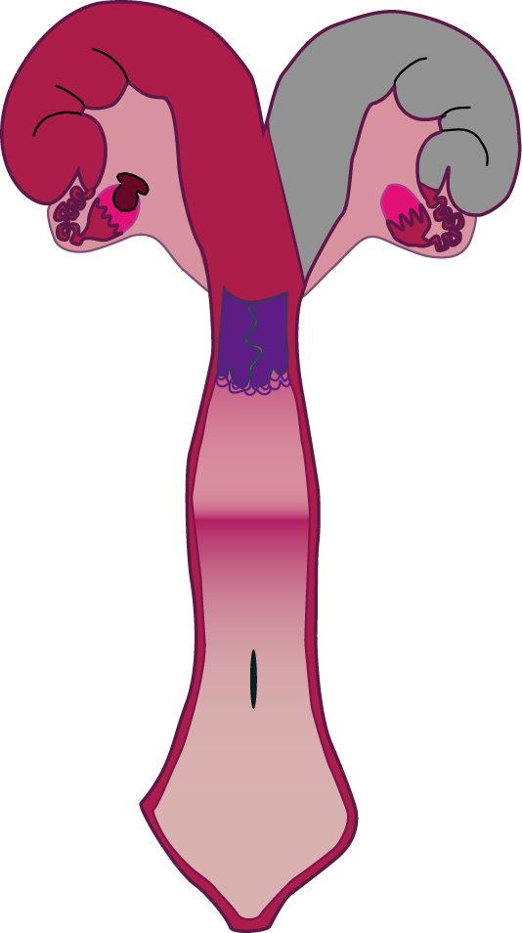
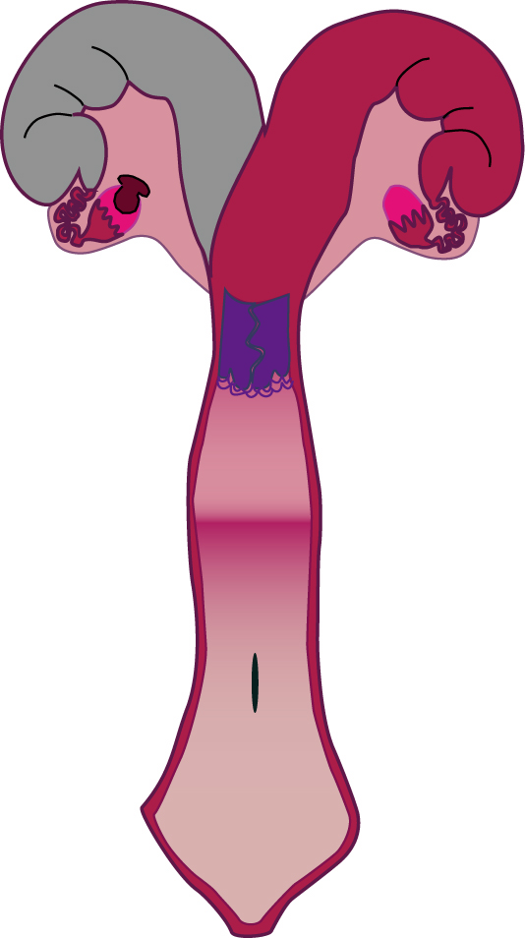
Luteolysis in Cows, Ewes, Sows
Normal
Uterus
Total
Hysterectomy
CL
CL Lifespan
Longer
CL Normal Lifespan
Similar to Gestation Length
Contralateral
Hysterectomy
Ipsilateral
Hysterectomy
CL Lifespan
Longer
CL Normal Lifespan
>35 days

Slide 16
Luteolysis
Uterus
PGF_{2α}
Oxytocin

Slide 17
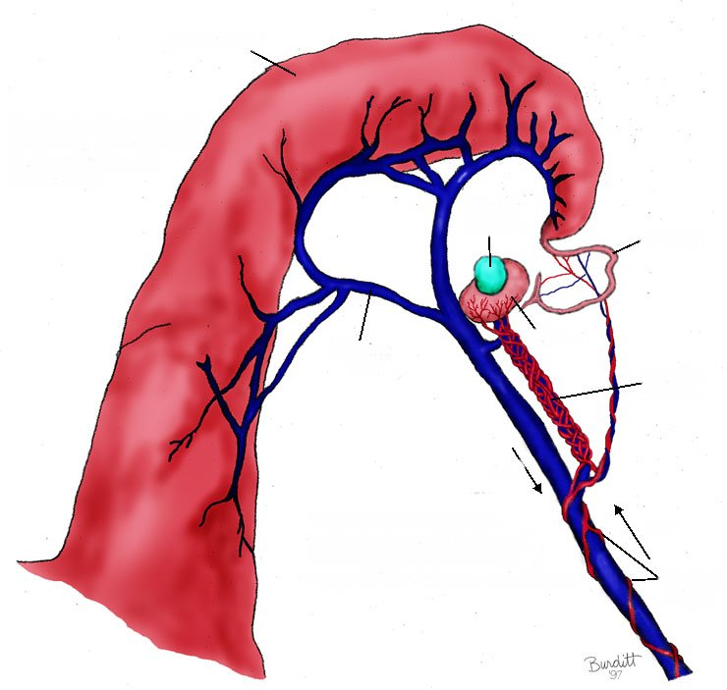
Prostaglandin F2α Control of Luteolysis
Uterine Horn
Progesterone from
CL stimulates
production of
uterine PGF2α after
day 15 in cow
Prostaglandin synthesis
by uterine endometrium
is released into the
uterine vein.
Corpus
Luteum
Oviduct
Ovary
Uterine
Vein
Ovarian Pedicle
PGF
PGF2α is picked up by
ovarian artery through
counter current exchange
and delivered back to the
ovary where it causes
lysis of the CL
PGF into Artery
Uterine Artery

Slide 18
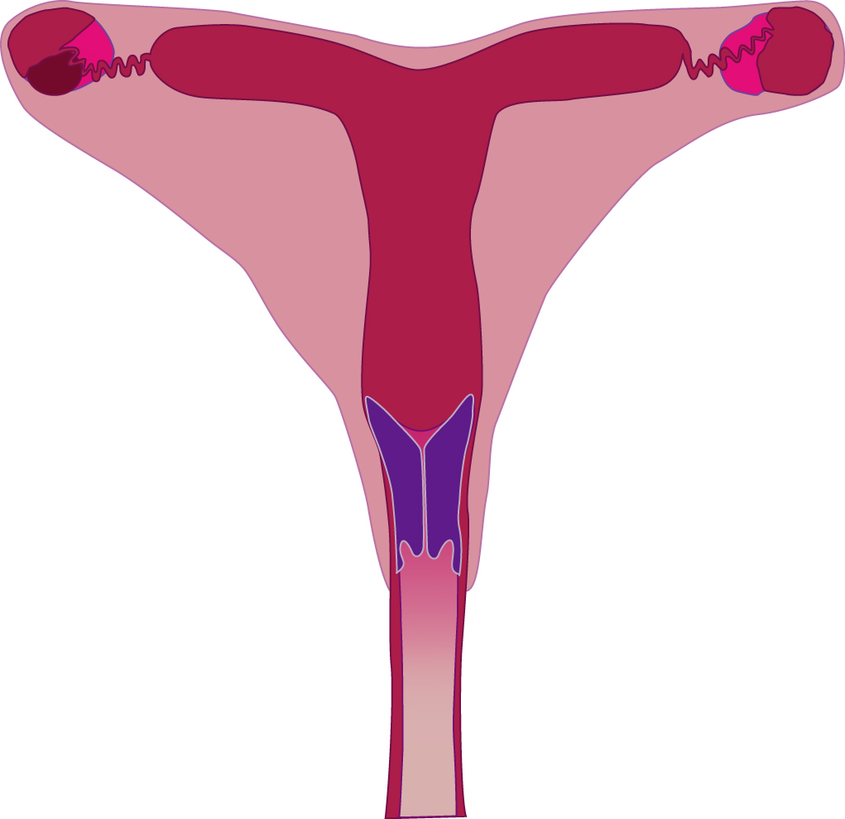
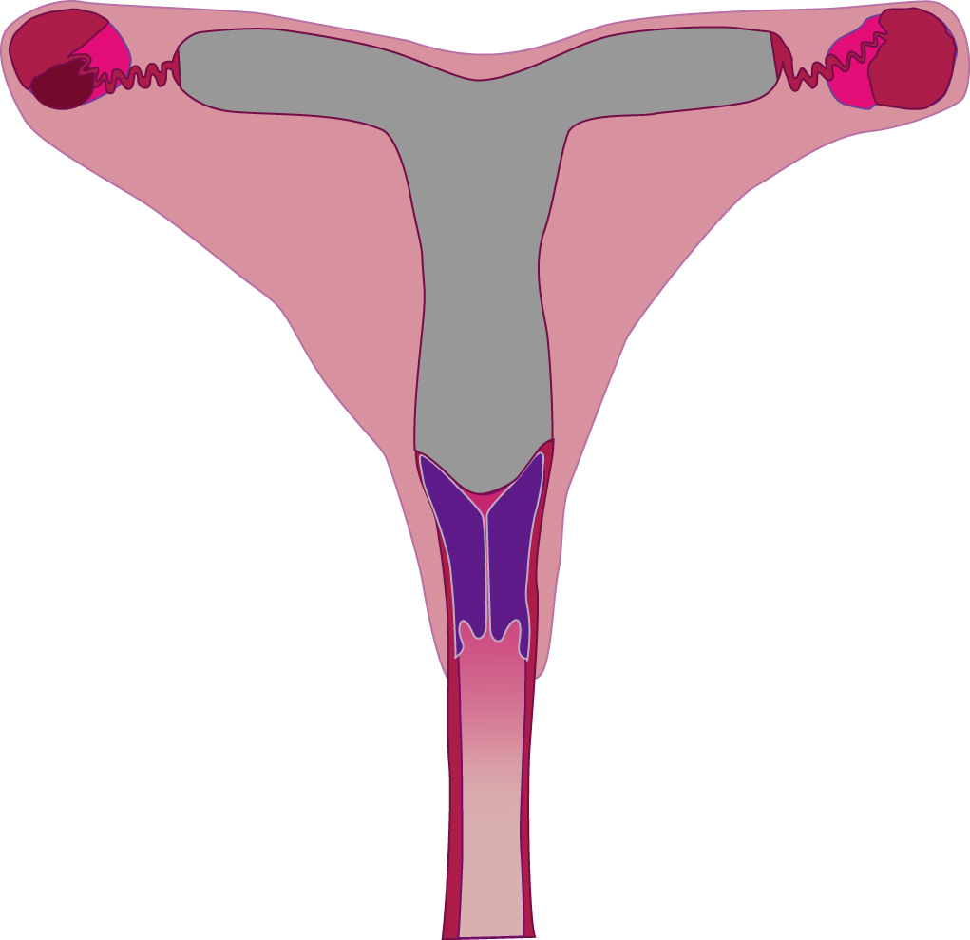
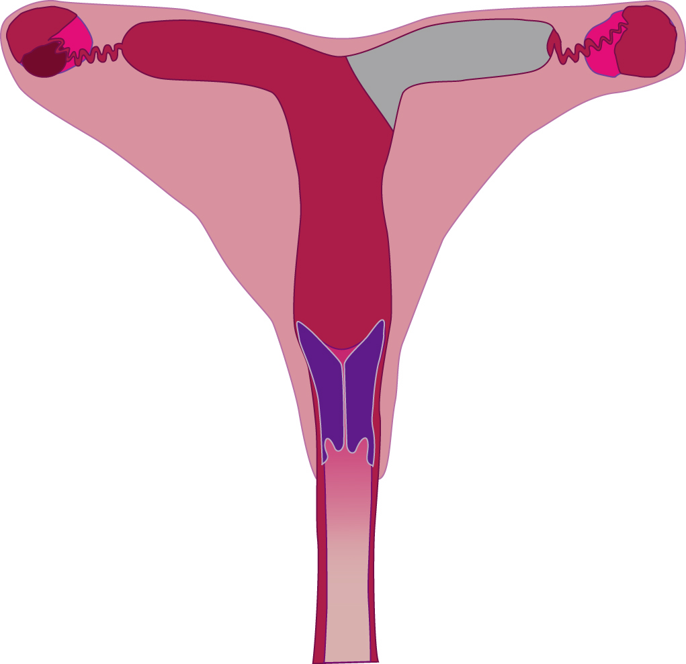
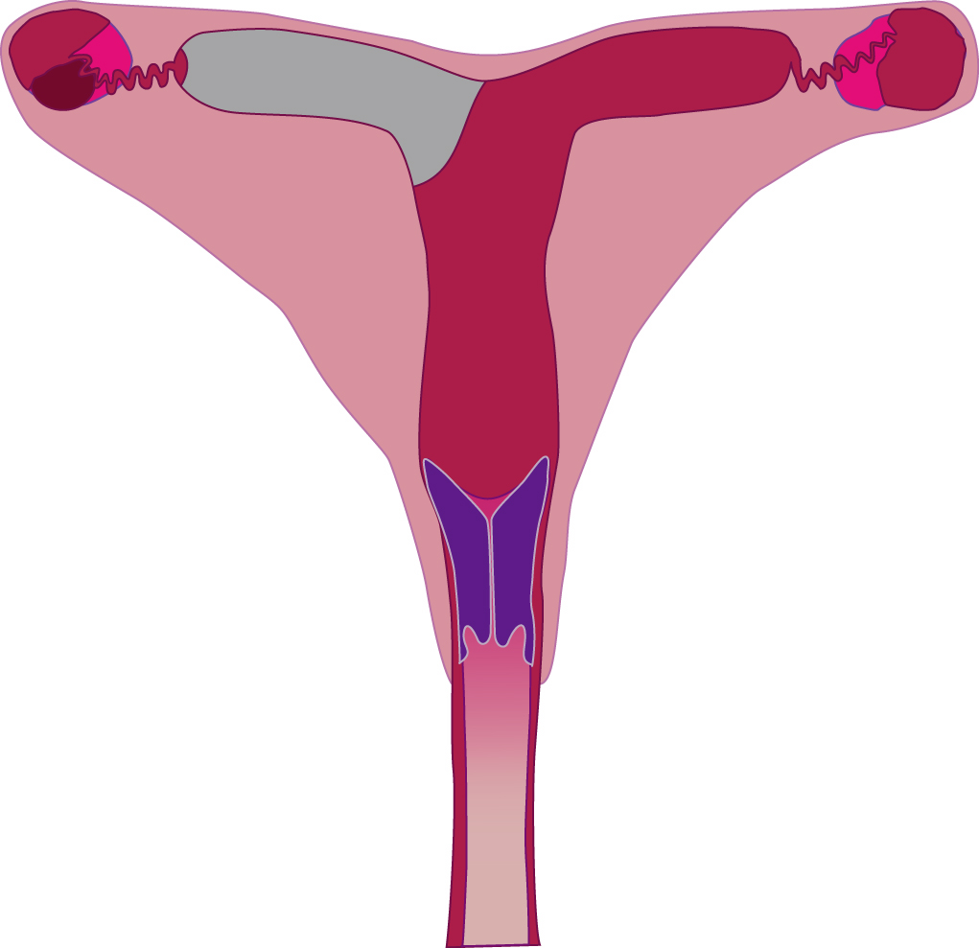
Normal
Uterus
Total
Hysterectomy
CL
CL Normal
Lifespan
CL Maintained
Luteolysis Mare
Contralateral
Hysterectomy
Ipsilateral
Hysterectomy
50% of CL’s Maintained
50% of CL’s Maintained

Slide 19
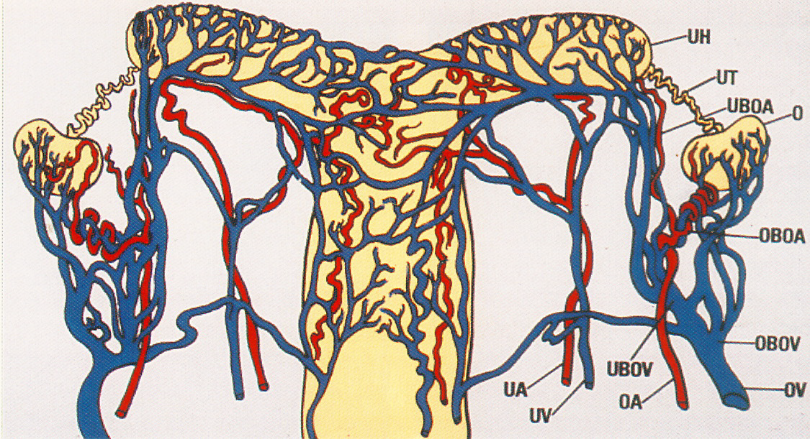
Blood Supply to Uterus and Ovary in the Mare

Slide 20
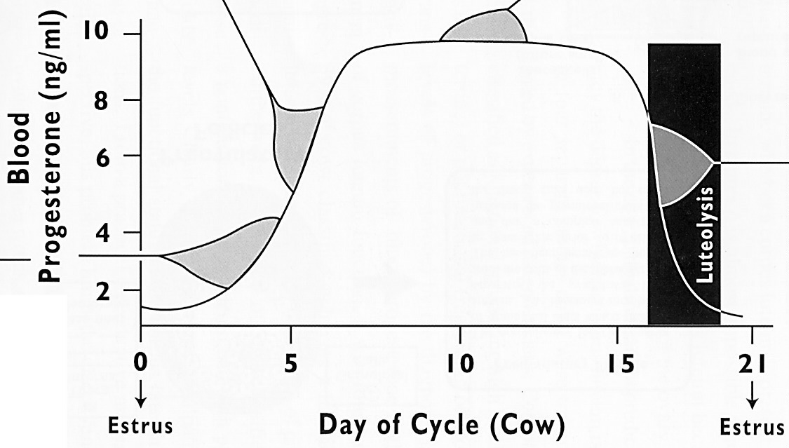
PGF Not Effective (Sow)
PGF Not Effective (Cow, Ewe, Mare)

Slide 21
Luteolysis
Uterus
PGF_{2α}
Oxytocin

Slide 22
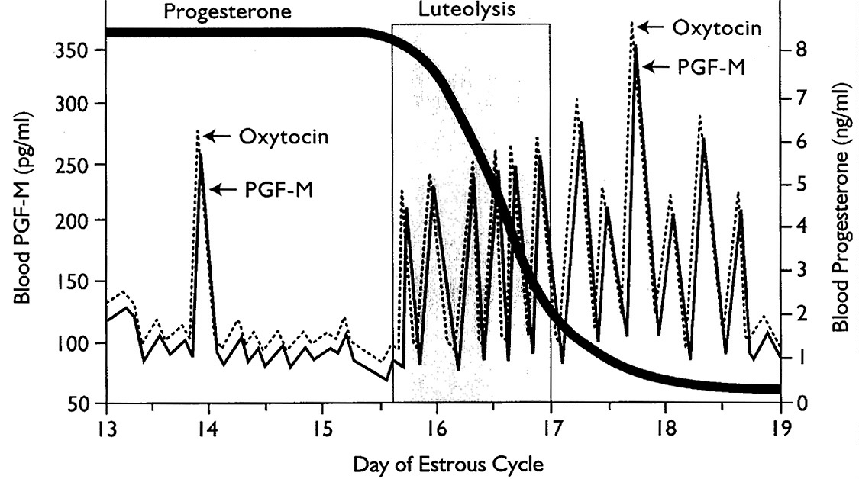

Slide 23
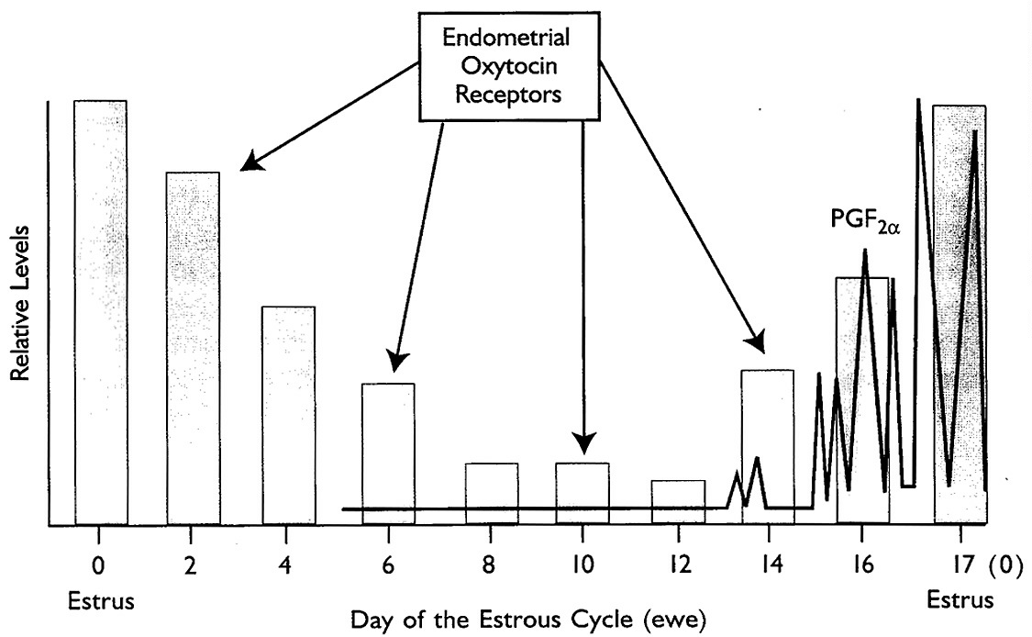

Slide 24
Relationship of Oxytocin and PGF2α
Posterior Pituitary
Anterior Pituitary
CL
Oxytocin
PGF2α
Ovary
Uterus

Slide 25
Luteolysis
decreased blood flow
cellular response
  apoptosis
  progesterone synthesis
Immune response
  Lymphocytes
  Macrophages

Slide 26
Molecular Mechanism of PGF
(Ca²⁺ Second Messenger)
Ca²⁺
PGF
Plasma
Membrane
DAG
PIP₂
Receptor
PIP₂
G-protein
PLC
Protein
Kinase C
IP₃
R
Ca²⁺
R
Cholesterol
Ca²⁺
Endoplasmic Reticulum
Apoptosis
Progesterone
Plasma Membrane

Slide 27
Luteolysis
decreased blood flow
cellular response
  apoptosis
  progesterone synthesis
Immune response
  Lymphocytes
  Macrophages

Slide 28
PGF action in CL
Small luteal cells
  PGF receptors few
Large luteal cells
  PGF receptors numerous
  Unsure what molecules come from large luteal cells but they do trigger regression of small luteal cells

Slide 29
Menstrual Cycle

Slide 30
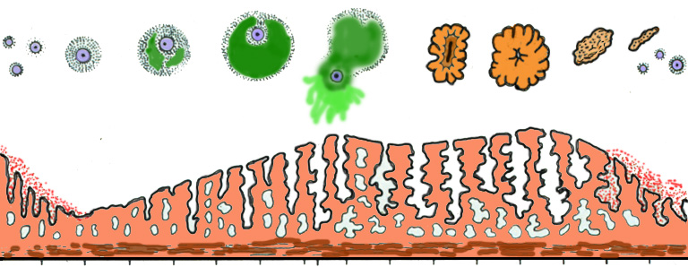
Anterior Pituitary Hormones
LH
FSH
Progesterone
Ovarian Hormones
Estradiol
Ovulation
Corpus
Albicans
Follicle
Corpus Luteum
Ovary
Recruitment
Dominance
Recruitment
Selection
Uterine
Endo-
metrium
2
4
6
8
10
12
14
16
18
20
22
24
26
28
2

Slide 31
Luteolysis in the Primate
Does not require the uterus
CL lifespan in the human is 12-14 days unless pregnancy occurs
  In the absence of pregnancy, CL self destructs
  Primate CL dependent on LH
  Luteal cells start to die in absence of LH, then produce intra-ovarian PGF_{2α} (oxytocin?) and luteal regression.

Slide 32
Luteolysis in the Primate (cont.)
Menstruation
  Drop in P₄ and E₂
  Endometrial PGF_{2α}, vasoconstriction, necrosis
  Endometrial inflammation and tissue degeneration

Slide 33
Manipulating Ovulation and
Estrous Synchronization
John Parrish

Slide 34
Why Cycle Control?
  Group females for parturition:
    Decrease labor, calving period
    More uniform weaning weights.
  Reduce or eliminate estrus detection.
  Needed for artificial insemination:
Reduce calving season

Slide 35
Manipulating Ovulation
Hormonal induction of ovulation
  PGF_{2α}
  GnRH
  Progestins
Superovulation
  FSH
  eCG

Slide 36
Cattle

Slide 37
Principle of PGF_{2α} Use
Regress active corpus luteum
  Only effective on a day 5 - 17 CL
  Not effective on days:
    1 - 4 (CL not responsive)
    18 - 21 (CL already regressed)
    Non-responsive period represents 1/3 of estrous cycle

Slide 38
Estrous Cycle in the Bovine
Progesterone
Ovulation
Follicular Size
Ovulation
9
16
21
Day After Ovulation

Slide 39
Induction of Ovulation with PGF_{2α}
Progesterone
Follicular Size
Ovulation
9
16
21
Day After Ovulation

Slide 40
Induction of Ovulation with PGF_{2α}
Progesterone
Follicular Size
PGF2α
Ovulation
9
16
21
Day After Ovulation

Slide 41
Induction of Ovulation with PGF_{2α}
Progesterone
Follicular Size
PGF2α
Ovulation
9
16
21
Day After Ovulation

Slide 42
Induction of Ovulation with PGF_{2α}
Progesterone
Follicular Size
PGF2α
Ovulation
9
16
21
Day After Ovulation

Slide 43
Induction of Ovulation with PGF_{2α}
Progesterone
Follicular Size
Works on CL
Ovulation time dependent on status of follicular wave
PGF2α
Ovulation
9
16
21
Day After Ovulation

Slide 44
Principle of GnRH Use
Luteinize or Ovulate a dominant follicle
  Terminates the current follicular wave
    Inhibin and Estradiol decrease
    FSH increases to “recruit” a new follicular wave
  No effect on old CL if present
  A dominant follicle must be present
  Generally followed by PGF_{2α} to regress CL formed or old CL

Slide 45
Principle of GnRH Use
Induce ovulation of a dominant follicle
  Used for timed AI
  No CL present
  Dominant follicle must be present

Slide 46
Ovsynch
GnRH
PGF2α
GnRH
Timed AI
7 Days
36 - 48 hours
8 - 18 hours
Eliminate current follicular wave
Luteolysis
Ovulates dominant follicle
Dairy - OK
Beef – Better with presynch or co-synch protocols
Notes:
Both principles of gnrh use in ovsych.

Slide 47
Ovsynch
Progesterone
Ovulation
Follicular Size
Dominance
Selection
Recruitment
Ovulation
9
16
21
Day After Ovulation

Slide 48
Ovsynch
Progesterone
Follicular Size
GnRH
Ovulation
9
16
21
Day After Ovulation

Slide 49
Ovsynch
Progesterone
Follicular Size
GnRH
Ovulation
9
16
21
Day After Ovulation

Slide 50
Ovsynch
Progesterone
Follicular Size
PGF_{2α}
GnRH
Ovulation
9
16
21
Day After Ovulation

Slide 51
Ovsynch
Progesterone
AI
Follicular Size
PGF_{2α}
GnRH
GnRH
Ovulation
9
16
21
Day After Ovulation

Slide 52
Ovsynch
GnRH
PGF2α
GnRH
Timed AI
7 Days
36 - 48 hours
8 - 18 hours
Eliminate current follicular wave
Luteolysis
Ovulates dominant follicle

Slide 53
Ovsynch Problems
Works best on animals that are near day 7 of the cycle at 1st GnRH
  Presynch
    PG, 14 days, PG, 10 days, Ovsynch
    G, 7 days, PG, 3 days, G, 7 days, Ovsynch (double Ovsynch)
    G, 7 days, PG, 11 days, Ovsynch
    G, 7 days, Ovsynch (GGPG)
    PG, 3 days, G, 7 days, Ovsynch (PG-3-G)

Slide 54
Use of Progestogens
Principle
  Provides progesterone
  Simulates a CL (not stimulate)
  Prevents ovulation
  Has no effect on the animal’s CL (ie. normal lifespan)
    Does not regress the CL!!!!
  Remove after animal’s CL regresses
    Current or next follicular wave will ovulate!!!!
    Occurs 2 – 5 days latter
    May use PGF_{2α} to regress animal’s CL
Administration
  Injection, Feed (MGA), Implant, Control Internal Drug Release (CIDR)

Slide 55
P₄ following CIDR Insertion
8
6
P₄ plasma level (ng/ml)
4
2
1
2
3
4
Hours

Slide 56
P₄ During Presence of CIDR
8
6
P₄ plasma level (ng/ml)
Removal of CIDR
4
2
2
4
6
8
Time (Days)

Slide 57
Normal Cycle
Progesterone
Follicular Size
Ovulation
9
16
21
Day After Ovulation

Slide 58
Normal Cycle
Follicular Size
CL Prog.
Ovulation
9
16
21
26
Day After Ovulation

Slide 59
CIDR
CIDR Prog.
Follicular Size
CL Prog.
Ovulation
9
16
21
26
Day After Ovulation

Slide 60
Co-Synch + CIDR
GnRH
GnRH
PGF_{2α}
AI
CIDR
60 ± 6 hrs
0
7
10
Treatment Day
Cows that come into estrus on day of AI have higher conception rates!

Slide 61
Select Synch + CIDR + TAI
GnRH
GnRH
PGF_{2α}
AI
CIDR
72 - 80 hrs
Heat Detect & AI
0
7
10
Treatment Day

Slide 62
Superovulation

Slide 63
Progestens Effect on Ovulation
Ovulation
Ovulation
Progesterone
From C.L.
Estrus
Estrus
0
17
21
Follicular Wave
Follicular Wave
Follicular Wave

Slide 64
Stimulating Follicular Development
eCG
or
FSH
Multiple
Ovulations
Ovulation
Estrus
Estrus
Progesterone
From C.L.
eCG or
FSH
PGF_{2α}
17
Estrus
Estrus
Progesterone.
First Follicular
Wave
10-12

Slide 65
Sheep
Progestin
  CIDR
  In season - works alone
  Out of season - requires eCG
Prostaglandin
  Only works in season
Lights - decrease day length
Melatonin - give orally or IM

Slide 66
Swine
Prostaglandin
  Not of practical
  Only effect days 12 - 17
Progestins - Altrenogest (Matrix)
  MGA causes ovarian cysts
  Regumate (oral) for 18 days
    Cost is $5 - $10/day
Wean Piglets
Puberty Induction - PG600 (eCG + HCG)

Slide 67
Equine
Prostaglandin
  Mare CL more sensitive than cow’s
  Only effective in season
HCG – ovulation induction, >35 mm follicle
Progestins
  Altrenogest (Regumate)
  Only effective in season
  Reduce estrus behavior in competition animals
Light
  16 hrs day light for 60 - 90 days.

