Slide 1
Animal Science 434
The Follicular Phase of the Estrous Cycle

Slide 2
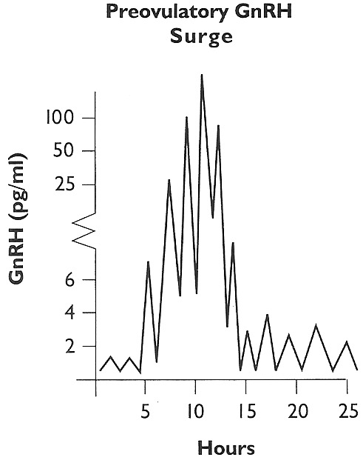
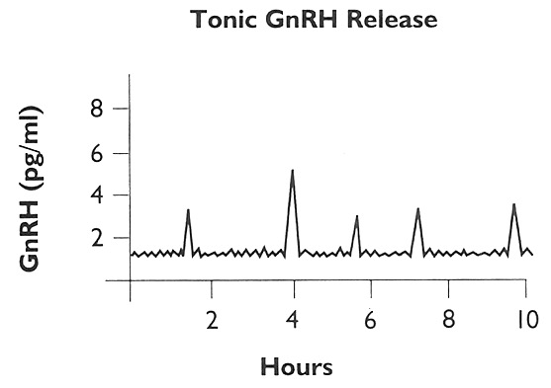
Tonic and Preovulatory Surge of GnRH
Preovulatory GnRH Surge
Tonic GnRH Release
GnRH (pg/ml)
GnRH (pg/ml)
Hours
Hours

Slide 3
Hypothalamus
Progesterone
Estradiol
(-)
(-)
GnRH
Anterior
Pituitary
LH, FSH
Inhibin (-)
Estradiol
LH
LH, FSH
CL
Follicle
Ovary

Slide 4
Tonic and Preovulatory Surge of GnRH
Preovulatory GnRH Surge
Tonic GnRH Release
GnRH (pg/ml)
GnRH (pg/ml)
Hours
Hours

Slide 5
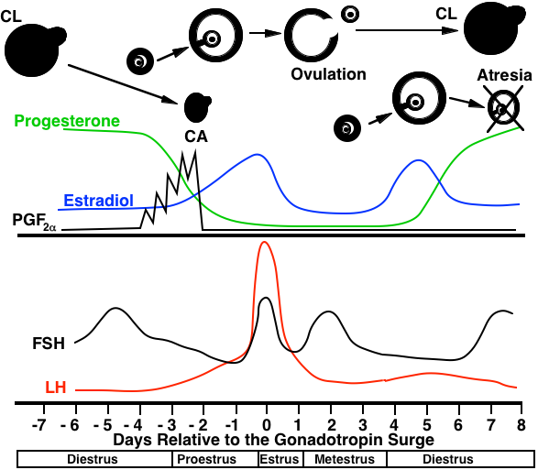
The
Follicular Phase

Slide 6
Hypothalamus
Progesterone
Estradiol
(-)
(-)
GnRH
Anterior
Pituitary
Start of Follicular Phase
Inhibin (-)
LH, FSH
Estradiol
LH
LH, FSH
CL
Follicle
Ovary

Slide 7
Hypothalamus
Estradiol
(-)
GnRH
Anterior
Pituitary
CL Regression
Inhibin (-)
LH, FSH
Estradiol
LH, FSH
Follicle
Ovary

Slide 8
Hypothalamus
Estradiol
(+)
GnRH
Anterior
Pituitary
Ends in LH surge and ovulation
LH, FSH
Inhibin (-)
Estradiol
LH, FSH
Follicle
Ovary

Slide 9
The
Follicular Phase

Slide 10
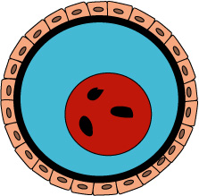
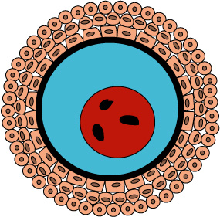
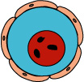
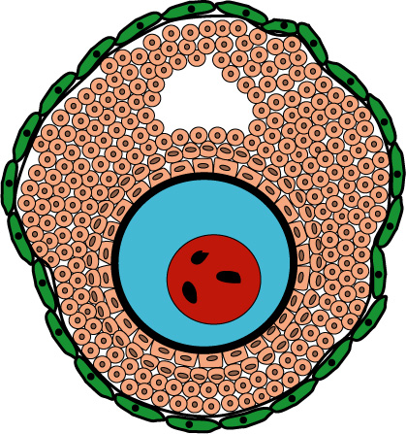
Follicular
Progression
Primary
Primordial
Secondary
Tertiary

Slide 11
Growth and Atresia of Follicles
Atresia

Slide 12
Fate of follicles and oocytes
At birth 100,000
12 months 75,000
4-6 years 21,000
Aged cow 2,500
Follicles undergo atresia at all stages of development.
Maximum number of oocytes ovulated for a cow
17 cycles/year x 8 year = 136 oocytes ovulated / lifespan
100 Days of Gestation 2.9 million
Superovulation or Ovum Pick-up (OPU) - rescue some
follicles from atresia

Slide 13
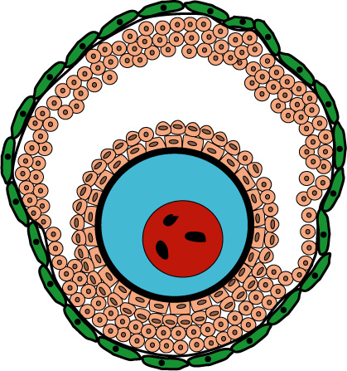
Initial Follicular Growth
Small Antral
Follicle
50 - 60 days
Gonadotropin
Independent
FSH
Recruitment

Slide 14
Follicular Waves in Cattle

Slide 15
Atresia
Follicular Size
Recruitment
Dominance
Ovulation
Selection
FSH Sensitive Pool
Ovulation
9
Day
16
21

Slide 16
Atresia
Progesterone
Follicular Size
Recruitment
Dominance
Ovulation
Selection
FSH Sensitive Pool
Ovulation
9
Day
16
21

Slide 17
Progesterone
estradiol
inhibin
FSH
Atresia
Follicular Size
Dominance
FSH estradiol (-)
inhibin (-)
Selection
FSH estradiol (-)
inhibin (-)
Recruitment
FSH estradiol (-)
Ovulation
9
Day
16
21

Slide 18
Progesterone
Follicular Size
Atresia
Dominance
Selection
Recruitment
Ovulation
9
Day
16
21

Slide 19
Progesterone
Follicular Size
Ovulation
9
Day
16
21

Slide 20
Progesterone
Follicular Size
Ovulation
9
Day
16
21

Slide 21
Progesterone
Ovulation
Follicular Size
Dominance
Selection
Recruitment
Ovulation
9
Day
16
21

Slide 22
Two Follicular Waves

Slide 23
Progesterone
Follicular Size
Dominance
Atresia
Ovulation
Selection
Recruitment
Day
Ovulation
10
21

Slide 24
Follicular Wave Emergence
Recruitment = Emergence
FSH always controls emergence
Increase in FSH precedes emergence

Slide 25
Species Variation in Follicular Waves
Cattle - 2 or 3 / cycle
Sheep - 4 or 5 / cycle
Pigs - 1 / cycle
Horses - 1 / cycle
Human - 1 / cycle
Cl-progesterone
Cl-progesterone, inhibin
If first wave stops/fails, then a second wave emerges!!!

Slide 26
Gonadotropin Action Within the Follicle

Slide 27
Antral Follicle
Theca Internal
Granulosa

Slide 28
Theca Interna
LH
Receptor
cAMP
Cholesterol
FSH
PKA
Receptor
Testosterone
cAMP
Blood
Test.
PKA
Estradiol
Granulosa

Slide 29
Theca Interna
Selection
LH
Dom. Foll.
Express LH Receptor
Receptor
cAMP
LH
Cholesterol
FSH
Receptor
PKA
Receptor
Testosterone
cAMP
cAMP
Blood
Test.
PKA
Estradiol
Granulosa

Slide 30
Ovulation

Slide 31
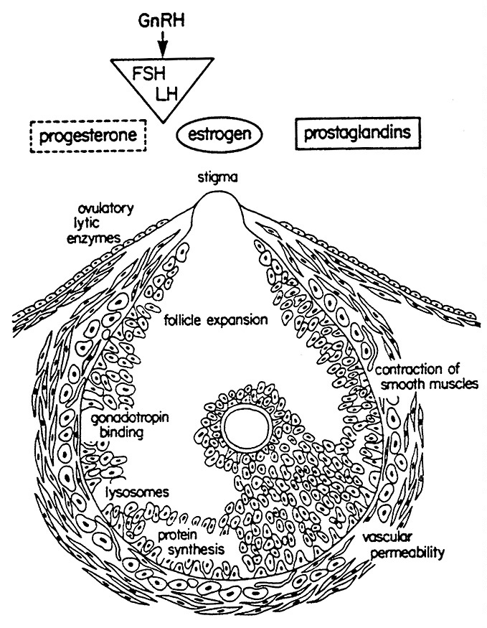
Germinal Epithelium
Tunica Albuginea
Theca Externa
Theca Interna
Basement Membrane
Granulosa

Slide 32
Blocking of these events in the
follicle prevents ovulation.
protein synthesis
steroid synthesis
prostaglandin synthesis
plasminogen activator synthesis

Slide 33
Preovulatory LH Surge
Cumulus
Expansion
Oocyte
Separates
From
Follicular
Wall
Ovulation

Slide 34
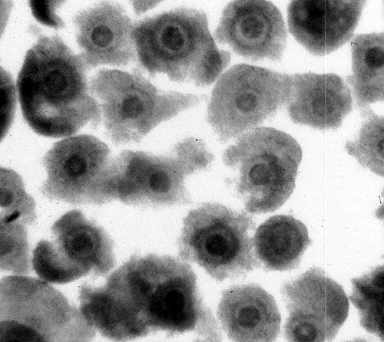
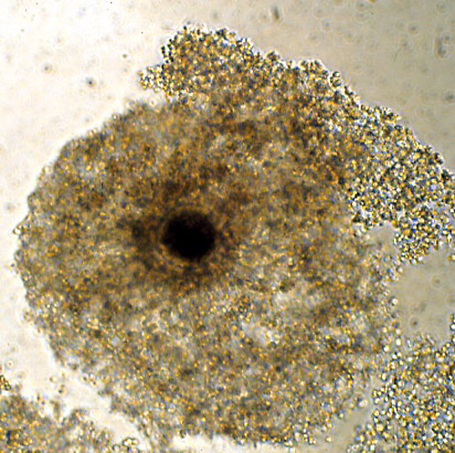
Cumulus Expansion
Hyaluronic Acid
and Protein Production
Unexpanded
Expanded

Slide 35
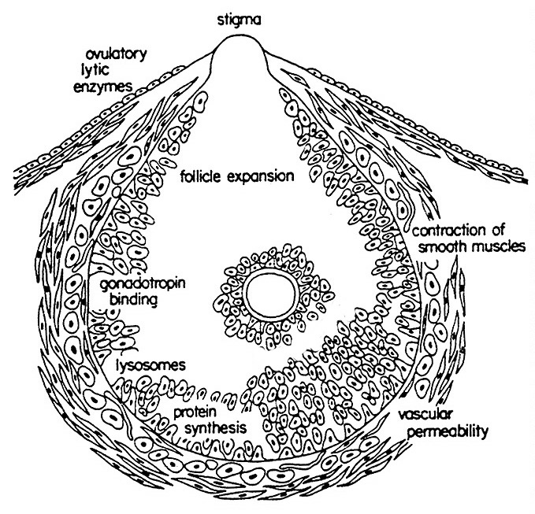
Cumulus and Oocyte
Separation

Slide 36
Preovulatory LH Surge
Cumulus
Expansion
Protein synthesis changes
in and around Follicle
Progesterone
Plasminogen
Activator
Prostaglandin Synthesis
PGE and PGF
Oocyte
Separates
From
Follicular
Wall
Ovulation

Slide 37
Preovulatory LH Surge
Histamine, PGE₂
Increased Blood
Flow to Ovary and
Follicle
Cumulus
Expansion
Protein synthesis changes
in and around Follicle
Progesterone
Plasminogen
Activator
Prostaglandin Synthesis
PGE and PGF
Vascular Permeability
Oocyte
Separates
From
Follicular
Wall
Plasminogen
Edema
Ovulation
Foll. pressure

Slide 38
Preovulatory LH Surge
Histamine, PGE₂
Increased Blood
Flow to Ovary and
Follicle
Cumulus
Expansion
Protein synthesis changes
in and around Follicle
Progesterone
Plasminogen
Activator
Prostaglandin Synthesis
PGE and PGF
Vascular Permeability
Oocyte
Separates
From
Follicular
Wall
Collagen. (inact.)
Plasmin
Plasminogen
Collagenase (act.)
Follicular Wall Weakens
Edema
Ovulation
Foll. pressure

Slide 39
Preovulatory LH Surge
Histamine, PGE₂
Increased Blood
Flow to Ovary and
Follicle
Cumulus
Expansion
Protein synthesis changes
in and around Follicle
Progesterone
Plasminogen
Activator
Prostaglandin Synthesis
PGE and PGF
Vascular Permeability
Oocyte
Separates
From
Follicular
Wall
Collagen. (inact.)
Plasmin
Plasminogen
Collagenase (act.)
Follicular Wall Weakens
Contraction
Sm. Muscle
Edema
Ovulation
Foll. pressure

Slide 40
Types of Ovulators

Slide 41
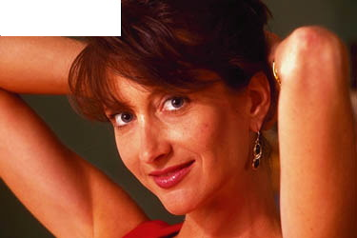
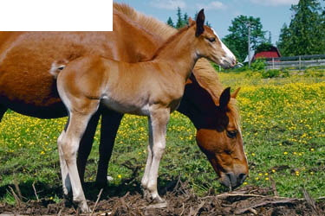
Spontaneous Ovulators

Slide 42
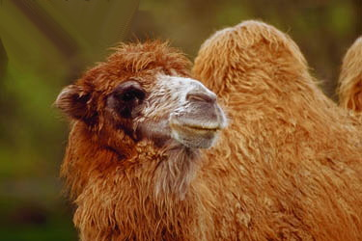
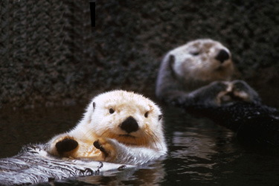
Induced Ovulators

Slide 43
Induced Ovulators
Nerve endings sensing copulation
Sensory Neurons
Copulation
Penis

Slide 44
Hypothalamus
Blood LH
LH
GnRH
Time (hr)
Stimulation
Posterior Pit.
Anterior Pit.
Spinal Chord

Slide 45
Induced Ovulators
LH
Nerve endings sensing copulation
Sensory Neurons
Copulation
Penis

Slide 46
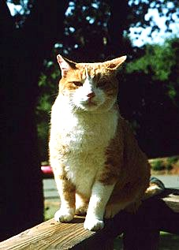
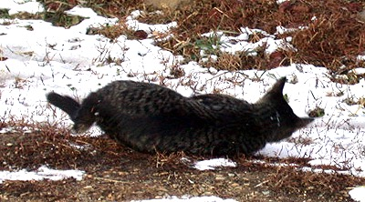
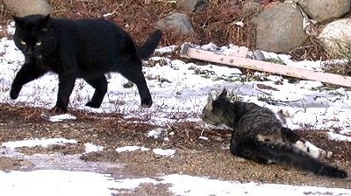
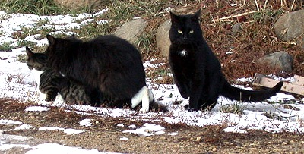
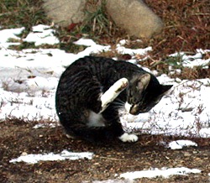
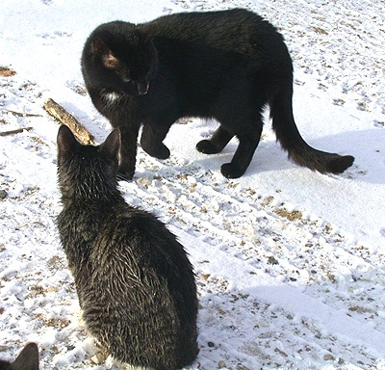
Cats
Induced Ovulators
Single copulation
  Only works 50% of the time
Multiple copulations
  Higher LH surge

Slide 47
Spontaneous Ovulators
Retain some neural control of ovulation
  heifers can alter the timing of the LH surge by clitoral stimulation
  human rape cases result in higher than expected pregnancy rates

Slide 48
Oogenesis
Primordial Germ Cells
Move to germinal ridge
Mitotic divisions
Oogonia
Follicle Cells
Meiosis
Interphase
DNA synthesis
Meiotic prophase
Primary Oocyte
Prophase of Meiosis
  Leptotene, Zygotene
  Pacytene, Diplotene
  Dictyotene
Meiotic Arrest

Slide 49
Gonadotropin
Independent
Growth
zona pellucida formation
mRNA production
Protein synthesis
Cortical granule formation
Gonadotropin
Dependent
nuclear maturation
cytoplasmic maturation
Remains primary oocyte until LH surge

Slide 50
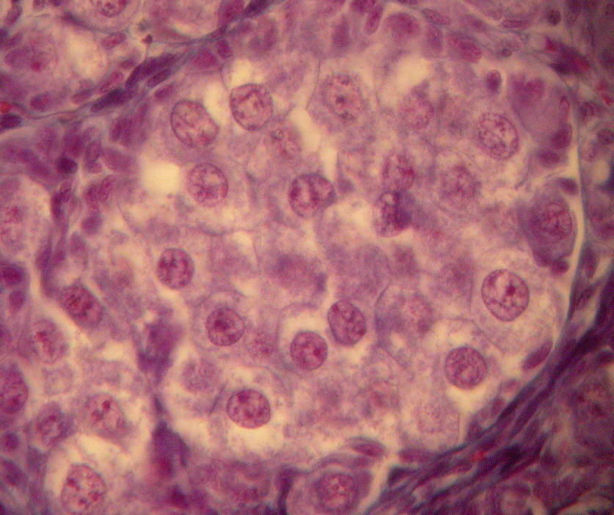
Oogonia in Egg Nest
Fetal Pig Ovary

Slide 51
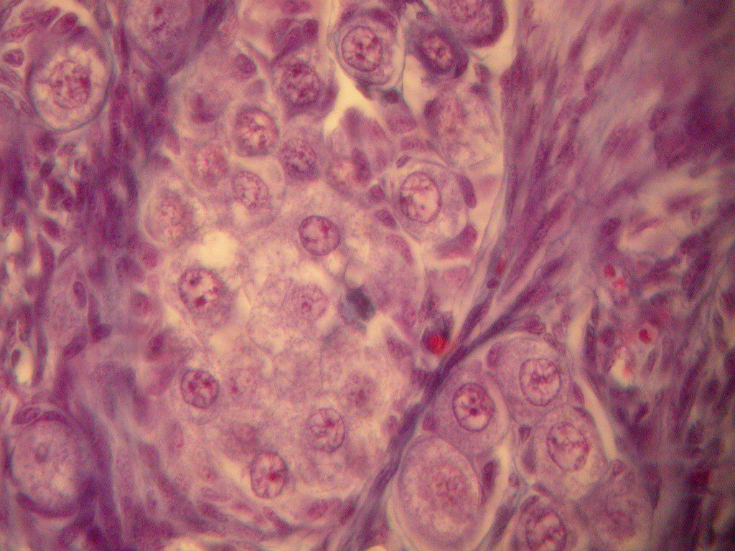
Oogonia
Primary Oocytes

Slide 52
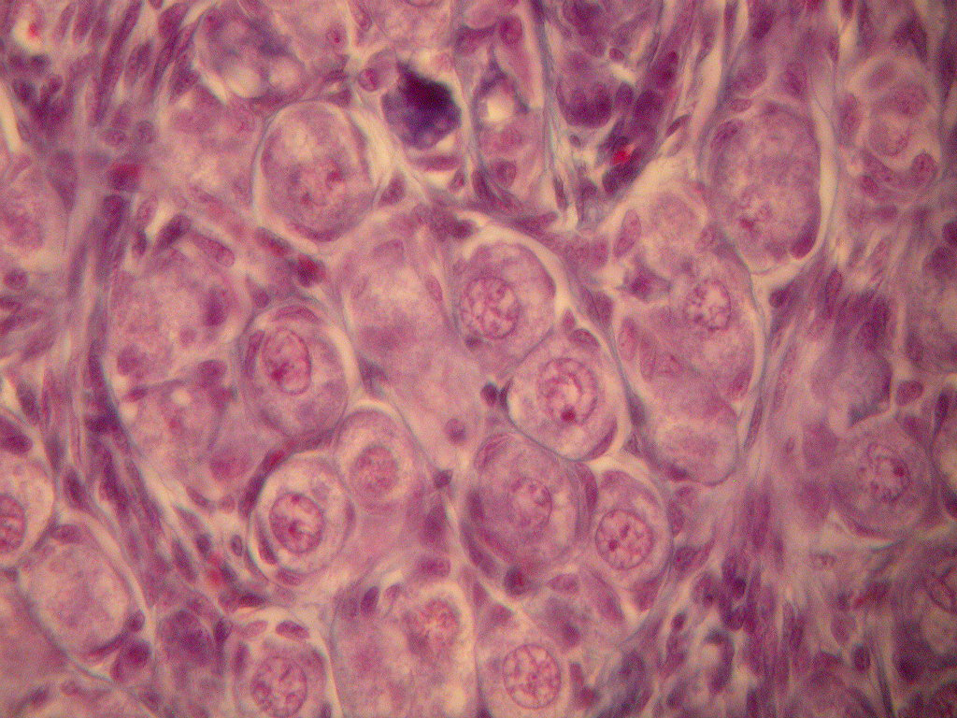
Primary Oocytes in Primordial Follicles

Slide 53
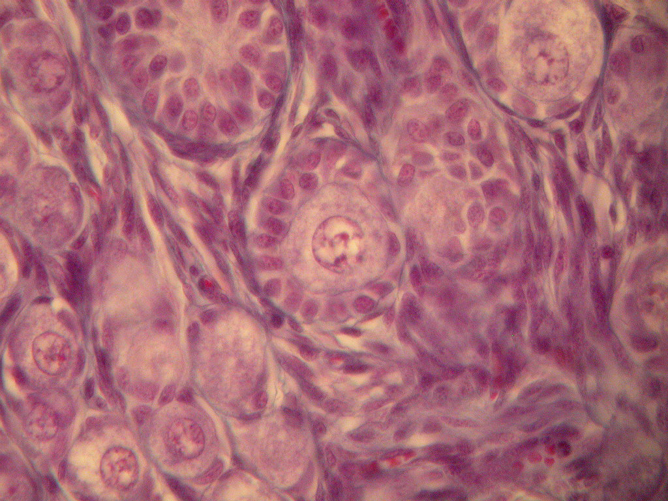
Primary Oocyte in Primary Follicle

Slide 54
Fetal Oocyte Development
Mitosis
Meiosis
Fertilization
Birth
Cow
280 d
Sow
114 d
Mouse
19 d

Slide 55
Ovulation of Tertiary Follicle

Slide 56
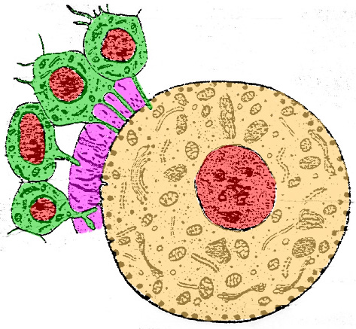
Formation of the Zona Pellucida
Corona Radiata
Zona Pellucida
Oocyte

Slide 57
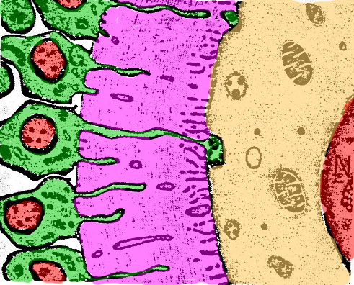
Corona Radiata
Zona Pellucida
Oocyte
Gap Junctions

Slide 58
During Oocyte Growth and Before the LH Surge
cAMP
OMI - Oocyte Maturation Inhibitor
MPF - Maturation promoting factor
GV - germinal vesicle
(nucleus)
OMI
cAMP
GV
PKA
pre-MPF
MPF
Gap Junctions Allow Cell to Cell Communication!

Slide 59
The LH Surge
Gap Junctions are Destroyed!

Slide 60
The LH Surge
cAMP
Resumption
of Meiosis
GVBD
PKA
GV
pre-MPF
MPF
Gap Junctions are Destroyed!

Slide 61
Resumption of Meiosis
First polar body emitted,
arrest at metaphase II
LH Surge
4N
4N
2N
Secondary
Oocyte
Ovulation
Primary Oocyte
(most
species)
N
N
2N
Zygote
(pronucleate egg)
Sperm Penetration

Slide 62
Resumption of Meiosis
First polar body emitted,
arrest at metaphase II
LH Surge
4N
4N
2N
Ovulation
Sperm Pen.
Dog, Fox
Secondary
Oocyte
Primary Oocyte
(most
species)
Ovulation
Dog, Fox
N
N
2N
Zygote
(pronucleate egg)
Sperm Penetration

