Slide 1
Animal Science 434
Reproductive Cycles in the Female

Slide 2
Terminology
Estrus is a noun.
  The cow is displaying estrus.
Estrous is an adjective.
  The length of the estrous cycle is 21 days.
Oestrus and Oestrous
  British and European spellings
Estrus and Heat are synonymous

Slide 3
Terminology (cont.)
Anestrus
  When the female is not having repeated estrous cycles.

Slide 4
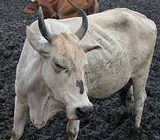
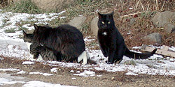
Types of Cyclicity
Polyestrus
Queen
Cow
Sow
Relative E₂
J
F
M
A
M
J
J
A
S
O
N
D

Slide 5
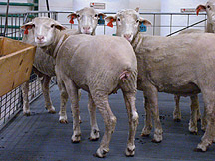
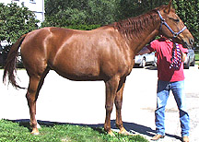
Types of Cyclicity
Seasonally
Polyestrus
Short day breeders
(Fall)
Long day breeders
(Spring)
Relative E₂
Relative E₂
J
F
M
A
M
J
J
A
S
O
N
D
J
F
M
A
M
J
J
A
S
O
N
D

Slide 6
Type of Cyclicity
Monoestrus
Dog
Wolf
Bear
Relative E₂
J
F
M
A
M
J
J
A
S
O
N
D

Slide 7
Average Reproductive Cycles
Species Length of Length of Ovulation Length of
Estrous Cycle Estrus Pregnancy
cow 21 days 18 hr 11 hr after 282 days
polyestrus end estrus
ewe 17 days 29 hr near end 148 days
seasonal (fall) estrus
sow 21 days 48-72 hr 35-45 hr 115 days
polyestrus after start
estrus
mare 21 days 4-8 days 3-6 day of 335 days
seasonal (spring) estrus
polyestrus (1-2 days
before end of
estrus)

Slide 8
Average Reproductive Cycles
Species Length of Length of Ovulation Length of
Estrous Cycle Estrus Pregnancy
Bitch 6 months 9 days 4 - 24 days 63 days
after start of estrus
Queen 17 days 9 days Induced 63 days

Slide 9
Variation in Cycle Types
Example Type of Follicular Ovulation & CL
Cycle Development CL Formation Function
Cow, ewe, Long Spontaneous Spontaneous Spontaneous
sow, mare
rats, mice, Short Spontaneous Spontaneous Induced
hamsters (4 days) (prolactin)
rabbit, cat, Induced Spontaneous Induced Induced
mink, ferret, (LH surge)
otter, alpaca

Slide 10





CL
Ovulation
CA
Progesterone
PGF
2
α
Estradiol
FSH
LH
-7
- 6
- 5
- 4
- 3
- 2
-1
0
1
2
3
4
5
6
7
8
Days Relative to the Gonadotropin Surge
Diestrus
Proestrus
Estrus
Metestrus
Diestrus

Slide 11
Phases of the Estrous Cycle
Follicular Phase
Luteal Phase

Slide 12
CL
Ovulation
CA
Progesterone
PGF
2
α
Follicular Phase
Estradiol
FSH
LH
-7
- 6
- 5
- 4
- 3
- 2
-1
0
1
2
3
4
5
6
7
8
Days Relative to the Gonadotropin Surge
Diestrus
Proestrus
Estrus
Metestrus
Diestrus

Slide 13
CL
Ovulation
CA
Progesterone
PGF
2
α
Estradiol
Luteal Phase
Luteal Phase
FSH
LH
-7
- 6
- 5
- 4
- 3
- 2
-1
0
1
2
3
4
5
6
7
8
Days Relative to the Gonadotropin Surge
Diestrus
Proestrus
Estrus
Metestrus
Diestrus

Slide 14
Stages of the Estrous Cycle
Proestrus
Estrus
Metestrus
Diestrus

Slide 15
CL
Ovulation
CA
Progesterone
PGF
2
α
Estradiol
FSH
LH
-7
- 6
- 5
- 4
- 3
- 2
-1
0
1
2
3
4
5
6
7
8
Days Relative to the Gonadotropin Surge
Diestrus
Proestrus
Estrus
Metestrus
Diestrus

Slide 16
CL
Ovulation
CA
Progesterone
PGF
2
α
Estradiol
FSH
LH
-7
- 6
- 5
- 4
- 3
- 2
-1
0
1
2
3
4
5
6
7
8
Days Relative to the Gonadotropin Surge
Diestrus
Proestrus
Estrus
Metestrus
Diestrus

Slide 17
CL
Ovulation
CA
Progesterone
PGF
2
α
Estradiol
FSH
LH
-7
- 6
- 5
- 4
- 3
- 2
-1
0
1
2
3
4
5
6
7
8
Days Relative to the Gonadotropin Surge
Diestrus
Proestrus
Estrus
Metestrus
Diestrus

Slide 18
CL
Ovulation
CA
Progesterone
PGF
2
α
Estradiol
FSH
LH
-7
- 6
- 5
- 4
- 3
- 2
-1
0
1
2
3
4
5
6
7
8
Days Relative to the Gonadotropin Surge
Diestrus
Proestrus
Estrus
Metestrus
Diestrus

Slide 19
CL
Ovulation
CA
Progesterone
PGF
2
α
Estradiol
FSH
LH
-7
- 6
- 5
- 4
- 3
- 2
-1
0
1
2
3
4
5
6
7
8
Days Relative to the Gonadotropin Surge
Diestrus
Proestrus
Estrus
Metestrus
Diestrus

Slide 20
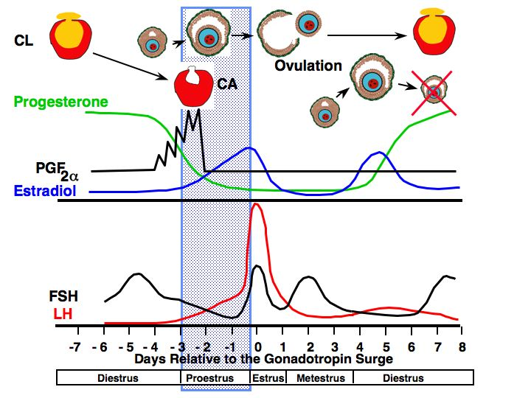
Follicular Phase
Proestrus
  Preovulatory follicle enlarges
  estrogen increases
  vascularity of the female reproductive tract increases
  endometrial glands begin to grow
  estrogen levels peak

Slide 21
CL
Ovulation
CA
Progesterone
PGF
2
α
Estradiol
FSH
LH
-7
- 6
- 5
- 4
- 3
- 2
-1
0
1
2
3
4
5
6
7
8
Days Relative to the Gonadotropin Surge
Diestrus
Proestrus
Estrus
Metestrus
Diestrus

Slide 22
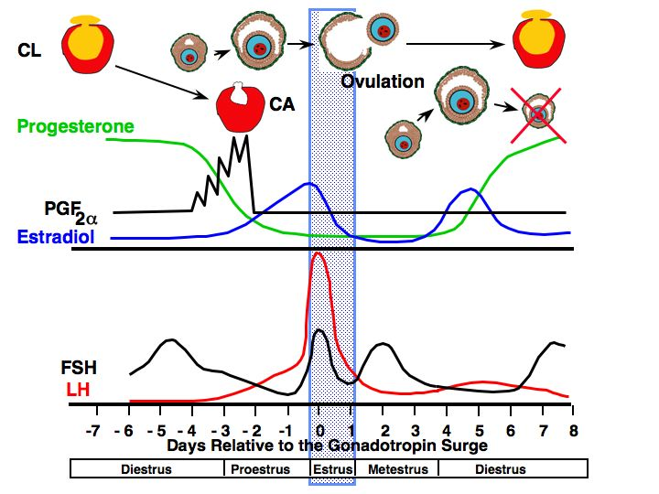
Follicular Phase
Estrus
  allows male to mount
  estrogen decreases
  LH surge occurs
  ovulation 24-48 hr after surge of LH
  uterine motility high with contractions moving toward oviduct
  sperm transport is optimal
  cervical mucus volume increases

Slide 23
CL
Ovulation
CA
Progesterone
PGF
2
α
Estradiol
FSH
LH
-7
- 6
- 5
- 4
- 3
- 2
-1
0
1
2
3
4
5
6
7
8
Days Relative to the Gonadotropin Surge
Diestrus
Proestrus
Estrus
Metestrus
Diestrus

Slide 24
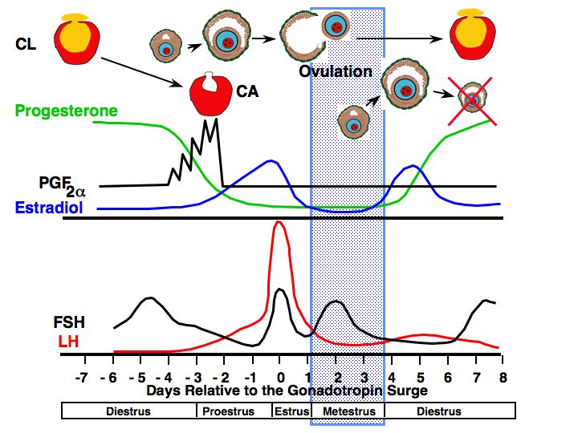
Luteal Phase
Luteal Phase
Metestrus
  estrogen low
  ovulation in cow
  corpus hemorrhagicum present
  uterus
    contractions subside
    endometrial glands continue to grow and become coiled
    in cattle bleeding occurs
  FSH increases
    triggering growth of follicles

Slide 25
CL
Ovulation
CA
Progesterone
PGF
2
α
Estradiol
FSH
LH
-7
- 6
- 5
- 4
- 3
- 2
-1
0
1
2
3
4
5
6
7
8
Days Relative to the Gonadotropin Surge
Diestrus
Proestrus
Estrus
Metestrus
Diestrus

Slide 26
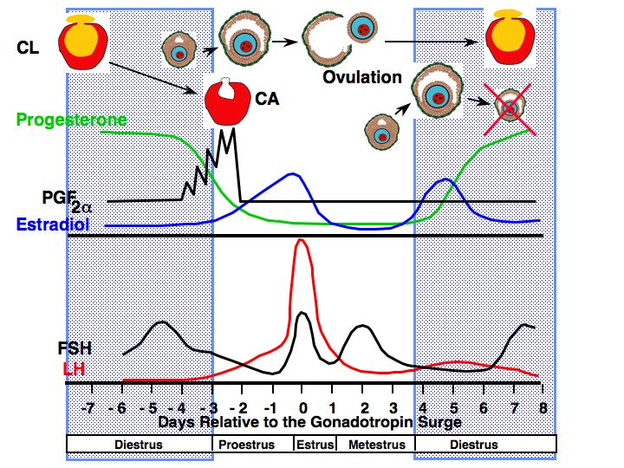
Luteal Phase
Luteal Phase
Diestrus
  progesterone high
  FSH
    Increases at some point to cause growth of ovulatory follicle
  Uterus
    Endo-gland secrets fluid but volume gradually decreases
    contraction stop
    CL regresses at the end of this period if female is not pregnant due to PGF release

Slide 27
Characteristics of Estrous Cycles
  Cow Ewe Sow Mare
  Estrous cycle (days) 21 17 21 21
  Proestrus (days) 3-4 2-3 3-4 2-3
  Estrus 12-18 hr 24-36 hr 48-72 hr 4-8 days
  Metestrus (days) 3-4 2-3 2-3 2-3
  Diestrus (days) 10-14 10-12 11-13 10-12

Slide 28
Hormonal Changes in the Bitch
Estrus
Proestrus
Anestrus
Progesterone
LH
Ovulation
FSH
E₂
-20
0
10
20
Days

Slide 29
Heat
20 day
Metestrus I
Metestrus II 70 days
Progesterone
Parturition
E₂
Prolactin
-20
0
20
40
60
80
Day of Metestrus

Slide 30
Hormonal Changes in the Queen
Queen in Estrus
(no mating)
Estrus
(9 days)
E₂
E₂
P₄
P₄
4
8
12
16
4
8
12
16
20
Weeks

Slide 31
Hormonal Changes in the Queen
Queen in Estrus
(no mating)
Estrus
E₂
E₂
P₄
Proestrus
(8 days)
P₄
4
8
12
16
4
8
12
16
20
Weeks

Slide 32
Hormonal Changes in the Queen
Queen in Estrus
(no mating)
Mating
Estrus
Parturition
Pregnancy
Lactation
E₂
E₂
P₄
Proestrus
P₄
4
8
12
16
4
8
12
16
20
Weeks

Slide 33
Causes of Anestrus
Pregnancy
Presence of Offspring
Season
Pathology
Nutrition
Stress

Slide 34
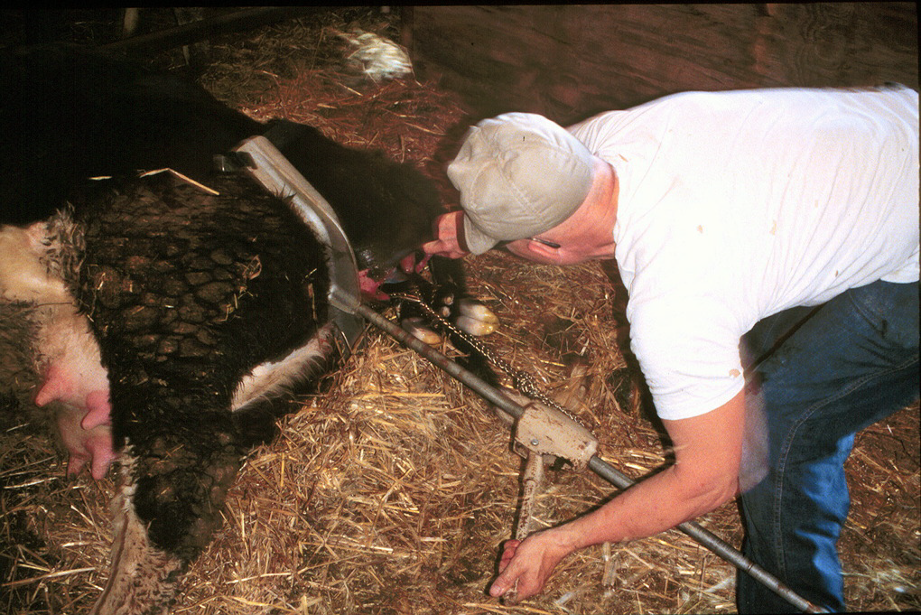
Gestational Anestrus

Slide 35
Gestational Anestrus
Progesterone during pregnancy
  negative feedback
After parturition anestrus continues
  progesterone exposure during pregnancy
  hypothalamus
    Lacks estradiol positive feedback
allows time for uterine involution

Slide 36
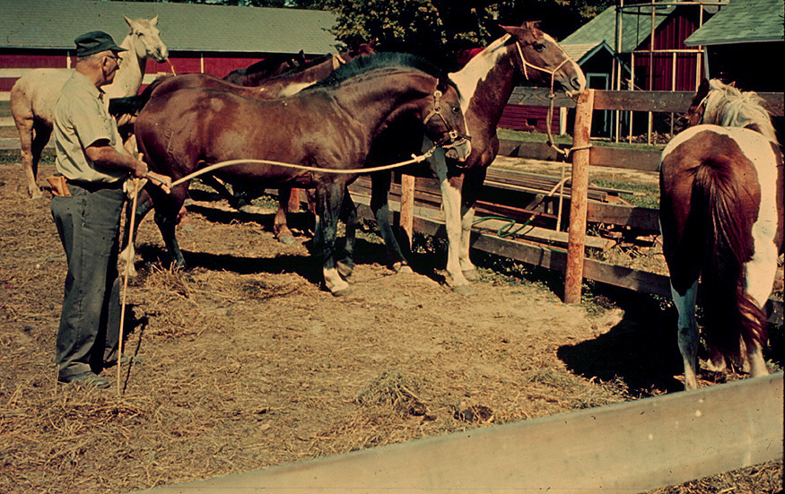
Seasonal Anestrus
Horses are long day breeders!

Slide 37
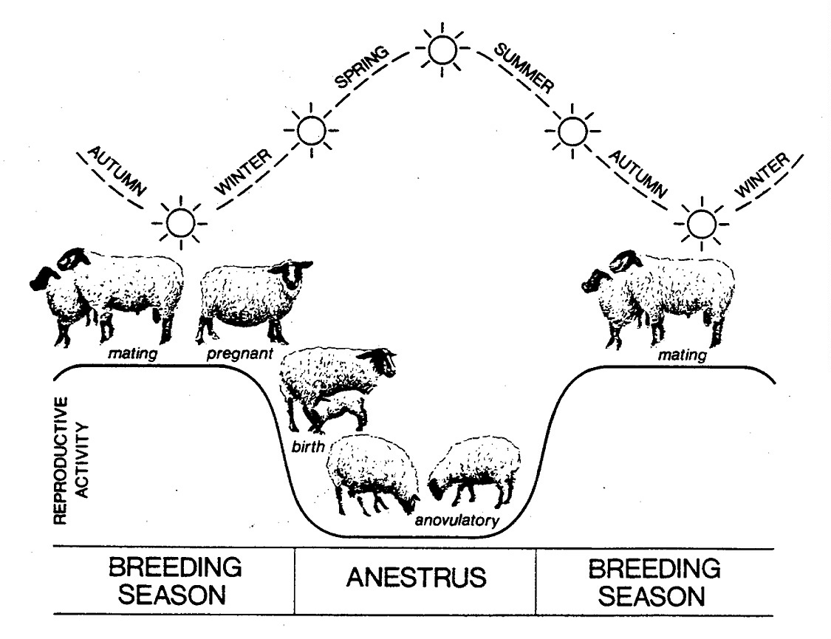
Sheep are short day breeders!

Slide 38
Seasonal Anestrus
just like entering puberty
silent ovulation

Slide 39
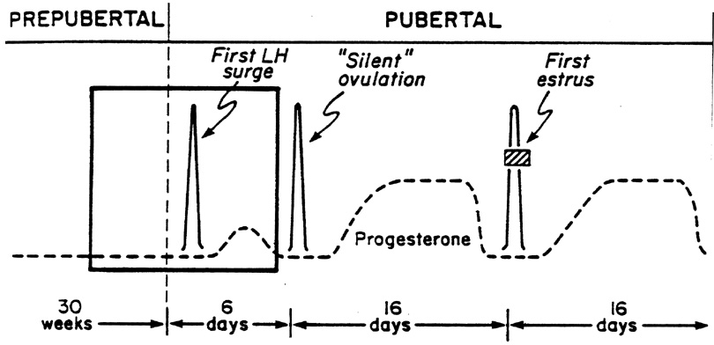
Silent Ovulation after Anestrus
Anestrus
Estrus
Primes
Hypothalamus
Brain (hypothalamus) must be primed with Progesterone
To Express Estrus in Response to Estrogen

Slide 40
Light
Pineal Gland
Eye
Night
Day
Hypothalamus
No Melatonin
Melatonin
Superior Cervical Ganglion
Long Days = Short nights = low melatonin
Short Days = Long nights = high melatonin

Slide 41
Long Days
Short Days
Melatonin
Melatonin
+
-
-
+
Mare
Ewe
Mare
Ewe
Kiss
Neurons
Kiss
Neurons
Kiss
Neurons
Kiss
Neurons
GnRH
GnRH
GnRH
GnRH
Cyclicity
Anestrus
Anestrus
Cyclicity

Slide 42
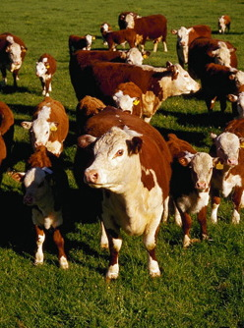
Lactational Anestrus

Slide 43
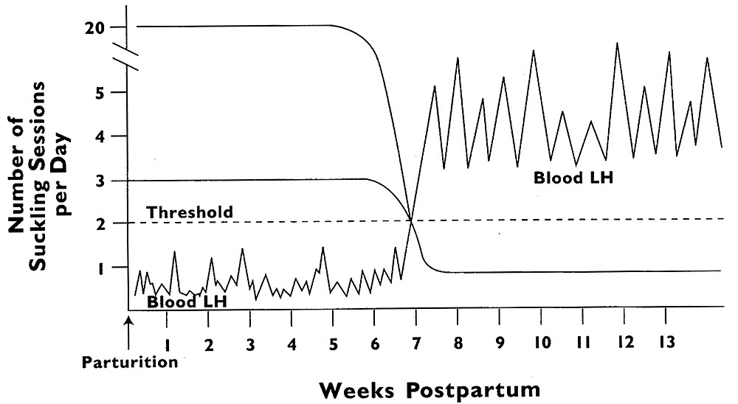
Suckling Effect on LH
Anestrus
Cyclicity

Slide 44
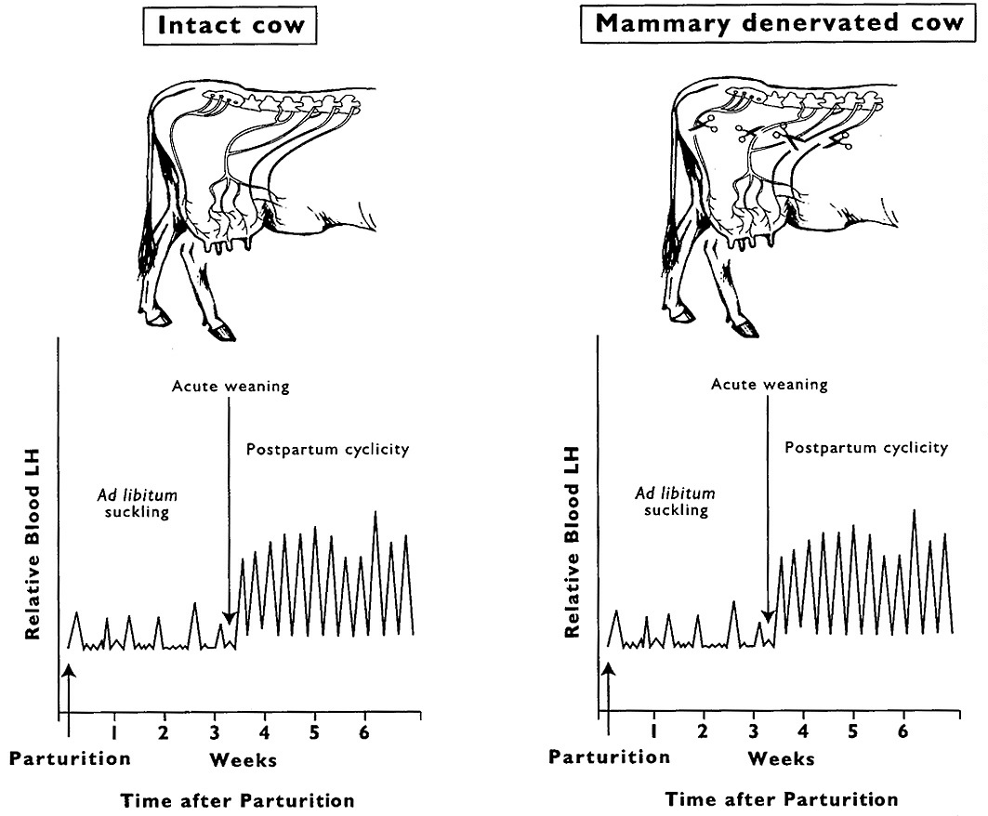

Slide 45
Lactational Anestrus
Suckling
Other offspring factors
  visual encounter
  olfactory encounter
  auditory encounter
Prolactin
  inhibits GnRH release
  major infertility problem in women who are not lactating

Slide 46
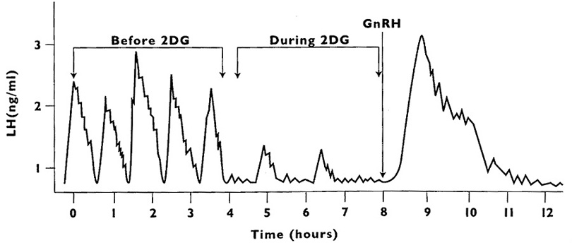
Nutritional Anestrus

Slide 47
Menstrual Cycle

Slide 48
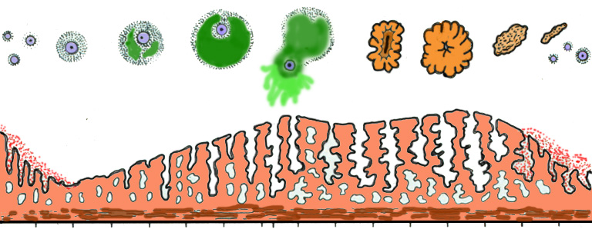
Anterior Pituitary Hormones
LH
FSH
Progesterone
Ovarian Hormones
Estradiol
Ovulation
Corpus
Albicans
Follicle
Corpus Luteum
Ovary
Recruitment
Dominance
Recruitment
Selection
Uterine
Endo-
metrium
2
4
6
8
10
12
14
16
18
20
22
24
26
28
2

Slide 49
Anterior Pituitary Hormones
LH
FSH
Progesterone
Menses
Menses
Ovarian Hormones
Estradiol
Ovulation
Follicle
Corpus Luteum
Ovary
5
days
5
days
Uterine
Endo-
metrium
2
4
6
8
10
12
14
16
18
20
22
24
26
28
2

Slide 50
Anterior Pituitary Hormones
LH
FSH
Progesterone
Ovarian Hormones
Follicular Phase
Estradiol
Ovulation
Follicle
Corpus Luteum
Ovary
9 days
Uterine
Endo-
metrium
2
4
6
8
10
12
14
16
18
20
22
24
26
28
2

Slide 51
Anterior Pituitary Hormones
LH
FSH
Progesterone
Ovarian Hormones
Luteal Phase
Estradiol
Ovulation
Follicle
Corpus Luteum
Ovary
14 days
Uterine
Endo-
metrium
2
4
6
8
10
12
14
16
18
20
22
24
26
28
2

Slide 52
Variation in Menstrual Cycle Length
25-day
cycle
Menses
Foll. Phase
Luteal Phase
Menses
5 days
6 days
14 days
28-day
cycle
Menses
Foll. Phase
Luteal Phase
Menses
5 days
9 days
14 days
35-day
cycle
Menses
Foll. Phase
Luteal Phase
Menses
5 days
16 days
14 days
Ovulation
Breast
Tenderness

Slide 53
Menstural Cycle Length
AGE
  Length
    15 - 19 year olds 35 days
    30 year olds 30 days
    35 year olds 28 days
  Variation
    More in teenagers
    Less in women in peak reproductive years

Slide 54
Influence of Lactation on Postpartum Menstrual Cycles (US and UK, 1987)
Not Lactating
  50% cycling by 8 months
  90% cycling by 12 months
Lactating (for 24 months)
  30% cycling by 12 months
  70% cycling by 24 months

Slide 55
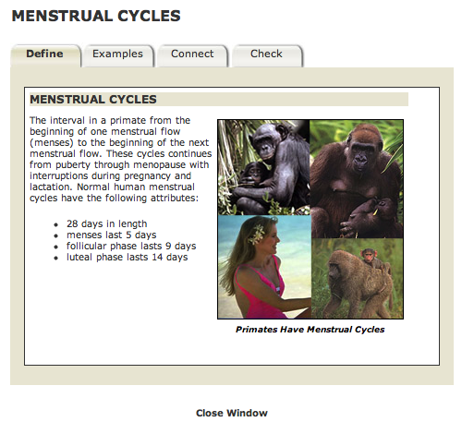
Concept Tutor

Slide 56
Rest are extra slides not normally used

Slide 57
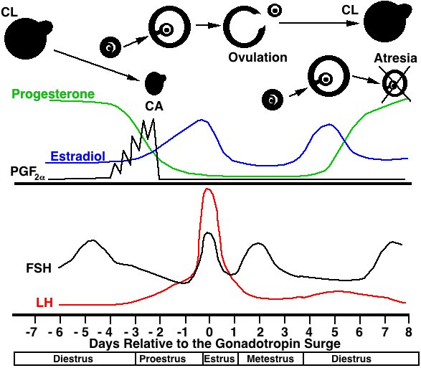

Slide 58
CL
Ovulation
CA
-7
- 6
- 5
- 4
- 3
- 2
-1
0
1
2
3
4
5
6
7
8
Days Relative to the Gonadotropin Surge
Diestrus
Proestrus
Estrus
Metestrus
Diestrus

Slide 59
CL
Ovulation
CA
Estradiol
FSH
LH
-7
- 6
- 5
- 4
- 3
- 2
-1
0
1
2
3
4
5
6
7
8
Days Relative to the Gonadotropin Surge
Diestrus
Proestrus
Estrus
Metestrus
Diestrus

Slide 60
CL
Ovulation
CA
Progesterone
PGF
2
α
Estradiol
FSH
LH
-7
- 6
- 5
- 4
- 3
- 2
-1
0
1
2
3
4
5
6
7
8
Days Relative to the Gonadotropin Surge
Diestrus
Proestrus
Estrus
Metestrus
Diestrus

