Slide 1
Animal Science 434
Reproductive Physiology
Endocrinology: Part B
John Parrish
Professor
Department of Animal Sciences

Slide 2
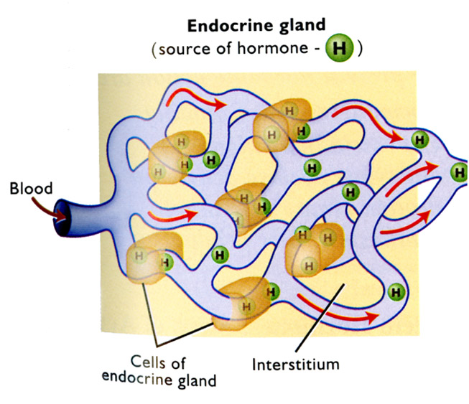
Mechanism of Hormone Action

Slide 3
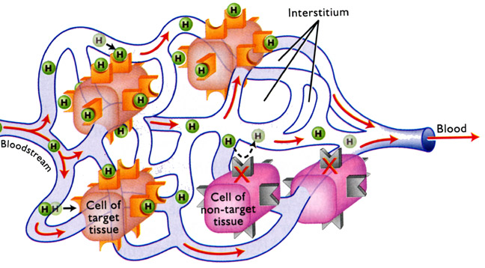
Mechanism of Hormone Action

Slide 4
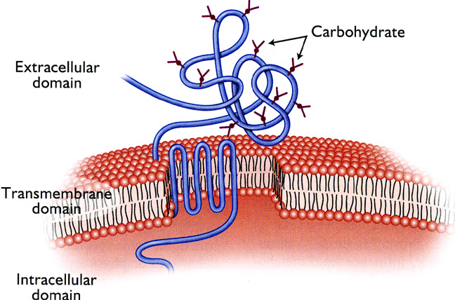
Receptor Structure

Slide 5
Mechanism of Hormone Action
Protein Hormones
(cAMP second messenger)
LH
Receptor
G
Plasma Membrane
Adenylate Cyclase
R
S-ER
Steroid Synthesis
Protein Kinase A
(PKA)
C
Mitochondria
Nucleus
DNA
Protein
R-ER
Protein Synthesis
Synthesis
(Enzymes)

Slide 6
Mechanism of Hormone Action
Protein Hormones
(cAMP second messenger)
LH
Receptor
G
Plasma Membrane
Adenylate Cyclase
ATP
cAMP
cAMP
R
R
S-ER
Steroid Synthesis
Protein Kinase A
(PKA)
C
C
Mitochondria
Nucleus
DNA
Protein
R-ER
Protein Synthesis
Synthesis
(Enzymes)

Slide 7
Mechanism of Hormone Action
Protein Hormones
(cAMP second messenger)
LH
Receptor
G
Plasma Membrane
Adenylate Cyclase
cAMP
R
ATP
cAMP
S-ER
Steroid Synthesis
Protein Kinase A
(PKA)
C
Mitochondria
(+ PO₄)
Histones
Nucleus
DNA
Protein
R-ER
Protein Synthesis
Synthesis
mRNA
(Enzymes)

Slide 8
Mechanism of Hormone Action
Protein Hormones
(cAMP second messenger)
LH
Receptor
G
Plasma Membrane
Adenylate Cyclase
Testosterone
cAMP
R
ATP
cAMP
S-ER
Steroid Synthesis
Protein Kinase A
(PKA)
C
Mitochondria
(+ PO₄)
Pregnenolone
Cholesterol
Histones
Cholesterol
Nucleus
DNA
Protein
R-ER
Protein Synthesis
Synthesis
mRNA
(Enzymes)

Slide 9
Mechanism of Hormone Action
Protein Hormones
(cAMP second messenger)
LH
Receptor
G
Plasma Membrane
Adenylate Cyclase
Testosterone
cAMP
R
ATP
cAMP
S-ER
Steroid Synthesis
Protein Kinase A
(PKA)
C
Mitochondria
(+ PO₄)
Pregnenolone
Cholesterol
Histones
Cholesterol
Nucleus
DNA
Protein
R-ER
Protein Synthesis
Synthesis
mRNA
(Enzymes)

Slide 10
cAMP Second Messenger Hormones
Anterior Pituitary Hormones
  LH, FSH, Prolactin
  STH, ACTH, TSH
Placental Hormones
  HCG, eCG

Slide 11
Protein Hormones (Ca²⁺ Second Messenger)
GnRH
Plasma
Membrane
Receptor
PIP₂
G-protein
PLC
Protein
Kinase C
R
Ca²⁺
Secretory
Granules
Endoplasmic Reticulum
Plasma Membrane

Slide 12
Protein Hormones (Ca²⁺ Second Messenger)
GnRH
Plasma
Membrane
PIP₂
Receptor
PIP₂
G-protein
PLC
Protein
Kinase C
R
Ca²⁺
Secretory
Granules
Endoplasmic Reticulum
Plasma Membrane

Slide 13
Protein Hormones (Ca²⁺ Second Messenger)
GnRH
Plasma
Membrane
DAG
PIP₂
Receptor
PIP₂
G-protein
PLC
Protein
Kinase C
IP₃
R
Ca²⁺
R
Ca²⁺
Secretory
Granules
Endoplasmic Reticulum
Plasma Membrane

Slide 14
Protein Hormones (Ca²⁺ Second Messenger)
Ca²⁺
GnRH
Plasma
Membrane
DAG
PIP₂
Receptor
PIP₂
G-protein
PLC
Protein
Kinase C
IP₃
R
Ca²⁺
R
Ca²⁺
Secretory
Granules
Endoplasmic Reticulum
Plasma Membrane

Slide 15
Protein Hormones (Ca²⁺ Second Messenger)
Ca²⁺
GnRH
Plasma
Membrane
DAG
PIP₂
Receptor
PIP₂
G-protein
PLC
Protein
Kinase C
IP₃
R
Ca²⁺
R
Ca²⁺
Secretory
Granules
Endoplasmic Reticulum
Fusion
Plasma Membrane
LH

Slide 16
Calcium Second Messenger Hormones
GnRH
  triggers release of LH in anterior pituitary
Oxytocin
  triggers contractions of smooth muscle
PGF_{2α}
  triggers apoptosis of cell
  inhibition of progesterone synthesis

Slide 17
Steroid Hormone Action (Slow)
Steroid
(estrogen)
Cell Membrane
Diffusion?
Change in Cell Physiology
Cytoplasm
Nucleus
New Protein
Receptor
DNA
R-ER
Protein synthesis
mRNA

Slide 18
Steroid Hormone Mechanism
Estradiol
Progesterone
Testosterone, Dihydrotestosterone
Cortisol

Slide 19
Steroid Hormone (Fast)
Ca²⁺
(cAMP second messenger)
Estradiol
Receptor
G
Plasma Membrane
Adenylate Cyclase
cAMP
R
ATP
cAMP
Protein Kinase A
(PKA)
Ca²⁺
C
(+ PO₄)
Smooth Muscle Contraction
(Uterine Myometrial Cell)
Histones
Nucleus
DNA
Protein
R-ER
Protein Synthesis
Synthesis
mRNA
(Enzymes)

Slide 20
Steroid Hormone (Fast)
Not the classical mechanism of action of a steroid hormone
Requires plasma membrane receptor
Operates via protein kinase activation
Estradiol – smooth muscle contraction of uterus
Progesterone – inhibits ion channels and thereby smooth muscle contraction of uterus, multiple kinases maybe involved

Slide 21
Feedback Loops
Hypothalamus
Neuro-secretory Cells
Releasing Hormones
Polypeptides
Portal Vein
-
Anterior Pituitary
-
Gonadotropins: FSH, LH
Proteins
Blood Stream
Gonads
[
Why only effects on
]
Receptor on Cell Surface
target organs
Cyclic AMP inside cell
{
Testosterone
Steroid Hormone Production
Estradiol
Progesterone
Blood Stream
Bound to Protein

Slide 22
Endocrine Feedback Loops
Negative
  gonadal steriods
    Testosterone, Progesterone, Estradiol
  Protein hormones
    inhibin
Positive
  Gonadal steroids
    estradiol

Slide 23
Chapter 5 of Textbook (Senger, 2012)
Contains more than covered here
Responsible for all material in book
Also Handout 4 (found in lecture outline)

Slide 24
