Slide 1
Animal Science 434
Reproductive Physiology
Endocrinology: Part A
John Parrish
Professor
Department of Animal Sciences

Slide 2
What is the function of the endocrine system?

Slide 3
Integration of Body Functions
nervous and endocrine systems are similar
nervous system
  seconds
endocrine system
  minutes and hours

Slide 4
Neuro-endocrine Response

Slide 5
Manipulation of the Endocrine System
Hormones can be used to regulate body functions
  growth (anabolic steroids)
  lactation (GH or STH)
  birth control (Estradiol, Progesterone)
  estrous cycle (PGF₂α)
  superovulation and embryo transplant (FSH,eCG)
  parturition (oxytocin)

Slide 6
Endocrine Gland
A ductless gland
Secretes substances (hormones) into blood or lymph that affect cells elsewhere in the body
The secretion does not involve loss of tissue

Slide 7
Exocrine Gland
A gland with ducts that are used for secretion

Slide 8
Hormone
Substance produced by endocrine gland
Acts on cells, tissues or organs at a place other than where produced
Acts as a catalyst.

Slide 9
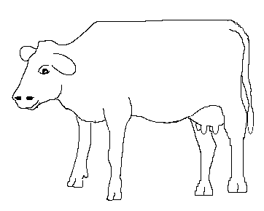
Endocrine Glands
Hypothalamus
Ovary
Pineal
Adrenal
Uterus
Pituitary
Placenta
Testes
(in bull)
Thyroid
Pancreas

Slide 10
Classification and Properties of Hormone
A. Site of Production
B. Type of action
1. Primary hormone of reproduction
2. Metabolic hormone
C. Chemical Structure
1. General structure
    Proteins and polypeptides
    Steroids
    Fatty acids
    Modified amino acid
2. Size

Slide 11
Classification and Properties of Hormone
A. Site of Production
B. Type of action
1. Primary hormone of reproduction
2. Metabolic hormone
C. Chemical Structure
1. General structure
    Proteins and polypeptides
    Steroids
    Fatty acids
    Modified amino acid
2. Size

Slide 12
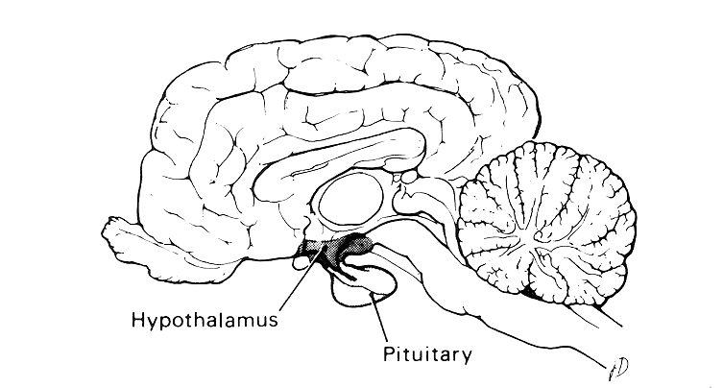
Location of the Hypothalamus and Pituitary Gland

Slide 13
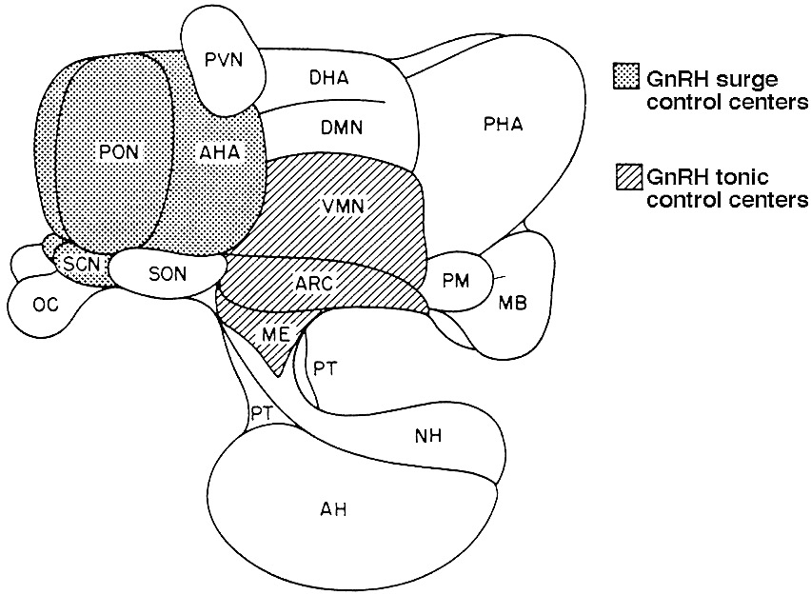
Hypothalamus

Slide 14
Function of Hypothalamus
appetite
thirst
body temperature
vasomotor activity
emotion
use of body nutrient reserves
activity of intestine
sleep
sexual behavior
Production and release of releasing hormones

Slide 15
Releasing Hormones of the Hypothalamus
Structure
  short chain polypeptides (3 - 44 amino acids)
General Function
  to cause the release of trophic hormones from the anterior pituitary gland

Slide 16
Releasing Hormones of the Hypothalamus
Hormones
  Gonadotropin releasing hormone (GnRH)
    LH, FSH release
  Thyrotrophin releasing hormone (TRH)
    TSH and prolactin release
  Corticotrophin releasing hormone (CRH)
    ACTH release
  Growth hormone releasing hormone (GH-RH)
  Somatostatin (growth hormone inhibiting hormone)

Slide 17
Hypothalamus

Slide 18
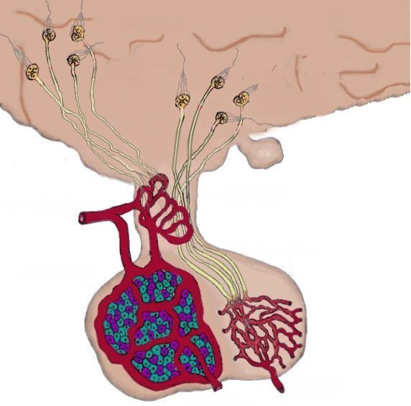
Cells of the Anterior Pituitary
Hypothalamus
Preoptic nuclei cell
Nerve Cells
Superior hypophyseal artery
Capillary plexus
Hypophyseal portal vessels
LH
FSH
Prolactin
STH
TSH
ACTH
Posterior pituitary
Capillary plexus

Slide 19
Hypothalamus and
Anterior Pituitary Gland

Slide 20
Anterior Pituitary Hormones
A. Structure
1. glycoproteins or proteins
B. Hormones
1. gonadotropins
  Follicle stimulating hormone (FSH)
  Luteinizing hormone (LH)
  Prolactin

Slide 21
Anterior Pituitary Hormones
2.Other trophic hormones
  Adrenal Corticotropin (ACTH)
  thyroid stimulating hormone (TSH)
  growth hormone (GH or STH)

Slide 22
Anterior Pituitary
Supraoptic nuclei cell
Hypothalamus
Paraventricular nuclei cell
Nerve Cells
Capillary plexus
Posterior pituitary
Oxytocin
ADH

Slide 23
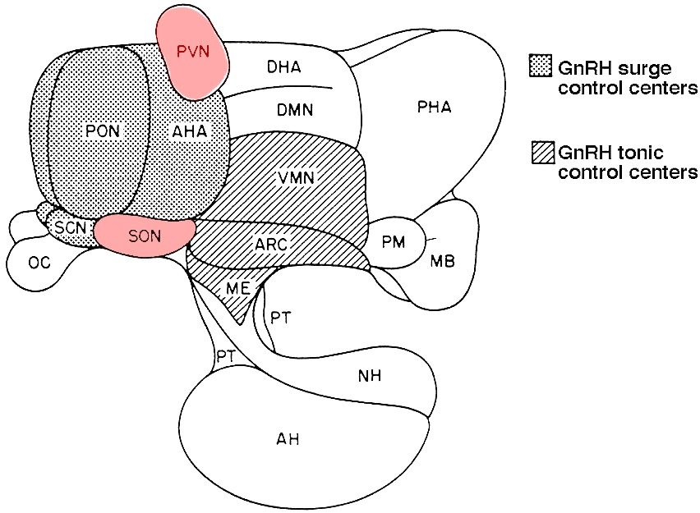
Hypothalamus
Nuclei that produce posterior pituitary hormones

Slide 24
Posterior Pituitary Hormones
A.Structure
  polypeptides (9 amino acids)
B. Hormone
  Oxytocin - contraction of smooth muscle

Slide 25
Placental Hormones
Equine Chorionic Gonadotropin (eCG)
  Formation of accessory CL and maintains pregnancy
Human Chorionic Gonadotropin (HCG)
  Maintains primate CL and pregnancy
Placental Lactogen (PL)
  Development of the mammary gland in the mother
Steroids - Estrogen and Progesterone

Slide 26
Gonadal Polypeptide Hormones
Relaxin
  Secreted by CL during pregnancy.
  Parturition
Inhibin
  Inhibits FSH release

Slide 27
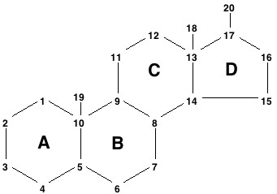
Gonadal Steroids
A. General
  Origin - ovary, testis, adrenal
  Structure

Slide 28
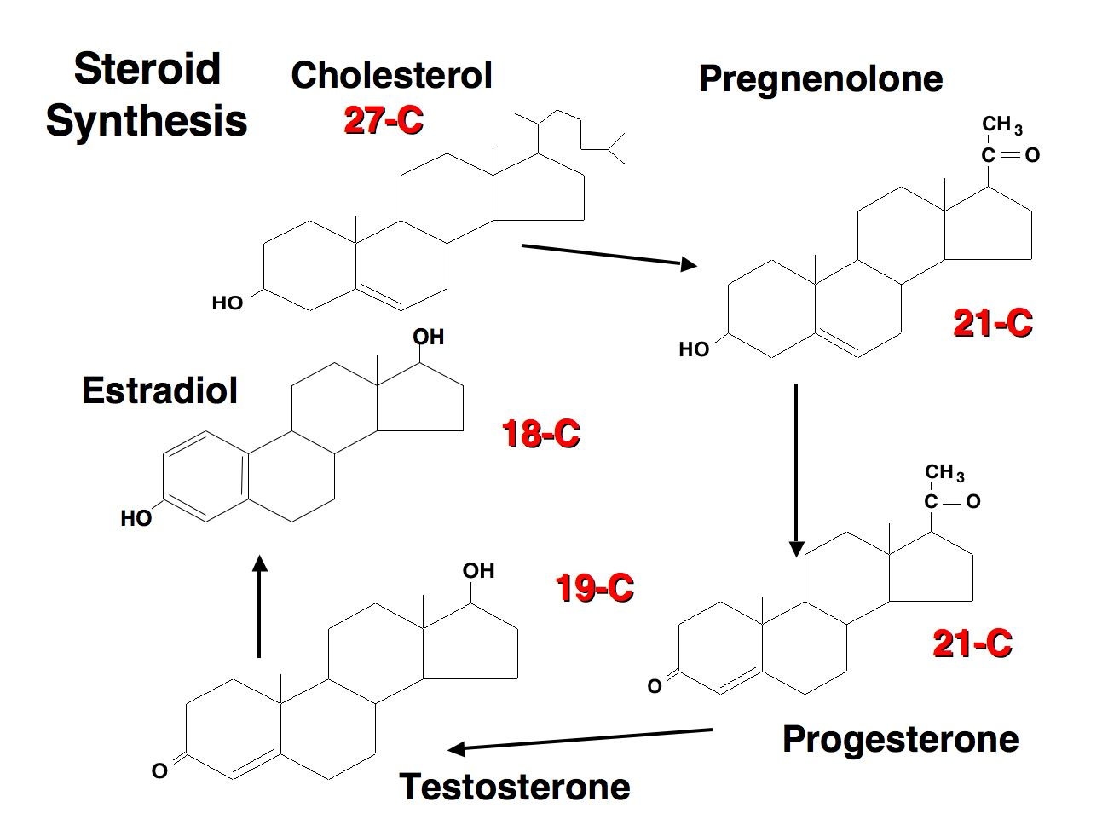

Slide 29
Side Chain Cleavage

Slide 30
Gonadal Steroids Cont.
General Cont.
  Solubility
    Bound to a binding protein for transport
Type of Steroids
  Androgens - Testosterone
  Estrogen - Estradiol
  Progestin - Progesterone

Slide 31
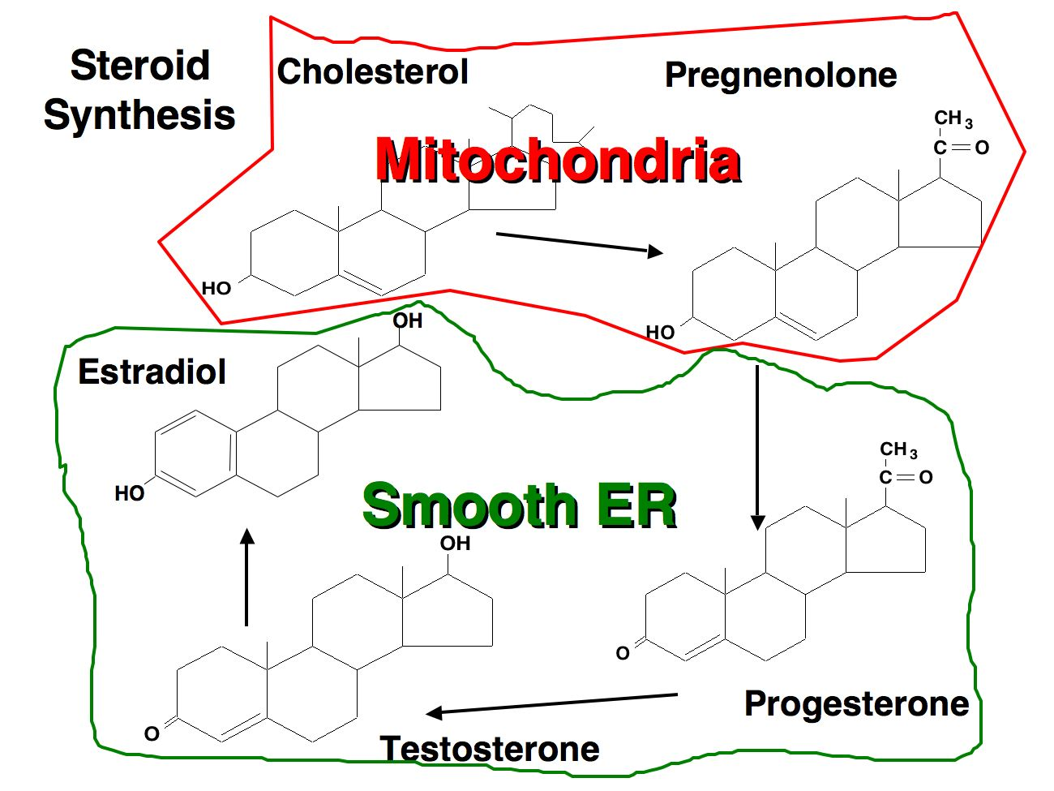

Slide 32
Other Hormones
A. Prostaglandins
  PGF_{2α}
  PGE_{2α}

Slide 33
Phospholipids
Prostaglandins
Many tissues
Local effects
Degraded in lung
PLA₂
COOH
Arachidonic Acid
Cyclo-oxygenase
COOH
Inhibited by aspirin
PGG₂
o
o
OOH
o
COOH
PGH₂
o
OH
PGE₂
PGF₂
O
OH
COOH
COOH
OH
OH
OH
OH

Slide 34
Phospholipids
PLA₂
COOH
Arachidonic Acid
Cyclo-oxygenase
o
COOH
PGG₂
o
OOH
Vasoconstriction
CL regression
Ovulation
Parturition
Sperm transport
Vasodilation
Maintain CL
Ovulation
Implantation
o
COOH
PGH₂
o
OH
PGE₂
PGF₂
O
OH
COOH
COOH
OH
OH
OH
OH

Slide 35
Other Hormones
B. Melatonin
  1. Secreted from the pineal gland.
  2. Is a modified amino acid
  3. Functions to integrate effects of light on reproductive processes.

Slide 36
Other Hormones
C. Human Menopausal Gonadotropin (hMG)
  Anterior pituitary gland
    Secreted in menopause, FSH-like activity
    Isolated from urine
      Perganol - superovulation

Slide 37
Classification and Properties of Hormone
A. Site of Production
B. Type of action
1. Primary hormone of reproduction
    (FSH, LH, estradiol, progesterone)
    What else?
2. Metabolic hormone
    (thyroxin, insulin, STH)

Slide 38
Classification and Properties of Hormone
Chemical Structure
  Polypeptides – hypothalamic
  Protein - pituitary, gonad
  Steroids - gonad, adrenal
  Fatty acid - many sources, prostaglandins
  Modified amino acid - pineal

Slide 39
Chemical Structure of Hormones
Polypeptide modified amino acid protein sex steroid fatty acid
GnRh melatonin LH Estradiol PGF
TRH FSH Progesterone
CRH Prolactin Testosterone
GHRH ACTH
Somatistatin TSH
Oxytocin GH or STH
Relaxin
Inhibin
2α

Slide 40
Chemical Structure of Hormones
Molecular size of hormones that regulate reproduction
Hormone Molecular Weight
FSH 30,000 to 37,000
LH 26,000 to 32,000
Prolactin 23,000 to 25,000
HCG 37,700
eCG 28,000
Inhibin >10,000
Relaxin 6,500
ACTH 4,500
Oxytocin 1,007
GnRH 1,200
Estradiol 300
Testosterone 300
Progesterone 300
PGF 300
2α

Slide 41
Chemical Structure of Hormones Cont.
Polypeptide and protein hormones are made of peptide bonds
O
H
Peptide Bond
H
H
N
C
C
O
H
H
R
N
C
C
O
H
R
These hormones can not be given orally!

Slide 42
Chemical Structure of Hormones Cont.
Steroid Biosynthesis
Cholesterol
Adrenal
Pregnenolone
Ovary or Testis
Progesterone
Progesterone
Cortisol
Testosterone
Estradiol
These hormones can be given orally!!!

Slide 43
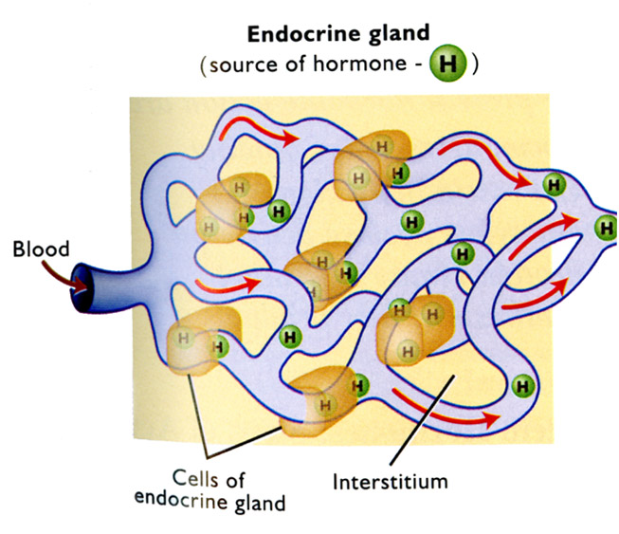
Mechanism of Hormone Action

