Slide 1
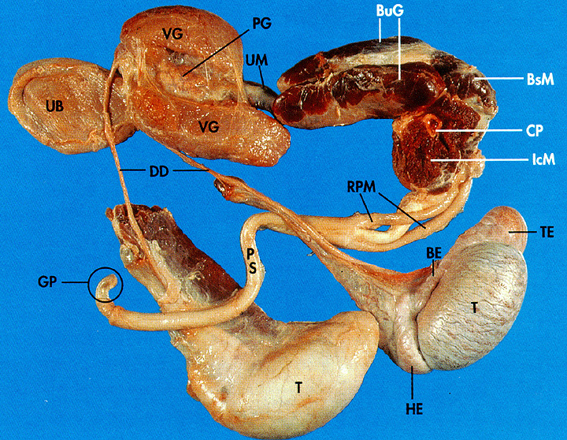
Animal / Dairy Science 434
Comparative Male Anatomy

Slide 2
Testis
Species Testis Wt. % Of Orientation
(grams) Body Wt.
bull 300+ .03 vertical
ram 250 .3 vertical
boar 350 .2 oblique
stallion 200 .03 horizontal
dog 25 .2 oblique/horz.
cat --- --- oblique
rabbit 2.5 .1 vertical
human 25 .03 vertical

Slide 3
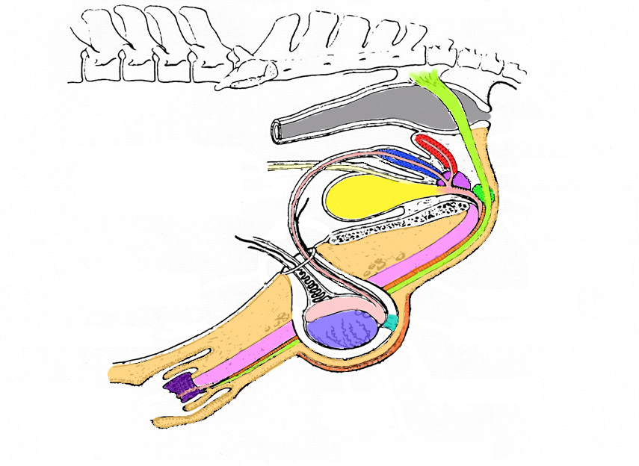
Reproductive Organs of the Stallion
Seminal Vesicles
Ampulla
Prostate
Rectum
Cowper’s Gland
Bladder
Vas Deferens
Retractor Penis
Muscle
Corpus Cavernosum
Gubernaculum
Caput
Cauda
Testis
Glans
Penis
Scrotum
Prepuce

Slide 4
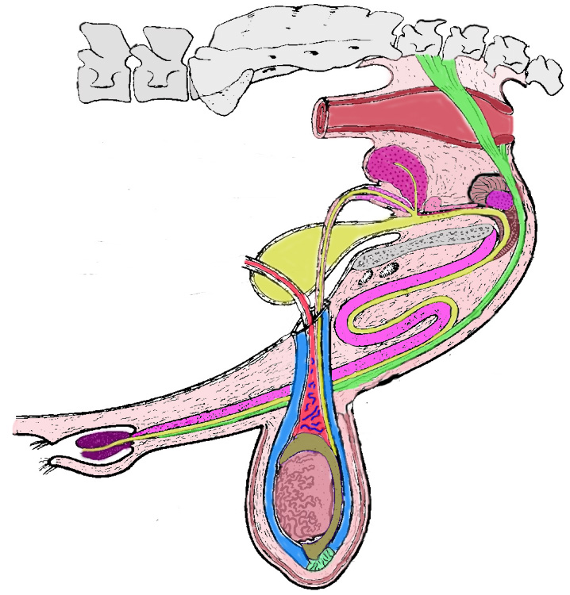
Reproductive Organs of the Bull
Prostate
Rectum
Cowpers Gland
Seminal Vesicles
Ampulla
Bladder
Vas Deferens
Retractor Penis
Muscle
Glans
Penis
Sigmoid
Flexure
Caput Epididymis
Scrotum
Prepuce
Testis
Cauda Epididymis
Gubernaculum

Slide 5
Reproductive Organs of the Bull
Vertical

Slide 6
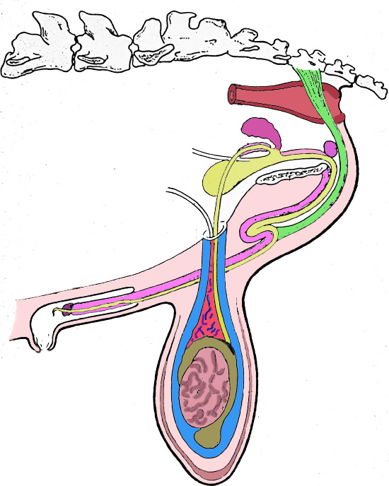
Ram
Vertical

Slide 7
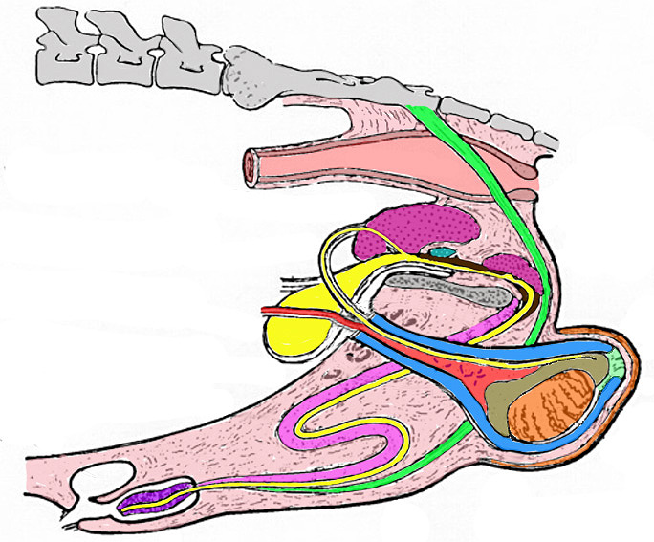
Boar
Oblique

Slide 8
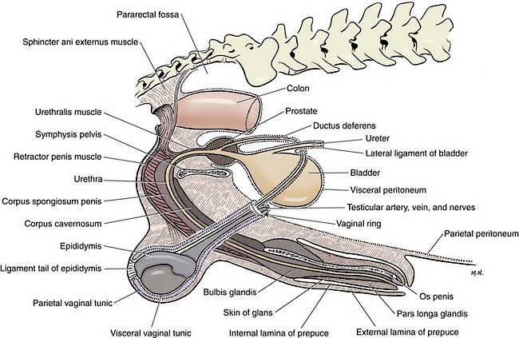
Anatomy of the Dog
Oblique to Horizontal

Slide 9
Stallion
Horizontal

Slide 10
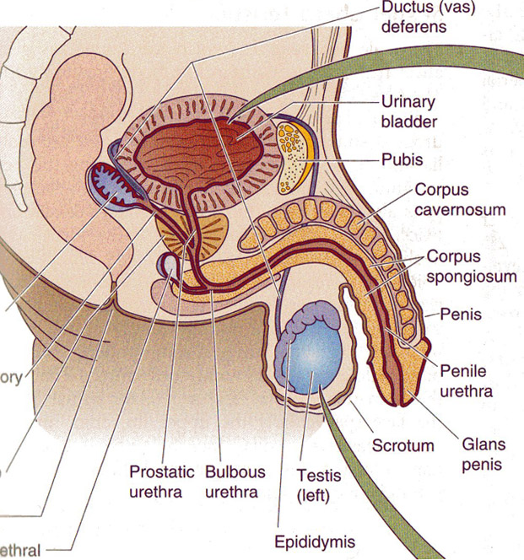
Human
Vertical

Slide 11
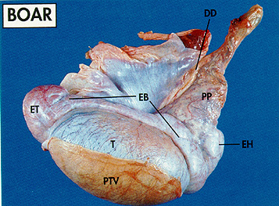
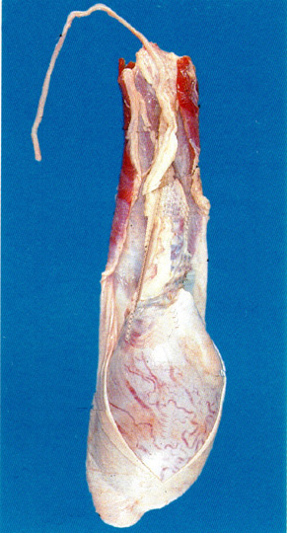
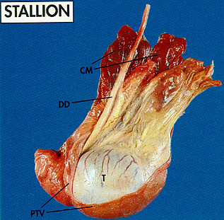
Testis Orientation
Bull
Tail
Head

Slide 12
Testis
Species Testis Wt. % Of Orientation
(grams) Body Wt.
bull 300+ .03 vertical
ram 250 .3 vertical
boar 350 .2 oblique
stallion 200 .03 horizontal
dog 25 .2 oblique/horz.
cat --- --- oblique
rabbit 2.5 .1 vertical
human 25 .03 vertical

Slide 13
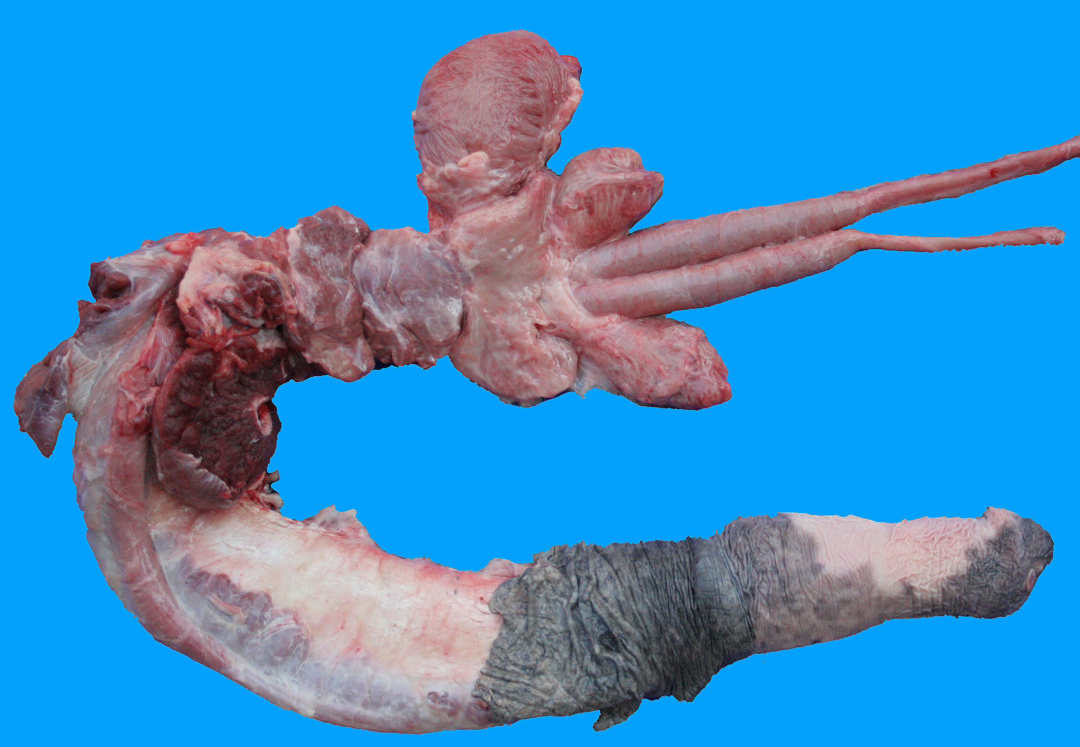
The Stallion
Bladder
Seminal
Vesicles
Cowper’s
Gland
Bulbospongiosus
Muscle
Vas Deferens
Ampulla
Crus
Penis
Body of
Prostate
Retractor
Penis
Muscle
Ischiocavernosus
Muscle
Pelvic Urethral Muscle

Slide 14
Pelvic Genitalia of the Stallion
Body of
Prostate
Cowper’s
Gland
Seminal
Vesicles
Bulbospongiosus
Muscle
Urethra
Ampulla
Colliculus Seminalis
Pelvic Urethral Muscle
No Disseminate
Prostate
Vas Deferens

Slide 15
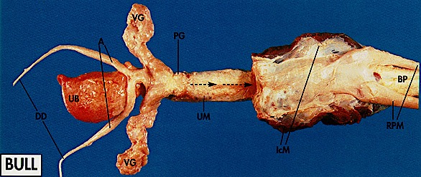
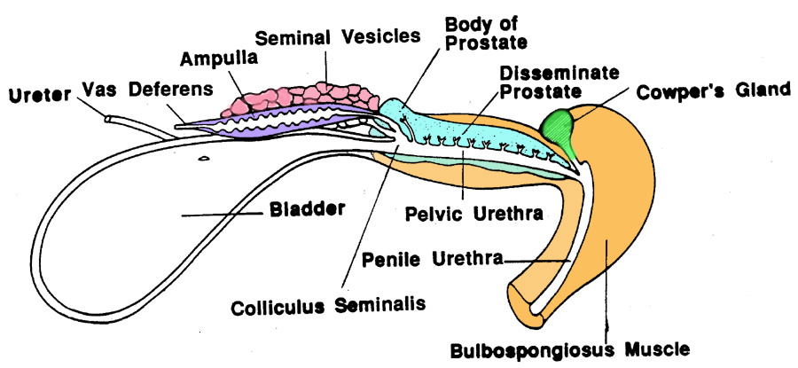

Slide 16
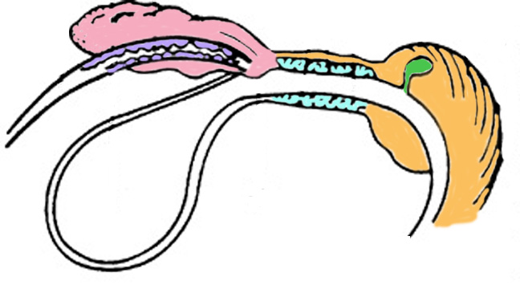
Ram
Seminal
Vesicles
Pelvic Urethral Muscle
Ampulla
Cowper’s
Gland
Prostate
Bladder
Vas Deferens
Bulbospongiosus
Muscle
No Body of the Prostate

Slide 17
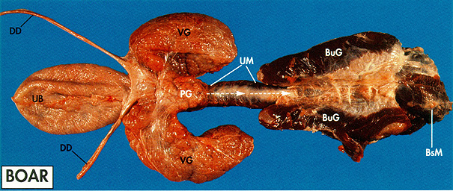
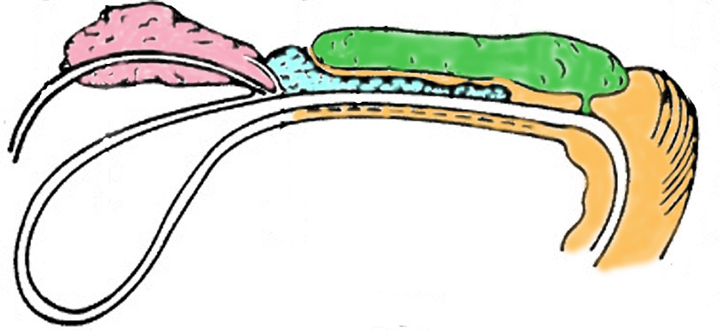
Seminal
Vesicles
Cowper’s Gland
Prostate
No Ampulla
Large Cowper’s
Vas Deferens
Bulbospongiosus
Muscle
Pelvic Urethral Muscle

Slide 18
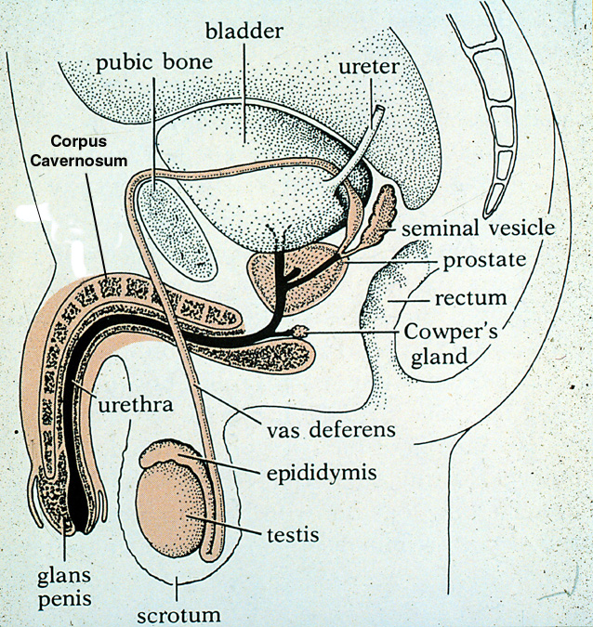
Human
No Disseminate
Prostate

Slide 19

Anatomy of the Dog
Os Penis
No ampulla, seminal vesicles,
disseminate prostate or Cowper’s gland

Slide 20
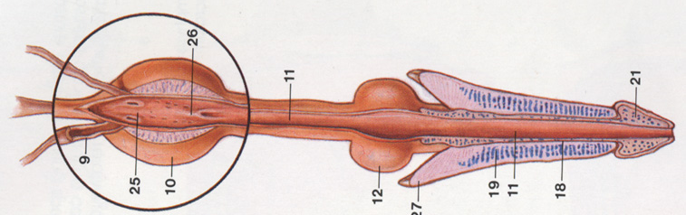
Cat (Tom) Reproductive Tract
Cowper’s Gland
Vas Deferens
Prostate
Corpus Cavernosum
Crus Penis
Glans Penis
Ampulla
No Seminal Vesicles or Disseminate Prostate

Slide 21
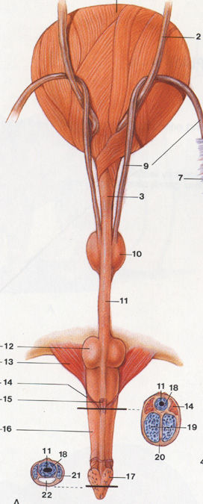
Cat (Tom) Reproductive Tract
Note how close the cowper’s gland is to the penis in the cat.

Slide 22
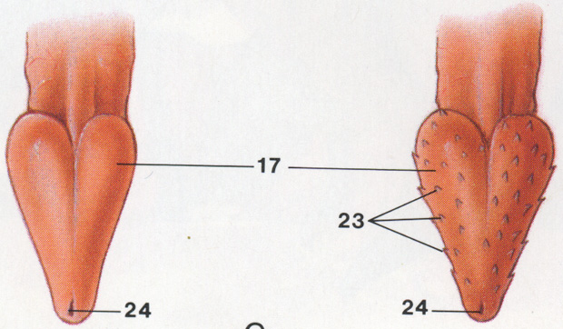
Cat Glans Penis

Slide 23
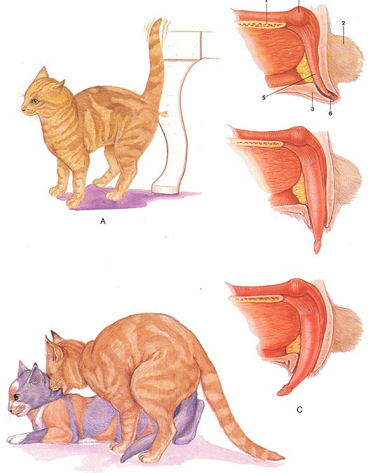
Feline Anatomy: Erection and Mating

Slide 24
Accessory Glands
Species Seminal Prostate Cowper's
Vesicles body disseminate
bull ++ + + +
ram + - + ++
boar +++ + + +++
stallion +++ ++ - (+) +
dog - ++ - -
Cat - ++ - ++
human + ++ - +

Slide 25
Accessory Gland Secretions
Species Seminal Prostate Cowper's
Vesicles
Bull No Clot Material
Ram No Clot Material
Boar Gel
Stallion Mucous
Dog No Clot Material
Human Clot Clot-Enzyme

Slide 26
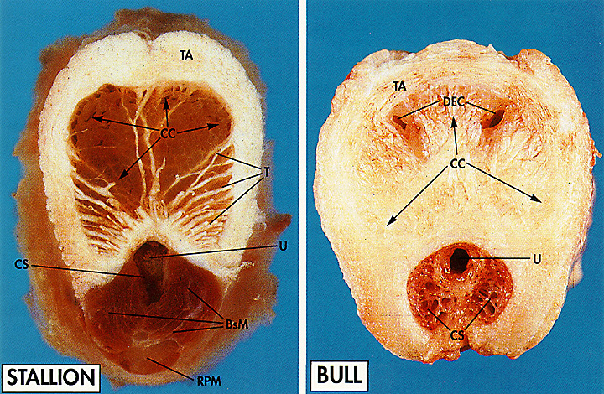
Penis Types
Muscular-Vascular
Fibroelastic

Slide 27
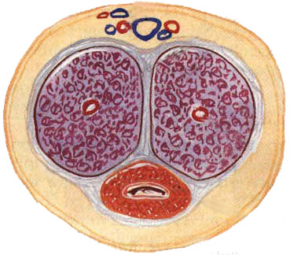
Human Penis Cross Section
Blood Vessels
Corpus Cavernosum
Muscular-Vascular
or
Fibroelastic?
Large Veins
Urethra
Corpus Spongiosum

Slide 28
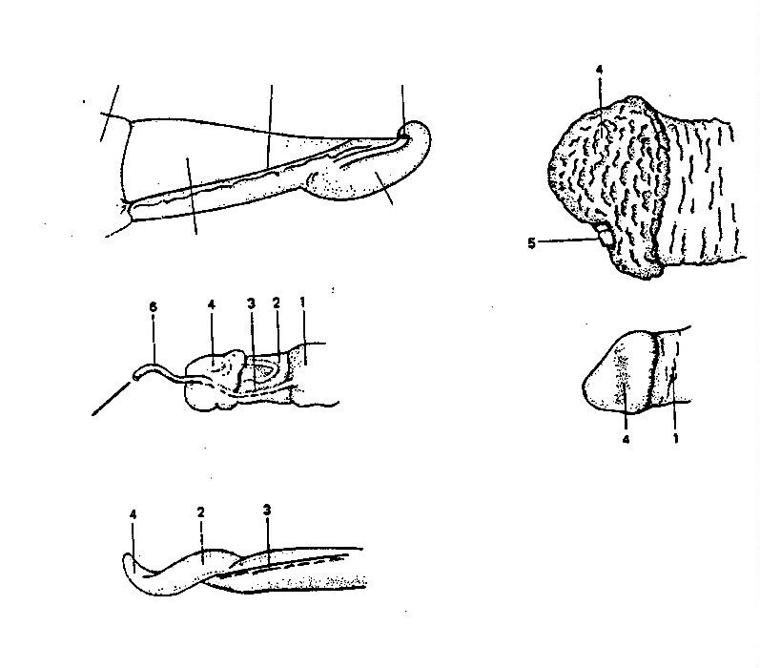
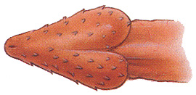
Internal
Prepuce
Urethral
Process
Raphe
Stallion
Bull
Free End of Penis
Glans
Penis
Human
Filiform
Appendage
Ram
Cat
Boar
Dog
No picture

Slide 29
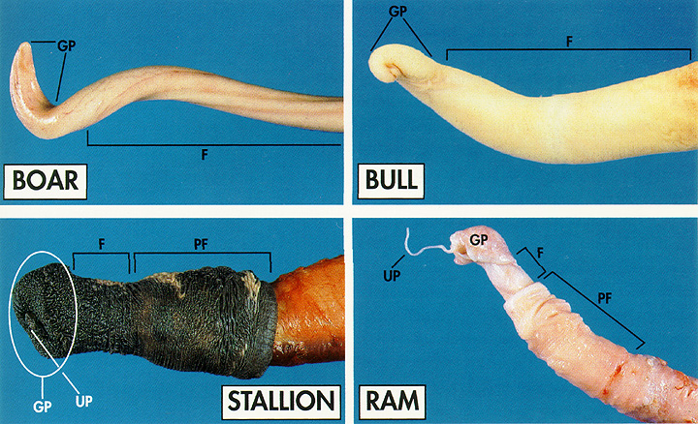
Comparison of Penis Types

Slide 30
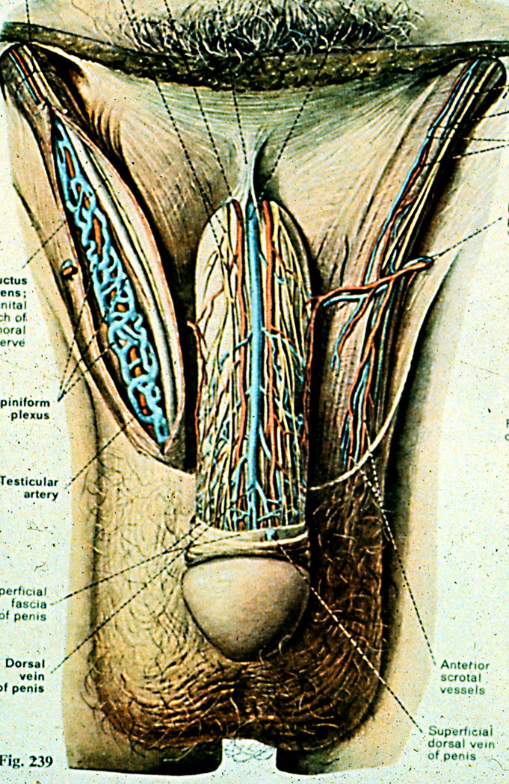
Human

Slide 31
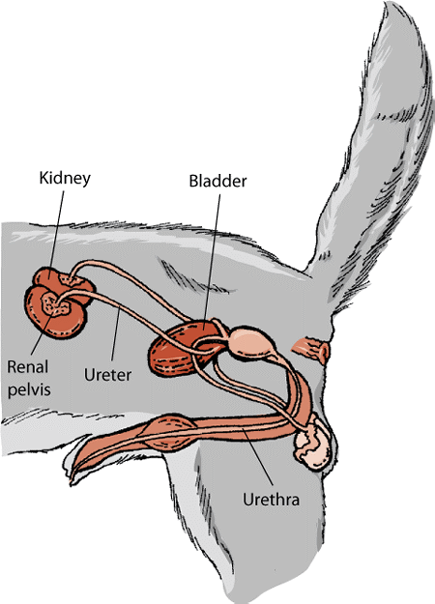
Dog Anatomy
Bulbus Glandis

Slide 32
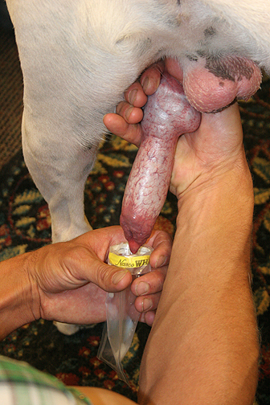
Semen Collection in the Dog

Slide 33
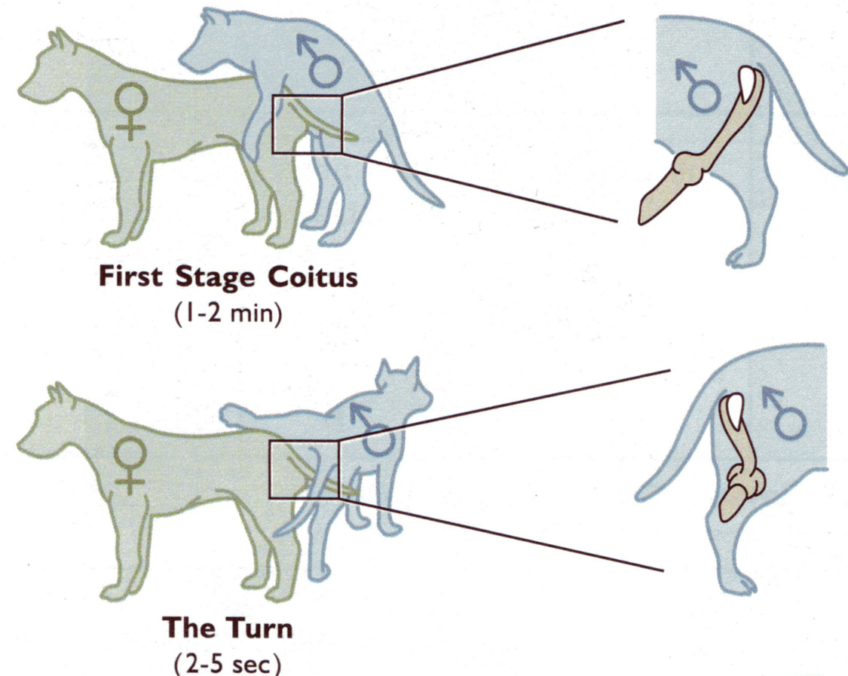
Canine Mating

Slide 34
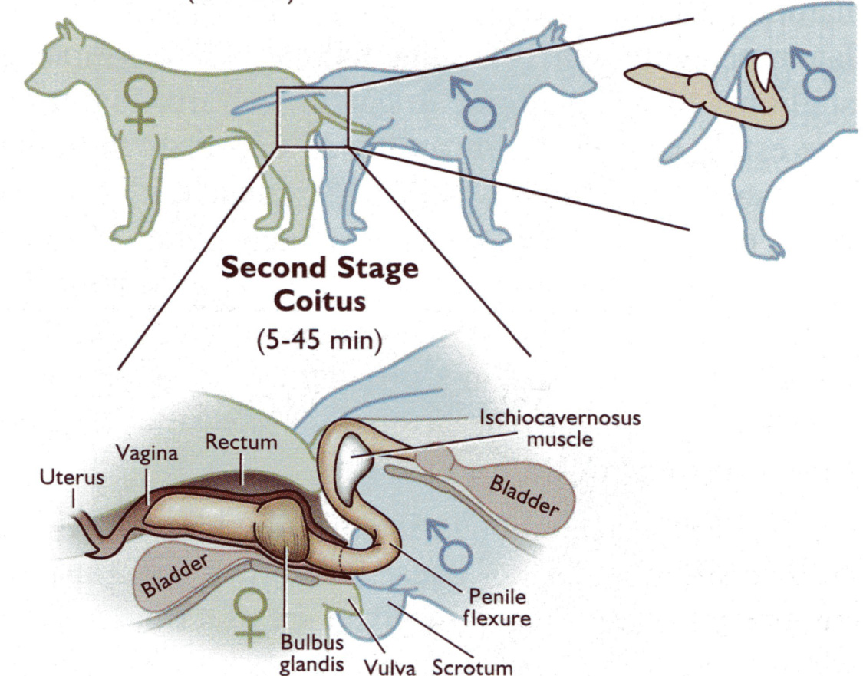
Canine Mating cont.

Slide 35
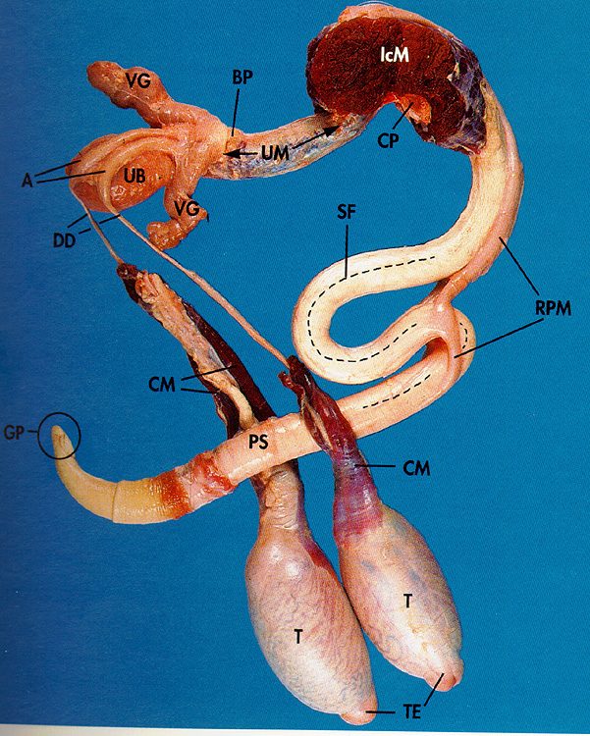
Sigmoid Flexure
Boar
Bull
Fibroelastic Penis

Slide 36
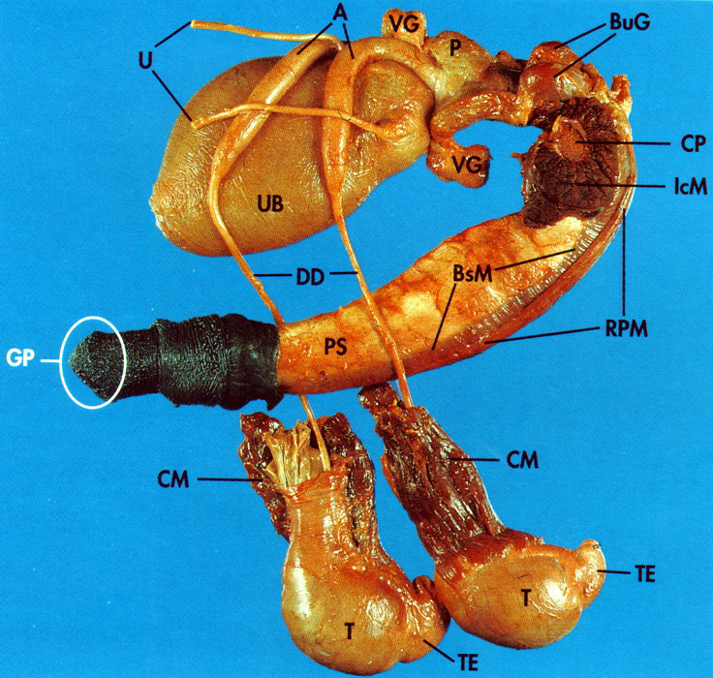
Muscular-Vascular Penis Type
Stallion

Slide 37
The Penis
Species Sigmoid Type Erectile Glans
Flexure Tissue
Bull yes FE + Glans
Ram yes FE + Glans
Boar yes FE + not distinct
Stallion no MV +++ Large Glans
Dog no MV +++ Large Glans
Cat no MV +++ Large Glans+
Spines
Human no MV +++ Large Glans
Dog – Os Penis

Slide 38
Erection and Ejaculation Characteristics
Male Speed Ejac. Semen Sperm Sperm Erection Time Vol. Conc. Num.
bull rapid short medium med.-high medium
ram rapid short small high medium
boar rapid long large low high
stallion slow moderate large low medium
dog slow long large low low
cat slow moderate small high low
human slow moderate medium low low
Large Testes = high sperm numbers
Large accessory glands = large volume of the ejaculate with lower
concentration of sperm

Slide 39
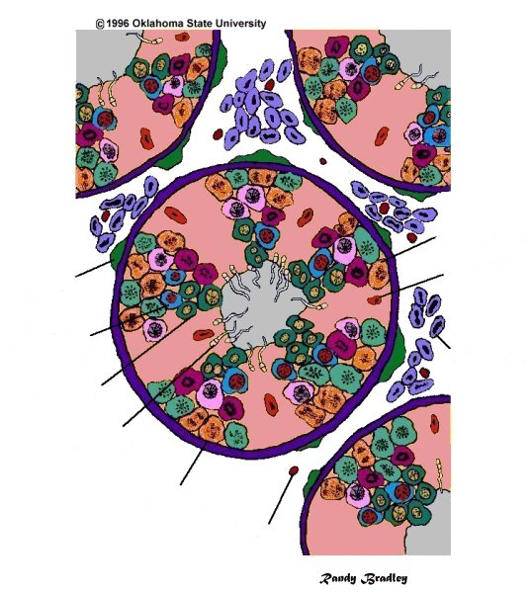
Seminiferous
Tubule
Primary
Spermatocyte
Spermatogonium
Sertoli Cells
Myoid Cells
Support spermatogenesis
Secondary
Spermatocyte
Leydig Cells
Testosterone synthesis
Round Spermatids
Spermatids
Basement
Membrane
Capillary

Slide 40
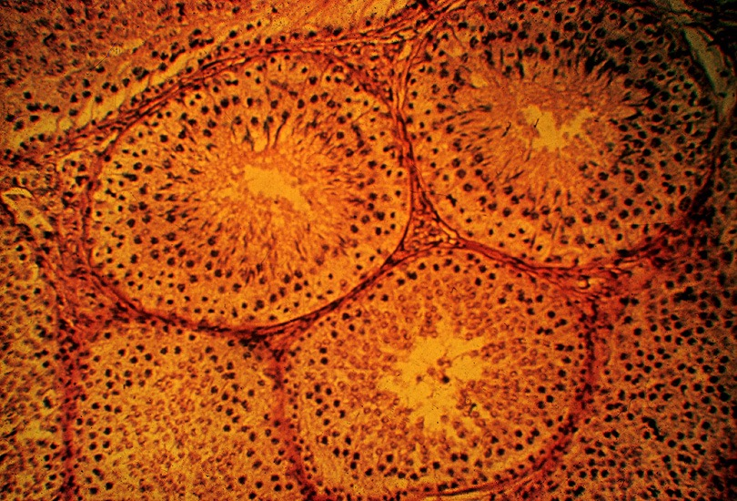
Seminiferous Tubules

Slide 41
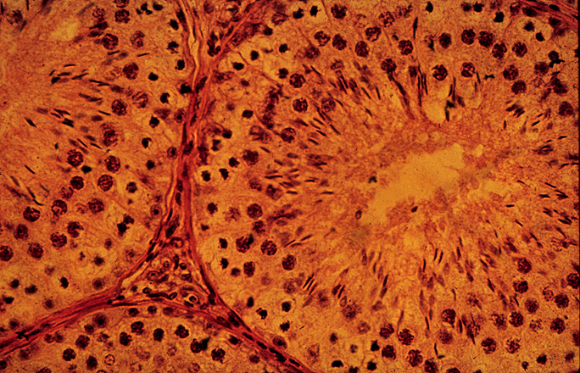
Seminiferous Tubule

Slide 42
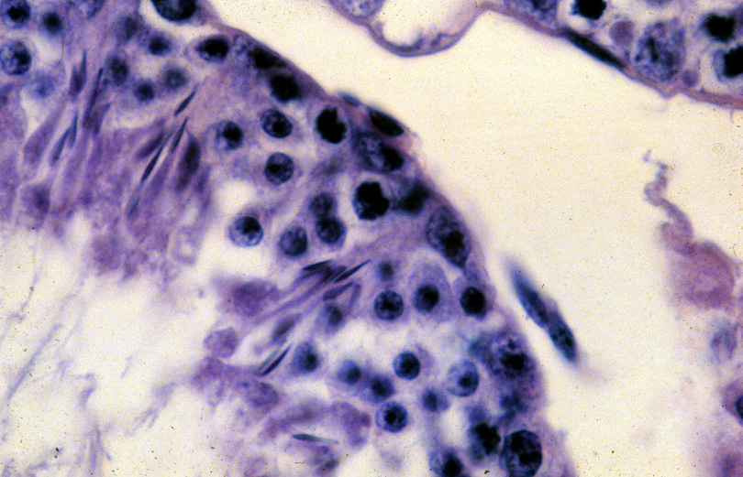
Sertoli Cell
Sertoli Cell

Slide 43
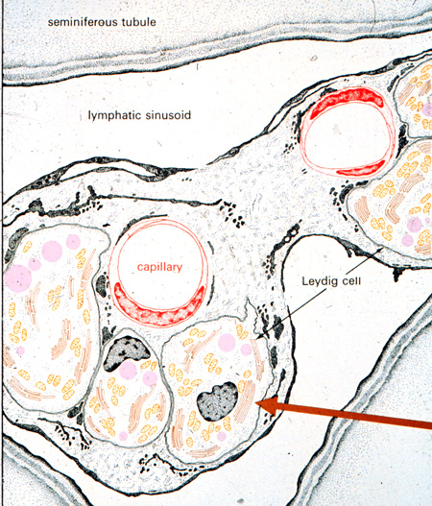
Interstitial Tissue (space)
Capillary
Leydig Cell

Slide 44
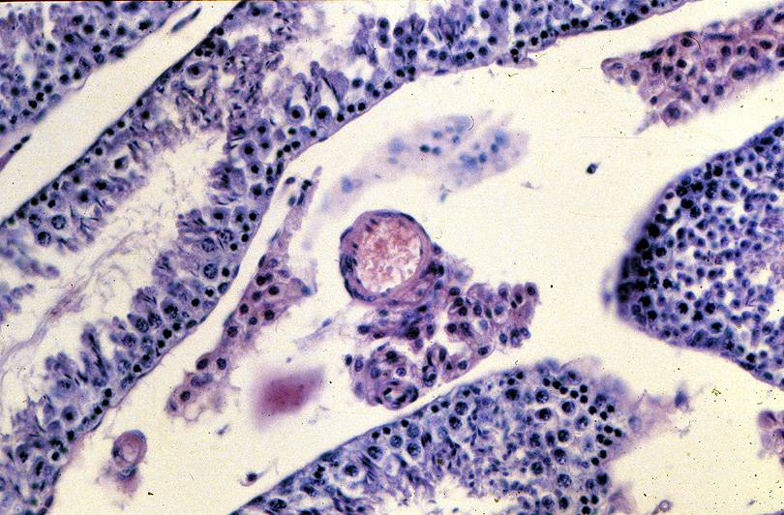
Capillary
Leydig
Cells

Slide 45
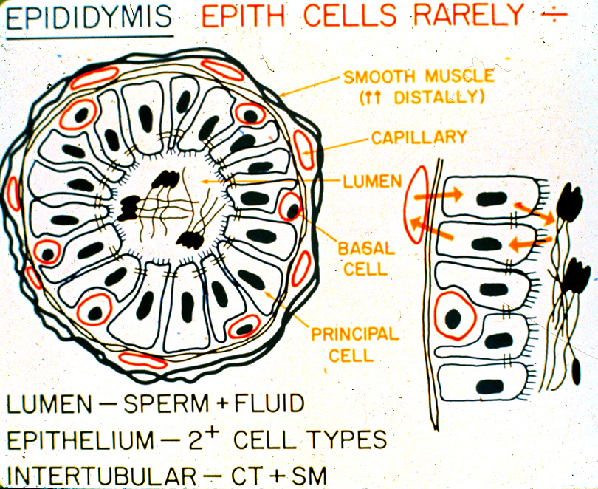

Slide 46
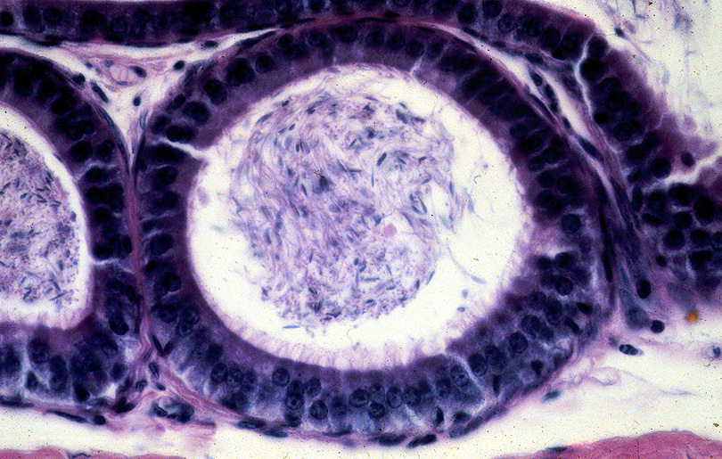
Epididymis
Principal Cell
Basal Cell
Stereo-Cillia

Slide 47
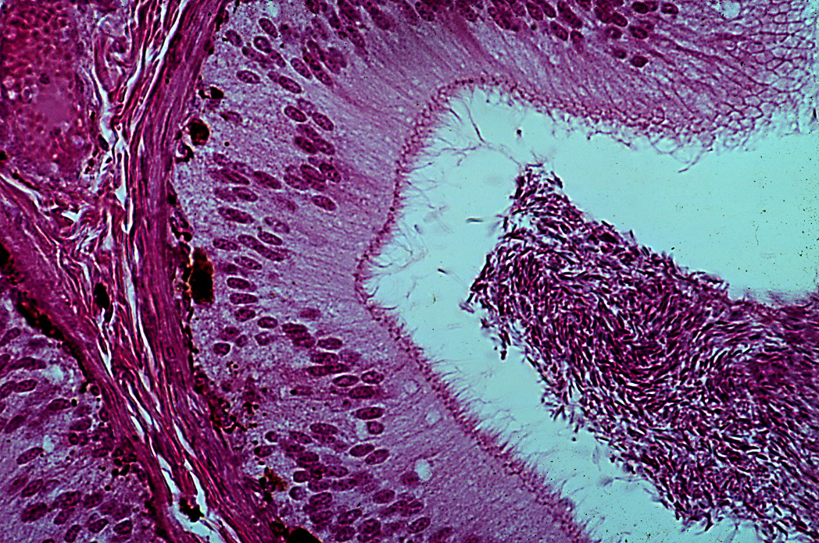
Cauda Epididymis near Vas Deferens

Slide 48
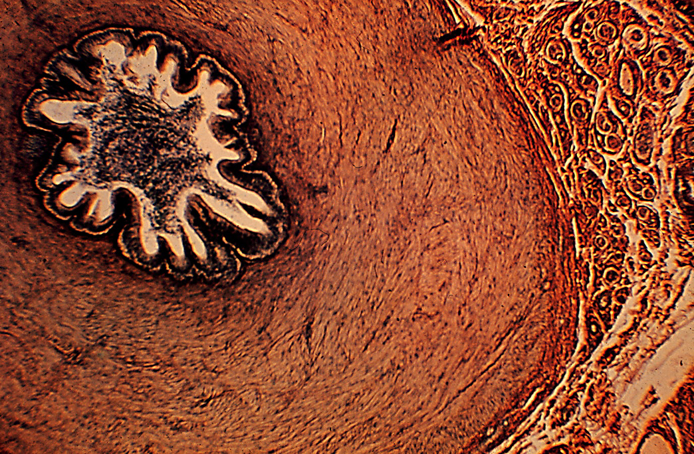
Sperm
Smooth Muscle
Vas Deferens

Slide 49
