Slide 1
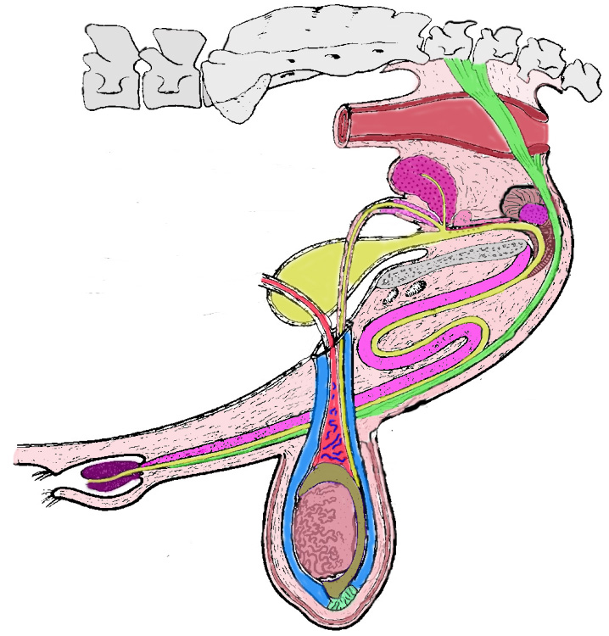
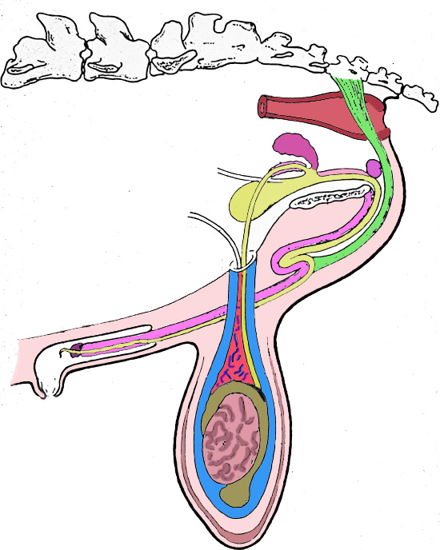

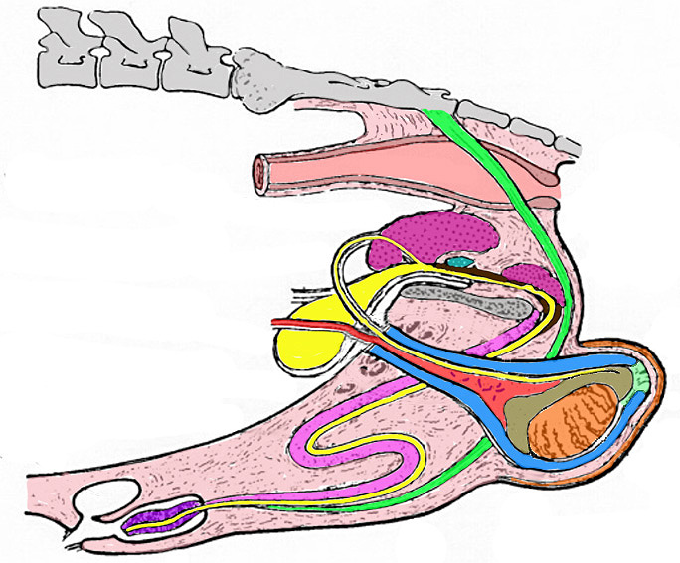
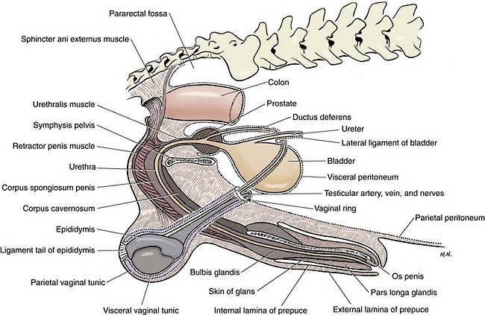
AS/DS 434
Comparative Male Anatomy

Slide 2
Testis
Species Testis Wt. % Of Orientation
(grams) Body Wt.
bull 300+ .03 vertical
ram 250 .3 vertical
boar 350 .2 oblique
stallion 200 .03 horizontal
dog 25 .2 oblique/horz.
rabbit 2.5 .1 vertical
human 25 .03 vertical

Slide 3
Reproductive Organs of the Bull
Prostate
Rectum
Cowpers Gland
Seminal Vesicles
Ampulla
Bladder
Vas Deferens
Retractor Penis
Muscle
Glans
Penis
Sigmoid
Flexure
Caput Epididymis
Scrotum
Prepuce
Testis
Cauda Epididymis
Gubernaculum

Slide 4
Reproductive Organs of the Bull
Vertical

Slide 5
Ram
Vertical

Slide 6
Boar
Oblique

Slide 7
Anatomy of the Dog
Oblique to Horizontal

Slide 8
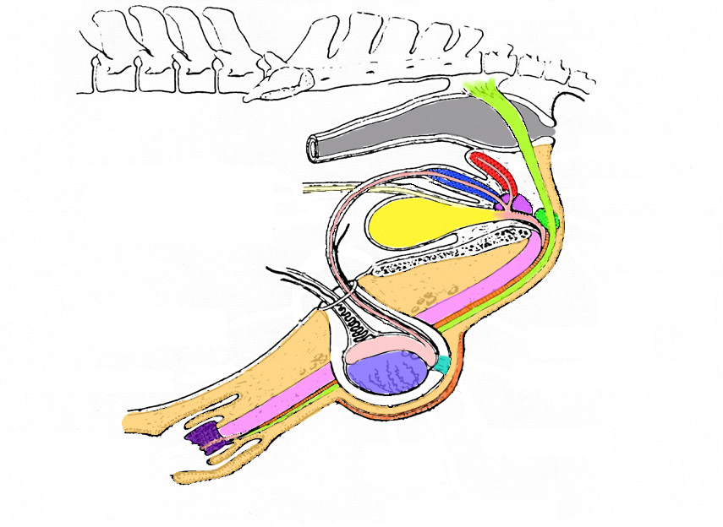
Stallion
Horizontal

Slide 9
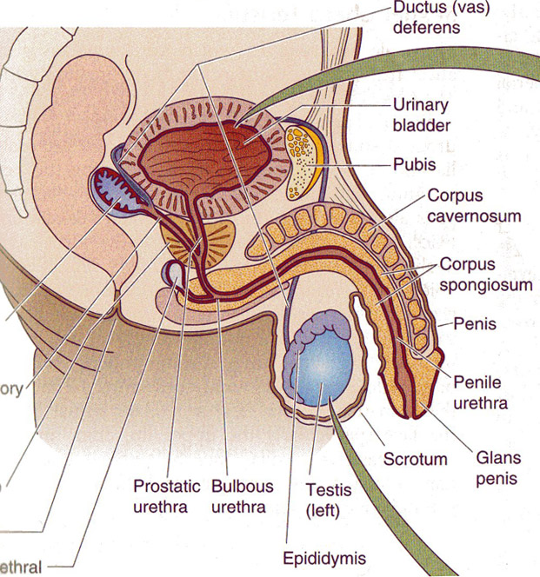
Human
Vertical

Slide 10
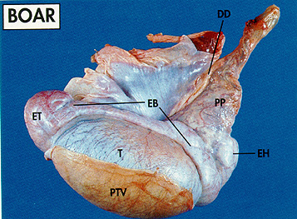
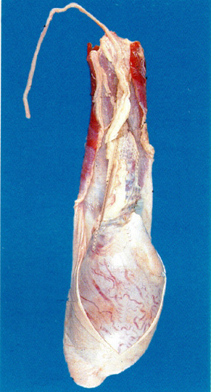
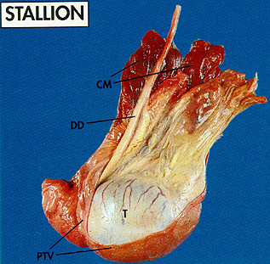
Testis Orientation
Bull
Tail
Head

Slide 11
Testis
Species Testis Wt. % Of Orientation
(grams) Body Wt.
bull 300+ .03 vertical
ram 250 .3 vertical
boar 350 .2 oblique
stallion 200 .03 horizontal
dog 25 .2 oblique/horizontal
rabbit 2.5 .1 vertical
human 25 .03 vertical

Slide 12

Quiz 4a
Remember to pause while you consider the answer to this question.
List the males with the following orientation to the testes:
Vertical –
Horizontal –
Oblique –

Slide 13
Quiz 4a
Remember to pause while you consider the answer to this question.
List the males with the following orientation to the testes:
Vertical – Bull, Ram, Human, Rabbit (Buck)
Horizontal – Stallion, Dog
Oblique – Boar, Dog

Slide 14
Quiz 4b
Which male has the largest testes by weight?

Slide 15
Quiz 4b
Which male has the largest testes by weight?
Boar has the largest.

Slide 16
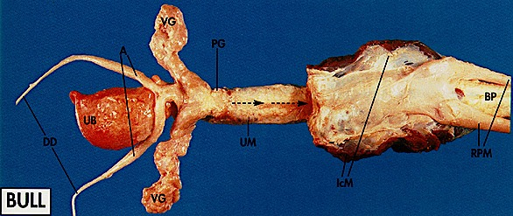
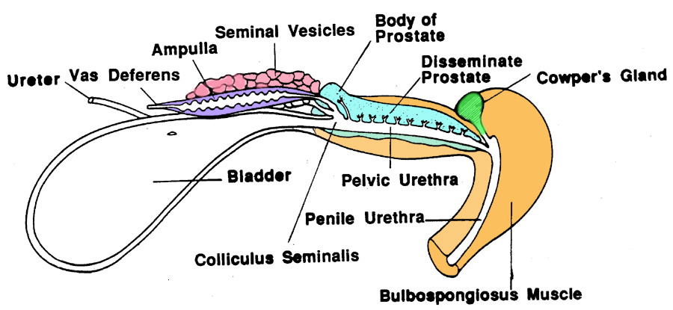

Slide 17
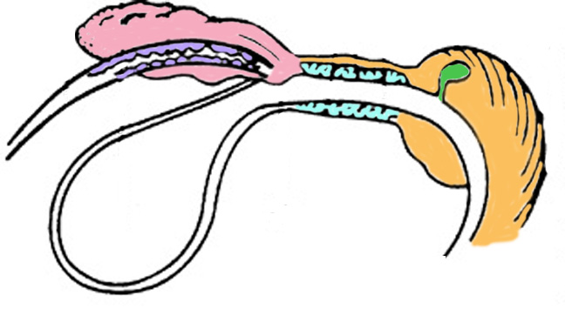
Ram
Seminal
Vesicles
Pelvic Urethral Muscle
Ampulla
Cowper’s
Gland
Prostate
Bladder
Vas Deferens
Bulbospongiosus
Muscle
No Body of the Prostate

Slide 18
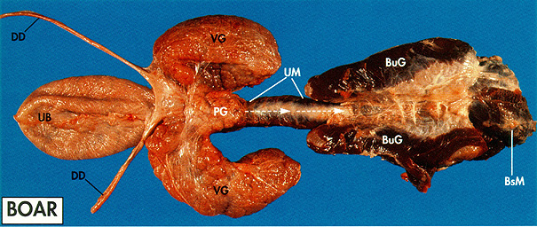
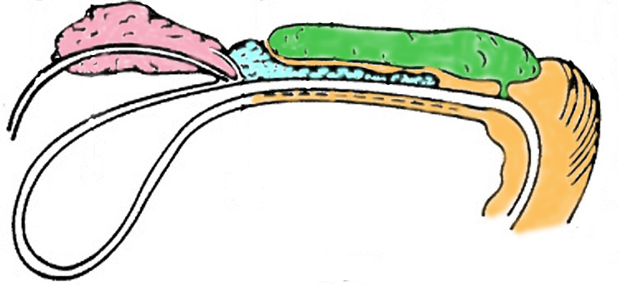
Seminal
Vesicles
Cowper’s Gland
Prostate
No Ampulla
Large Cowper’s
Vas Deferens
Bulbospongiosus
Muscle
Pelvic Urethral Muscle

Slide 19
Reproductive Organs of the Stallion
Seminal Vesicles
Ampulla
Prostate
Rectum
Cowper’s Gland
Bladder
Vas Deferens
Retractor Penis
Muscle
Corpus Cavernosum
Gubernaculum
Caput
Cauda
Testis
Glans
Penis
Scrotum
Prepuce

Slide 20
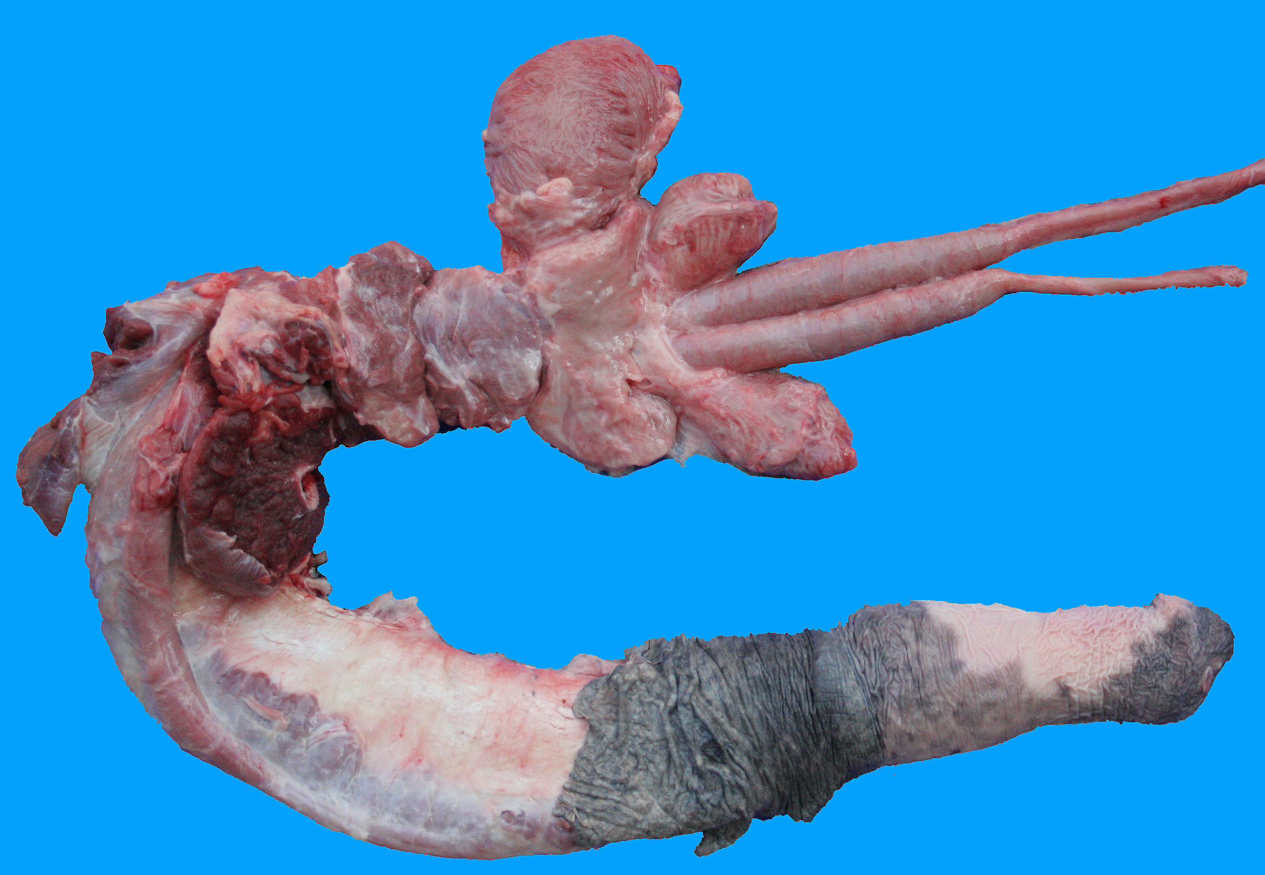
The Stallion
Bladder
Seminal
Vesicles
Cowper’s
Gland
Bulbospongiosus
Muscle
Vas Deferens
Ampulla
Crus
Penis
Body of
Prostate
Retractor
Penis
Muscle
Ischiocavernosus
Muscle
Pelvic Urethral Muscle

Slide 21
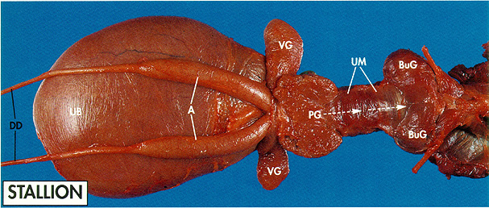
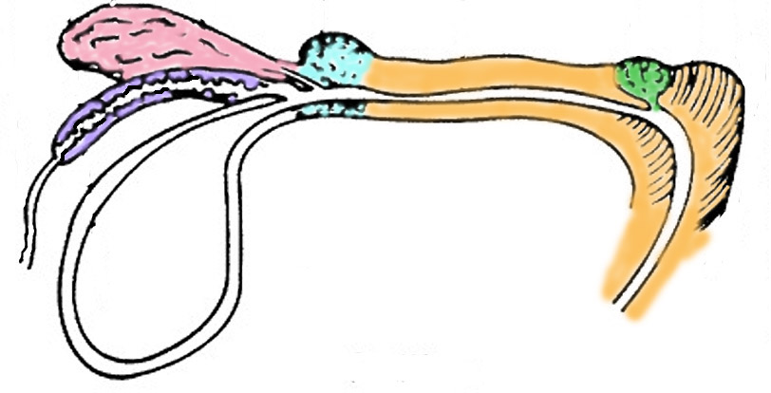
Prostate
Cowper’s Gland
Seminal
Vesicles
Ampulla
No Disseminate
Prostate
Bulbospongiosus
Muscle
Vas Deferens
Pelvic Urethral Muscle

Slide 22
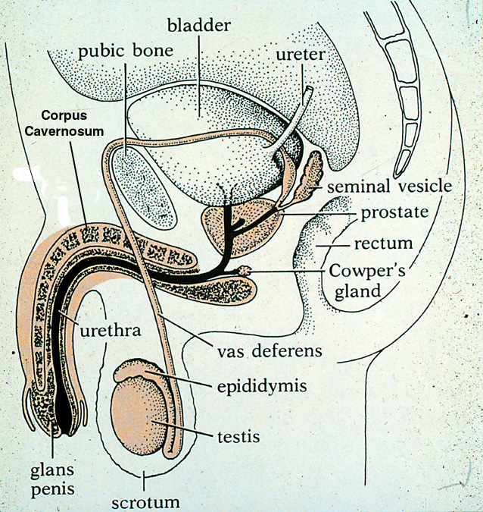
Human
No Disseminate
Prostate

Slide 23

Anatomy of the Dog
No ampulla, seminal vesicles,
disseminate prostate or Cowper’s gland

Slide 24
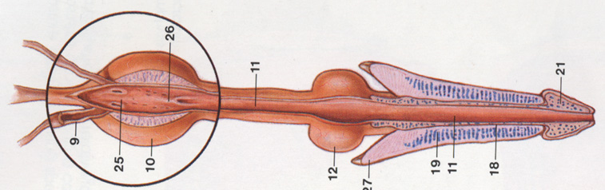
Cat (Tom) Reproductive Tract
Cowper’s Gland
Vas Deferens
Prostate
Corpus Cavernosum
Crus Penis
Glans Penis
Ampulla
No Seminal Vesicles or Disseminate Prostate

Slide 25
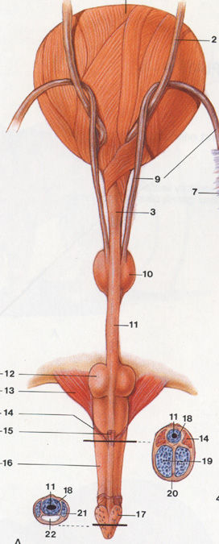
Cat (Tom) Reproductive Tract
Note how close the cowper’s gland is to the penis in the cat.

Slide 26
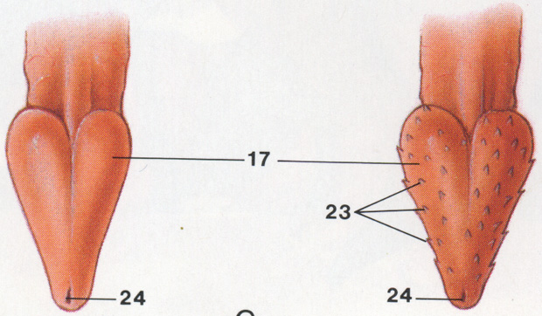
Cat Glans Penis

Slide 27
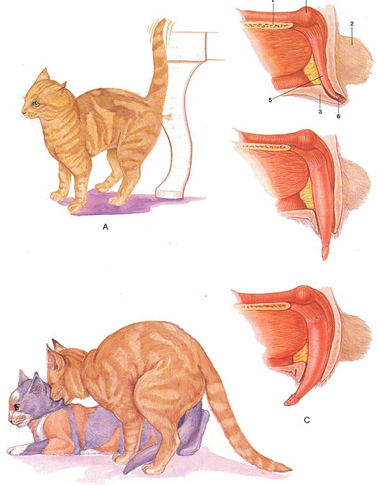
Feline Anatomy: Erection and Mating

Slide 28
Accessory Glands
Species Seminal Prostate Cowper's
Vesicles body disseminate
bull ++ + + +
ram + - + ++
boar +++ + + +++
stallion +++ ++ - (+) +
dog - ++ - -
Cat - ++ - ++
human + ++ - +

Slide 29
Accessory Gland Secretions
Species Seminal Prostate Cowper's
Vesicles
Bull No Clot Material
Ram No Clot Material
Boar Gel
Stallion Mucous
Dog No Clot Material
Human Clot Clot-Enzyme

Slide 30
Quiz 4c
Which accessory sex gland is present in all the species we have studied?

Slide 31
Quiz 4c
Which accessory sex gland is present in all the species we have studied?
Prostate as either the body or disseminate portion.

Slide 32
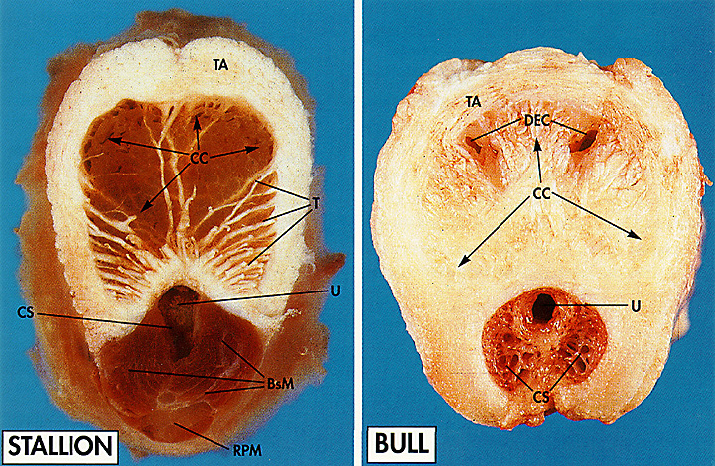
Penis Types
Muscular-Vascular
Fibroelastic

Slide 33
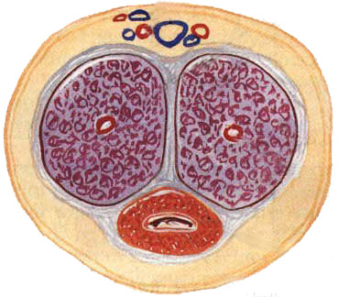
Human Penis Cross Section
Blood Vessels
Corpus Cavernosum
Muscular-Vascular
or
Fibroelastic?
Large Veins
Urethra
Corpus Spongiosum

Slide 34
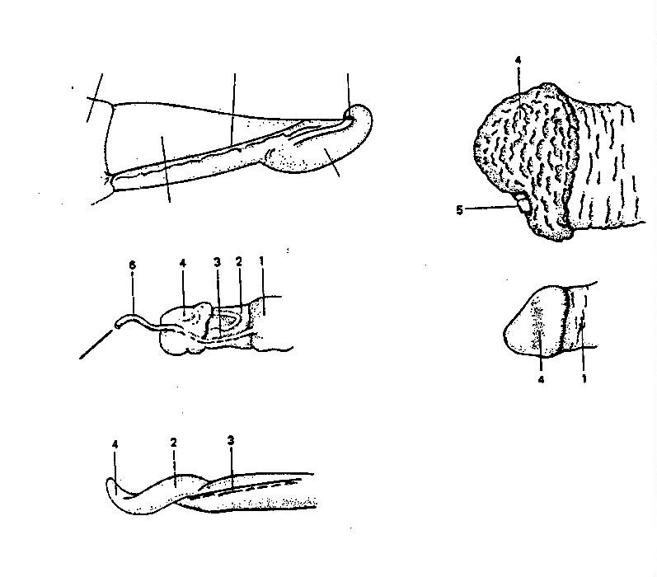
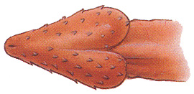
Internal
Prepuce
Urethral
Process
Raphe
Stallion
Bull
Free End of Penis
Glans
Penis
Human
Filiform
Appendage
Ram
Cat
Boar
Dog
No picture

Slide 35
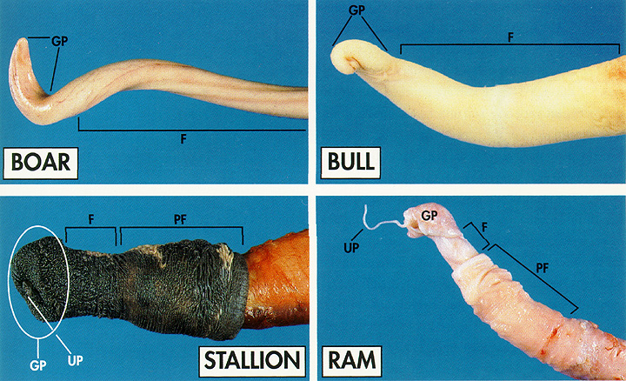
Comparison of Penis Types

Slide 36
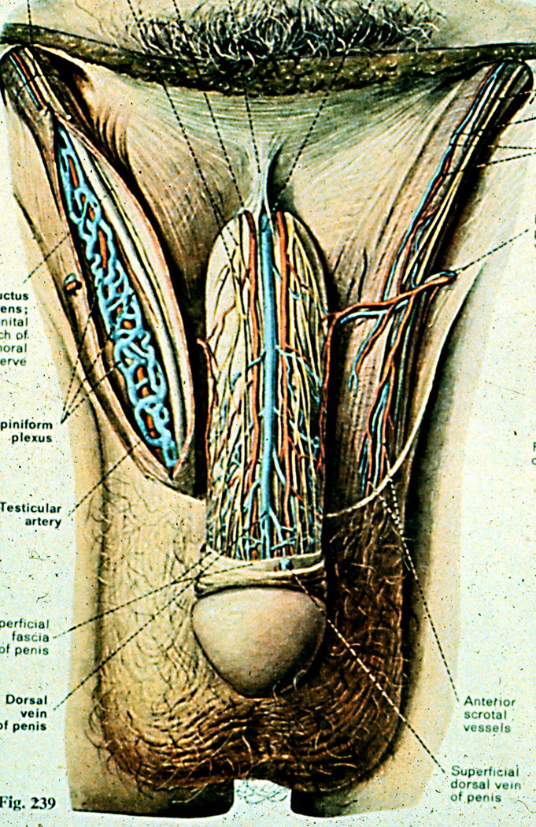
Human

Slide 37
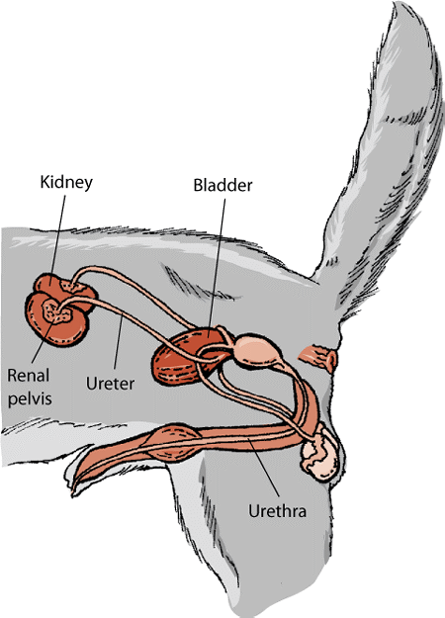
Dog Anatomy
Bulbus Glandis

Slide 38
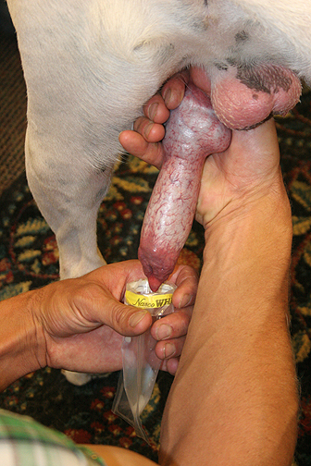
Semen Collection in the Dog

Slide 39
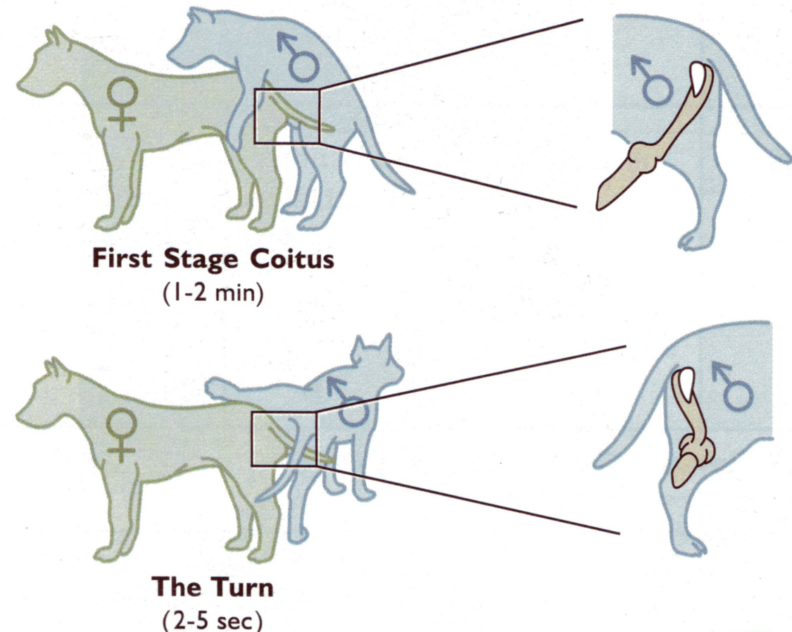
Canine Mating

Slide 40
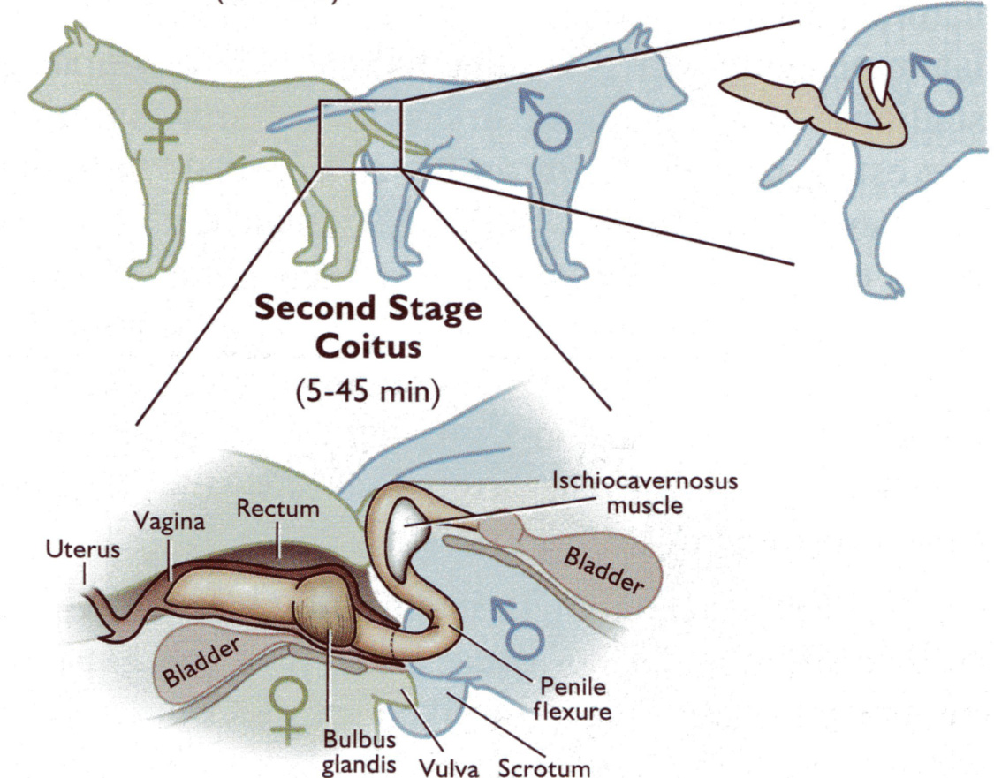
Canine Mating cont.

Slide 41
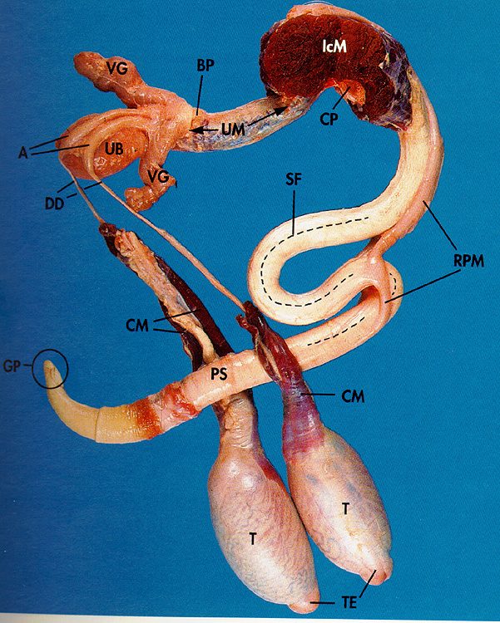
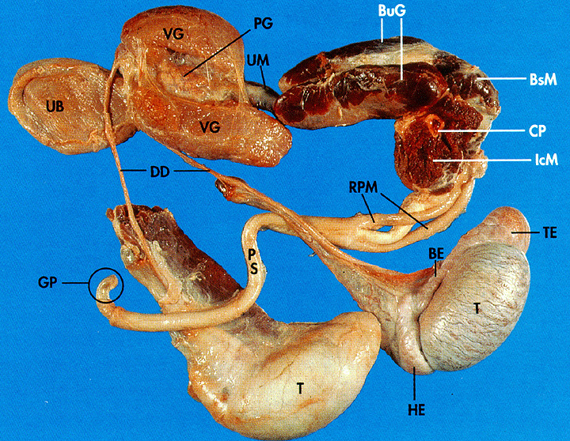
Sigmoid Flexure
Boar
Bull
Fibroelastic Penis

Slide 42
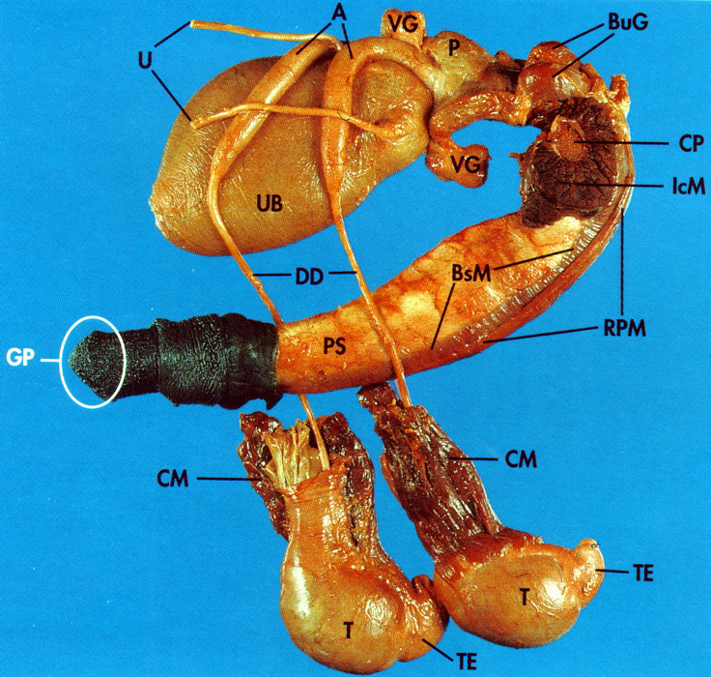
Muscular-Vascular Penis Type
Stallion

Slide 43
The Penis
Species Sigmoid Type Erectile Glans
Flexure Tissue
Bull yes FE + Glans
Ram yes FE + Glans
Boar yes FE + not distinct
Stallion no MV +++ Large Glans
Dog no MV +++ Large Glans
Cat no MV +++ Large Glans+
Spines
Human no MV +++ Large Glans

Slide 44
Erection and Ejaculation Characteristics
Male Speed Ejac. Semen Sperm Sperm Erection Time Vol. Conc. Num.
bull rapid short medium med.-high medium
ram rapid short small high medium
boar rapid long large low high
stallion slow moderate large low medium
dog slow long large low low
cat slow moderate small high low
human slow moderate medium low low
Large Testes = high sperm numbers
Large accessory glands = large volume of the ejaculate with lower
concentration of sperm

Slide 45

Quiz 4d
If a penis has a sigmoid flexure then is a vascular muscular or fibro-elastic?
Notes:
What about twins?

Slide 46
Quiz 4d
If a penis has a sigmoid flexure then is a vascular muscular or fibro-elastic?
Fibro-elastic
Notes:
What about twins?

