Slide 1
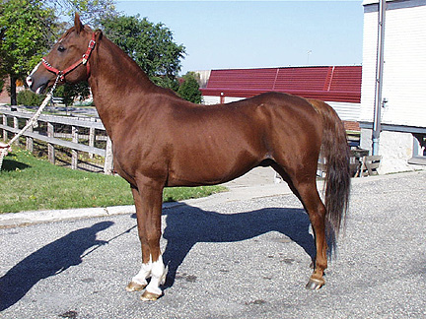
Animal/Dairy Science 434
Male Reproductive Tract Anatomy

Slide 2
Learning Objectives
To be able to describe the male reproductive system in the stallion.
  Structure
  Function

Slide 3
Testis
Epididymis
Factory
<1 - 25 X 10⁹ sperm/day
“Plant” must be air conditioned
Finishing School
  Fluid Absorption
  8-25 X 10⁹ sperm
    membrane changes
    nuclear & flagellar stabilization
    motility, fertility
    cytoplasmic droplet translocation
Penis
Delivery System
  Erection
  Protrusion
  Ejaculation
Tail of Epididymis
Warehouse and Delivery
  Storage 10-50 X 10⁹ sperm
  Sperm for 5-10 ejaculates
  Smooth muscle contractions upon sexual stimulation
Accessory Sex Glands
Alterations & Packaging
Metabolic substrates
Surface coatings
Transport for sperm

Slide 4
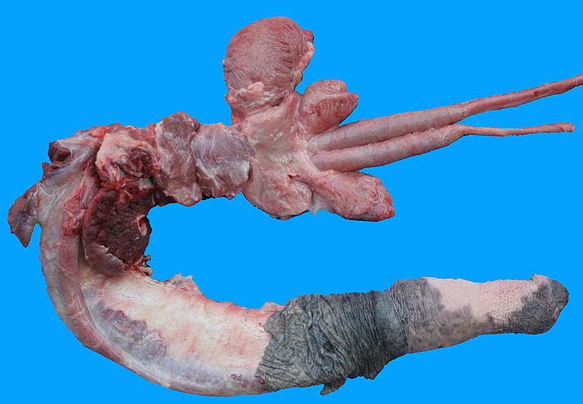
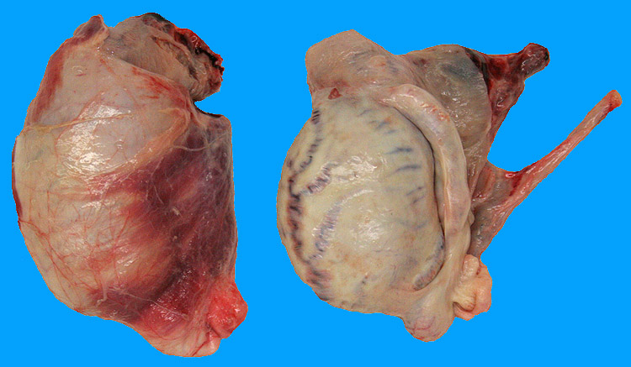
Stallion Reproductive Tract
Pelvic Tract
Testes
Penis

Slide 5
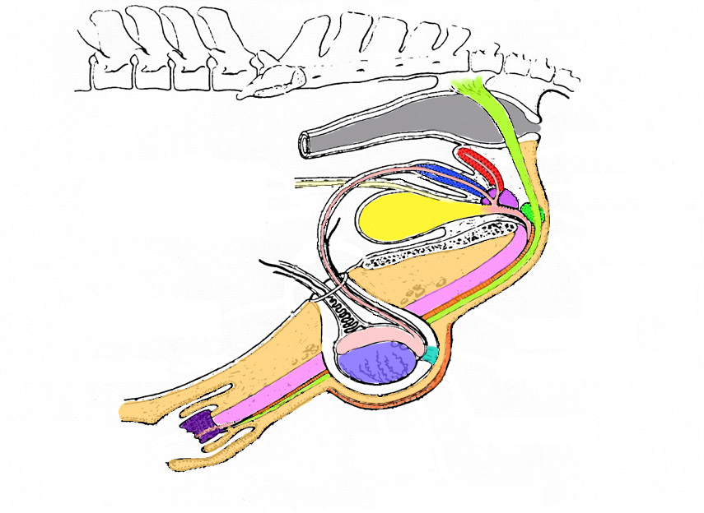
Reproductive Organs of the Stallion

Slide 6
Reproductive Organs of the Stallion
Testis
Primary Sex Organ

Slide 7
Tunica Vaginalis
Parietal
Visceral

Slide 8
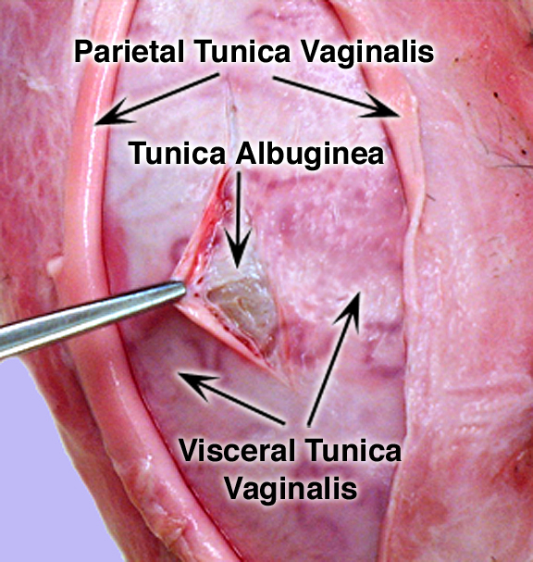
Tunica Albuginea

Slide 9
Scrotum
Thermosensor
Radiator
Protective sac
Scrotum

Slide 10
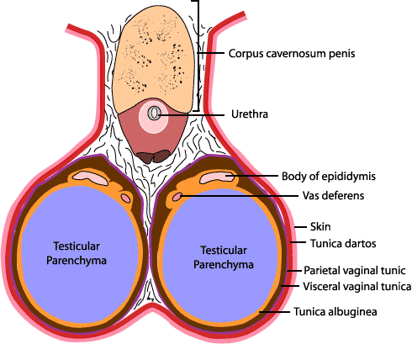
Scrotal Cross Section - Stallion

Slide 11
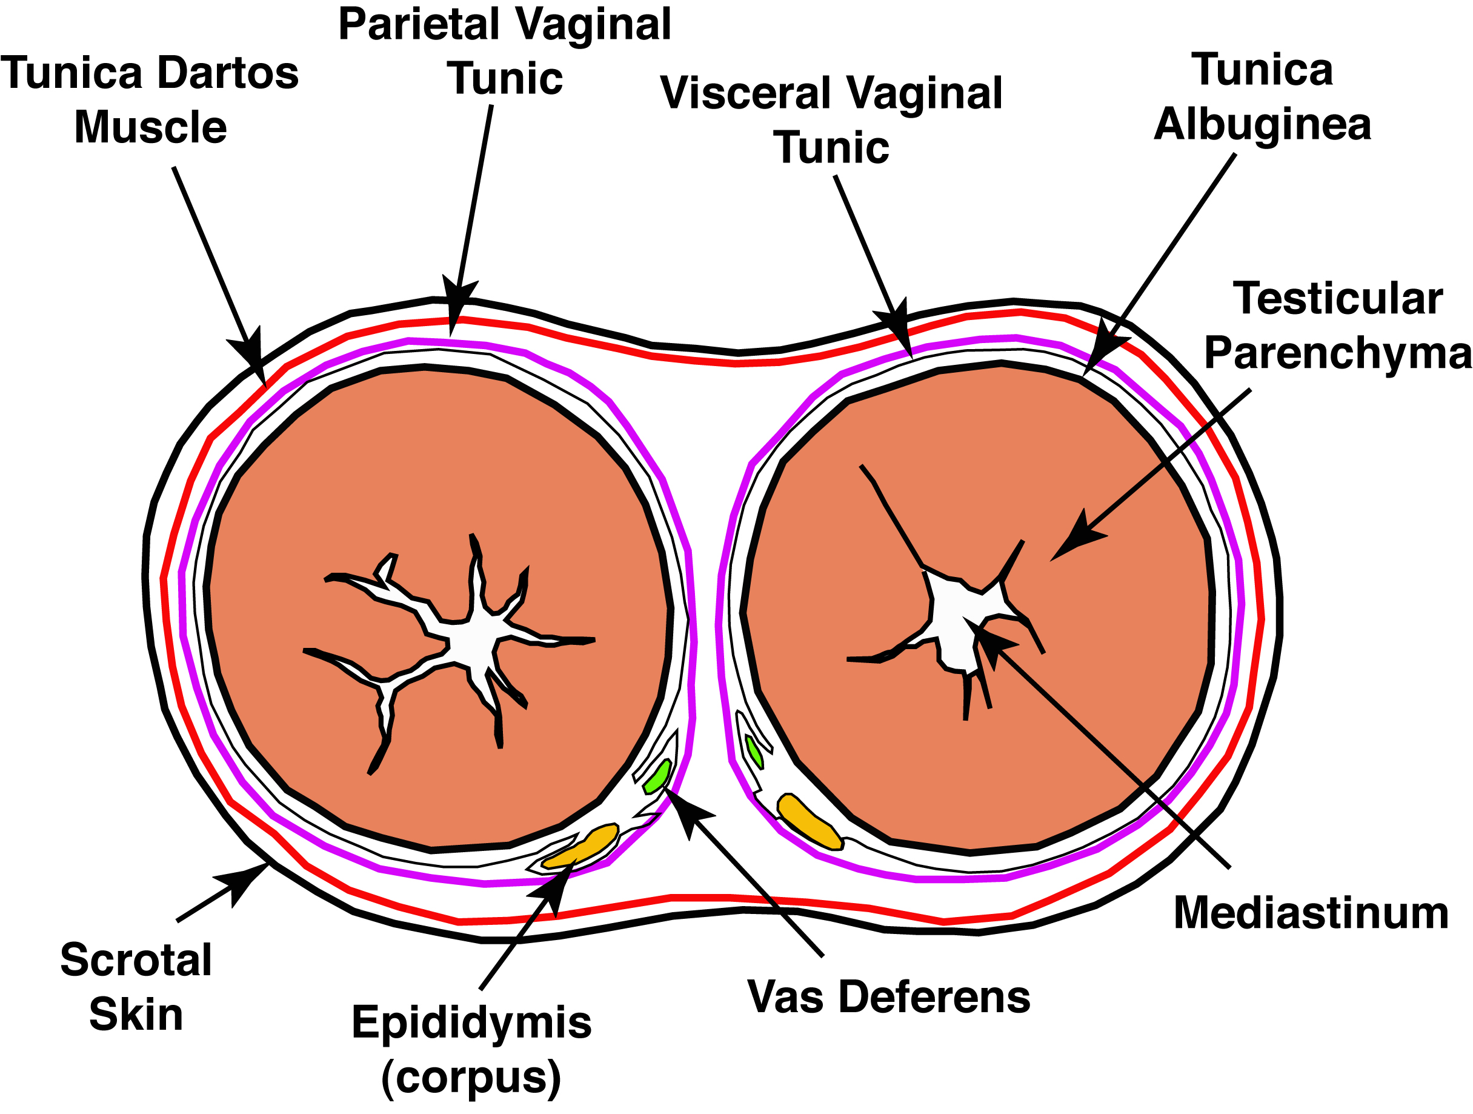
Scrotal Cross Section

Slide 12
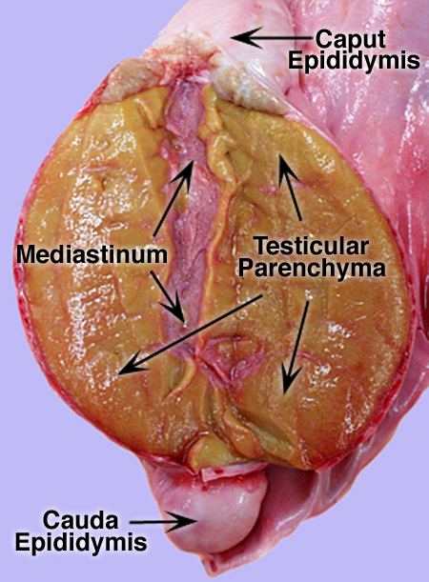
Scrotal Longitudinal
Section

Slide 13
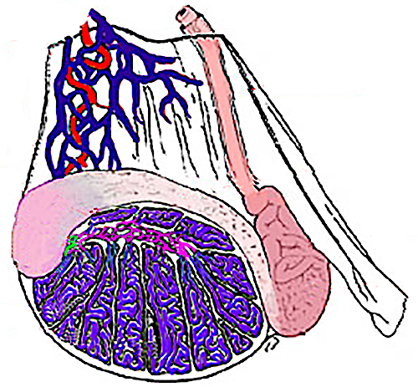
Equine Testis and Spermatic Chord

Slide 14
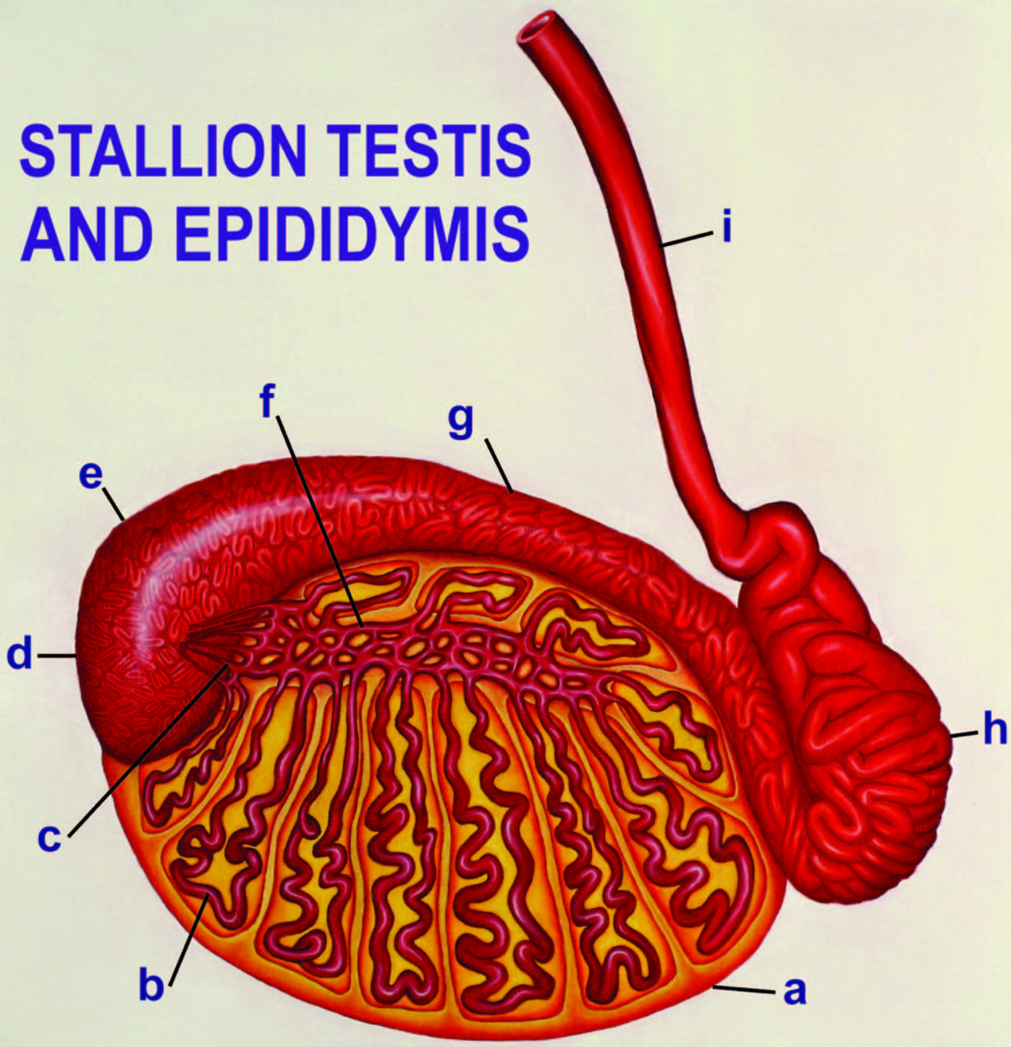
Tunica Albuginea
Seminiferous tubule
Efferent Ducts
Initial Segment
Caput (head)
Rete testis
Corpus (body)
Cauda (Tail)
Vas Deferens
Varner and Johnson, 2007

Slide 15
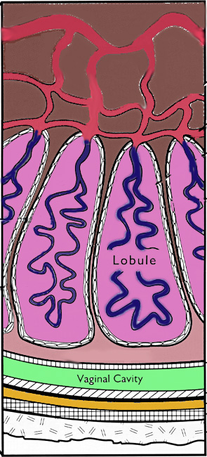
The Testis
Mediastinum
Rete Testis
Seminiferous
Tubule
Interstitial
Tissue
Tunica Albuginea

Slide 16
Primary Sex Organ
Testes
  Testosterone
  Sperm
Secondary Sex Organs
Efferent Ducts
Epididymis
  Caput
  Corpus
  Cauda
Vas Deferens
Varner and Johnson, 2007

Slide 17
Spermatic Chord
Testicular
Artery
Vas Deferens
TV
TA
Testicular
Vein
Pampiniform
Plexus
EC
VD
External Cremaster
Muscle

Slide 18
Spermatic Chord
Vascular, lymphatic and nerves
Heat exchanger
Houses cremaster muscle
Pampiniform Plexus
  Counter Current Exchange
    Arterial Blood 39C, 4.8 ng T/ml
    Venus blood 34C, 70 ng T/ml

Slide 19
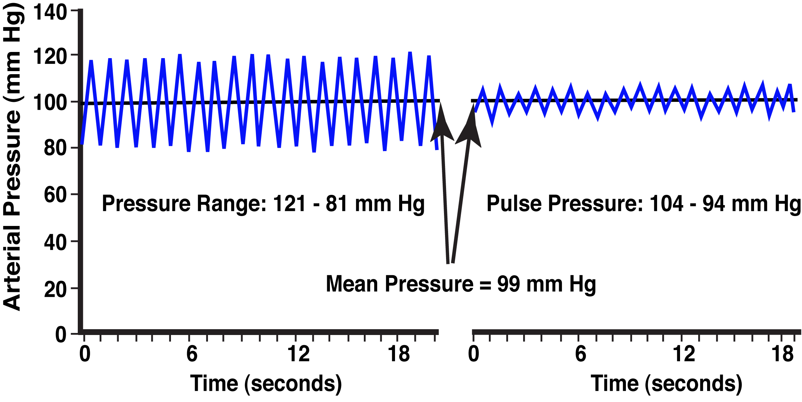
Testis Arterial Pulse
Testicular Artery
In Spermatic Chord
Testicular Artery
In Testes

Slide 20
Spermatic Chord
External Cremaster Muscle

Slide 21
Reproductive Organs of the Stallion
Tunica Dartos

Slide 22
Contraction of the Tunica Dartos
Testis
Tunica Dartos
Smooth muscle
Androgen dependent
(Testosterone)

Slide 23
Reproductive Organs of the Stallion
Gubernaculum

Slide 24
Reproductive Organs of the Stallion
Pelvic Genitalia

Slide 25
Pelvic Genitalia of the Stallion
Body of
Prostate
Cowper’s
Gland
Seminal
Vesicles
Bulbospongiosus
Muscle
Urethra
Ampulla
Colliculus Seminalis
Pelvic Urethral Muscle
No Disseminate
Prostate
Vas Deferens

Slide 26

The Stallion
Bladder
Seminal
Vesicles
Cowper’s
Gland
Bulbospongiosus
Muscle
Vas Deferens
Ampulla
Crus
Penis
Body of
Prostate
Retractor
Penis
Muscle
Ischiocavernosus
Muscle
Pelvic Urethral Muscle

Slide 27
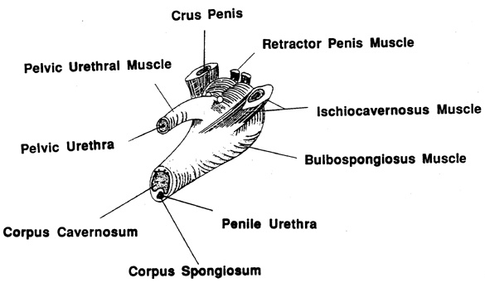
Bulb of the Penis

Slide 28
Reproductive Organs of the Stallion
Seminal Vesicles
Ampulla
Prostate
Rectum
Cowpers Gland
Bladder
Vas Deferens
Retractor Penis
Muscle
Gubernaculum
Caput
Cauda
Testis
Glans
Penis
Scrotum

Slide 29
Cross Section of Stallion Penis
Tunica Albuginea
Corpus Cavernosum
Urethra
Bulbospongiosus
Muscle
Corpus Spongiosum
Retractor Penis Muscle

Slide 30
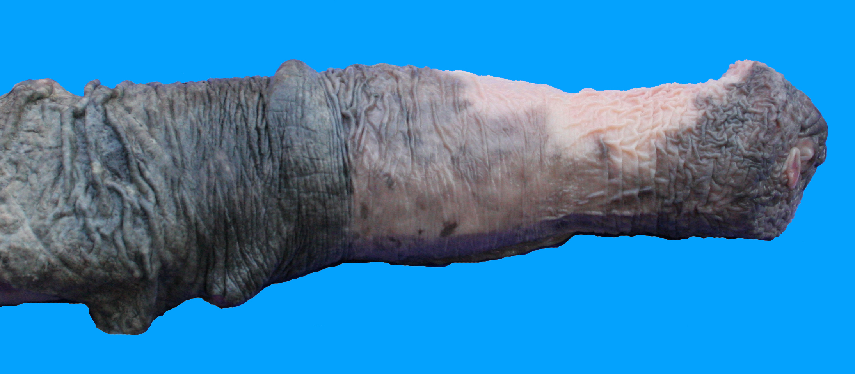
Equine Penis
Free Part of Penis
Urethral Process
Glans Penis
Prepuce (Retracted)

Slide 31
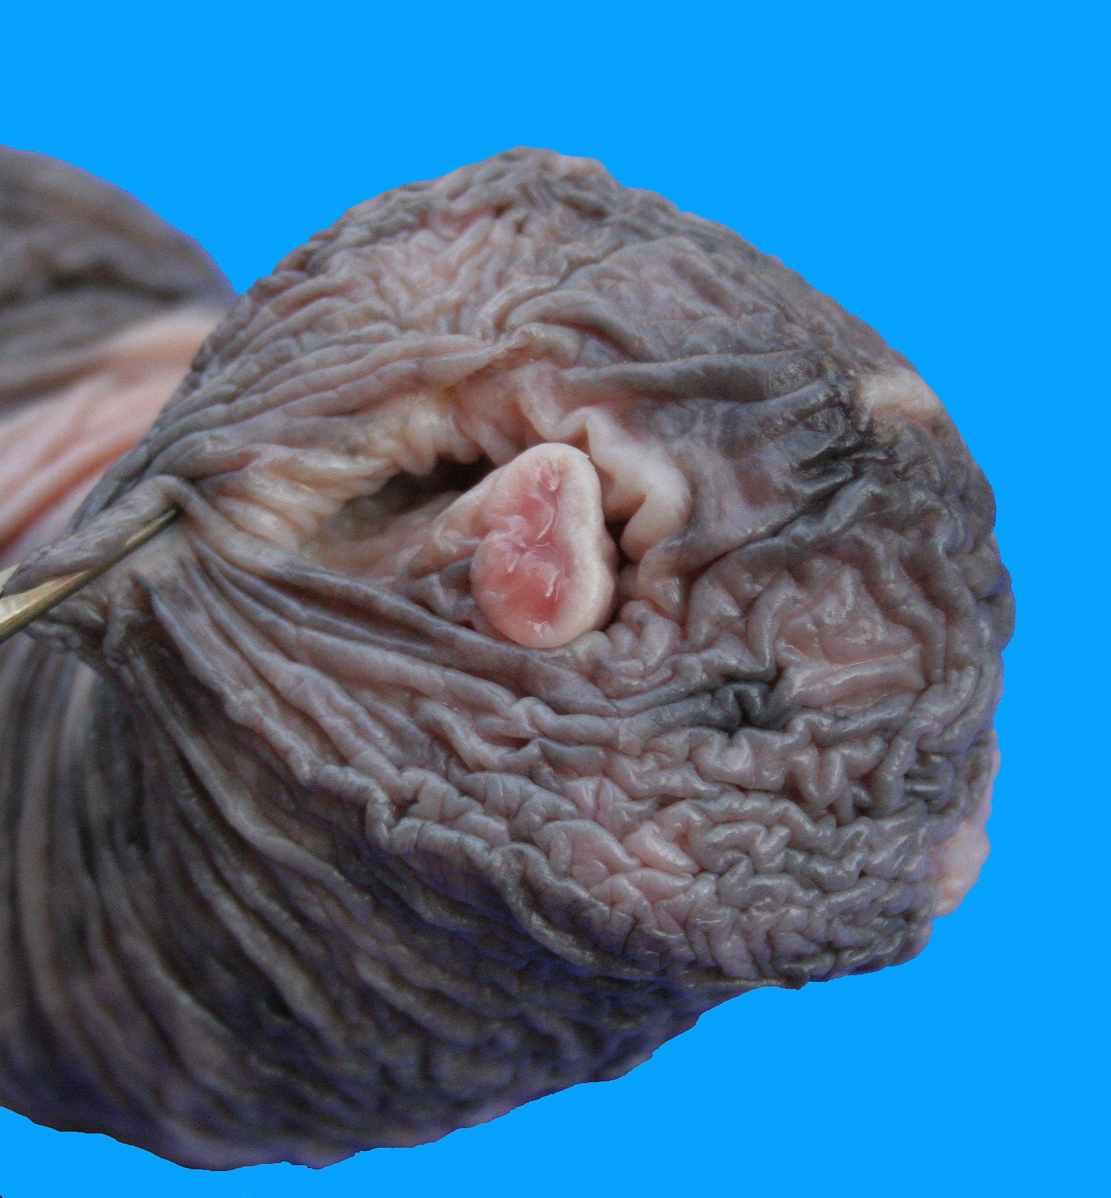
Glans Penis
Urethral Process
Fossa Glandis
(urethral sinus)

