Slide 1
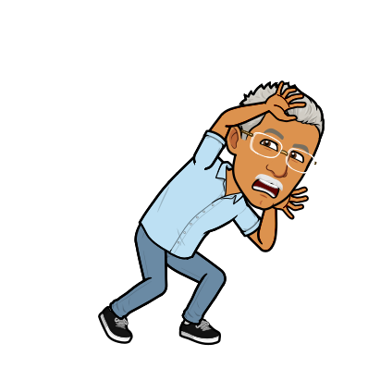
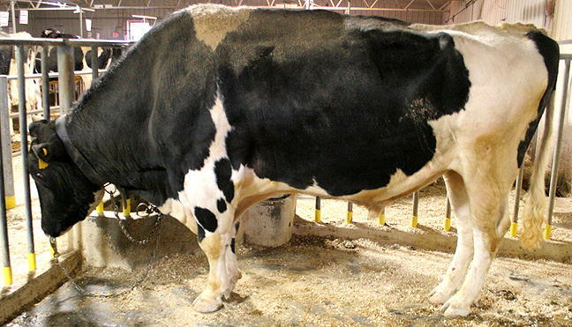
Animal/Dairy Science 434
Male Reproductive Tract Anatomy

Slide 2
Testis
Epididymis
Factory
1-25 X 10⁹ sperm/day
“Plant” must be air conditioned
Finishing School
  Fluid Absorption
  8-25 X 10⁹ sperm
    membrane changes
    nuclear & flagellar stabilization
    motility, fertility
    cytoplasmic droplet translocation
Penis
Delivery System
  Erection
  Protrusion
  Ejaculation
Tail of Epididymis
Warehouse and Delivery
  Storage 10-50 X 10⁹ sperm
  Sperm for 5-10 ejaculates
  Smooth muscle contractions upon sexual stimulation
Accessory Sex Glands
Alterations & Packaging
Metabolic substrates
Surface coatings
Transport for sperm

Slide 3
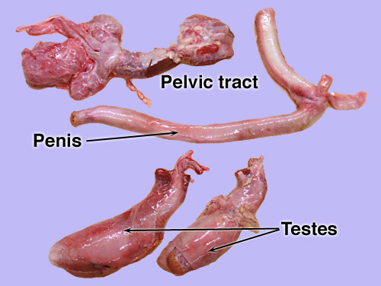
Bull Reproductive Tract

Slide 4
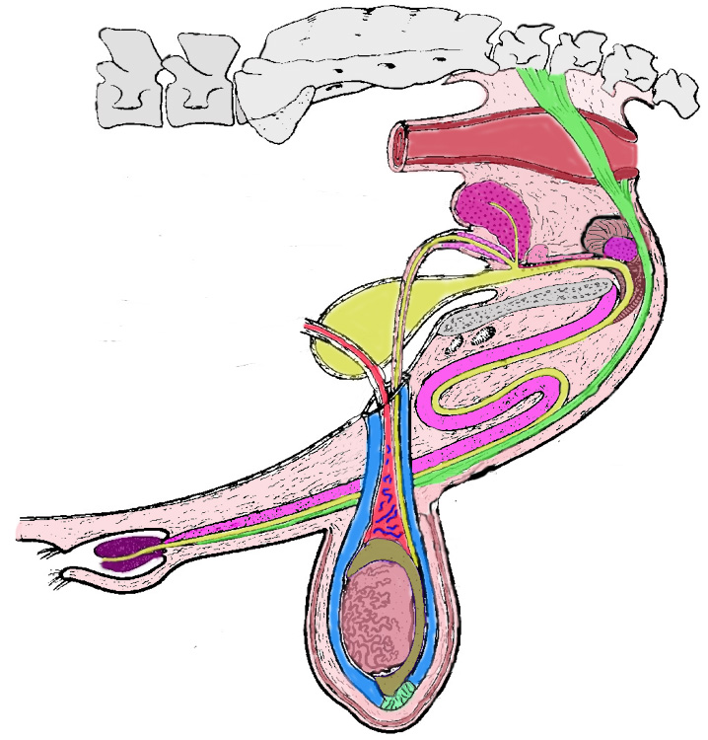
Reproductive Organs of the Bull

Slide 5
Reproductive Organs of the Bull
Testosterone
Sperm
Testis
Primary Sex Organ

Slide 6
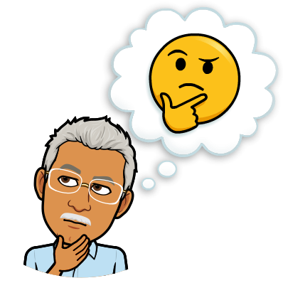
Quiz 3a
What are the 2 major functions of the testes?

Slide 7
Quiz 3a
What are the 2 major functions of the testes?
The formation of sperm and production of the hormone testosterone.

Slide 8
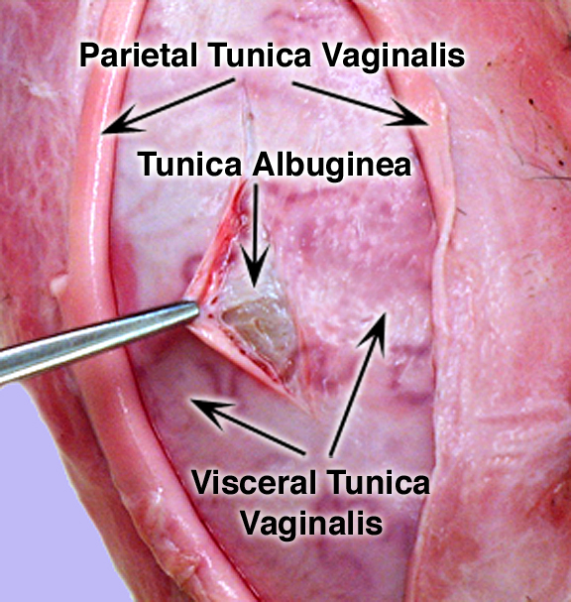
Bull Testis

Slide 9
Bull Tract
Thermosensor
Radiator
Protective sac
Scrotum

Slide 10
Bull Tract
Longitudinal Section
Cross Section

Slide 11
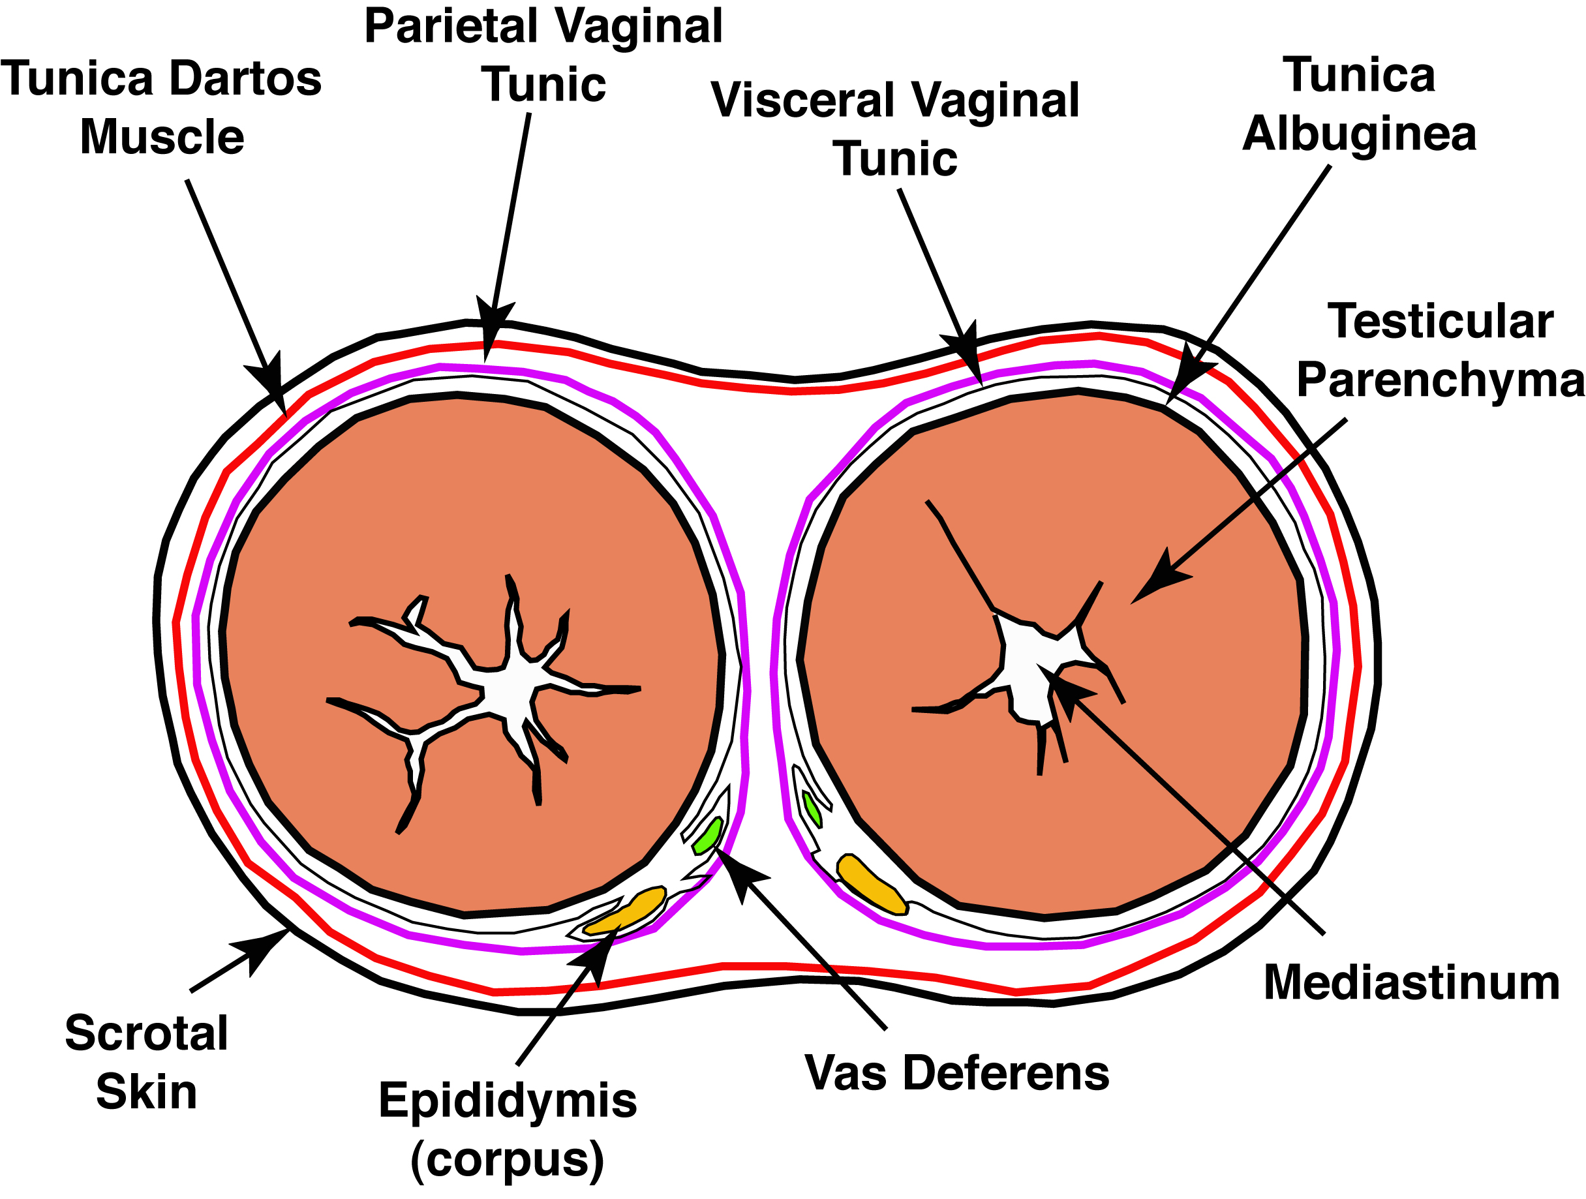
Scrotal Cross Section

Slide 12
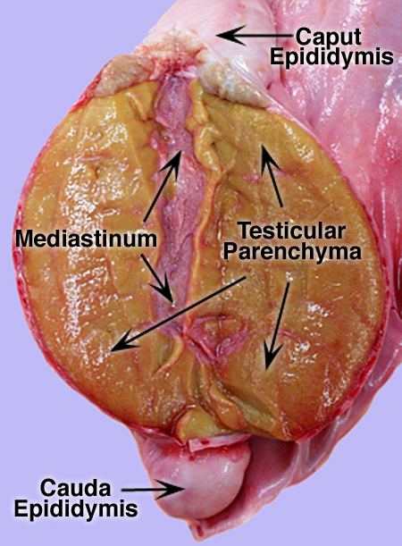
Scrotal Longitudinal
Section

Slide 13
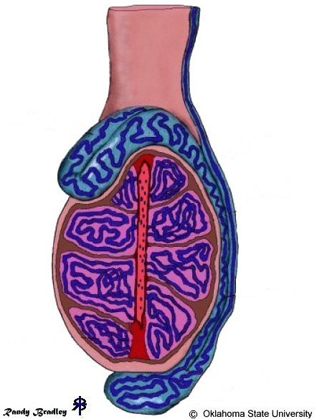
Structure of the Testis
Seminiferous Tubule
Tunica Albuginea
Rete Testis
(within the mediastinum)

Slide 14
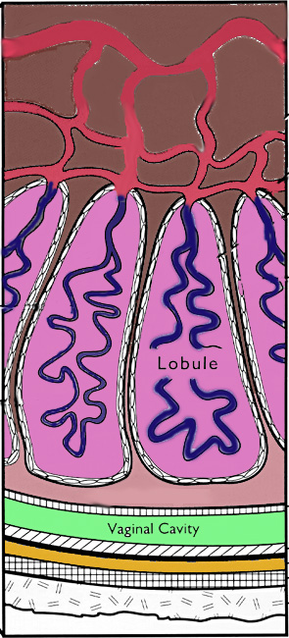
The Testis
Mediastinum
Rete Testis
Seminiferous
Tubule

Slide 15
Structure of the Testis
Seminiferous Tubule
Tunica Albuginea
Rete Testis
(within the mediastinum)

Slide 16
Structure of the Testis
Spermatic Cord
Secondary Sex Organs
Vas Deferens
Caput Epididymis
Vasectomy
Vas Efferentia
6-12 tubules
Corpus
Epididymis
Cauda Epididymis

Slide 17
Structure of the Testis
Spermatic Cord
Vas Deferens
Caput Epididymis
Vasectomy
Vas Efferentia
6-12 tubules
Seminiferous Tubule
Tunica Albuginea
Corpus
Epididymis
Rete Testis
(within the mediastinum)
Cauda Epididymis

Slide 18
Quiz 3b
Sperm are produced in what structure within the testes?
Where are sperm stored in the male reproductive tract?

Slide 19
Quiz 3b
Sperm are produced in what structure within the testes?
Seminiferous Tubules
Where are sperm stored in the male reproductive tract?
Tail of the Epididymis (Cauda Epididymis).

Slide 20
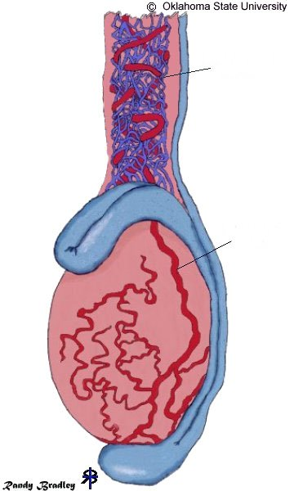
Spermatic Chord
Pampiniform
Plexus
Vascular, lymphatic and nerves
Heat exchanger
Houses cremaster muscle
Testicular
Artery
Pampiniform Plexus
  Counter Current Exchange
    39°C - 34°C
    70 ng T/ml - 4.8 ng T/ml

Slide 21
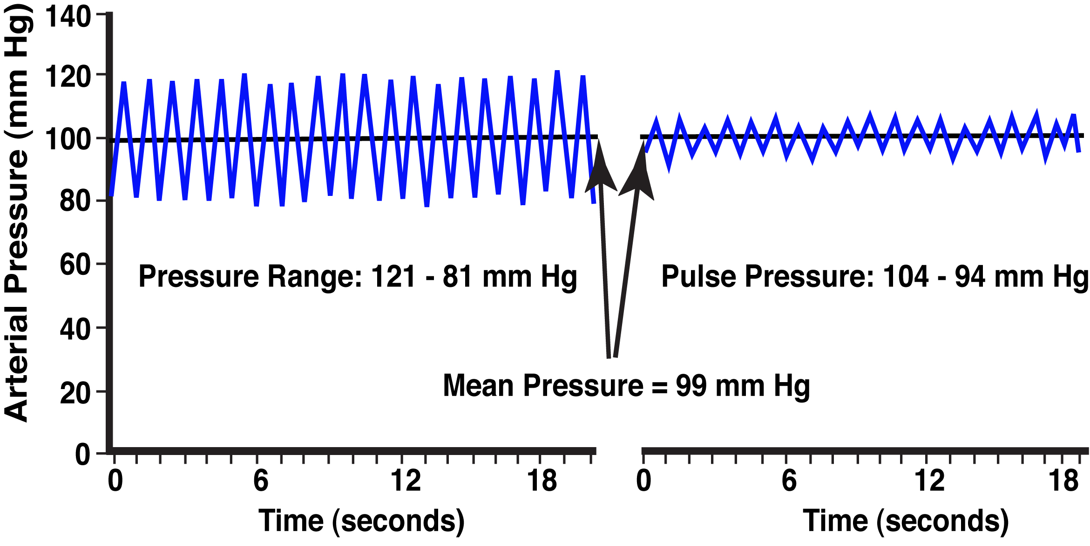
Testis Arterial Pulse
Spermatic
Artery
Pampiniform
Plexus
Testicular
Artery
Testicular
Artery

Slide 22
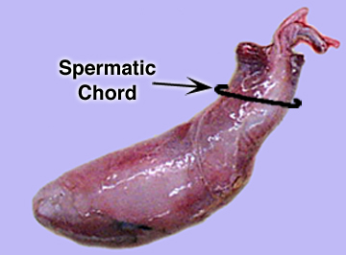
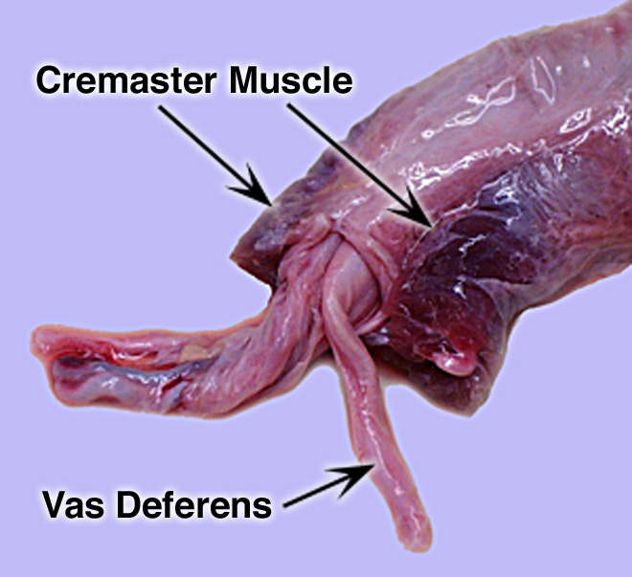
Spermatic Chord
Pampiniform
Plexus

Slide 23
Bull Tract
Tunica Dartos

Slide 24
Contraction of the Tunica Dartos
Testis
Tunica Dartos
Smooth muscle
Androgen dependent
(Testosterone)

Slide 25
Bull Tract
Gubernaculum

Slide 26
Question 3c
How is the testis cooled?

Slide 27
Question 3c
How is the testis cooled?
The blood is cooled by the pampiniform plexus and the testis can be raised or lowered by the tunica dartos.
The external cremaster functions in fight or flight events.

Slide 28
Bull Tract
Pelvic Genitalia

Slide 29
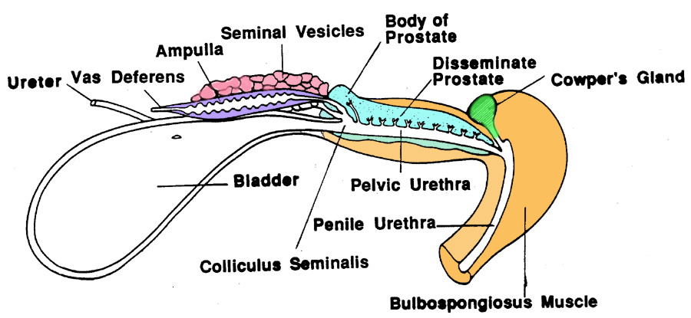
Pelvic Genitalia of the Bull
Pelvic Urethra
Muscle

Slide 30
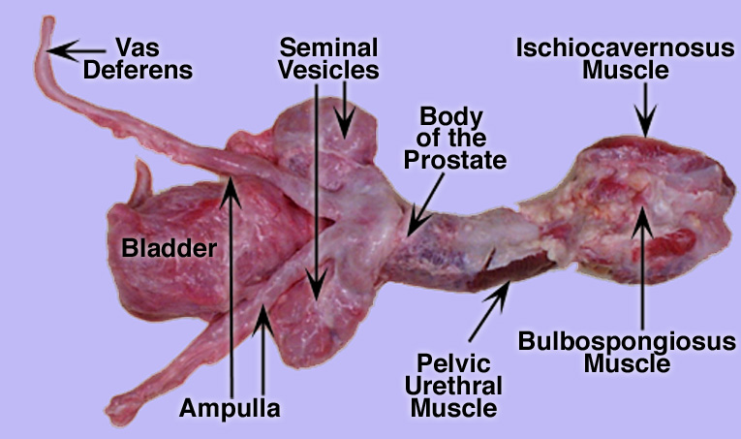
Bull

Slide 31
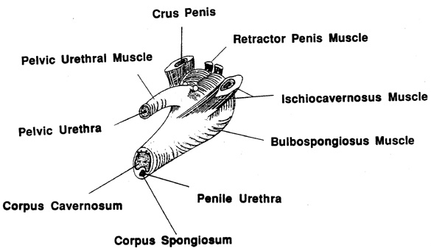
Bulb of the Penis

Slide 32
Reproductive Organs of the Bull
Prostate
Rectum
Cowpers Gland
Seminal Vesicles
Ampulla
Bladder
Vas Deferens
Retractor Penis
Muscle
Sigmoid
Flexure
Glans
Penis
Caput Epididymis
Scrotum
Testis
Cauda Epididymis
Gubernaculum

Slide 33
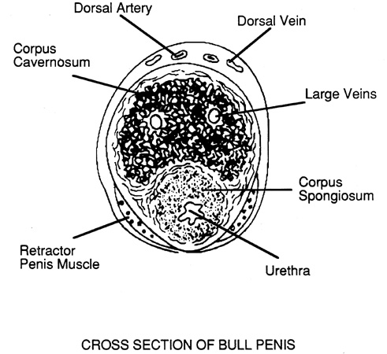
Cross Section of Bull Penis

Slide 34
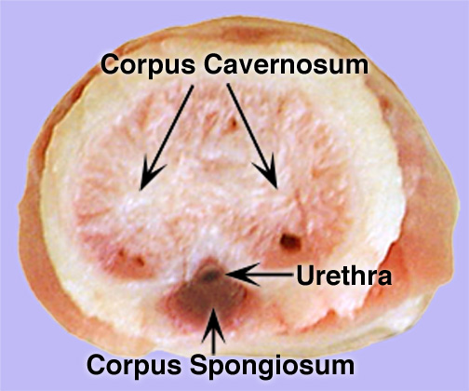
Penis Cross Section

Slide 35
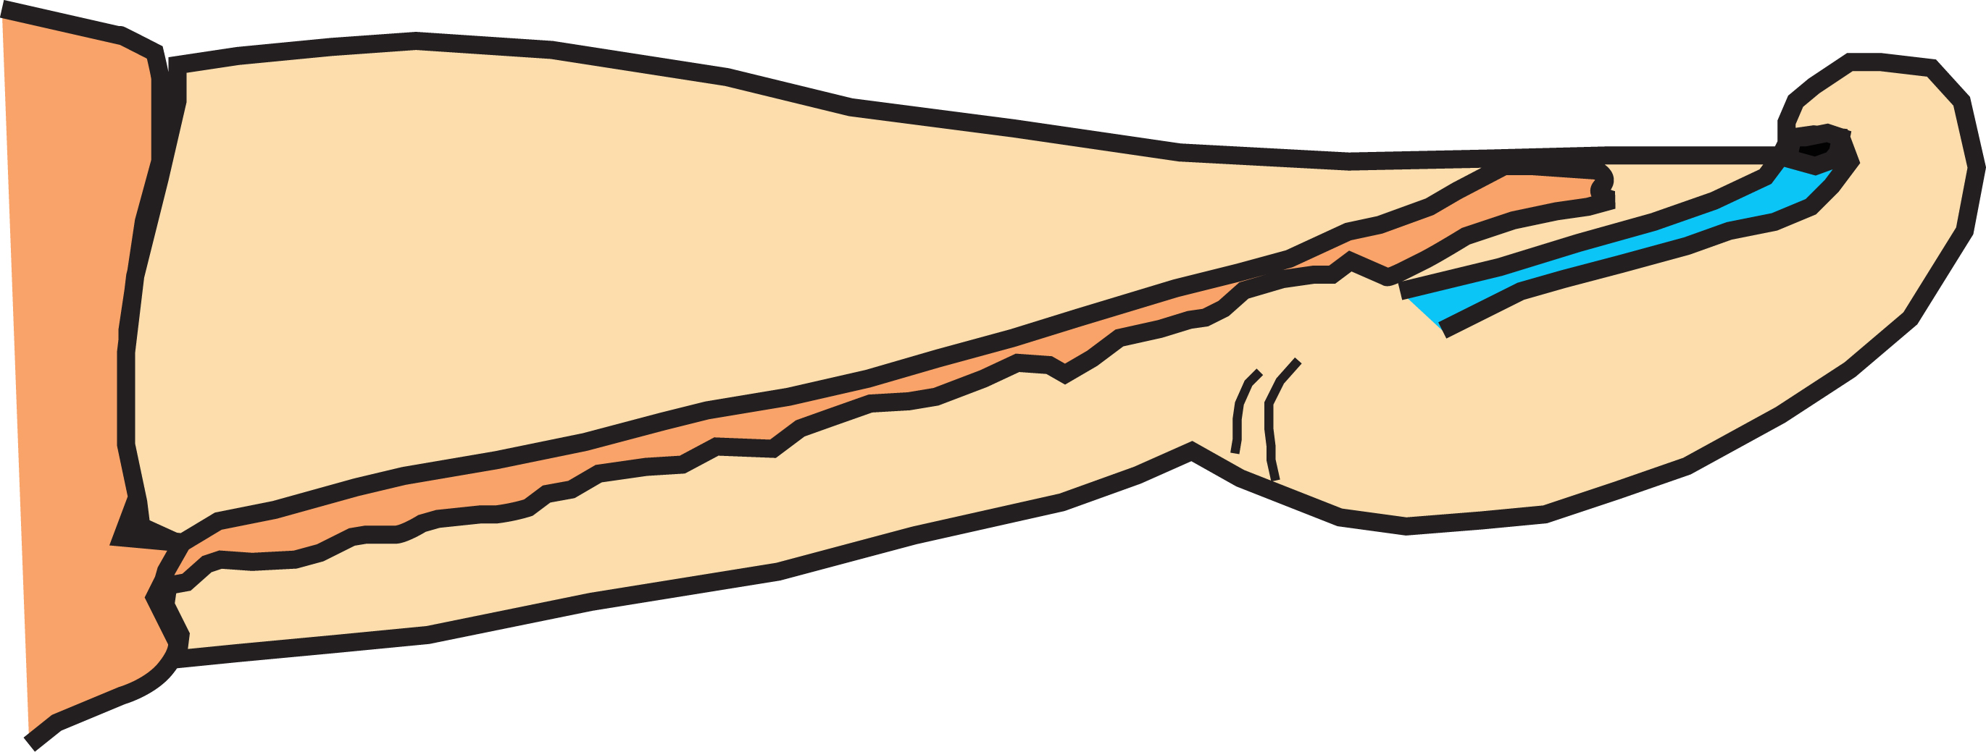
Glans Penis of the Bull
Free Part of Penis
Urethral Process
Raphe
Glans Penis
Prepuce (Retracted)

Slide 36
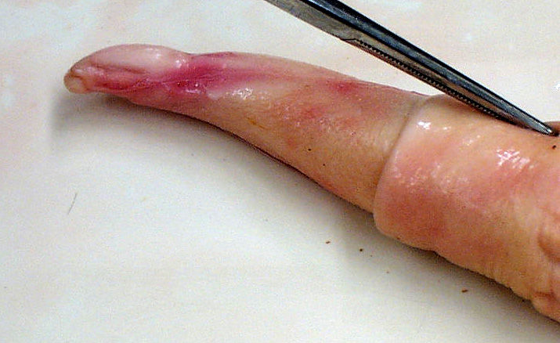
Glans Penis
Urethral Process
Glans Penis
Raphe
Free Part of Penis
Prepuce (Retracted)

Slide 37
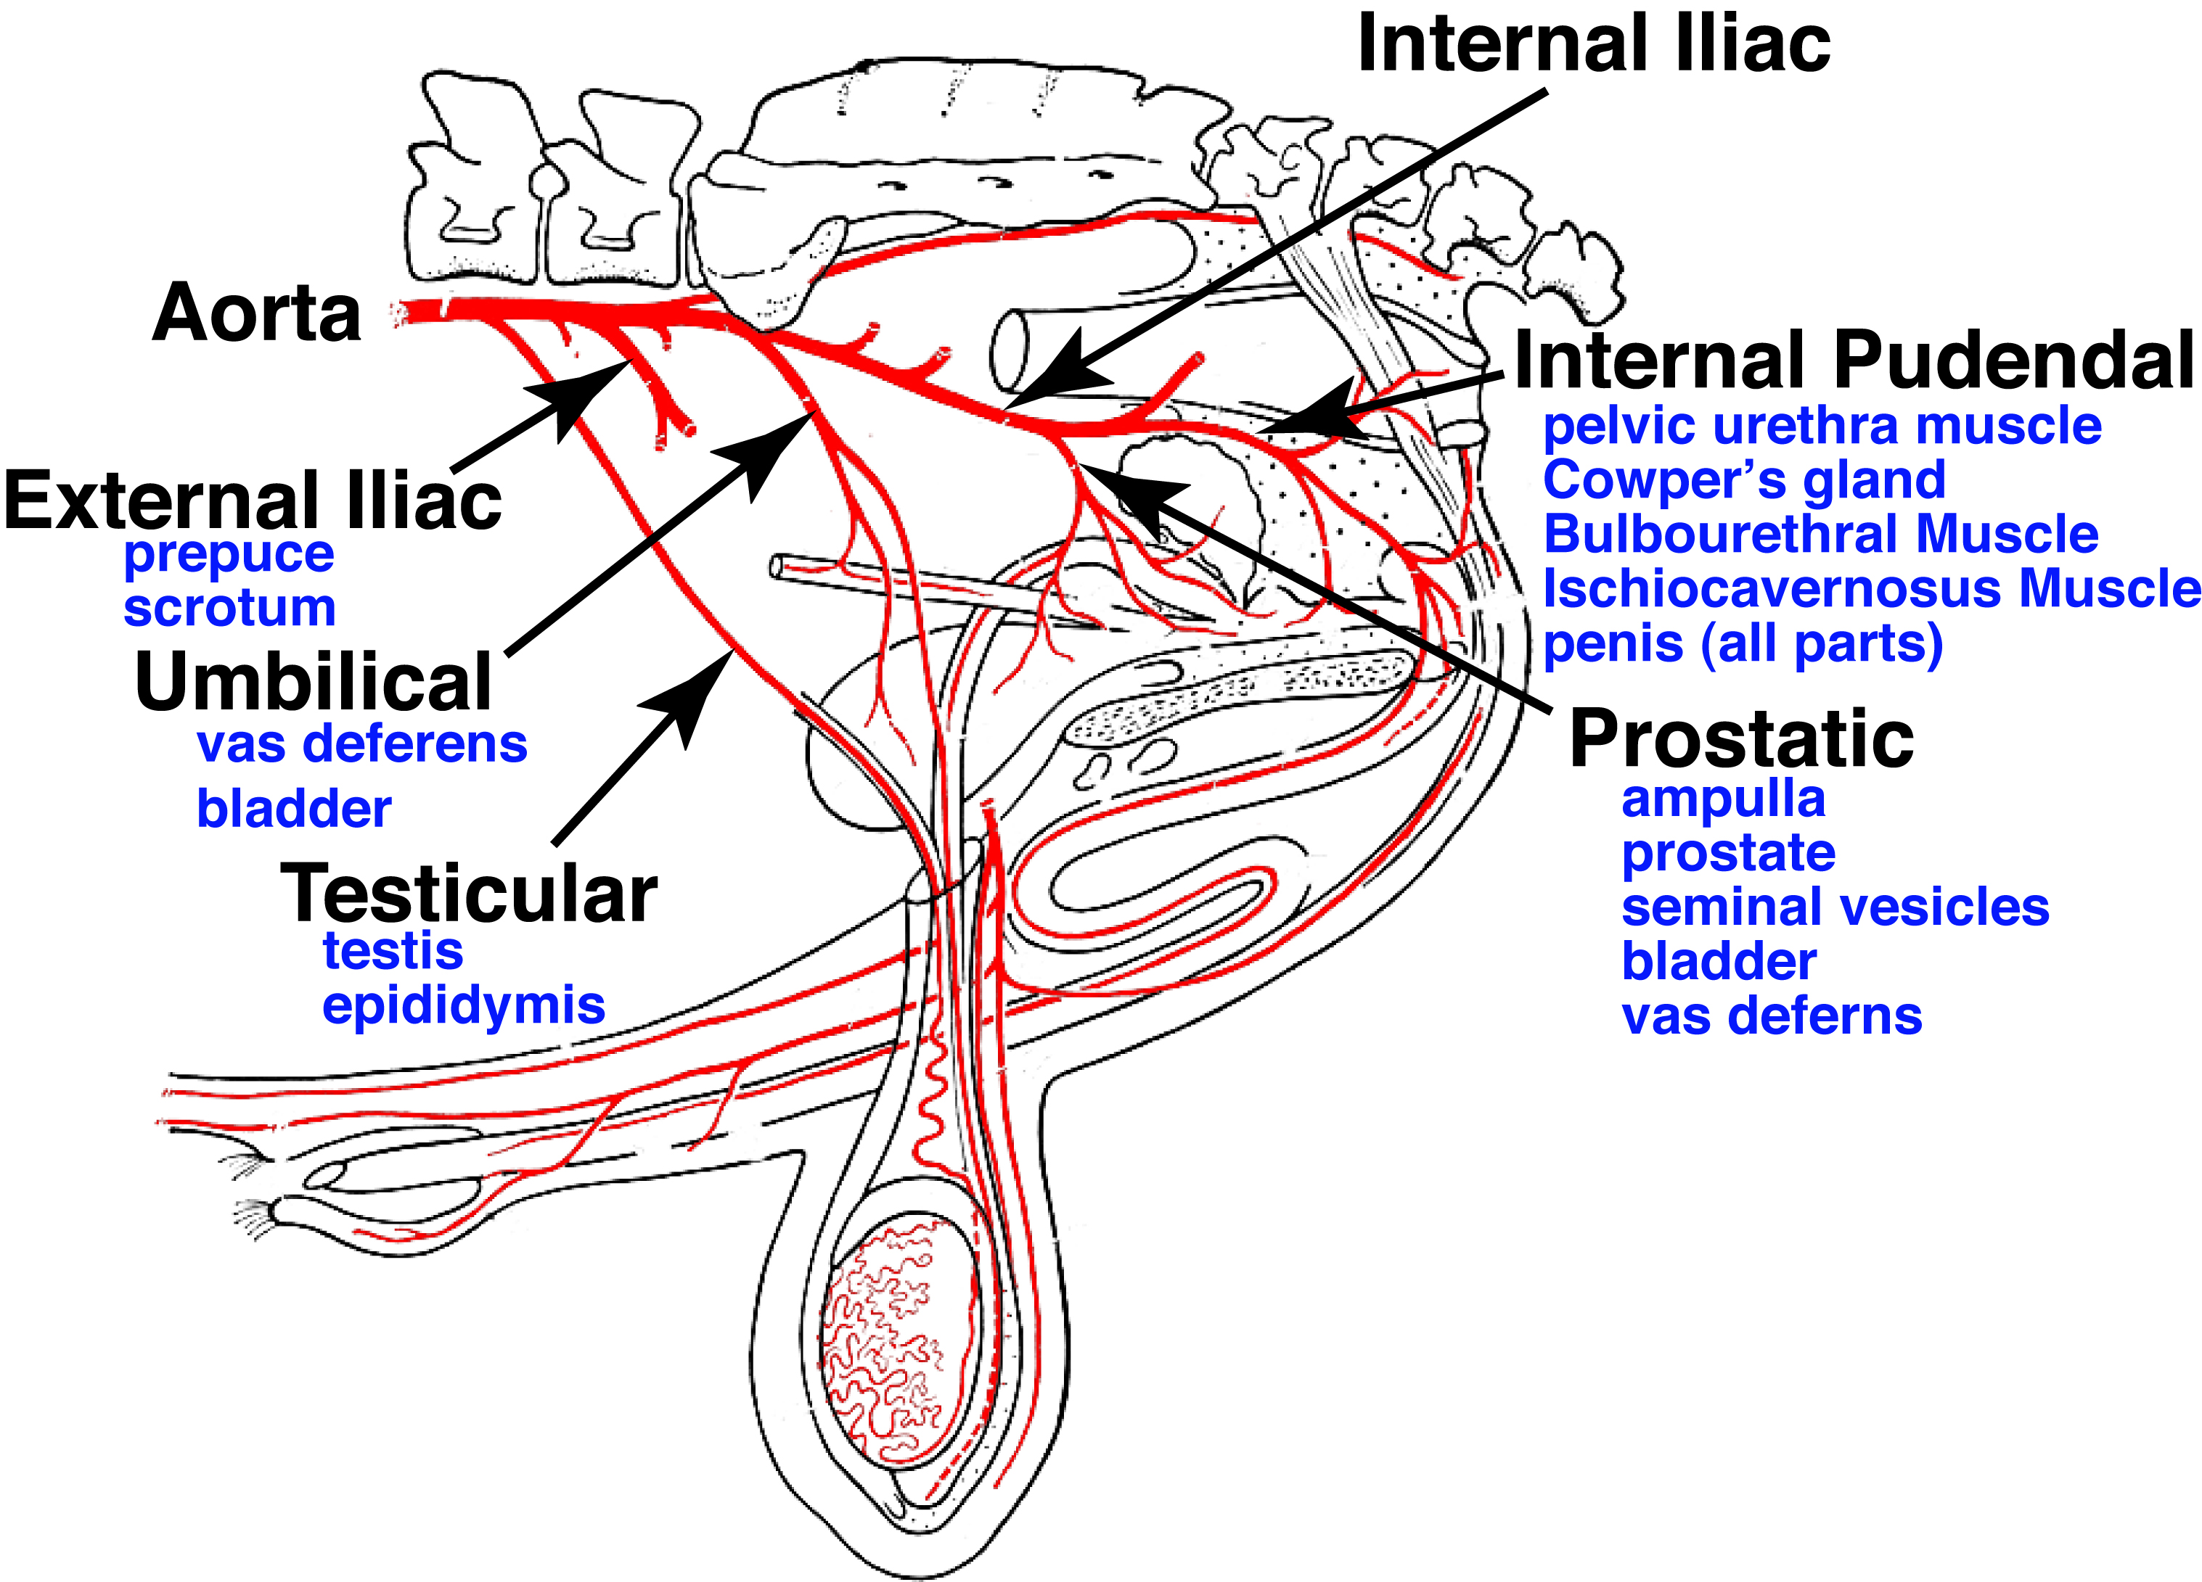
Arterial Supply

Slide 38

Quiz 3d
What is a vasectomy and how does this differ from castration?

Slide 39
Quiz 3d
What is a vasectomy and how does this differ from castration?
Vasectomy is when the vas deferens is cut to prevent a male from getting a female pregnant.
Castration is when the testes are removed and will prevent a pregnancy but also eliminates testosterone and therefore male behavior.

Slide 40
Reproductive Organs of the Bull
Prostate
Rectum
Cowpers Gland
Seminal Vesicles
Ampulla
Bladder
Retractor Penis
Muscle
Vas Deferens
Sigmoid
Flexure
Glans
Penis
Caput Epididymis
Scrotum
Testis
Cauda Epididymis
Prepuce
Gubernaculum

