Slide 1
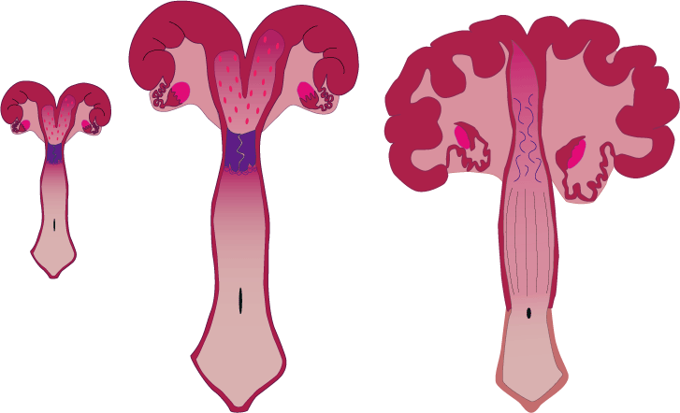
Animal/Dairy Science 434
Female comparative anatomy;
History of Reproductive Physiology

Slide 2
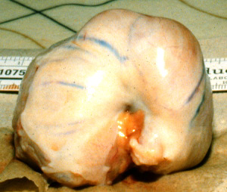
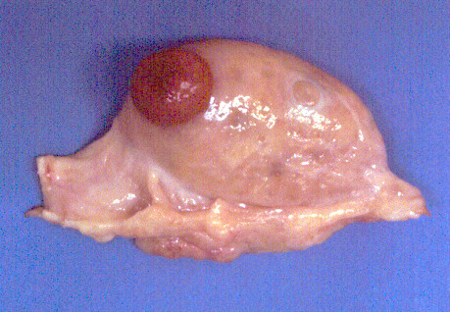
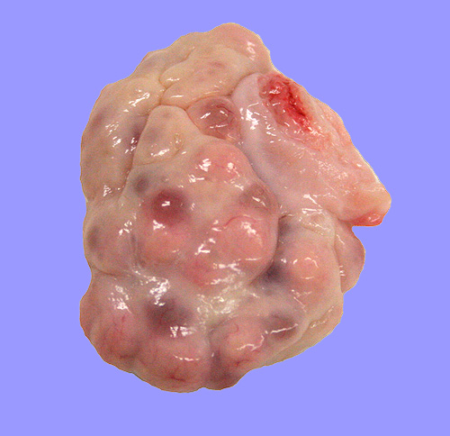
Ovarian Differences
Cow
Mare
Sow

Slide 3
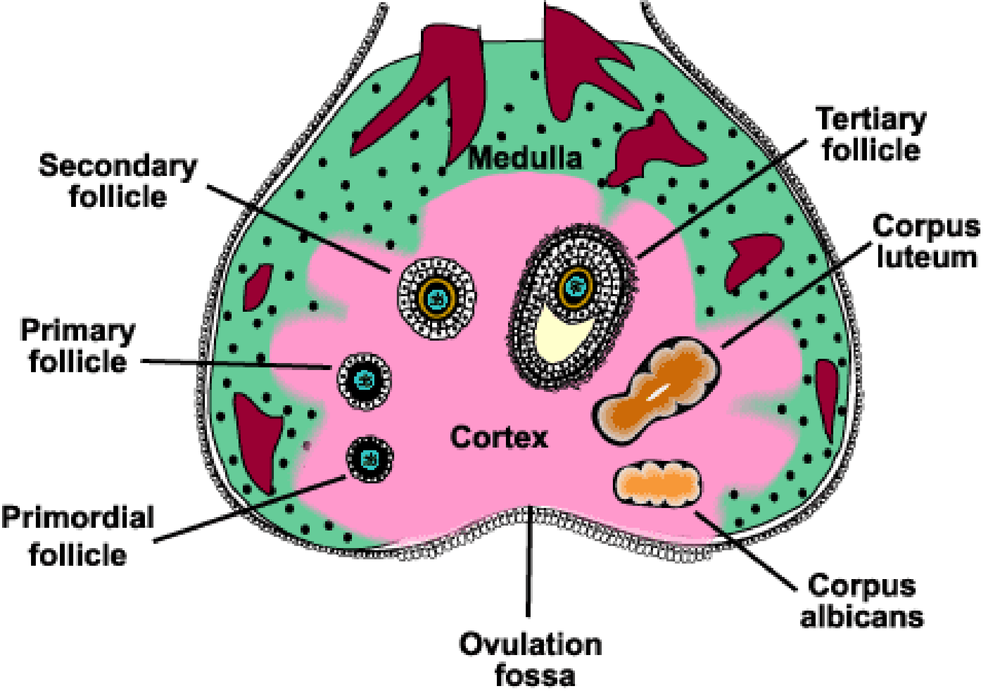
Equine Ovary
}
Blood and lymphatic
Vessels & nerves
Hilus
Tunica
Albuginea
Germinal
Epithelium
85% of Ovarian
Cancers

Slide 4
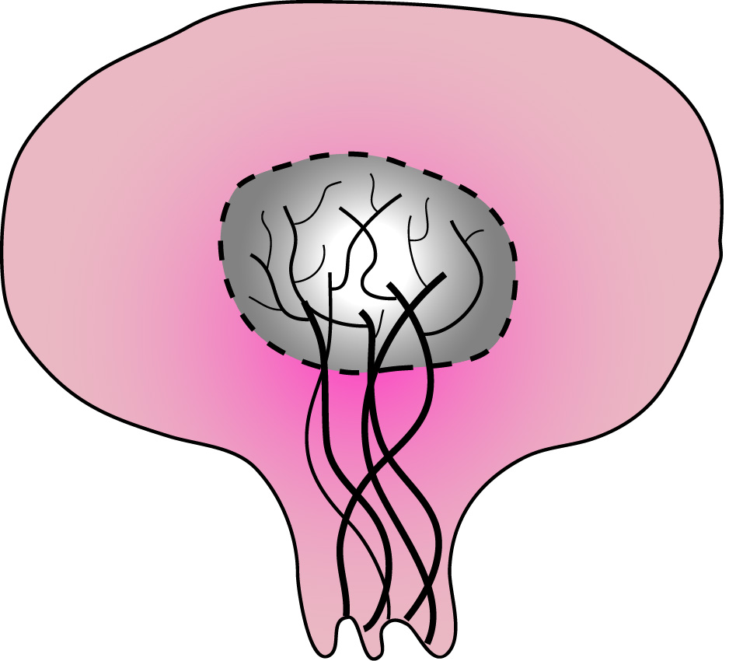
Cow, Ewe, Human, Sow Ovary
Germinal
Epithelium
Cortex
85% of Ovarian
Cancers
Medulla
Tunica
Albuginea
Blood and lymphatic
Vessels & nerves
}
Hilus

Slide 5
Cow
Cow, Sow, Ewe, Human
Sow
Cortex on outside
Ovulation can occur on any point of the ovary

Slide 6
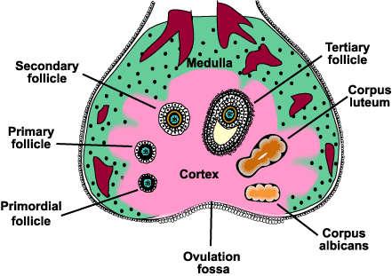
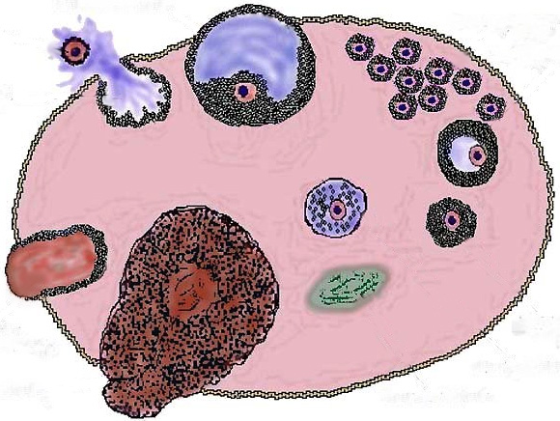
Cow
Mare

Slide 7
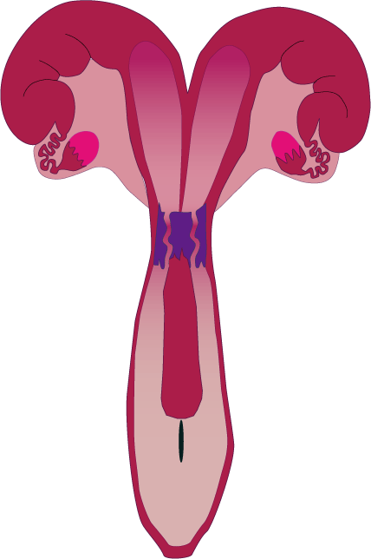
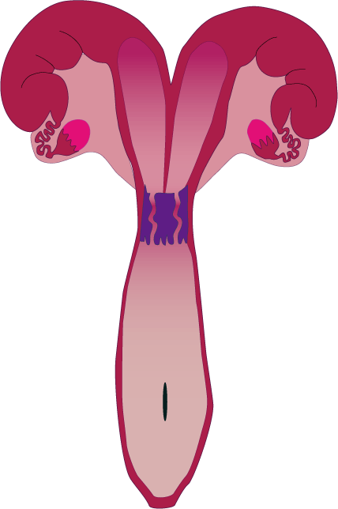
Duplex
Rabbit,
Mouse
Oposum
2 Uterine Horns
2 Cervixes
2
Vaginas
1
Vagina

Slide 8
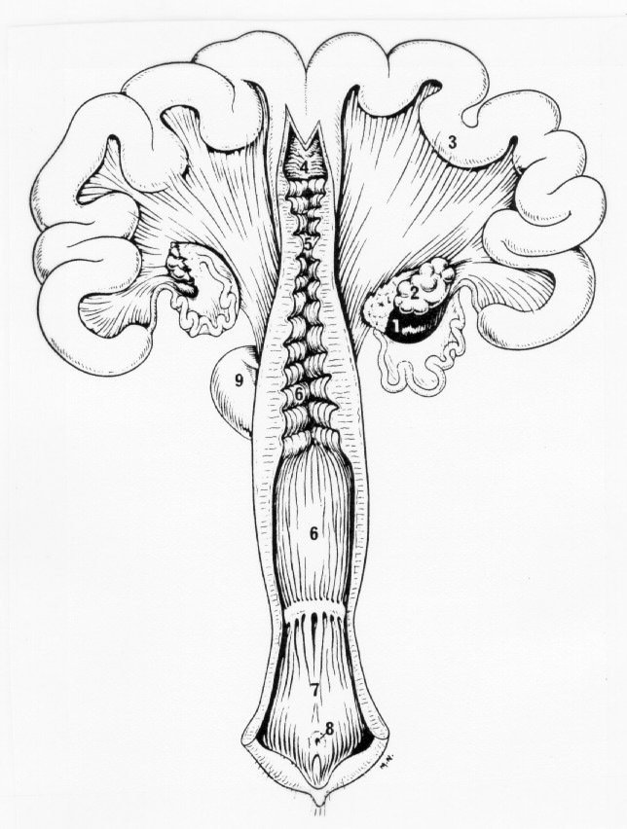
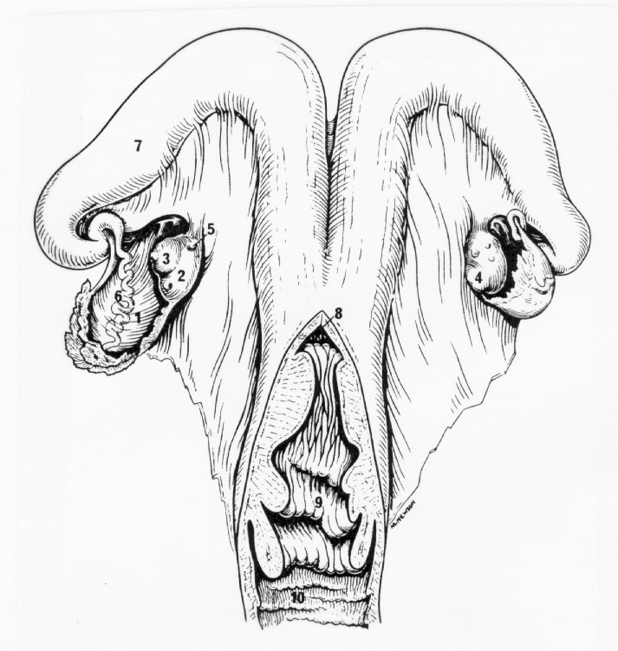
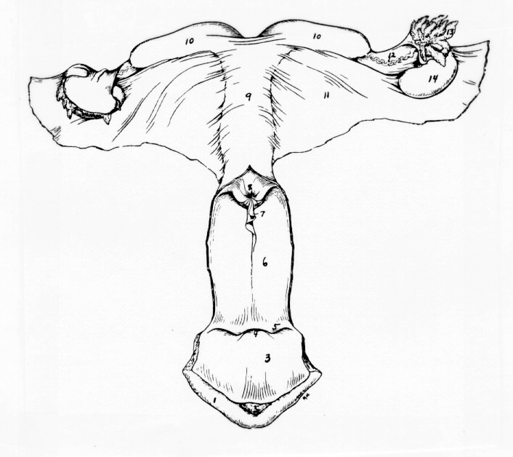
Uterine and Cervical Differences
Cow
Sow
Mare

Slide 9
Bicornuate
Cow
Sow
Ewe
Smaller uterine horns
1 Vagina
1 Cervix
1 Uterine Body
2 Uterine Horns
Large uterine horns

Slide 10
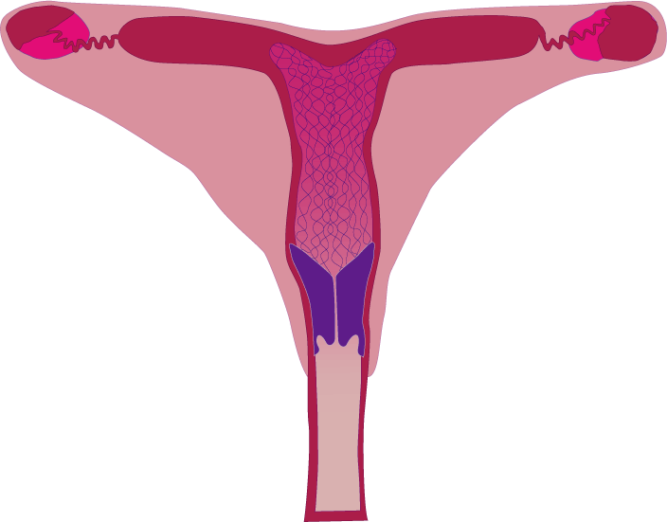
Bicornuate
Mare
Large uterine body
Smaller uterine horns
1 Vagina
1 Cervix
1 Uterine Body
2 Uterine Horns

Slide 11
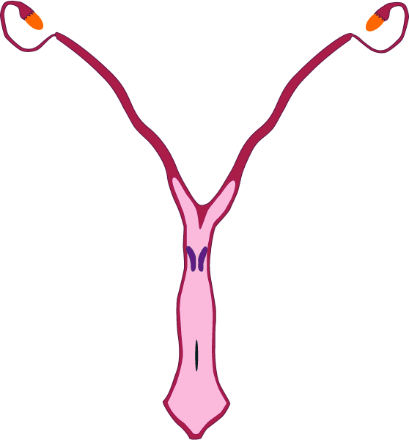
Bicornuate
Bitch
(Canine)
Queen
(Feline)
1 Vagina
1 Cervix
1 Uterine Body
2 Uterine Horns
Small uterine body
Long uterine horns

Slide 12
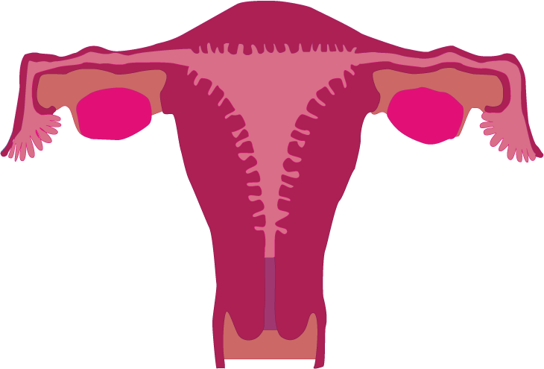
Simplex
Woman
Large uterine body
No uterine horns
1 Vagina
1 Cervix
1 Uterine Body

Slide 13
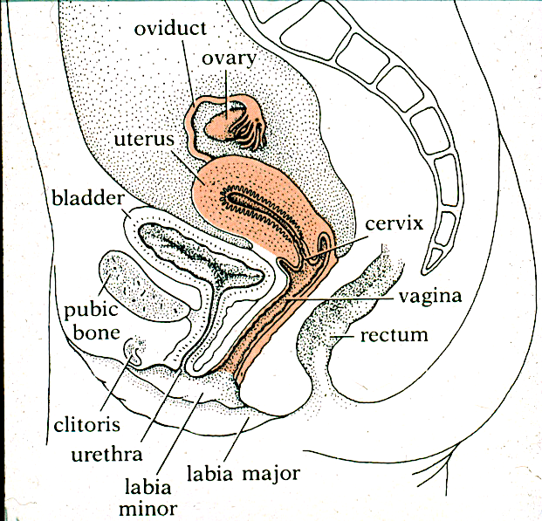
Human Tract

Slide 14
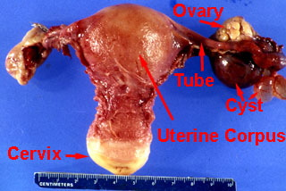
Human Tract

Slide 15
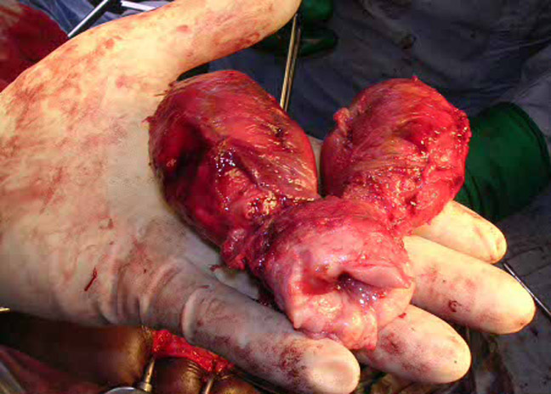
A 47-year old woman underwent a hysterectomy for excessively heavy menses. She had previously had four normal deliveries. This structure was removed, what is wrong?

Slide 16
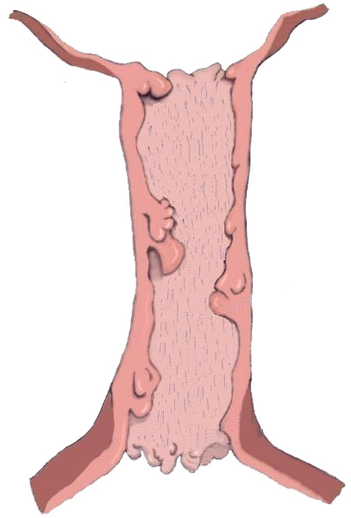
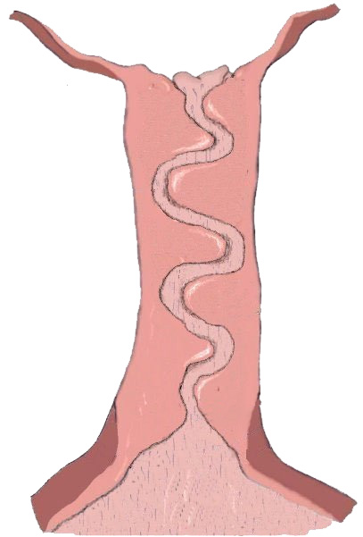
Uterine Body
Uterine Body
Longitudinal
Folds
Mare
Sow
No
obstacles
Interdigitating
pads
No
fornix
vagina
Fornix Vagina
Vagina
Vagina

Slide 17
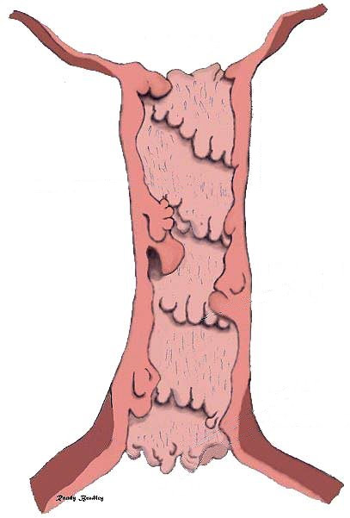
COW
Uterine Body
Internal Cervical Os
Cervix is composed of thick connective tissue
Mucus is secreted near the time of breeding and ovulation.
Cow has 4-5
annular rings
Cervix
External Cervical Os
Vagina

Slide 18
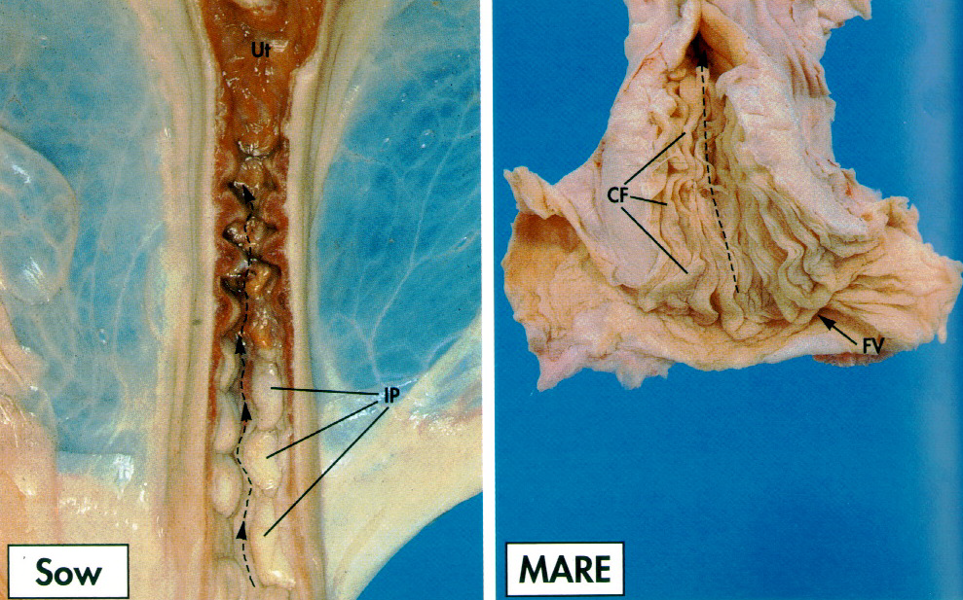
Cervix
Cervical
Folds
FV
IP
Sow
Mare

Slide 19
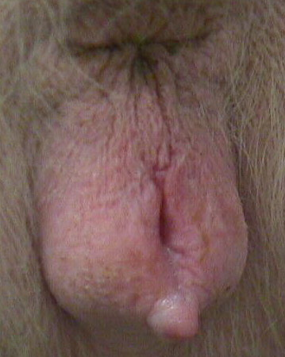
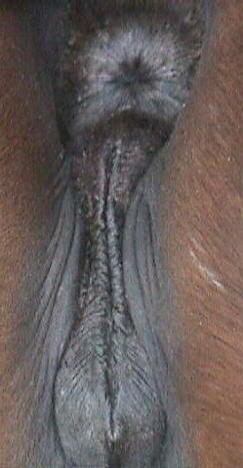
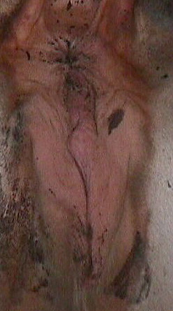
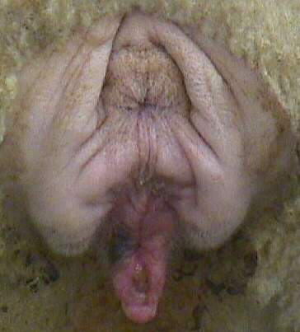
External Genitalia
Sow
Mare
Cow
Ewe

Slide 20
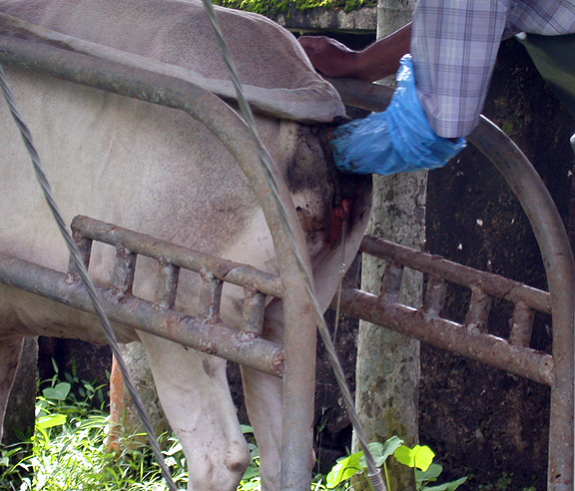
What is this?

Slide 21
Human Tract

Slide 22
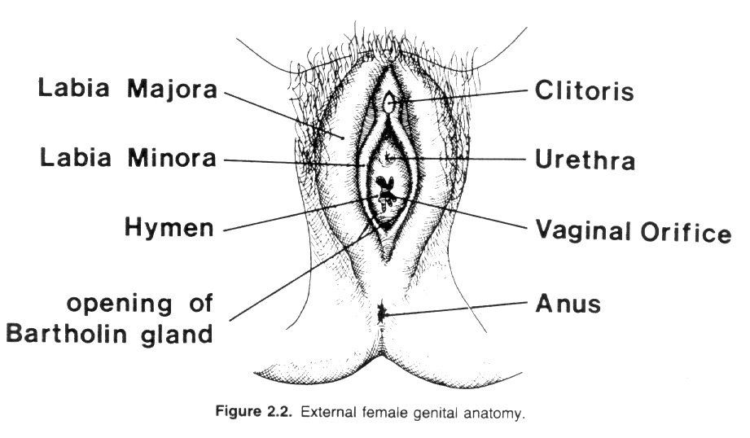
External Genitalia

Slide 23
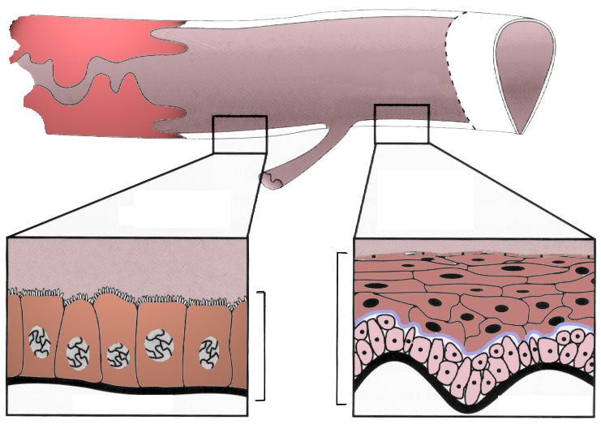
Vagina
Anterior Vagina
Posterior Vagina (Vestibule)
Cervix
Vulva-Vaginal Sphincter
(Hymen)
Fornix
Columnar
Epithelium
Stratified
Squamous
Epithelium
Urethra
Mucosa
Submucosa
Submucosa

Slide 24
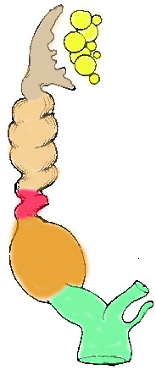

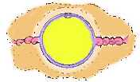
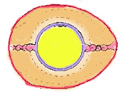
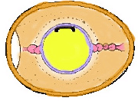
Avian Female Anatomy
Infundibulum
Ovary
perivitelline
membrane
albumen
chalazae
Magnum
Oviduct
shell membrane
Isthmus
Uterus
cleaving blastodisc
Intestine
24 hrs
50K-cells
Left side of
Reproductive
Tract Develops!!
Shell Gland
Right
Oviduct
vagina
shell
cloaca

Slide 25
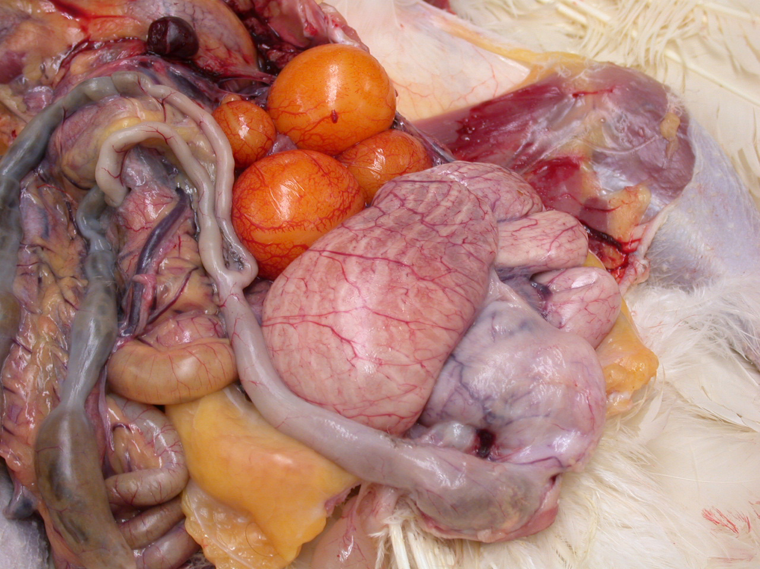
Chicken
Tract
Ovary
Magnum
Intestine
Shell Gland

Slide 26
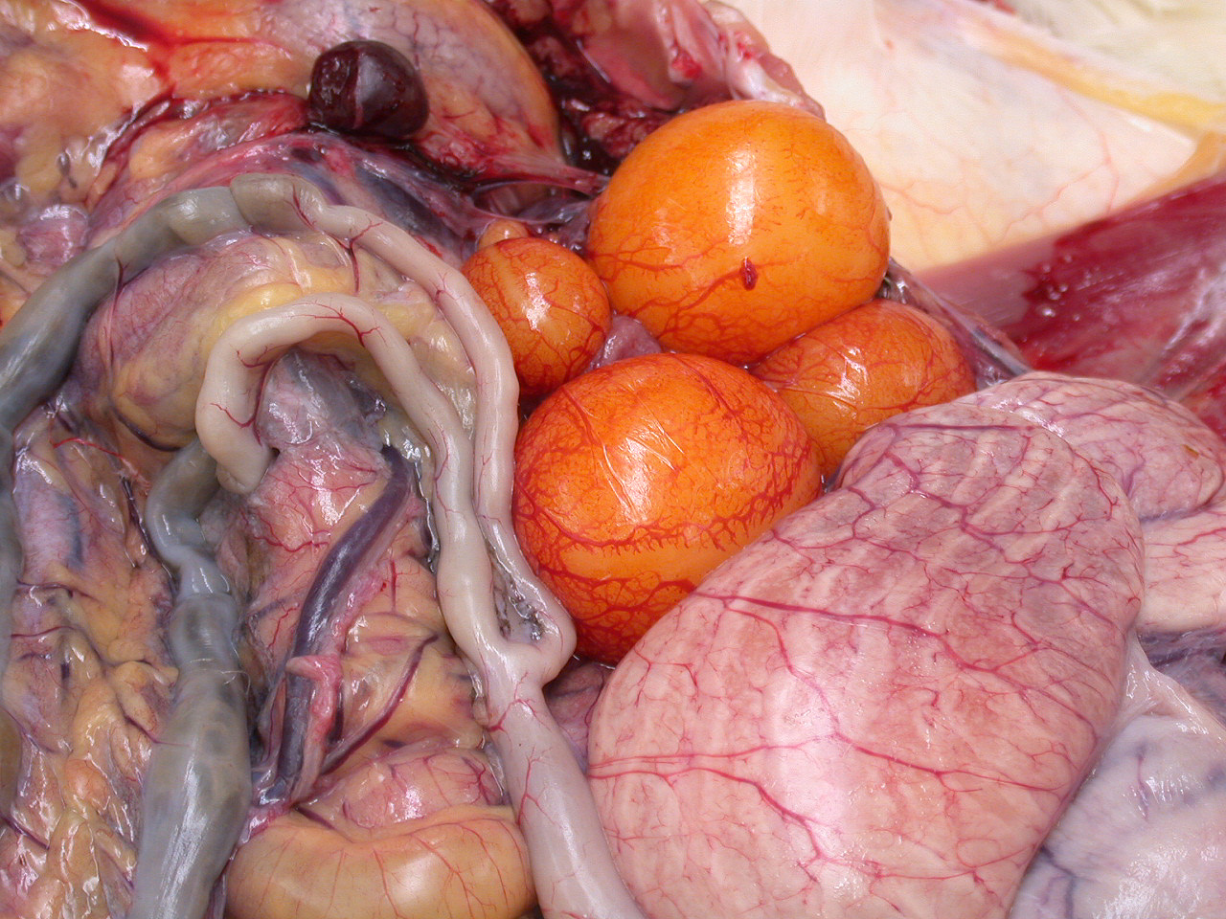
Chicken
Ovary
Hierarchal
Follicles

Slide 27
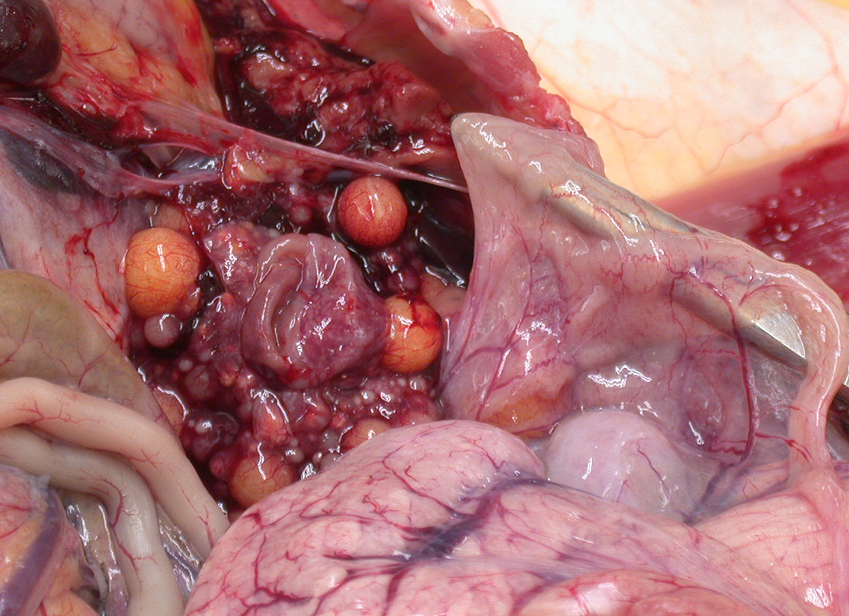
Ovary with large follicles removed
Ruptured follicle

Slide 28
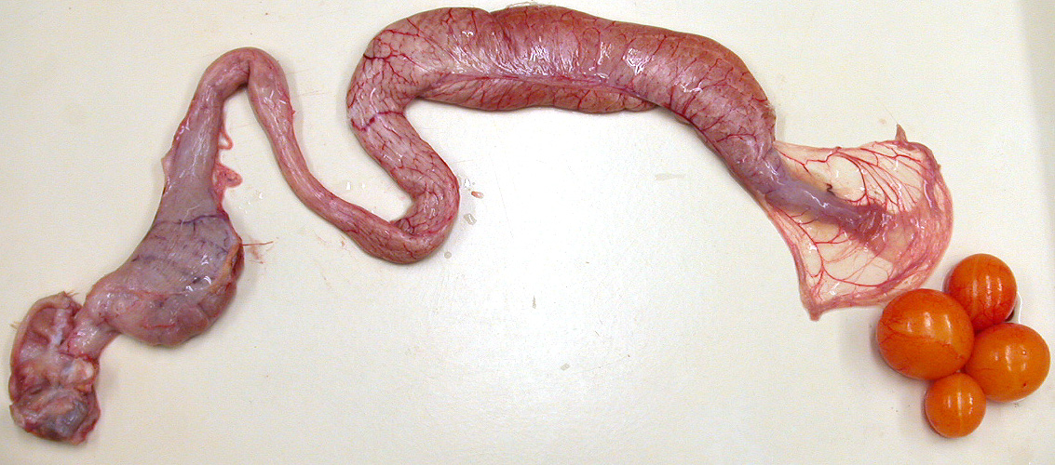
Chicken Reproductive Tract
Isthmus
Infundibulum
Magnum
Shell Gland
Follicles
Cloaca

Slide 29
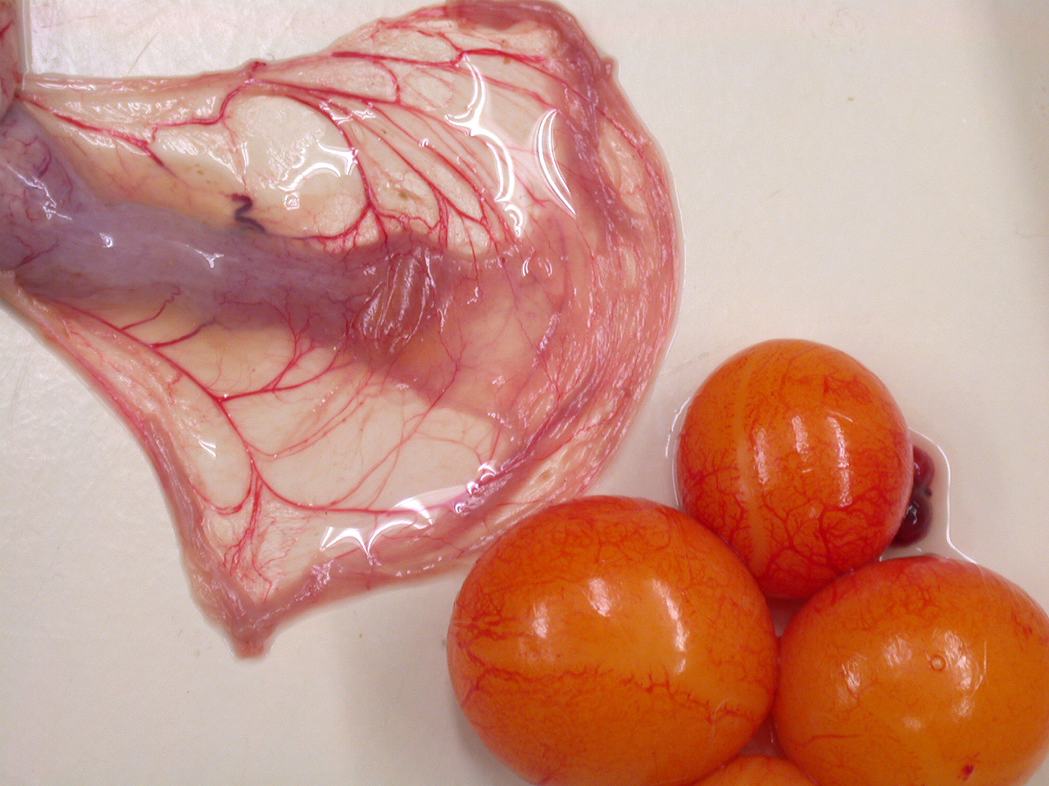
Infundibulum

Slide 30
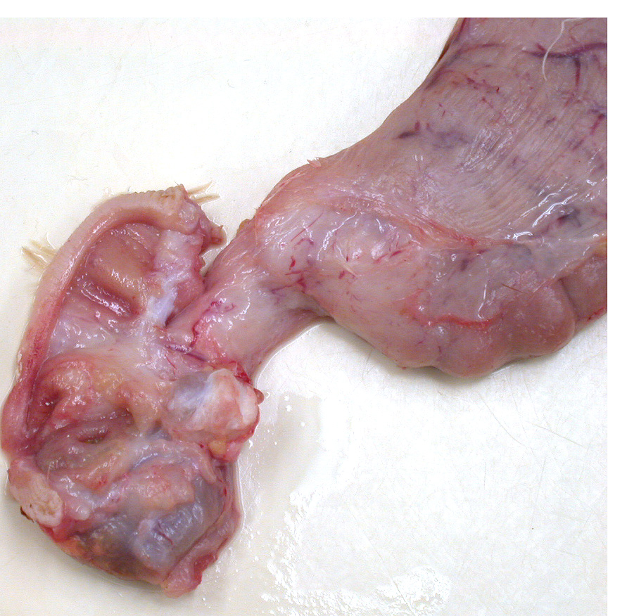
Cloaca
Vagina
Vaginal opening
Intestine opening

Slide 31
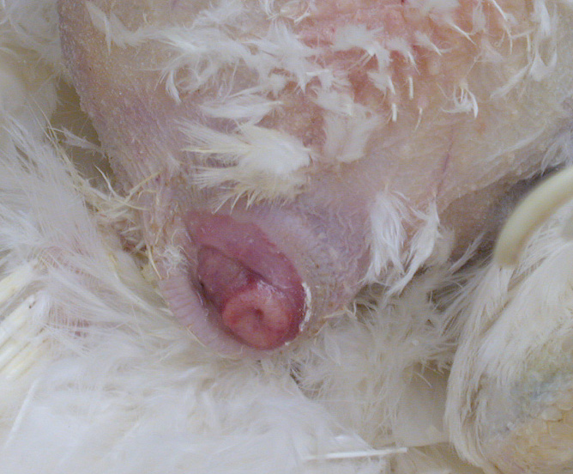
Cloaca of Chicken
Intestine opening
Vagina opening

Slide 32
Historical Development of Reproductive Physiology
Covered in Book, Chapter 1
Material will be covered in Lecture exam I
Notes are in this section in PPTX file.
Notes:
Aristotle - 384 to 322 BC
First recorded idea on how the reproductive system functions described in “Generation of Animals”
Thought fetus arose from menstrual blood because during pregnancy menstruation stopped
Also thought semen initiated development when seminal fluid was deposited in the female during copulation.
Semen came from all parts of the body and testes were only to keep the transporting ducts from getting chinked or plugged with seminal fluid.

Slide 33
Historical Development of Reprod. Physiol.
Aristotle 384-322 BC
Fetus arises from menstrual blood
Seminal plasma initiates the conversion of menstrual blood
Semen from all parts of body
Generation
of Animals
Notes:
Aristotle - 384 to 322 BC
First recorded idea on how the reproductive system functions described in “Generation of Animals”
Thought fetus arose from menstrual blood because during pregnancy menstruation stopped
Also thought semen initiated development when seminal fluid was deposited in the female during copulation.
Semen came from all parts of the body and testes were only to keep the transporting ducts from getting chinked or plugged with seminal fluid.

Slide 34
The Age of Gross Anatomy
Fallopius (1562)
  Describes the oviduct
Coiter (1573)
  Describes the corpus luteum
Regnier de Graff (1672)
  Describes the antral follicle (Graafian Follicle)
Notes:
Fallopius -1562
described oviduct
Coiter - 1573 (student of Fallopius)
discovered the corpus luteum
Regnier de Graaf - 1672
Describe the antral follicle on the ovary that we often now call the Graafian follicle.
He killed rabbits at 30 minute intervals after copulation and found wound like scars on ovary corresponds to the number of embryos in the uterus but thought whole follicle was the egg.
van Lewwenhoek - 1677
developed a simple microscope
a medical student suggested semen might contain living cells
saw small particles that moved and he called these “animalcules”
found animalcules in semen from males of many species

Slide 35
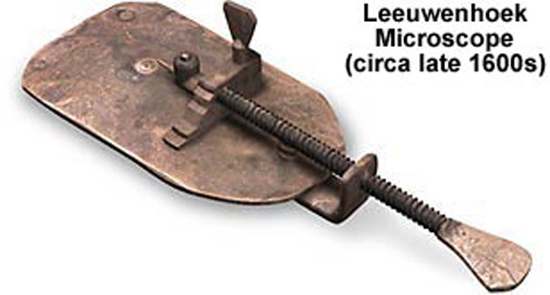
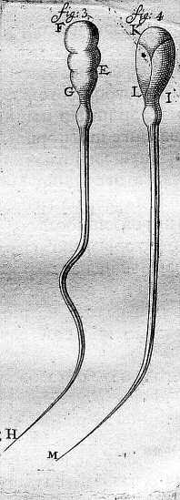
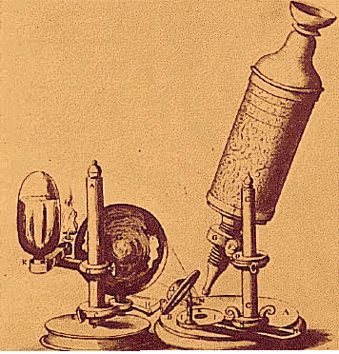

Development of the Microscope
van Leewenhoek (1677)
  Describes spermatozoa in semen

Slide 36
What is the role of spermatozoa?
Spallanzani (1780)
  Sperm were the fertilizing agent in semen
  Successful artificial insemination of a dog
Dumas (1825)
  Proves sperm the fertilizing agent
Notes:
Spallanzani - 1780
Italian priest
1 drop of dog semen could be diluted with 25 lbs. of fluid and could still be able to fertilize
performed the first artificial insemination in dogs
Dumas - 1825
collected oocytes from rabbit follicles and surmised animalcules united with these to from the embryo

Slide 37
Modern Reprod. Physiology
Gonads produce steroid hormones
Regulation of estrous cycles in females
Radioimmunoassay (RIA)
Artificial Insemination
Cryopreservation
Prostaglandin used to control estrous cycles
Biotechnology
Notes:
Gonads produce steroid hormones
controlled by the pituitary gland
alter the function of the reproductive tissues
Cyclicity in females
occurs repeatedly with a periodic frequency between ovulations
Radioimmunoassay (RIA)
development lead to measurement of hormones and lead to methods to manipulate hormone levels
Artificial Insemination
understanding sperm function lead to success of AI, semen cooling and freezing
Semen Cryopreservation
Prostaglandin used to control estrous cycles
In 1960’s discovered how prostaglandin’s regulated the length of the estrous cycle. Used this information to manipulate the cycle.
Biotechnology
separation of X and Y bearing sperm, embryo transfer, embryo freezing, electronic estrous detection, in vitro fertilization, cloning are forefront's of reproductive physiology research

Slide 38
Approach to Applications
Develop basic knowledge of how system works
Investigate methods that can perturb the system
Manipulate the system to improve reproduction
  Estrus Synchronization
  Timed insemination and ovulation
Notes:
Begin by developing a basic knowledge base of how a particular reproductive system works.
A series of investigation then examine what kind of methods can be used to perturb the system.
We then manipulate the system to improve reproduction.

Slide 39
Enhancing Reproduction
Small improvements have profound effects on production
  3% improvement in birth rate results in an additional:
    1 million beef calves/year
    3.2 million pigs/year
    3.7 million gallons of milk/year
Notes:
The first area in applications of reproductive physiology is in enhancing reproduction. Even a small improvement can have profound effects on animal production across the US. For example, a 3% improvement in birth rate could result in an additional
1 million beef calves/year
3.2 million pigs/year
3.7 million gallons of milk/year
Should we be doing this???
Limited land and that land is decreasing.

Slide 40
Current Trends
Metabolic
and
Physiologic
Changes
Production
Reproduction
Continuing need to:
  improve reproductive performance
  understand how to apply new technology

Slide 41
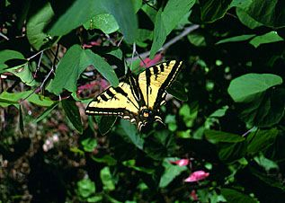
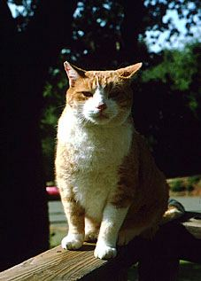
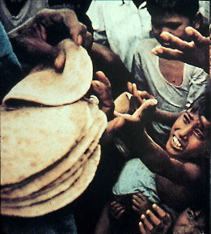
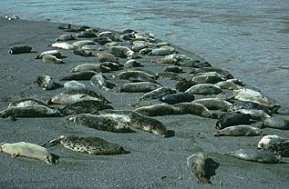
Limiting Reproduction
Insects
Pets
Humans
Wildlife
Notes:
The second area for applications is in limiting reproduction.
HUMANS: Most of you would likely first think of this in respect to humans. As the worlds population increases, there will be an increased need to control reproduction so that resources are not depleted and pollution does not make our planet uninhabitable.
PETS: We already control reproduction in pets by spaying or neutering dogs and cats. Cheaper ways of accomplishing this will always be of interest.
INSECTS: Population control of insects will likely involve the control of reproduction as chemical toxins continue to have damaging effects to humans.
Wildlife: A good example of this is the deer population needs to be limited in agricultural areas to prevent crop damage.

