Slide 1
Animal Science/Dairy Science 434
Reproductive Physiology
Female Anatomy
John Parrish, Professor, UW-Madison

Slide 2
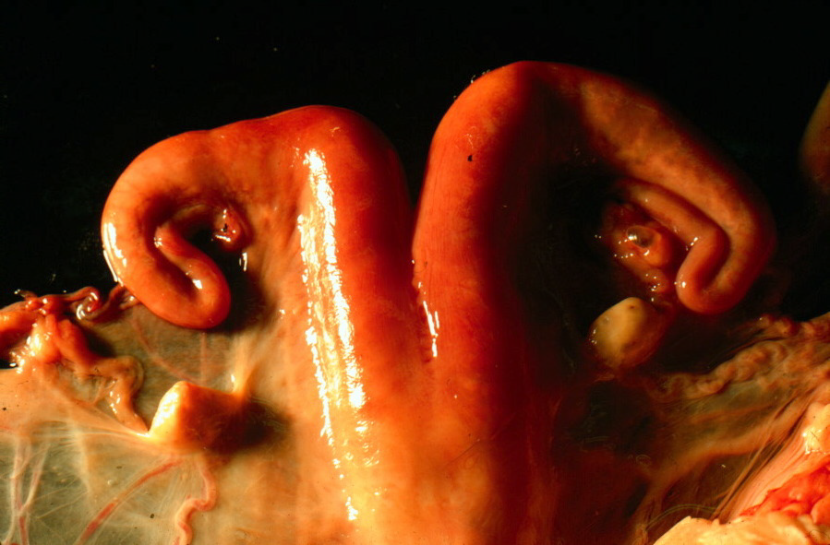
Female Reproductive Tract Anatomy

Slide 3
Learning Objectives
To be able to describe the female reproductive system in cattle.
  Structure
  Function

Slide 4
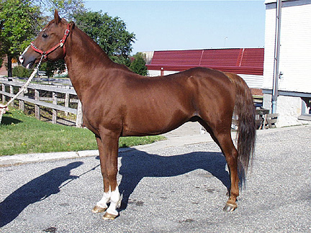
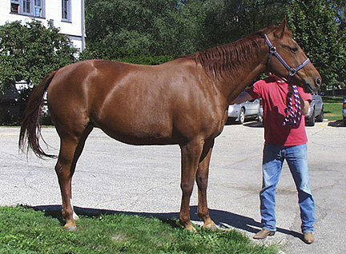
Equine - Horse
Male
Stallion
Female
Mare

Slide 5
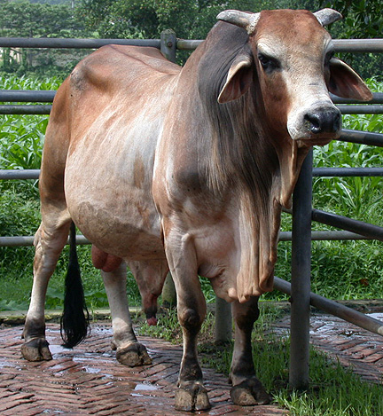
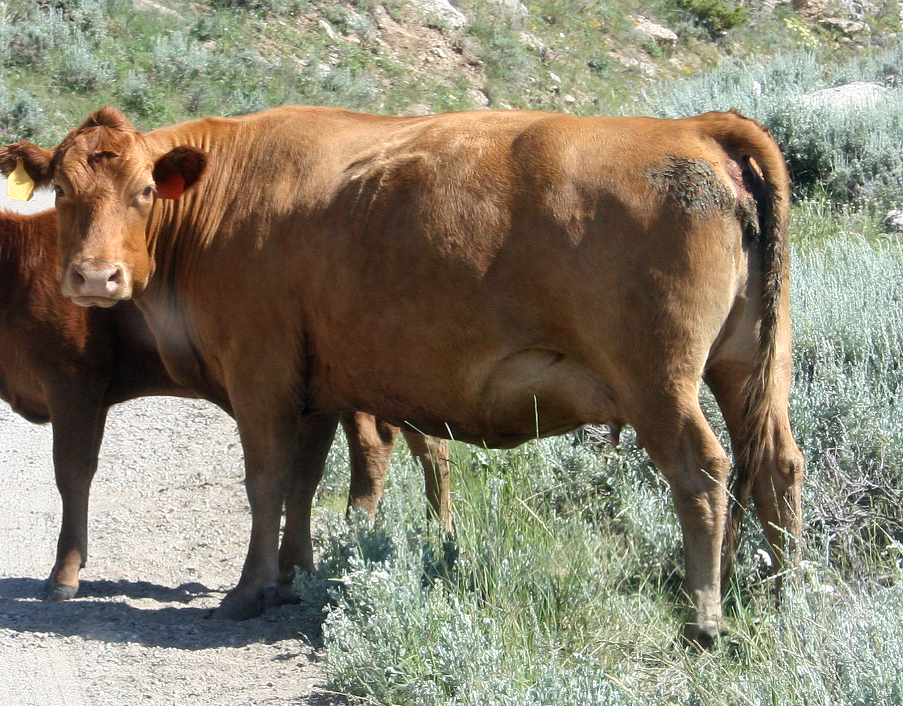
Bovine - Cattle
Male
Bull
Female
Cow

Slide 6
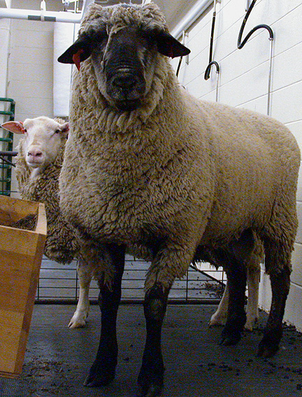
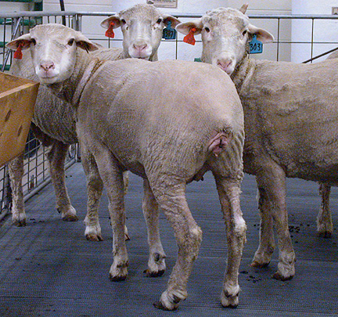
Ovine - Sheep
Male
Ram
Female
Ewe

Slide 7
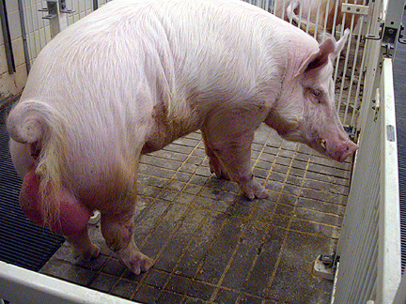
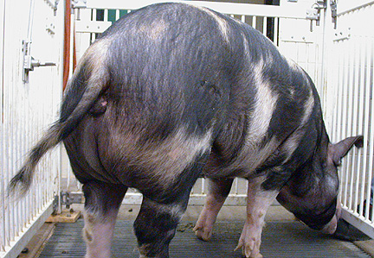
Porcine - Swine - Pig
Male
Boar
Female
Sow

Slide 8
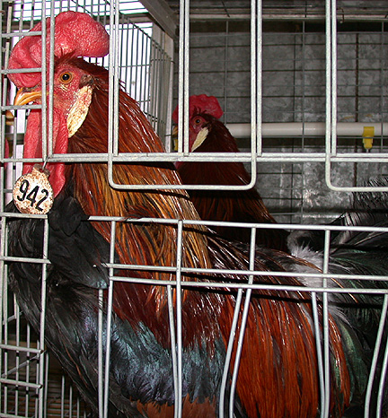
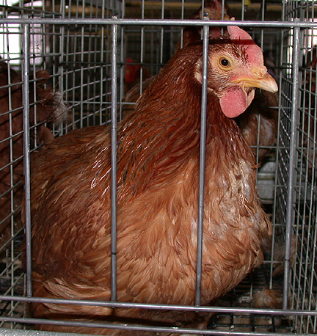
Avian - Chicken
Male
Rooster
Female
Hen

Slide 9
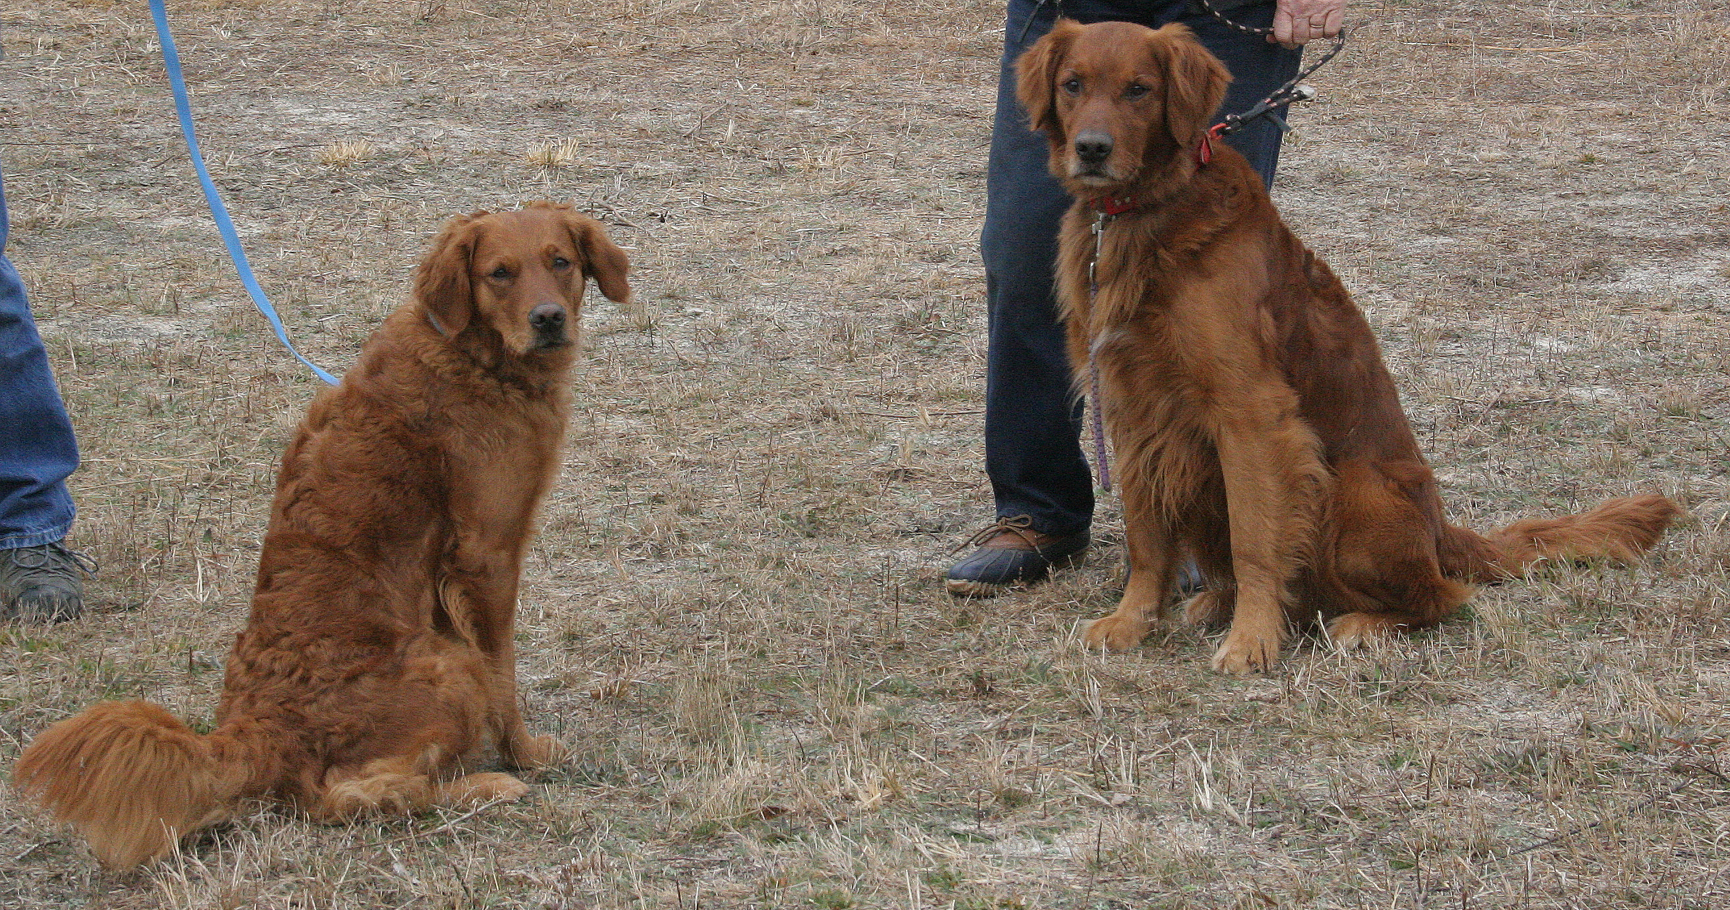
Canine
Female
Bitch
Male
Dog
Buddy
Kalli

Slide 10
Feline
Female
Queen
Male
Tom

Slide 11
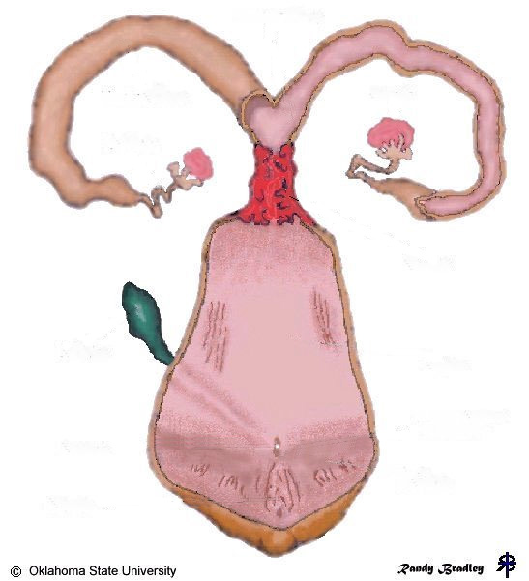
Uterine Body
Uterine Horn
Uterine Horn
Ovary
Ovary
Oviduct
Oviduct
Cervix
Bladder
Vagina
Urethra
Vulva
Clitoris

Slide 12
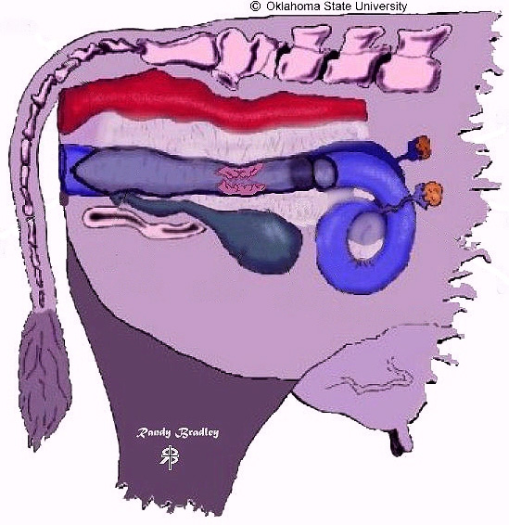
Rectum
Uterus
Vulva
Ovary
Vagina
Pelvis
Bladder
Cervix
Oviduct
Broad Ligament

Slide 13
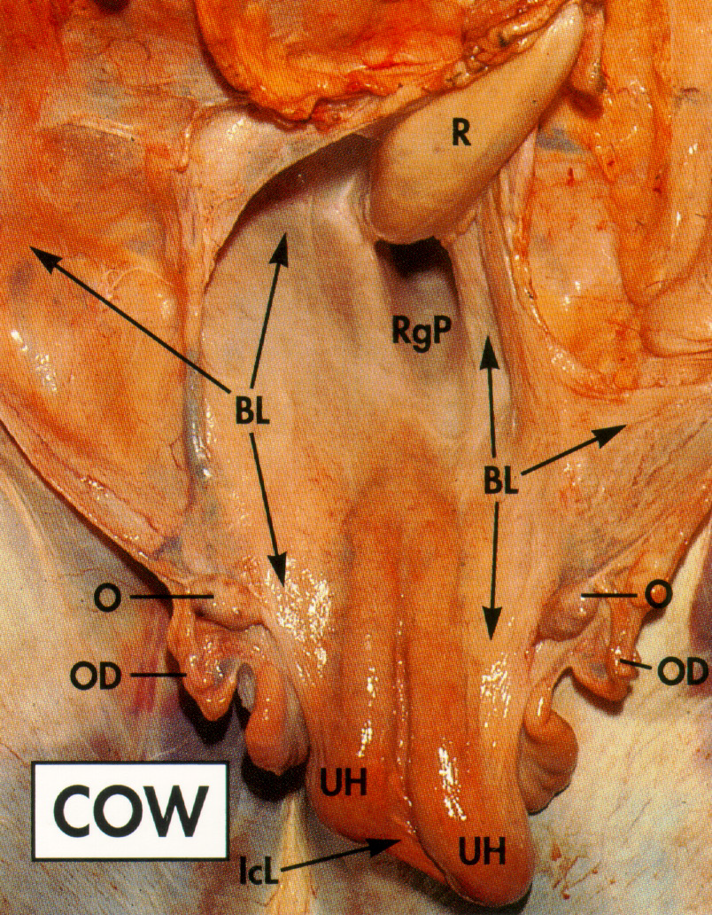
Broad Ligament
connective tissue sheet which supports and suspends the reproductive tract
BL - Broad Ligament
UH - Uterine Horn
O - Ovary
OD - Oviduct

Slide 14
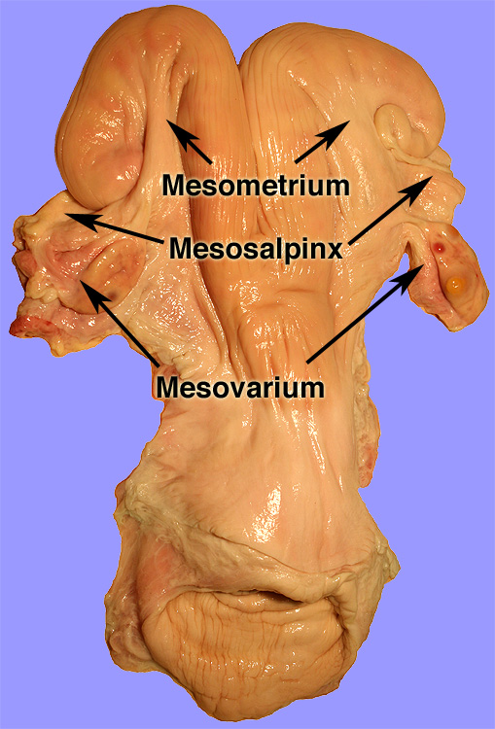
Broad Ligament
Mesometrium
  Supports Uterus
Mesosalpinx
  Supports Oviduct
Mesovarium
  Supports Ovary

Slide 15
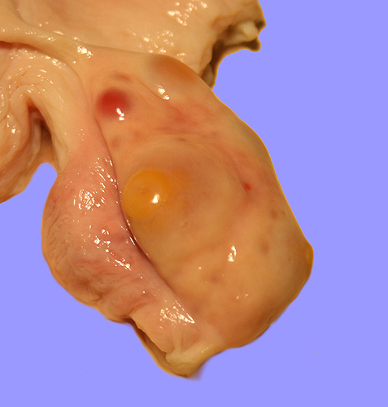
Ovary - Primary Sex Organ
Functions
  Hormonal
    Estrogen
    Progesterone
  Female gamete
    Oocyte

Slide 16
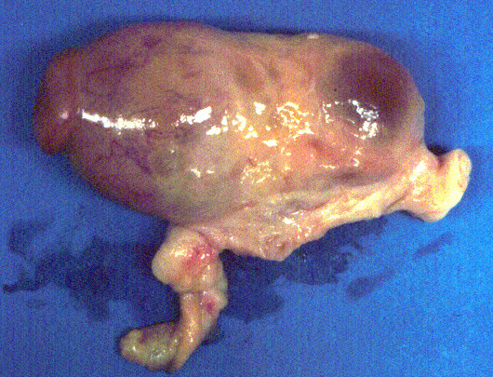
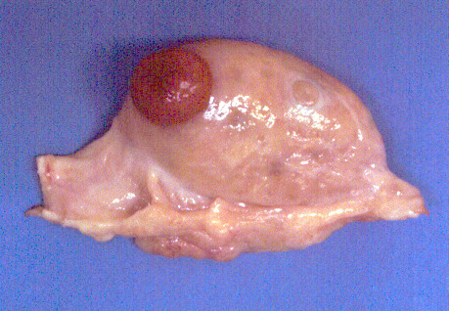
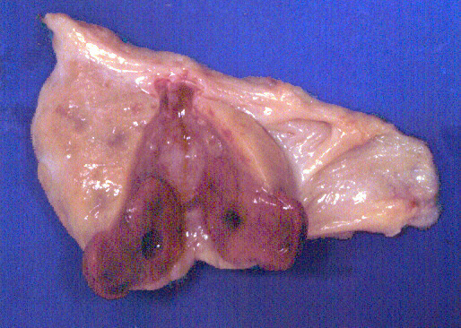
Ovary
Follicle
- Estrogen, Oocyte
Corpus Luteum
Corpus Luteum
Progesterone
Progesterone

Slide 17
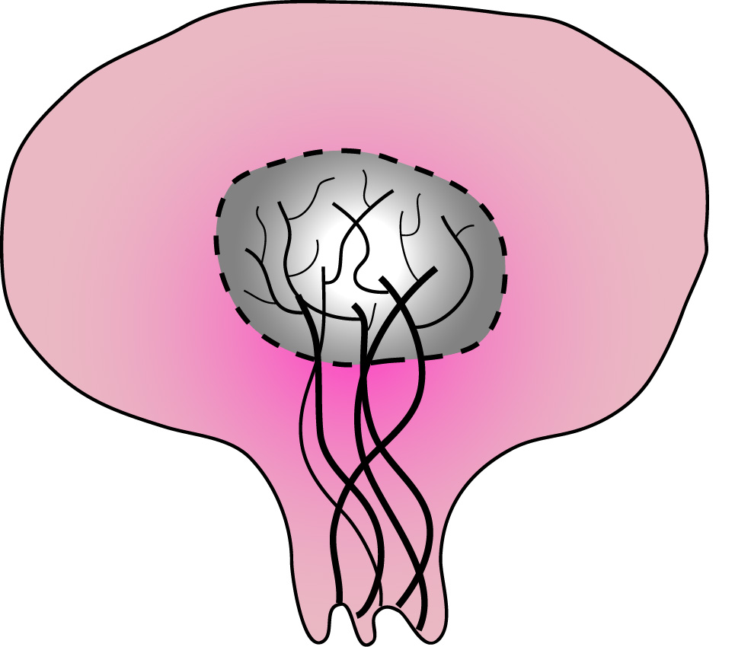
Ovary
Germinal
Epithelium
Cortex
85% of Ovarian
Cancers
Medulla
Tunica
Albuginea
Blood and lymphatic
Vessels & nerves
}
Hilus

Slide 18
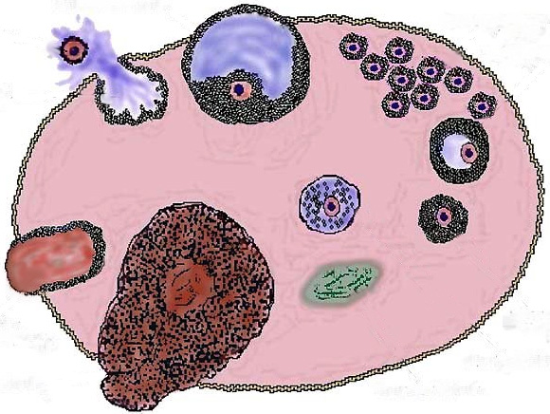
Ruptured follicle
(ovulation)
Tertiary follicle
Primary follicle
Egg nest
Tertiary
follicle
Atretic follicle
Secondary follicle
Corpus
hemorrhagicum
Corpus albicans
Corpus luteum

Slide 19
Ruptured follicle
(ovulation)
Tertiary follicle
Primary follicle
Tertiary
follicle
Atretic follicle
Secondary follicle
Corpus
hemorrhagicum
Corpus albicans
Corpus luteum

Slide 20
Ruptured follicle
(ovulation)
Tertiary follicle
Primary follicle
Tertiary
follicle
Atretic follicle
Secondary follicle
Corpus
hemorrhagicum
Corpus albicans
Corpus luteum

Slide 21
Ruptured follicle
(ovulation)
Tertiary follicle
Primary follicle
Tertiary
follicle
Atretic follicle
Secondary follicle
Corpus
hemorrhagicum
Corpus albicans
Corpus luteum

Slide 22
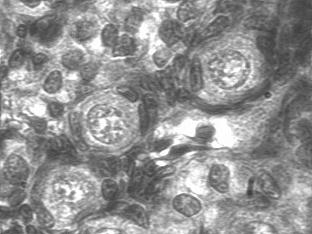
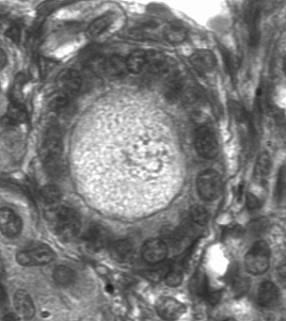
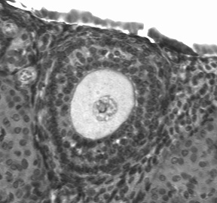
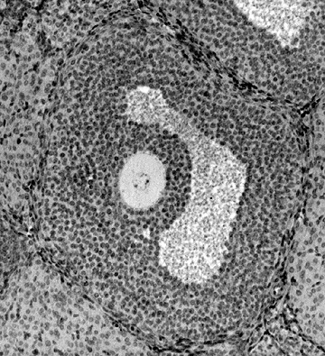
Primordial Follicle
Follicle Cells
Nucleus
Flattened cells
surround oocyte
Primary Follicle
Ooplasma
Increase in size of oocyte and
height of follicular cells
Follicular Cells
Secondary follicle
Oocyte
Surrounded by several
layers of follicular cells
Tertiary follicle
Fluid filled cavity
Differentiation of cell layers
in the follicle wall
Antrum

Slide 23
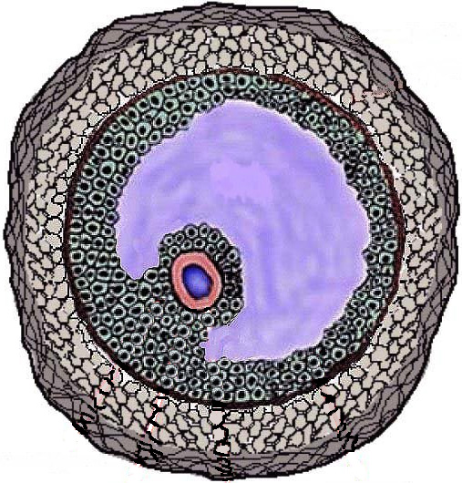
Tertiary Follicle
Theca Externa
Antrum
(Follicular Fluid)
Theca Interna
Basement
Membrane
Granulosa
Oocyte
Cumulus Oophorus

Slide 24
Tertiary Follicle
Theca Interna
Granulosa
Oocyte
Cumulus
Oophorus
Antrum

Slide 25
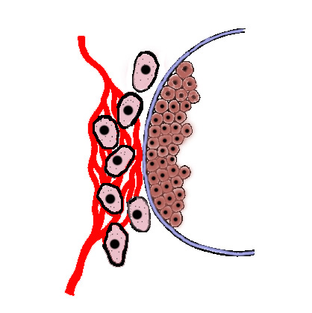
Follicular Blood Supply
Theca interna cells
Basement Membrane
Granulosa cells
Capillary
network
Follicular
fluid

Slide 26
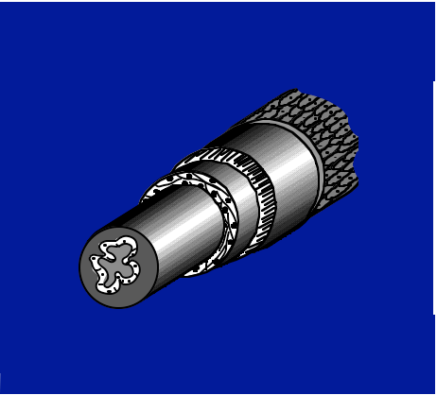
Secondary Sex Organ: A Series of Tubes to Convey the Oocyte/Embryo/Fetus to the Outside
Serosa
Submucosa
Lumen
Longitudinal smooth
muscle layer
Circular smooth
muscle layer
Mucosa
Muscularis

Slide 27
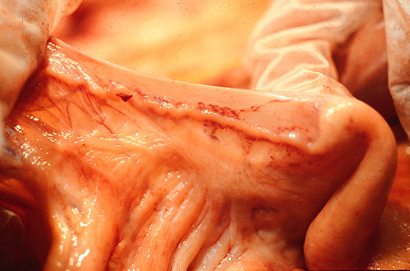
Functions of Oviduct
Gamete Transport
  Sperm
  Oocyte
Supports early embryo development
Transport of embryo to uterus

Slide 28
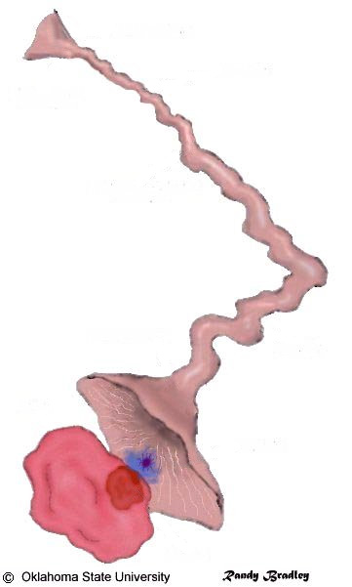
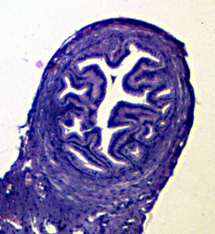
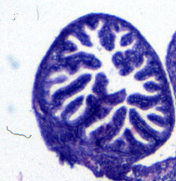
Uterine Horn
Isthmus
Utero-Tubal Junction
Oviduct
Ampullary-Isthmic
Junction
Ampulla
Infundibulum
(20 - 30 cm²)
Ostium
Cumulus Oophorus
and Oocyte
Fimbria
Ovary
Follicle

Slide 29
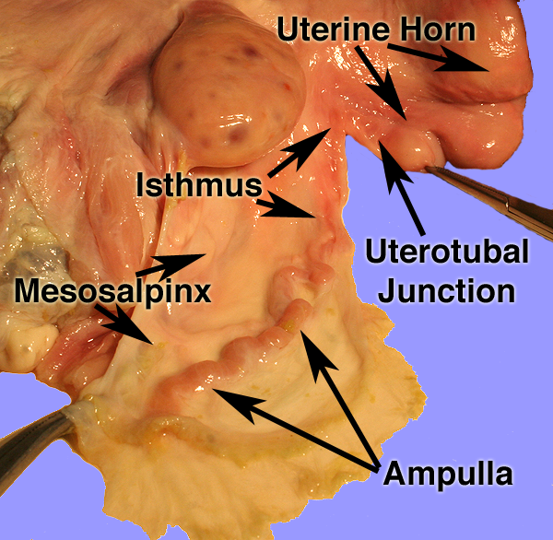
Oviduct

Slide 30
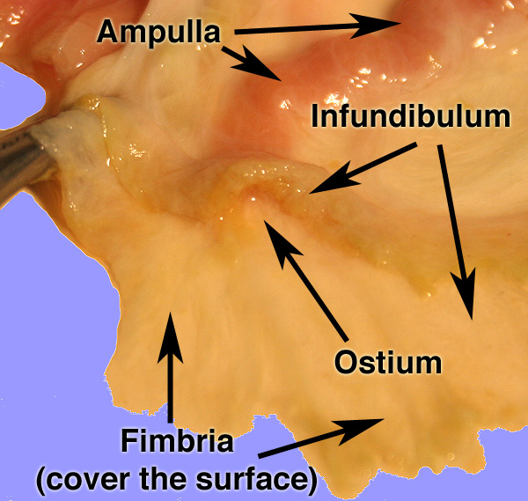
Oviduct

Slide 31
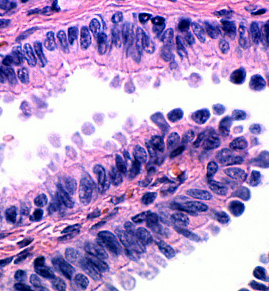
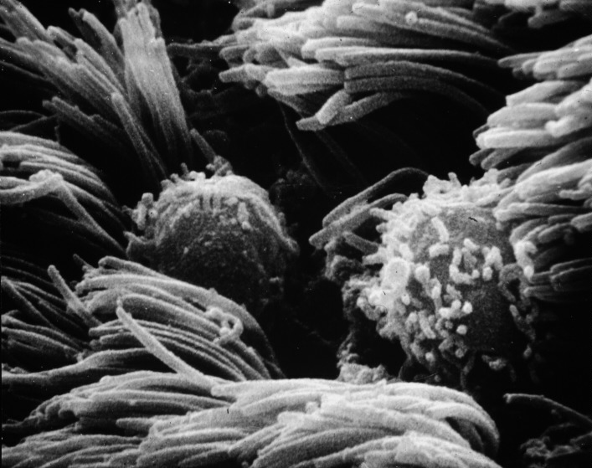
Oviduct Histology
Mucosa
Ciliated Columnar
Nonciliated Columnar

Slide 32
Functions of the Uterus
Muscle contractions
  Transport sperm
  Expel fetus and placenta
Absorption and phagocytosis
Partially prepares sperm for fertilization
  capacitation
Provides environment for embryo and fetal growth
Hormone production
  Prostaglandin F2α production

Slide 33
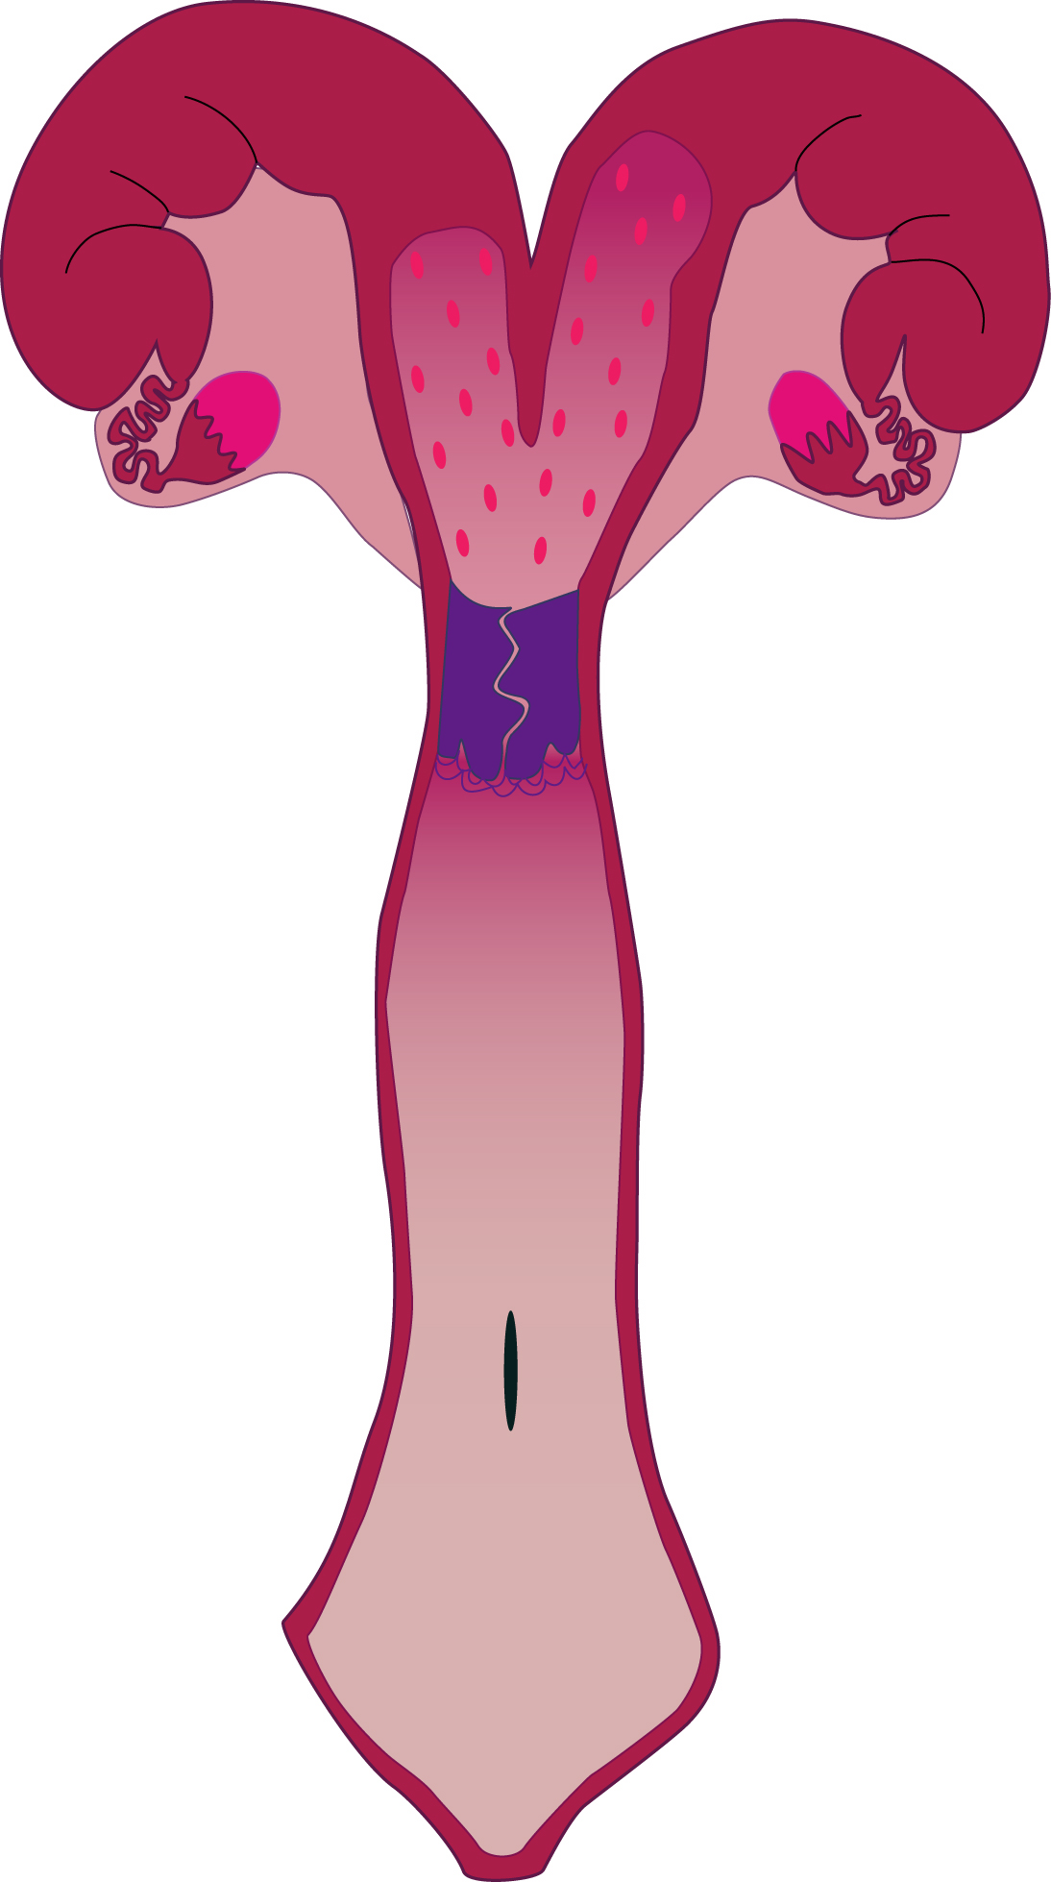
Uterus (bovine)
horn
Bicornuate
  poorly to moderately developed uterine horns
  uterine body
  one cervix
body
cervix

Slide 34
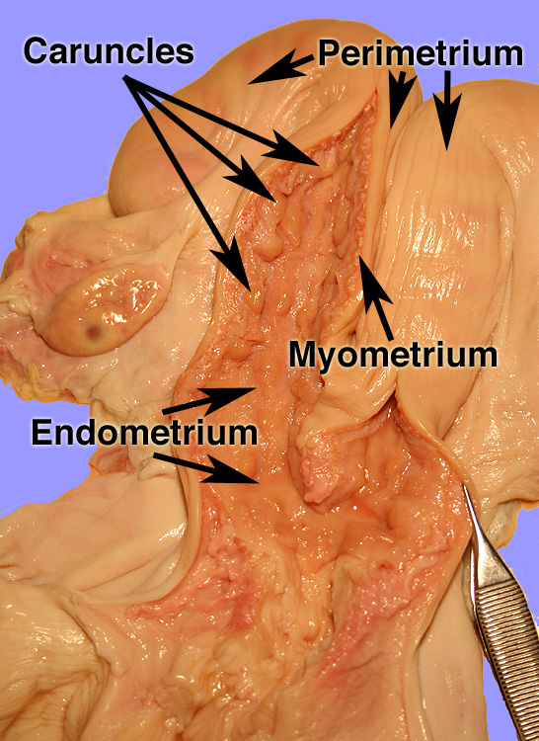
Uterus

Slide 35
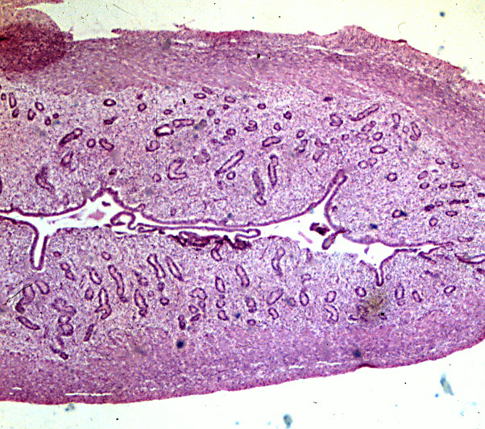
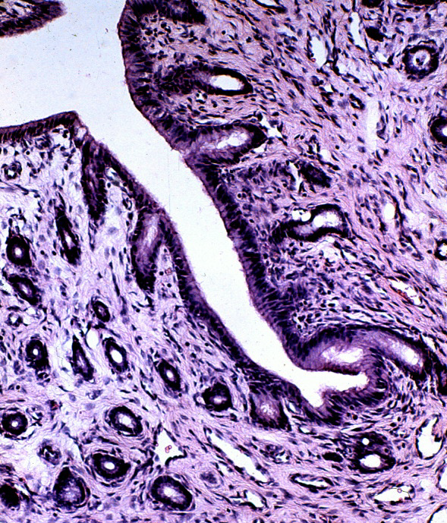
Uterine Histology
Endometrium
Endometrial
Glands
Perimetrium
Myometrium

Slide 36
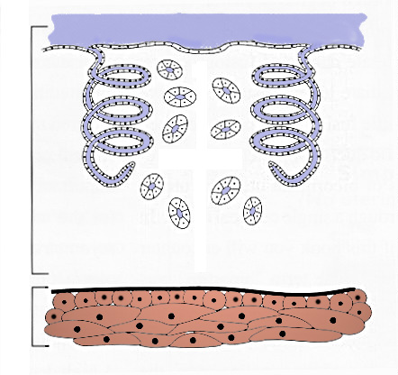
Uterine Histology
Mucosa
Endometrial
Gland
Endometrium
Submucosa
Myometrium
Perimetrium

Slide 37
Functions of the Cervix
Transport of sperm
Barrier to sperm (species dependent)
Reservoir for sperm
Blocking bacterial invasion during pregnancy
Birth canal

Slide 38
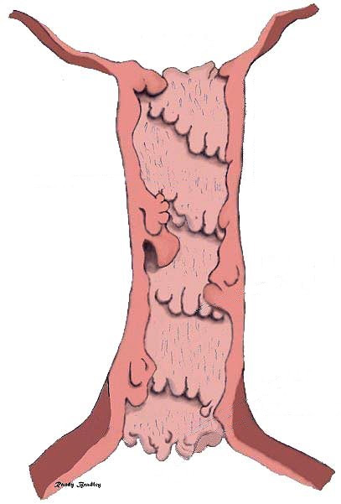
COW
Uterine Body
Cervix is composed of thick connective tissue
Internal Cervical Os
Mucus is secreted near the time of breeding and ovulation.
Cervix
Cow has 4-5
annular rings
External Cervical Os
Vagina

Slide 39
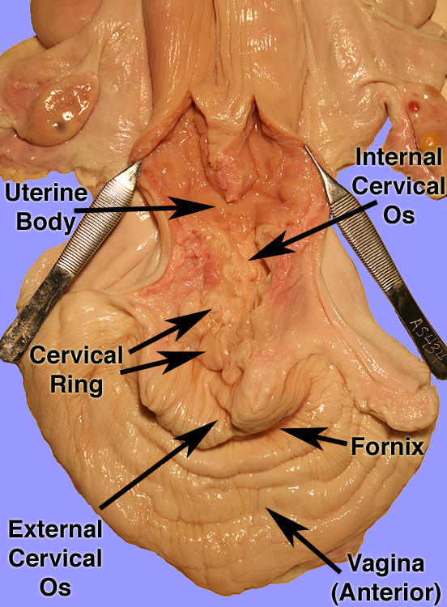
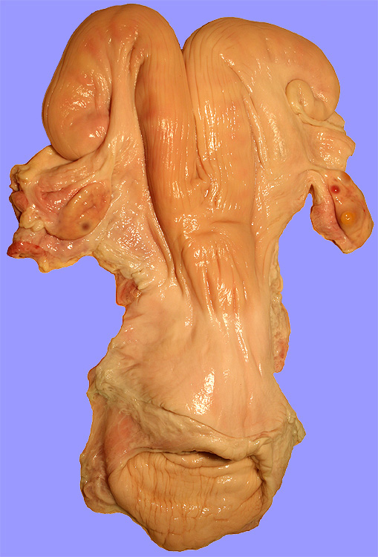

Slide 40
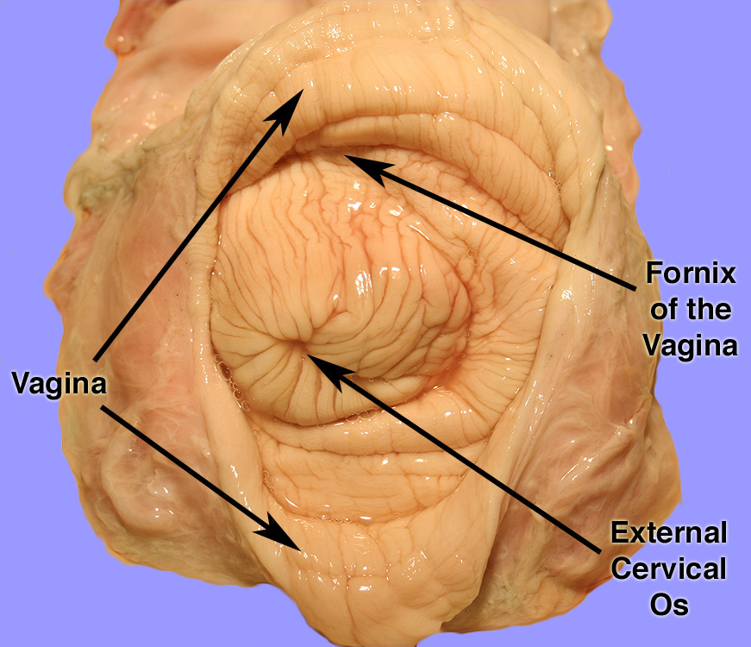
External Cervical Os

Slide 41
Functions of the Vagina
Copulatory organ
Glands secrete lubrication
Birth canal
Glands secrete pheromones

Slide 42
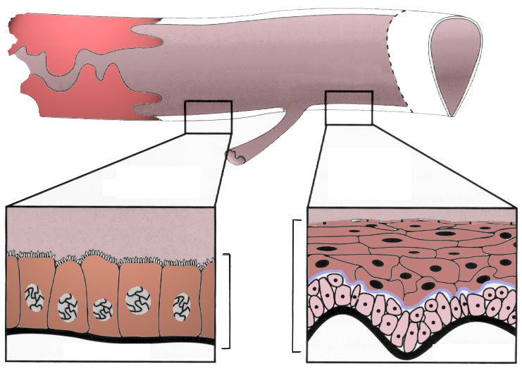
Vagina
Anterior Vagina
Posterior Vagina (Vestibule)
Cervix
Fornix
Vulva-Vaginal Sphincter
Stratified
Squamous
Epithelium
Columnar
Epithelium
Urethra
Mucosa
Submucosa
Submucosa

Slide 43
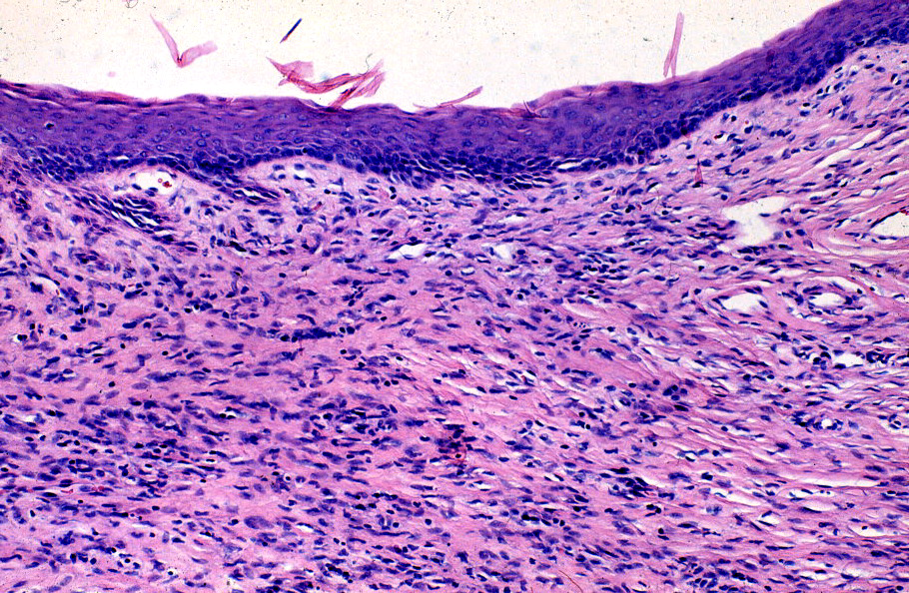
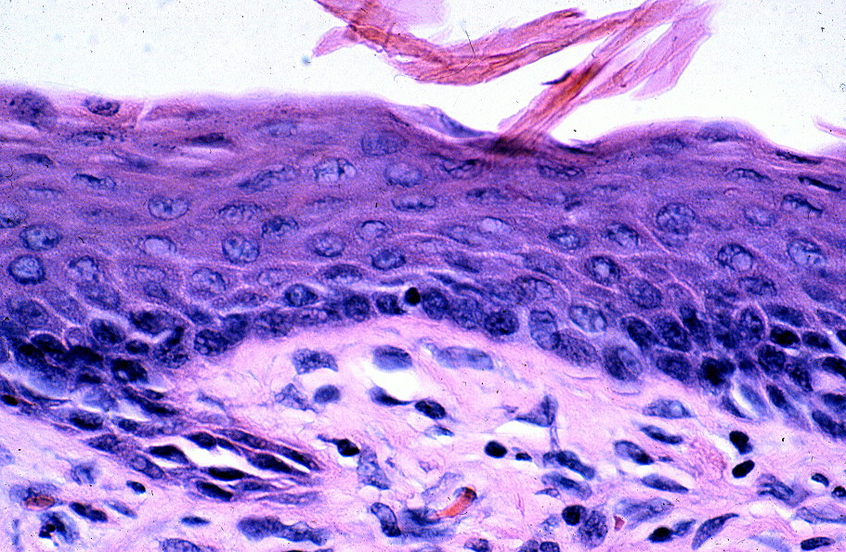
Posterior Vaginal Histology
Stratified Squamous
Epithelium
Mucosa
Submucosa

Slide 44
Function of External Genitalia
Labia
  Closes entrance to vagina
Clitoris
  Female sensory organ

Slide 45
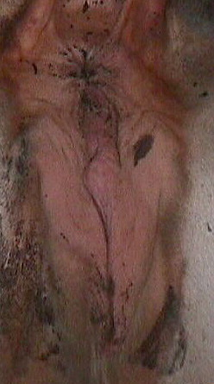

External Genitalia of the Cow
Anus
Vulva
Labia
Clitoris
Labia

Slide 46
Phenomena For Fertility
vagina dentata - a vagina with teeth
female bedbug - no vagina
hysterectomy - if woman went to long without becoming pregnant then uterus would wonder in body causing hysteria and other distresses
hyena - clitoris is very large and looks like the male penis; female also has a false scrotum (labia); female is the dominate sex and produces more testosterone than male

