Slide 1

Animal Science/Dairy Science 434
Reproductive Physiology
Female Anatomy
John Parrish, Professor, UW-Madison

Slide 2
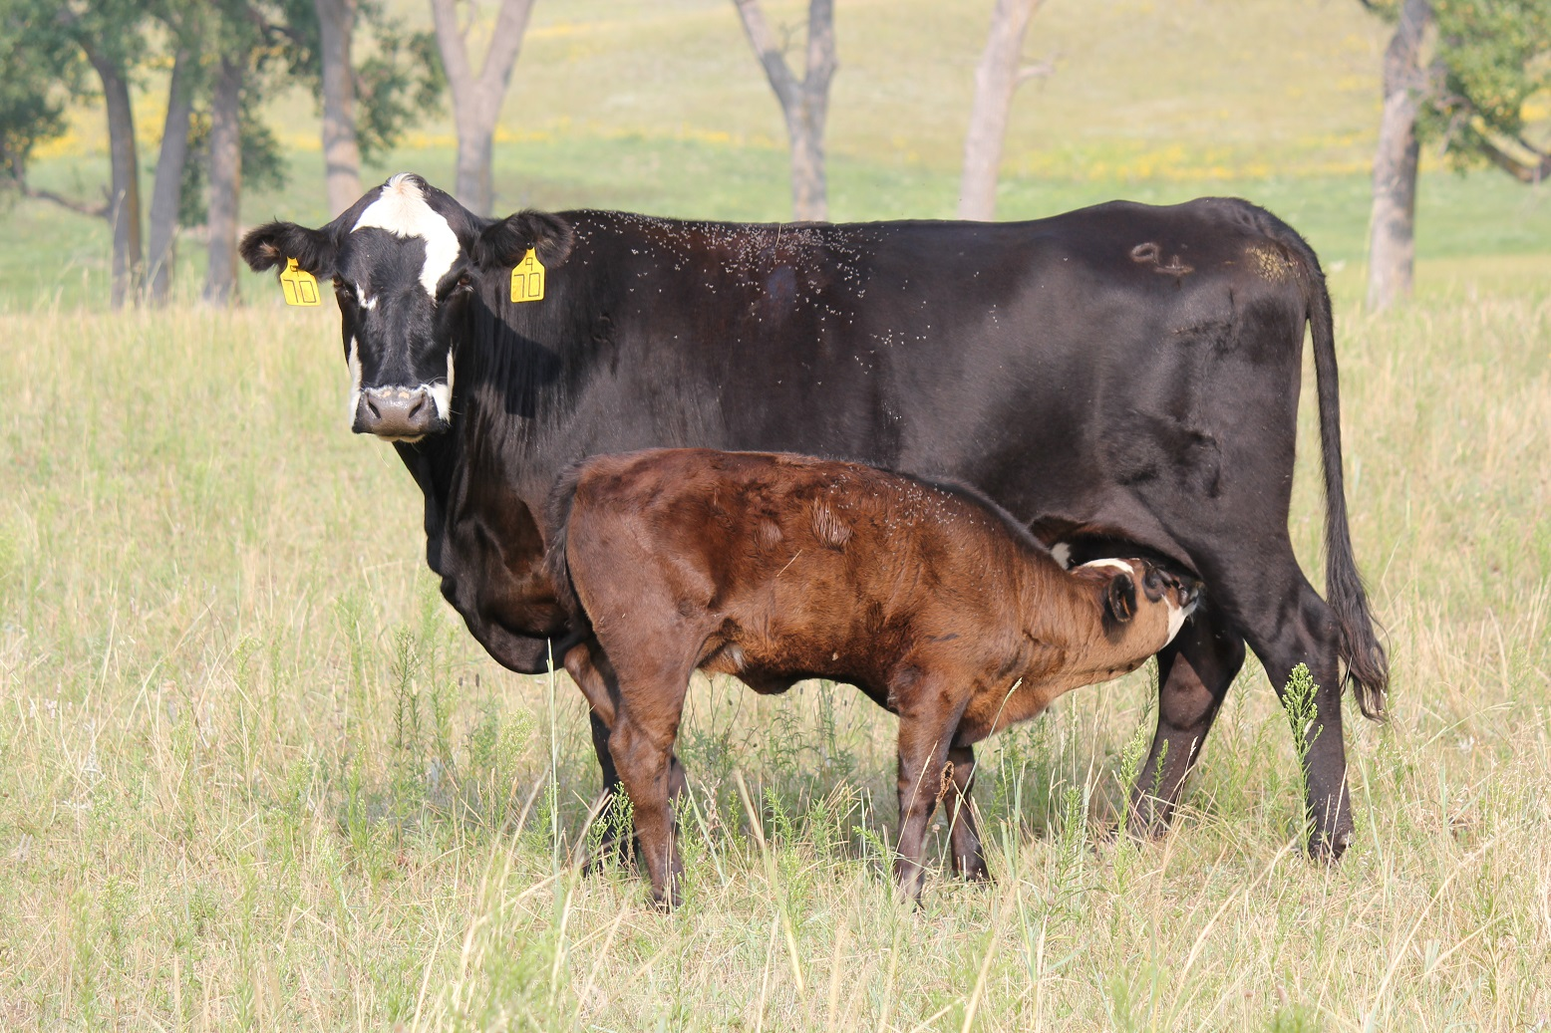
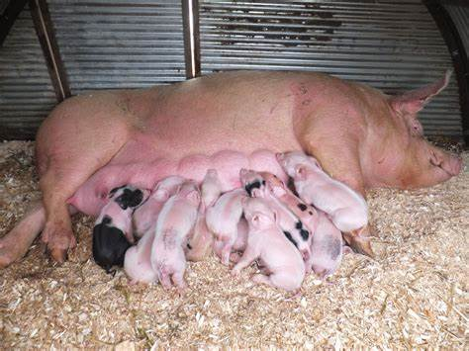
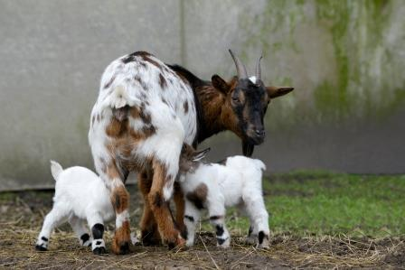
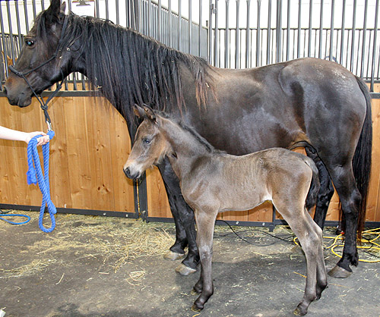
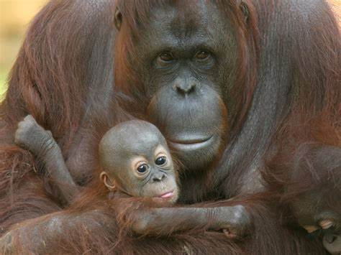
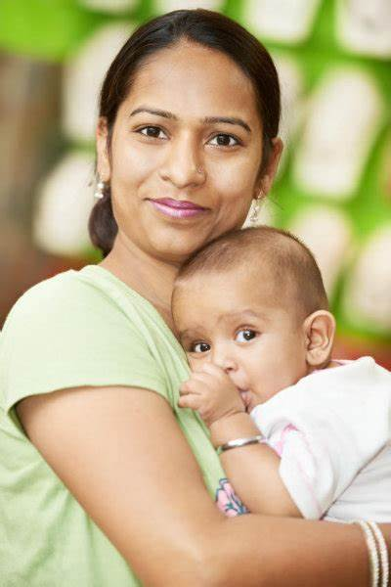
Notes:
Lets look at these different species and think about why do they have different number of young born? Cattle the norm is 1 calf, Goats the norm is 2 – 3 kids, pigs the norm is now 14 – 18 piglets, horses the norm is 1 foal, primates certainly vary but in general the norm is 1 young born as in this orangutang and this human mother. We will try to answer why this is the case over the next 2 lecture topics.

Slide 3
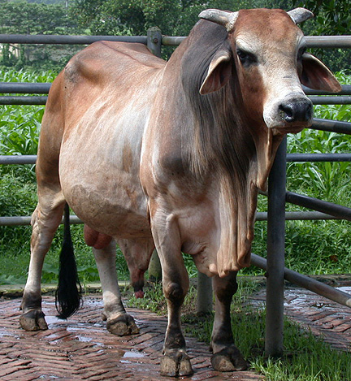
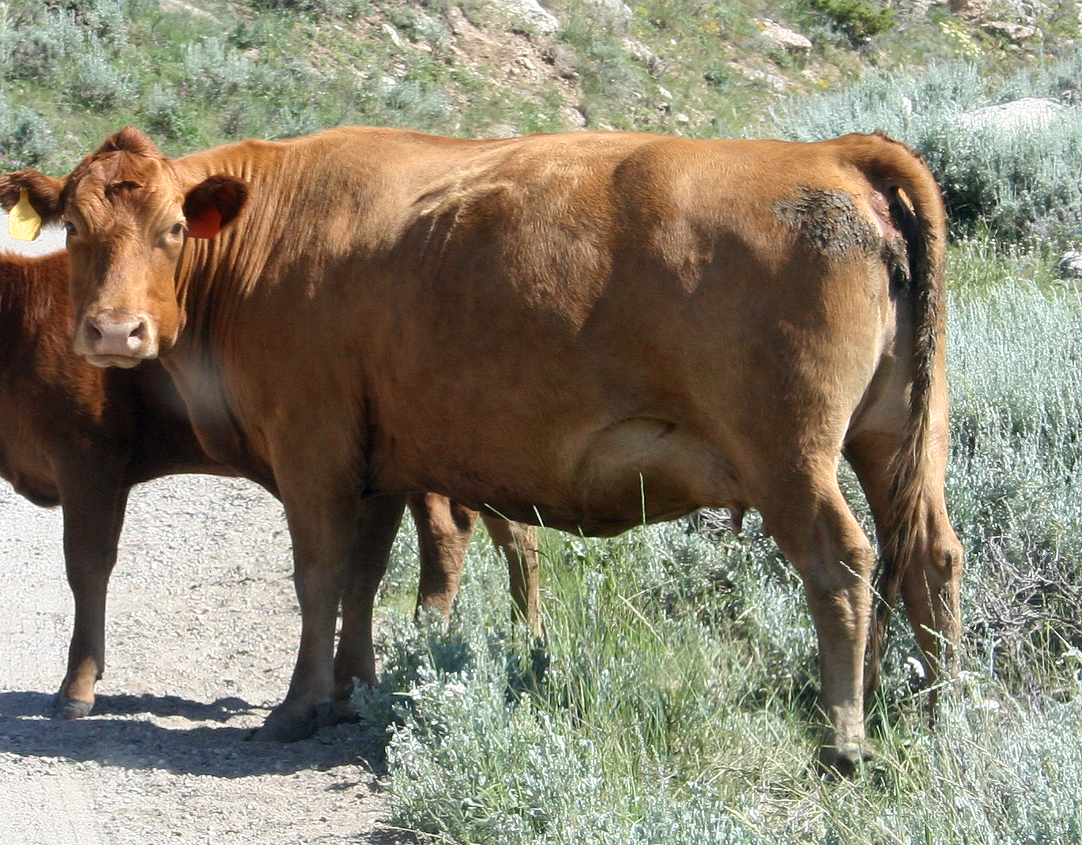
Bovine - Cattle
Male
Bull
Female
Cow
Notes:
Many of you will not be familiar with livestock terms so let me go over a few of the species and names of the sexes.
In the bovine or cattle, the male is the bull and female is the cow.

Slide 4
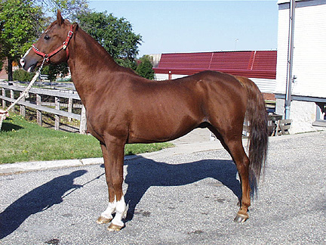
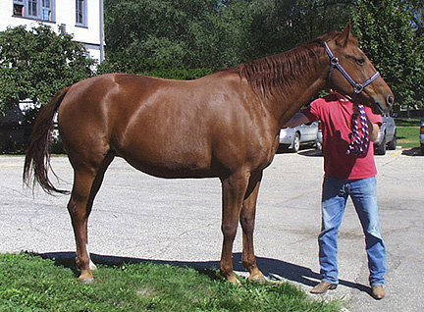
Equine - Horse
Male
Stallion
Female
Mare

Slide 5
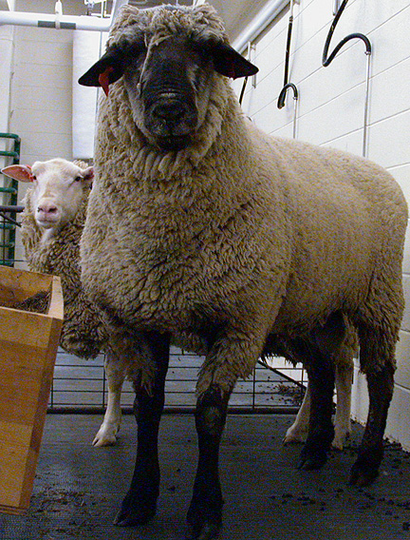
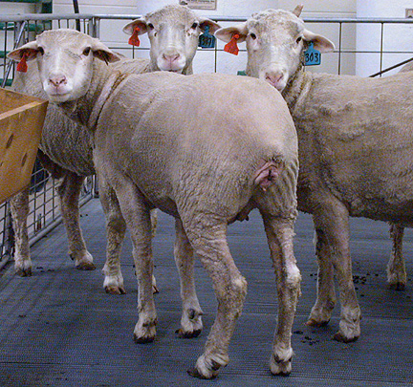
Ovine - Sheep
Male
Ram
Female
Ewe

Slide 6
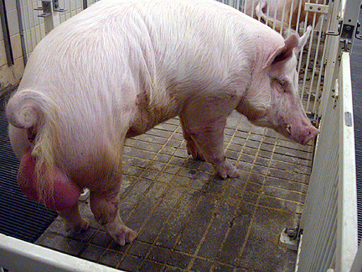
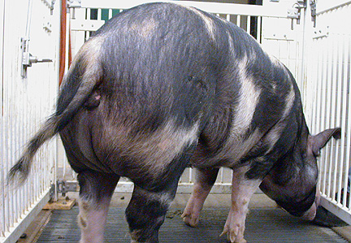
Porcine - Swine - Pig
Male
Boar
Female
Sow

Slide 7
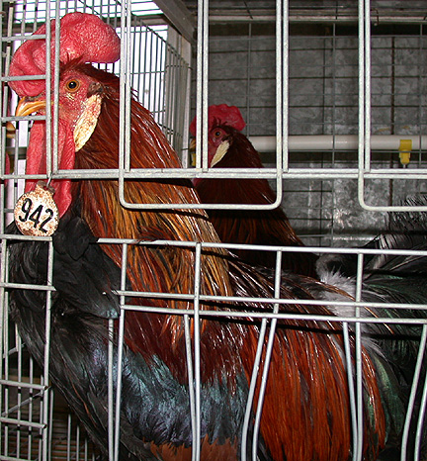
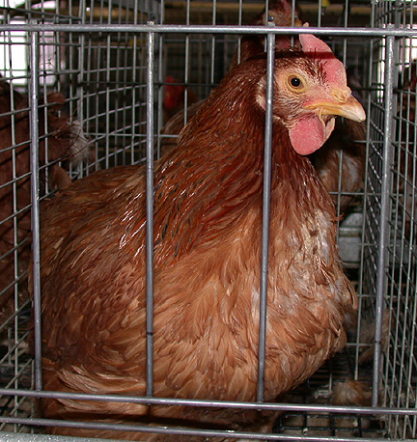
Avian - Chicken
Male
Rooster
Female
Hen

Slide 8
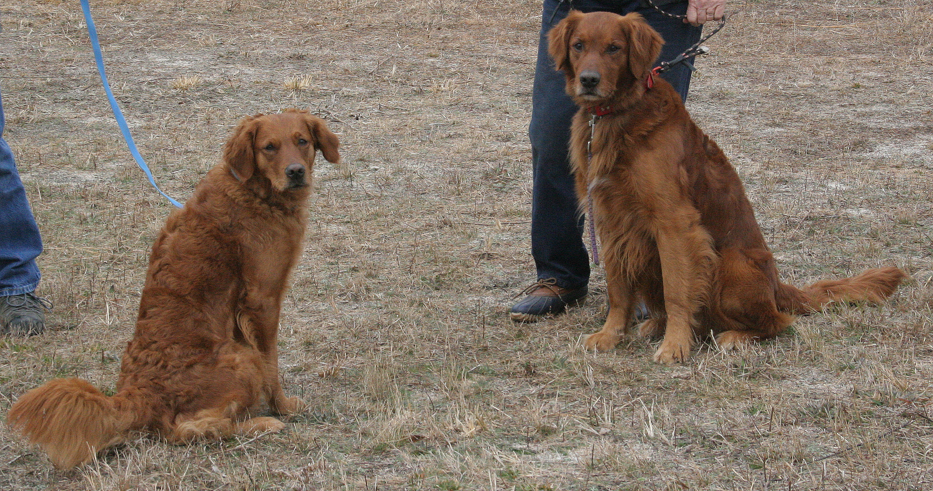
Canine
Female
Bitch
Male
Dog
Buddy
Kalli
Notes:
The correct terminology for the sexes in the canine is the female is the bitch and the male is the dog. We will use correct terminology in this class.

Slide 9
Feline
Female
Queen
Male
Tom

Slide 10

Quiz 1a
Pause this video and take the quiz below by writing you answers on your notes.
What is the name of the female for each of the following:
Bovine –
Equine –
Porcine –
Canine -

Slide 11

Quiz 1a
Pause this video and take the quiz below by writing you answers on your notes.
What is the name of the female for each of the following:
Bovine – Cow or Heifer
Equine – Mare or Filly
Porcine – Sow or Gilt
Canine - Bitch

Slide 12
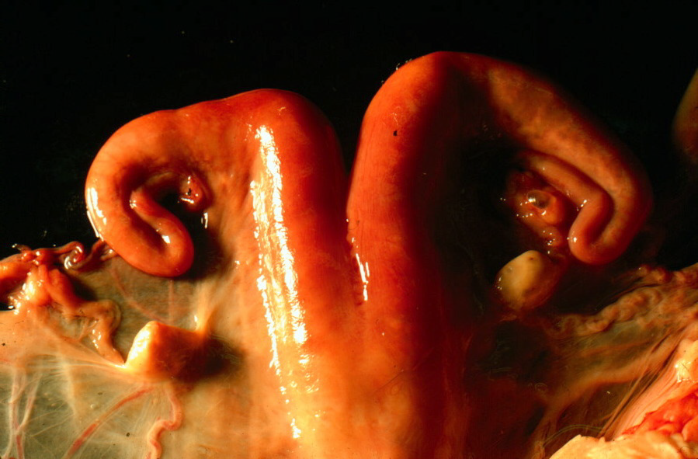
Female Reproductive Tract Anatomy
Notes:
Let's come back now to our question of why the number of young born differs among species. The key lies in the reproductive tract anatomy and physiology. Let's examine the bovine or cow first. Please note that you should be reading the required chapters in your textbook prior to the lecture for deeper understanding and test taking.

Slide 13
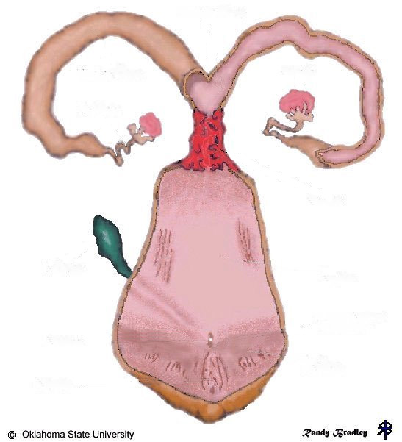
Uterine Body
Uterine Horn
Uterine Horn
Ovary
Ovary
Oviduct
Oviduct
Cervix
Bladder
Vagina
Urethra
Vulva
Clitoris

Slide 14
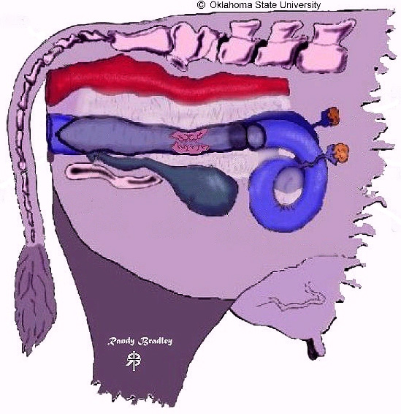
Rectum
Uterus
Vulva
Ovary
Vagina
Pelvis
Bladder
Cervix
Oviduct
Broad Ligament

Slide 15
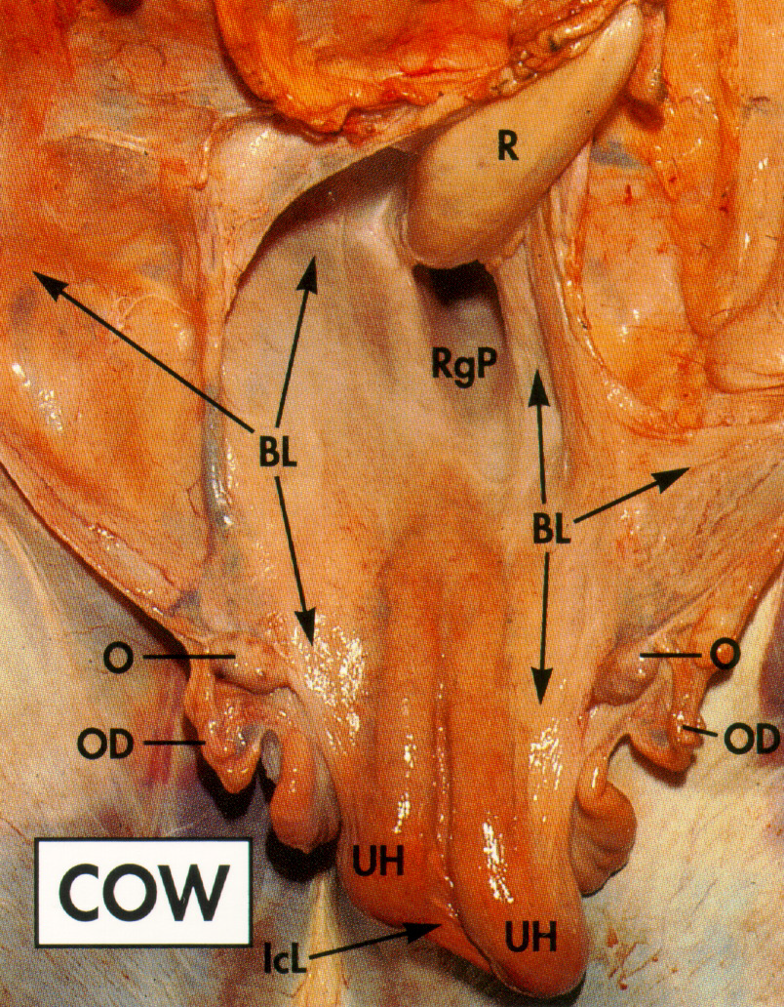
Broad Ligament
BL - Broad Ligament
UH - Uterine Horn
O - Ovary
OD - Oviduct
Notes:
The reason the reproductive tract does not just flop down in the pelvic cavity is that it is surrounded and supported by the broad ligament that is sheet of connective tissue.

Slide 16
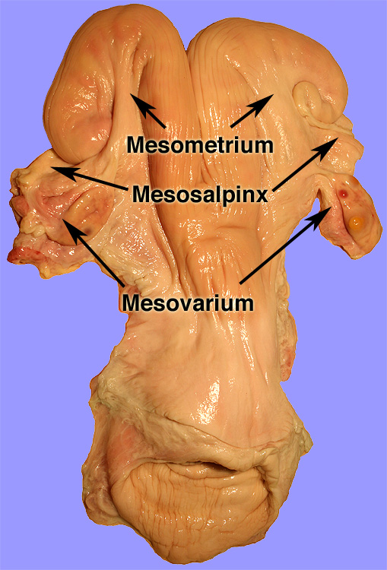
Broad Ligament
Notes:
Mesometrium supports the uterus, mesosalpinx supports the oviduct and mesovarium supports the ovary.

Slide 17
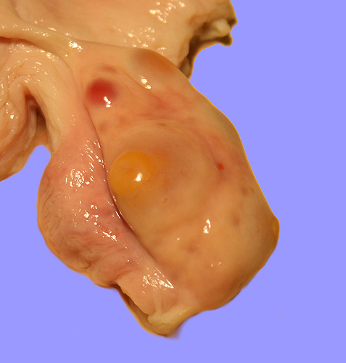
Ovary
Notes:
The ovary is known as the primary sex organ. The functions of the ovary are to produce two major hormones, estrogen and progesterone. It also produces the oocyte or the female gamete.

Slide 18
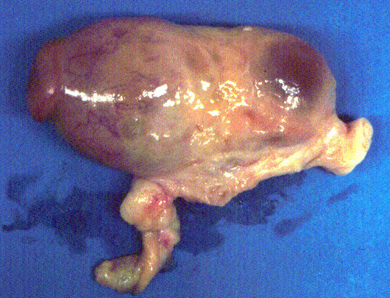
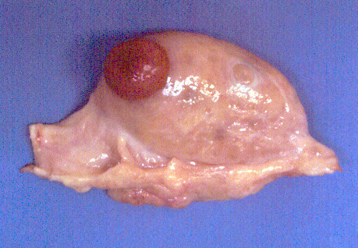
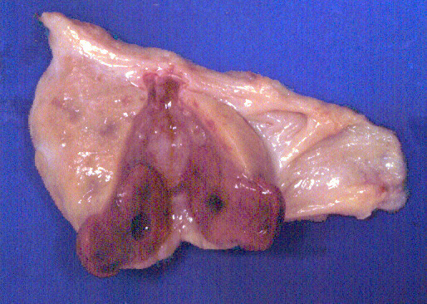
Ovary
Follicle
- Estrogen, Oocyte
Corpus Luteum
Corpus Luteum
Progesterone
Progesterone
Notes:
In the bovine it is easy to see the 2 major structures on the ovary, the follicle and the Corpus Luteum (CL). The follicle contains the oocyte and releases the hormone estrogen. The corpus luteum releases the hormone progesterone.

Slide 19
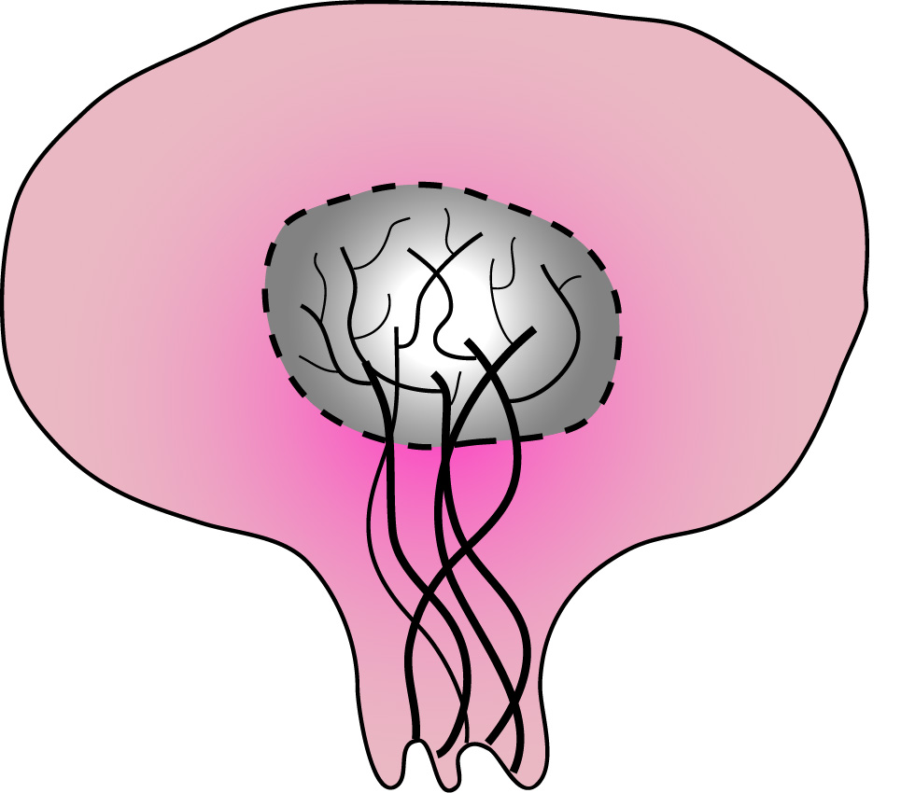
Ovary
Germinal
Epithelium
Cortex
85% of Ovarian
Cancers
Medulla
Tunica
Albuginea
Blood and lymphatic
Vessels & nerves
}
Hilus

Slide 20
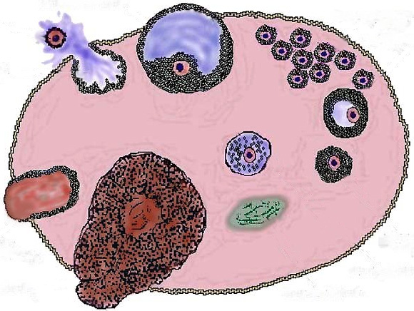
Ruptured follicle
(ovulation)
Tertiary follicle
Primary follicle
Egg nest
Tertiary
follicle
Atretic follicle
Secondary follicle
Corpus
hemorrhagicum
Corpus albicans
Corpus luteum

Slide 21
Ruptured follicle
(ovulation)
Tertiary follicle
Primary follicle
Tertiary
follicle
Atretic follicle
Secondary follicle
Corpus
hemorrhagicum
Corpus albicans
Corpus luteum

Slide 22
Ruptured follicle
(ovulation)
Tertiary follicle
Primary follicle
Tertiary
follicle
Atretic follicle
Secondary follicle
Corpus
hemorrhagicum
Corpus albicans
Corpus luteum

Slide 23
Ruptured follicle
(ovulation)
Tertiary follicle
Primary follicle
Tertiary
follicle
Atretic follicle
Secondary follicle
Corpus
hemorrhagicum
Corpus albicans
Corpus luteum

Slide 24
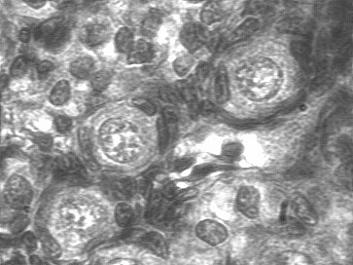
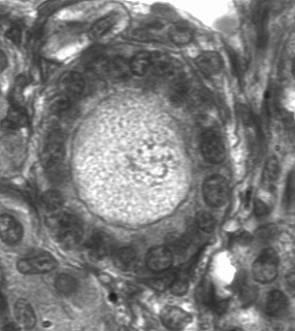
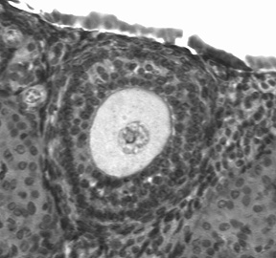
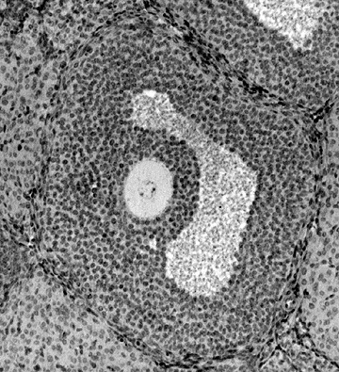
Follicle Cells
Primordial Follicle
Nucleus
Primary Follicle
Ooplasma
Secondary follicle
Follicular Cells
Oocyte
Tertiary follicle
Antrum
Notes:
Primordial Follicle – flattened follicle cells but 1 layer.
Primary Follicle – follicle cells still 1 layer but now are more cuboidal (square).
Secondary Follicle – multiple layers of follicle cells.
Tertiary Follicle – Fluid filled with multiple well differentiated layers of follicle cells.

Slide 25
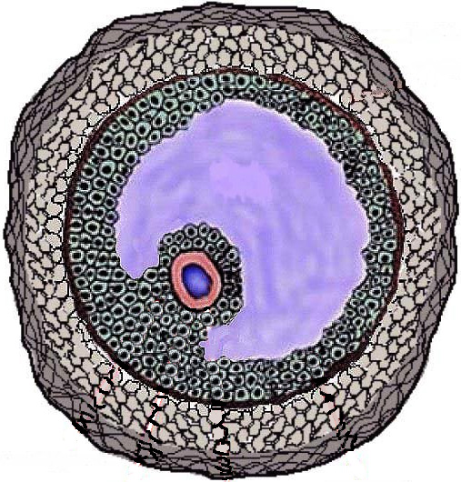
Tertiary Follicle
Theca Externa
Antrum
(Follicular Fluid)
Theca Interna
Basement
Membrane
Granulosa
Oocyte
Cumulus Oophorus

Slide 26
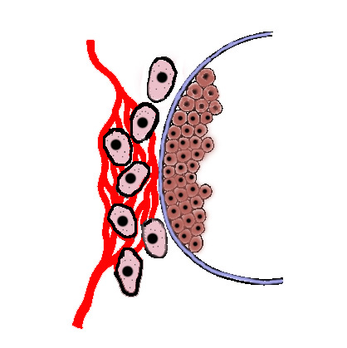
Follicular Blood Supply
Theca interna cells
Basement Membrane
Granulosa cells
Capillary
network
Follicular
fluid
Notes:
Blood supply does not pass the basement membrane in the tertiary follicle. Hormones in the follicular fluid from ganulosa cells must diffuse out and then be picked up by blood the flows through capillary network around the theca cells.

Slide 27

Quiz 1b
The follicle progresses from the primordial, primary, secondary, tertiary, Corpus hemorrhagicum, Corpus luteum and finally the Corpus Albicans in a counter circular motion around the ovary of the cow.
True
False

Slide 28
Quiz 1b
The follicle progresses from the primordial, primary, secondary, tertiary, Corpus hemorrhagicum, Corpus luteum and finally the Corpus Albicans in a counter circular motion around the ovary of the cow.
True
False ✔︎
Notes:
No that was just the diagram I used to explain the different structures. They really occur in place. The sequence described however is correct.

Slide 29
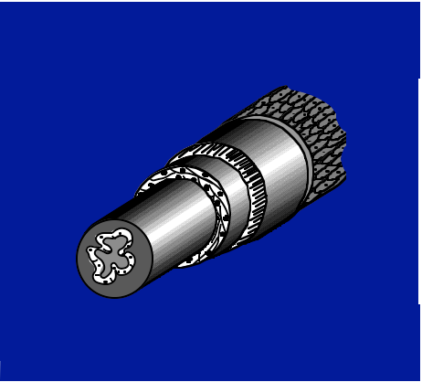
Secondary Sex Organ: A Series of Tubes to Convey the Oocyte/Embryo/Fetus to the Outside
Serosa
Submucosa
Lumen
Longitudinal smooth
muscle layer
Circular smooth
muscle layer
Mucosa
Muscularis

Slide 30
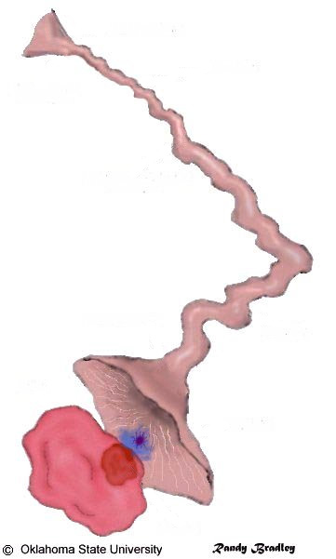
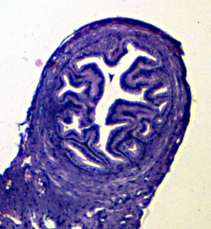
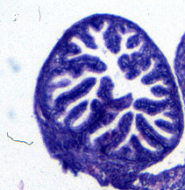
Uterine Horn
Isthmus
Utero-Tubal Junction
Oviduct
Ampullary-Isthmic
Junction
Ampulla
Infundibulum
(20 - 30 cm²)
Ostium
Cumulus Oophorus
and Oocyte
Fimbria
Ovary
Follicle

Slide 31
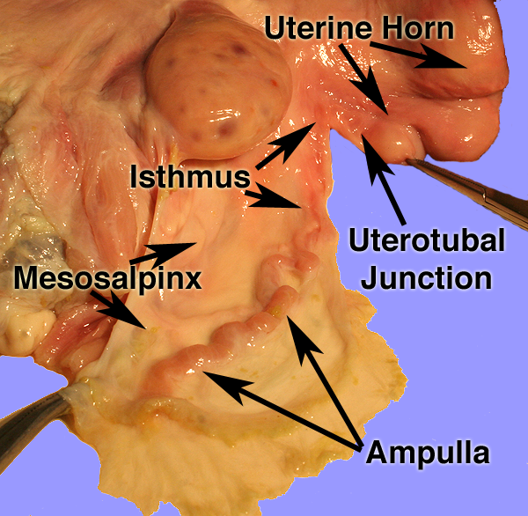
Oviduct

Slide 32
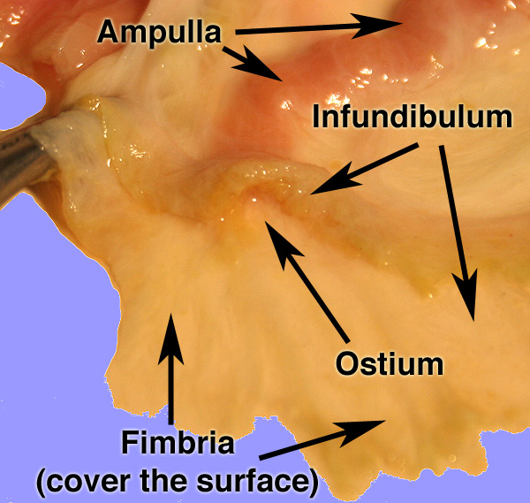
Oviduct

Slide 33
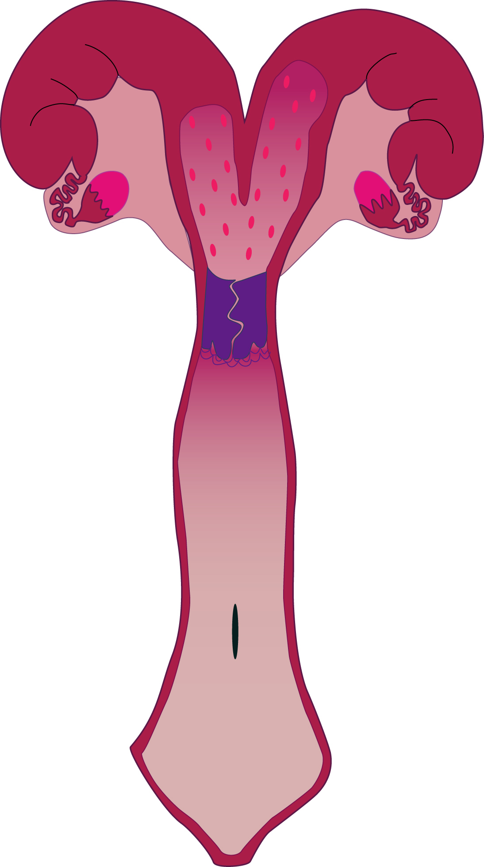
Uterus (bovine)
horn
body
cervix
Notes:
Bicornuate type uterus with 2 uterine horns, 1 uterine body and one cervix.

Slide 34
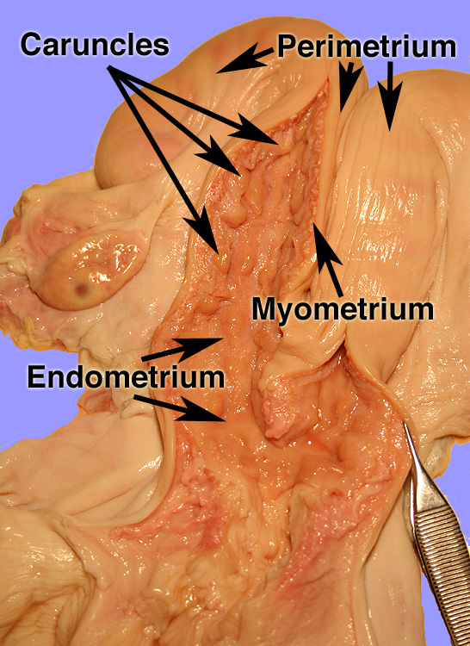
Uterus

Slide 35
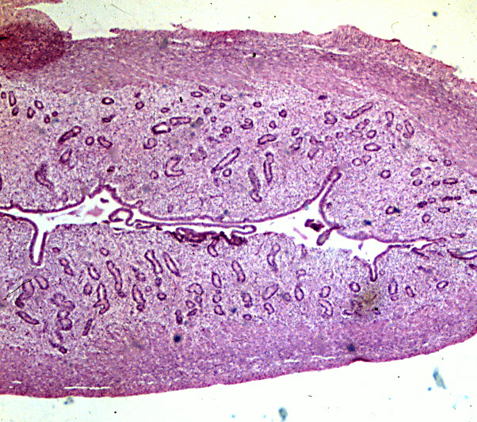
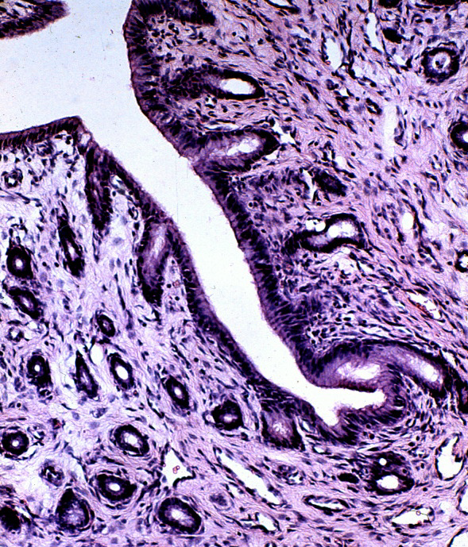
Uterine Histology
Endometrium
Endometrial
Glands
Perimetrium
Myometrium

Slide 36
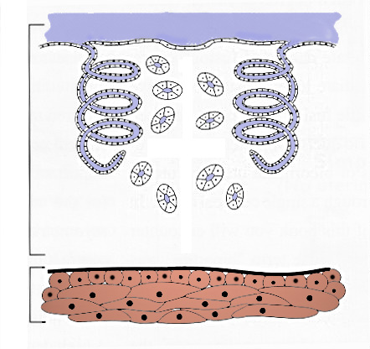
Uterine Histology
Mucosa
Endometrial
Gland
Endometrium
Submucosa
Myometrium
Perimetrium

Slide 37
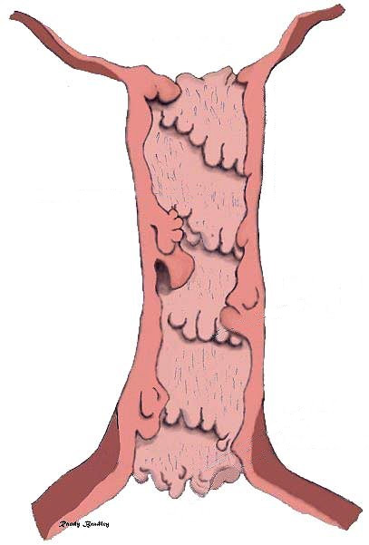
COW
Uterine Body
Cervix is composed of thick connective tissue
Internal Cervical Os
Mucus is secreted near the time of breeding and ovulation.
Cervix
Cow has 4-5
Cervical Rings
External Cervical Os
Vagina

Slide 38
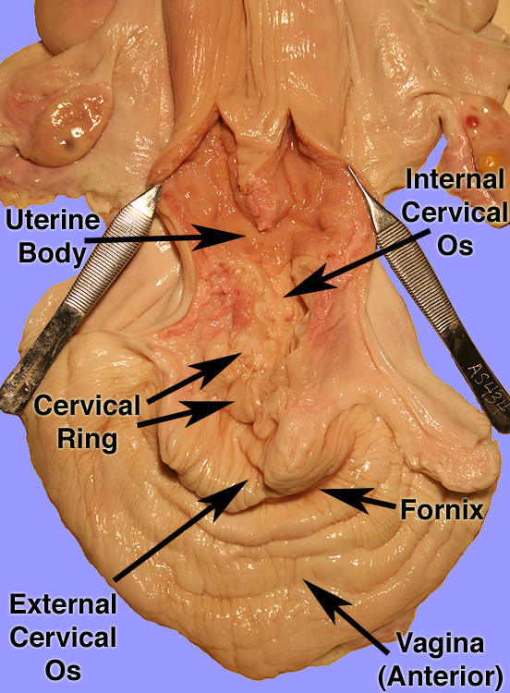
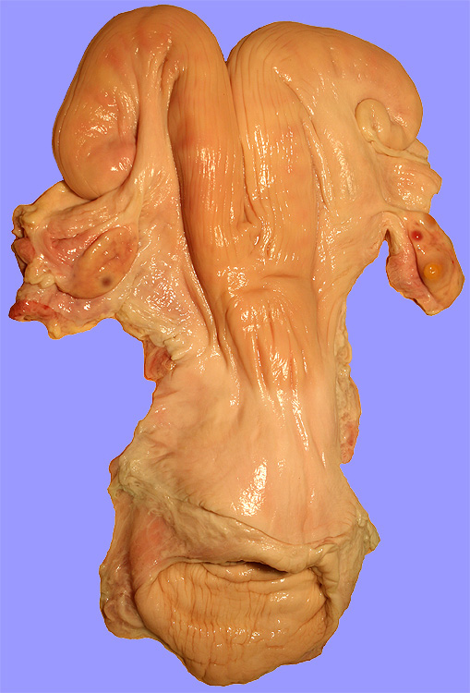

Slide 39
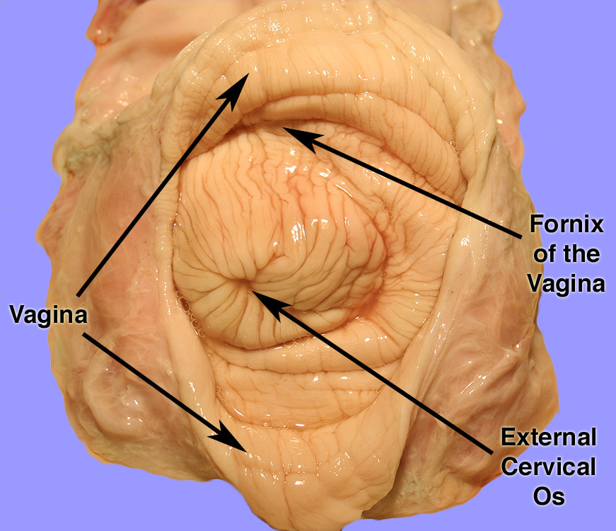
External Cervical Os

Slide 40
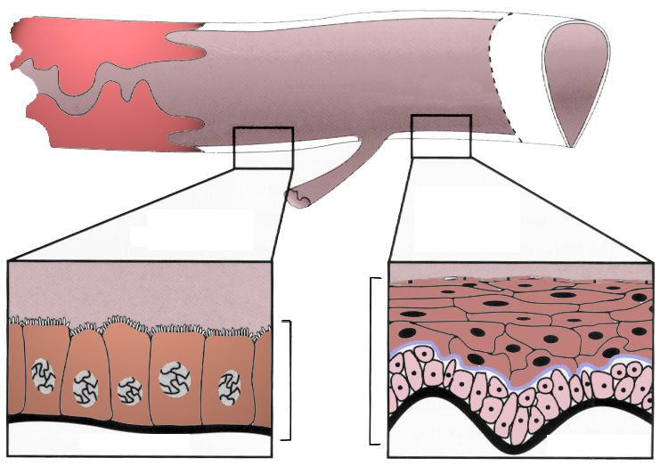
Vagina
Anterior Vagina
Posterior Vagina (Vestibule)
Cervix
Fornix
Vulva-Vaginal Sphincter
Stratified
Squamous
Epithelium
Columnar
Epithelium
Urethra
Mucosa
Submucosa
Submucosa

Slide 41


External Genitalia of the Cow
Vulva
Anus
Labia
Clitoris
Labia

Slide 42

Quiz 1c
What are the key components that ensure the bovine has only 1 or at most 2 calves ?

Slide 43
Quiz 1c
What are the key components that ensure the bovine has only 1 or at most 2 calves ?
The ovary only ovulates 1 or at most 2 oocytes at a time.
The uterus is not large enough to handle more than 1 or 2 calves as they fill an entire horn each.

Slide 44
Phenomena For Fertility
vagina dentata - a vagina with teeth
female bedbug - no vagina
hysterectomy - if woman went to long without becoming pregnant then uterus would wonder in body causing hysteria and other distresses
hyena - clitoris is very large and looks like the male penis; female also has a false scrotum (labia); female is the dominate sex and produces more testosterone

